Slide 1
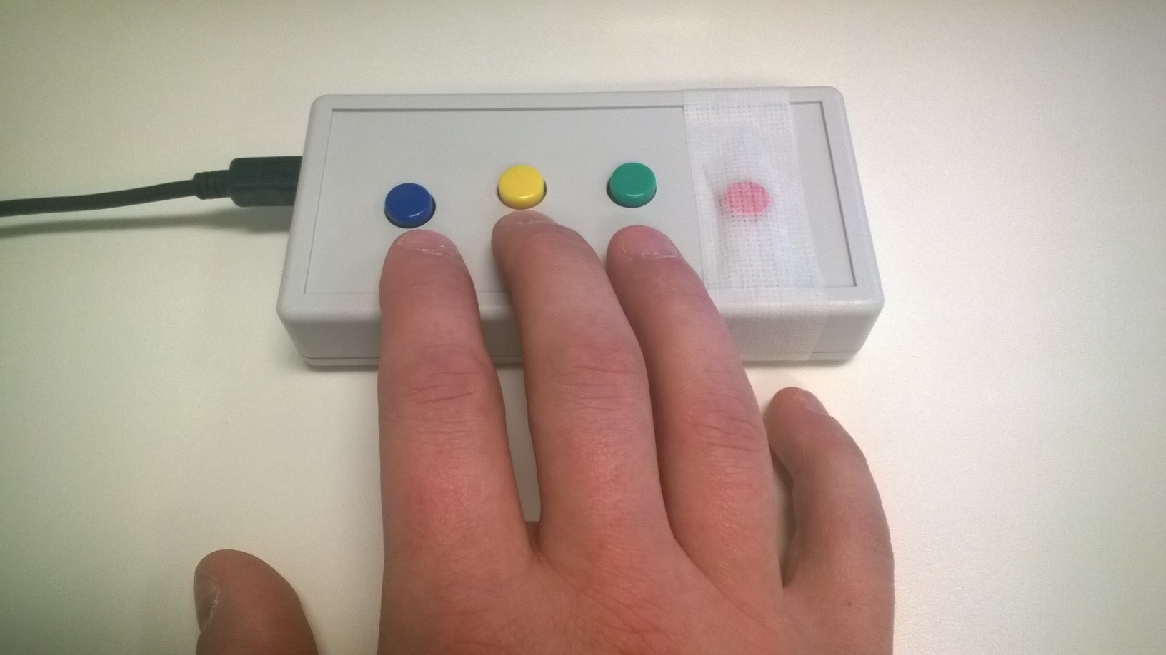
You will be using a button box like the one shown to make responses while you are in the scanner. Place your hand so that you can use your index and middle fingers to press the right and left buttons. Your ring finger will be used at times to select responses.
Please tell the experimenter if you have any questions about how to use the button box.
Left
Right
Select
RIGHT
PRESS THE RIGHT BUTTON TO CONTINUE

Slide 2
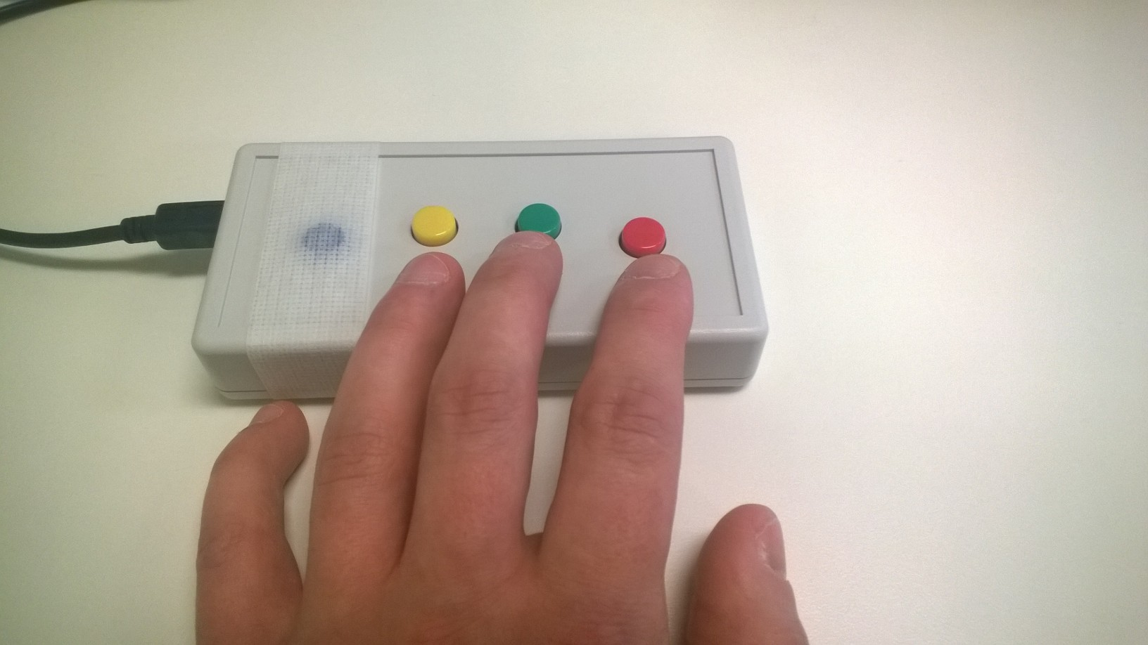
You will be using a button box like the one shown to make responses while you are in the scanner. Place your hand so that you can use your index and middle fingers to press the right and left buttons. Your ring finger will be used at times to select responses.
Please tell the experimenter if you have any questions about how to use the button box.
Left
Select
Right
RIGHT
PRESS THE RIGHT BUTTON TO CONTINUE

Slide 3
Picture Task
RIGHT
PRESS THE RIGHT BUTTON TO CONTINUE
Notes:
Inside the scanner

Slide 4
For this task, you will see a series of images.
Please attend to them carefully.
RIGHT
PRESS THE RIGHT BUTTON TO CONTINUE

Slide 5
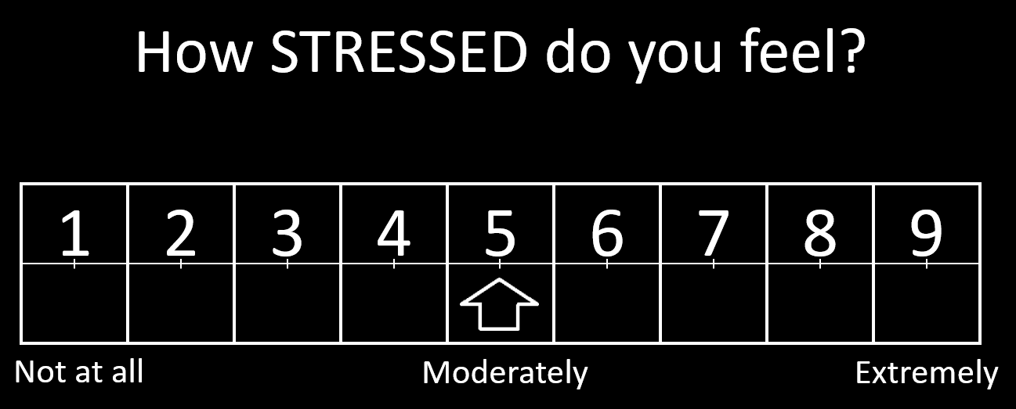
At times, you will be asked to make ratings on a 9-point scale like the one below. Please use your index and middle fingers to move the arrow, and your ring finger to make a selection.
You will have 5 seconds to make your response. If you fail to respond in the 5 seconds, don’t worry about it. Just get ready for the next trial.
RIGHT
PRESS THE RIGHT BUTTON TO CONTINUE

Slide 6
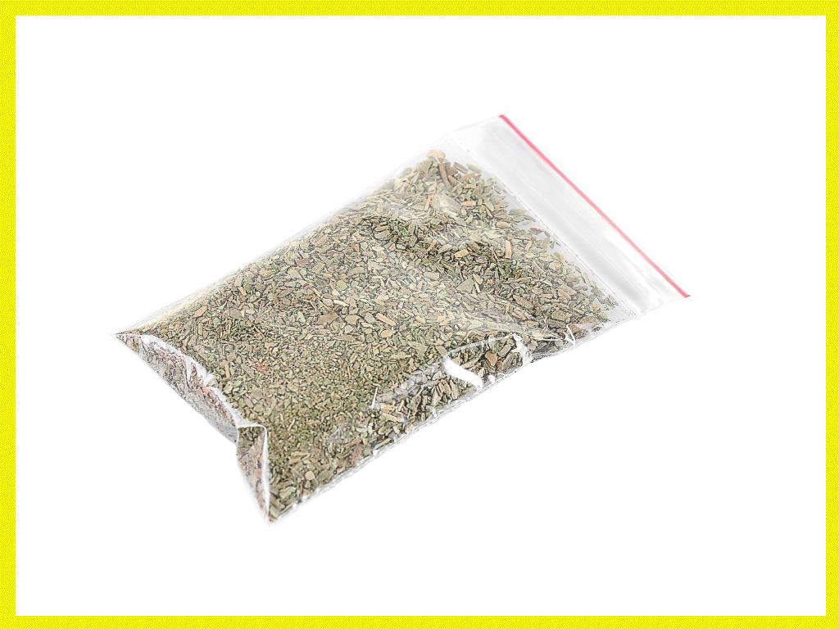
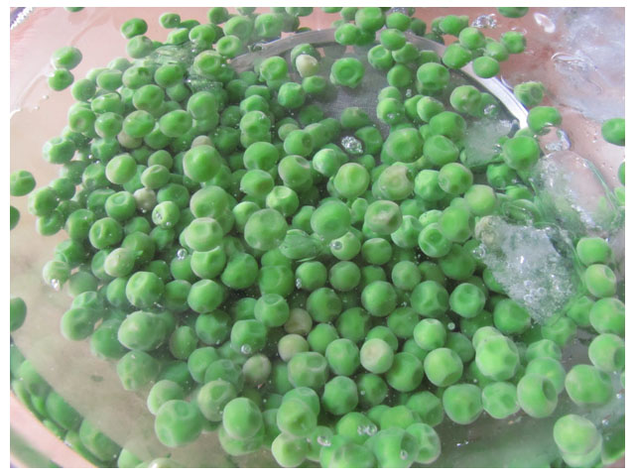
At times, a yellow border will appear around one of the images, as shown. When this happens, press any button to make the border disappear.
RIGHT
PRESS THE RIGHT BUTTON TO CONTINUE

Slide 7
Some of the pictures will be related to drug use. This may induce “drug craving” inside you. This is a normal response.
Please do not try to avoid or suppress your feelings when you see the pictures.
RIGHT
PRESS THE RIGHT BUTTON TO CONTINUE

Slide 8
You will hear a guided relaxation recording at the end of each run. During this time, please follow along with the voice.
The scanner will continue to run for a few minutes after the recording ends. Please keep your eyes open and continue to remain as still as possible.
Now you will complete a practice session. Please let the experimenter know if you have any questions
RIGHT
PRESS THE RIGHT BUTTON TO CONTINUE

Slide 9
Press the RIGHT button when you are ready to begin
RIGHT
PRESS THE RIGHT BUTTON TO CONTINUE
Notes:
Inside the scanner

Slide 10
Picture Task
RIGHT
PRESS THE RIGHT BUTTON TO CONTINUE
Notes:
Inside the scanner

Slide 11
Now you will complete the picture task. Please pay attention to the pictures as they appear, and use the button box to make ratings.
Left
Right
Select
PRESS THE RIGHT BUTTON TO CONTINUE

Slide 12
Now you will complete the picture task. Please pay attention to the pictures as they appear, and use the button box to make ratings.
Select
Left
Right
PRESS THE RIGHT BUTTON TO CONTINUE

Slide 13
Press any button when the image has a yellow border.
RIGHT
PRESS THE RIGHT BUTTON TO CONTINUE

Slide 14
Remember, some images will be related to drug use and may induce “drug craving” inside you.
This is a normal response and we ask you to focus on the images and try not to suppress or avoid your feelings.
Let your brain respond to them normally.
RIGHT
PRESS THE RIGHT BUTTON TO CONTINUE

Slide 15
Picture Task
RIGHT
PRESS THE RIGHT BUTTON TO CONTINUE
Notes:
Inside the scanner

Slide 16
Now you will complete another run of the Picture Task.
PRESS THE RIGHT BUTTON TO CONTINUE

Slide 17
Press the RIGHT button when you are ready to begin
This is run 1 of 7
PRESS THE RIGHT BUTTON TO CONTINUE
Notes:
Inside the scanner

Slide 18
Press the RIGHT button when you are ready to begin
This is run 2 of 7
PRESS THE RIGHT BUTTON TO CONTINUE
Notes:
Inside the scanner

Slide 19
Press the RIGHT button when you are ready to begin
This is run 3 of 7
PRESS THE RIGHT BUTTON TO CONTINUE
Notes:
Inside the scanner

Slide 20
Press the RIGHT button when you are ready to begin
This is run 4 of 7
PRESS THE RIGHT BUTTON TO CONTINUE
Notes:
Inside the scanner

Slide 21
Press the RIGHT button when you are ready to begin
This is run 5 of 7
PRESS THE RIGHT BUTTON TO CONTINUE
Notes:
Inside the scanner

Slide 22
Press the RIGHT button when you are ready to begin
This is run 6 of 7
PRESS THE RIGHT BUTTON TO CONTINUE
Notes:
Inside the scanner

Slide 23
Press the RIGHT button when you are ready to begin
This is run 7 of 7
PRESS THE RIGHT BUTTON TO CONTINUE
Notes:
Inside the scanner

