Slide 1
Focused Attention
RIGHT
PRESS THE RIGHT BUTTON TO CONTINUE
Notes:
Inside the scanner

Slide 2
This task will have three types of trials:
heart attention, stomach attention, and target attention.
Each trial lasts 10 seconds.
LEFT
RIGHT
PRESS THE RIGHT BUTTON TO CONTINUE

Slide 3
When you see “HEART”: focus your attention on the sensation of your heart in your chest.
When you see “LUNGS”: focus your attention on the sensation of your breath in your chest.
During these trials, do not focus your attention on a different part of the body.
LEFT
RIGHT
PRESS THE RIGHT BUTTON TO CONTINUE

Slide 4
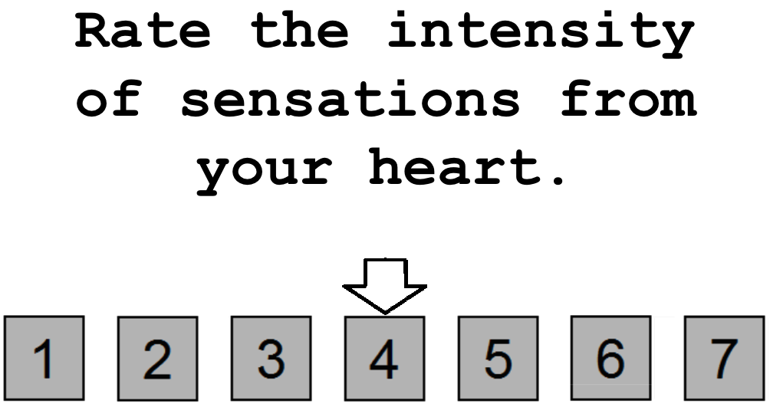
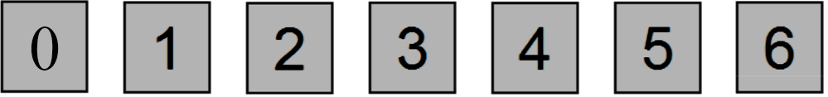
Occasionally, you will be asked to rate on a scale of 0 to 6 your experience. For example, you might see the word “HEART” for 10 seconds, during which time you would focus your attention on the sensations of your heart in your chest. Afterward, you might see the screen shown below
LEFT
RIGHT
PRESS THE RIGHT BUTTON TO CONTINUE
Notes:
NOTE: change rating scale from (1 to 7) to (0 to 6)

Slide 5
You would then use a button box to indicate your rating on the 0-to-6 scale; 0 = no sensation, 3 = moderate sensation, and 6 = extreme sensation.
Use your index and middle fingers to move the arrow, and your ring finger to make a selection.
LEFT
RIGHT
PRESS THE RIGHT BUTTON TO CONTINUE
Notes:
NOTE: also change rating scale from (1 to 7) to (0 to 6)

Slide 6
Note that you might be very aware of your heartbeat when it beats quickly, or even slowly. If you were extremely aware of your heartbeat, you might provide a rating of 6. In contrast, if you experienced no sensation from your heart during the preceding 10 seconds, you might provide a rating of 0.
You will have 5 seconds to make your response. If you fail to respond in the 5 seconds, don’t worry about it. Just get ready for the next trial.
LEFT
RIGHT
PRESS THE RIGHT BUTTON TO CONTINUE
Notes:
NOTE: also change rating scale from (1 to 7) to (0 to 6)

Slide 7
Similarly, if you were extremely aware that your lungs were very full, you might provide a rating of 6. Alternatively, if you were extremely aware that your lungs were empty, you might also provide a rating of 6. In contrast, if you experienced no sensation from your lungs during the preceding 10 seconds, you might provide a rating of 0.
LEFT
RIGHT
PRESS THE RIGHT BUTTON TO CONTINUE
Notes:
CHANGE RATE INSTRUCTION BOX: “Rate your awareness of sensations from your heart.” NOTE: also change rating scale from (1 to 7) to (0 to 6)

Slide 8
During the target detection trials, you will see the word “TARGET” appear in the middle of the screen. At fixed intervals, the color of the word “TARGET” will briefly change to a lighter shade of gray. Your job will be to focus your attention on these color changes and notice how intensely the color changes over the ten-second interval. In short, notice how much brighter the word becomes during these color changes. After approximately half of the target detection trials you will make a rating on a scale of 0 to 6 to indicate the intensity of the color change you saw. You will have 5 seconds to make your response. If you fail to respond in the 5 seconds, don’t worry about it. Just get ready for the next trial.
LEFT
RIGHT
PRESS THE RIGHT BUTTON TO CONTINUE

Slide 9

Here is an example of what a target detection trial may look like.
LEFT
Notes:
Add screenshot.

Slide 10

Here is an example of what a target detection trial may look like.
LEFT
Notes:
Add screenshot.

Slide 11
Here is an example of what a target detection trial may look like.
LEFT
Notes:
Add screenshot.

Slide 12
Here is an example of what a target detection trial may look like.
LEFT
RIGHT
PRESS THE RIGHT BUTTON TO CONTINUE
Notes:
Add screenshot.

Slide 13
The time between trials will be variable. Between trials you will see a “+” in the center of the screen. Whenever you see the “+” simply do your best to clear your mind and prepare for the next trial.
LEFT
RIGHT
PRESS THE RIGHT BUTTON TO CONTINUE

Slide 14
Now you will complete a practice run of the Focused Attention Task.
LEFT
RIGHT
PRESS THE RIGHT BUTTON TO CONTINUE

Slide 15
Press the RIGHT button when you are ready to begin
LEFT
RIGHT
PRESS THE RIGHT BUTTON TO CONTINUE
Notes:
Inside the scanner

Slide 16
Focused Attention
PRESS THE RIGHT BUTTON TO CONTINUE
Notes:
Inside the scanner

Slide 17
Now you will complete the Focused Attention Task.
Remember, when you see the words HEART or LUNGS, focus your attention on sensations coming from that part of your body.
When you see the word TARGET, focus your attention on how intensely it changes colors
PRESS THE RIGHT BUTTON TO CONTINUE

Slide 18
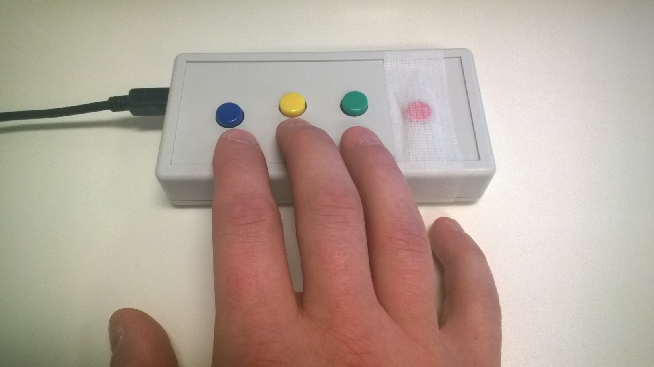
When you are asked to make a rating, use your index, middle, and ring fingers to rate the intensity of the sensations you felt or the intensity of the color change.
Left
Right
Select
PRESS THE RIGHT BUTTON TO CONTINUE

Slide 19
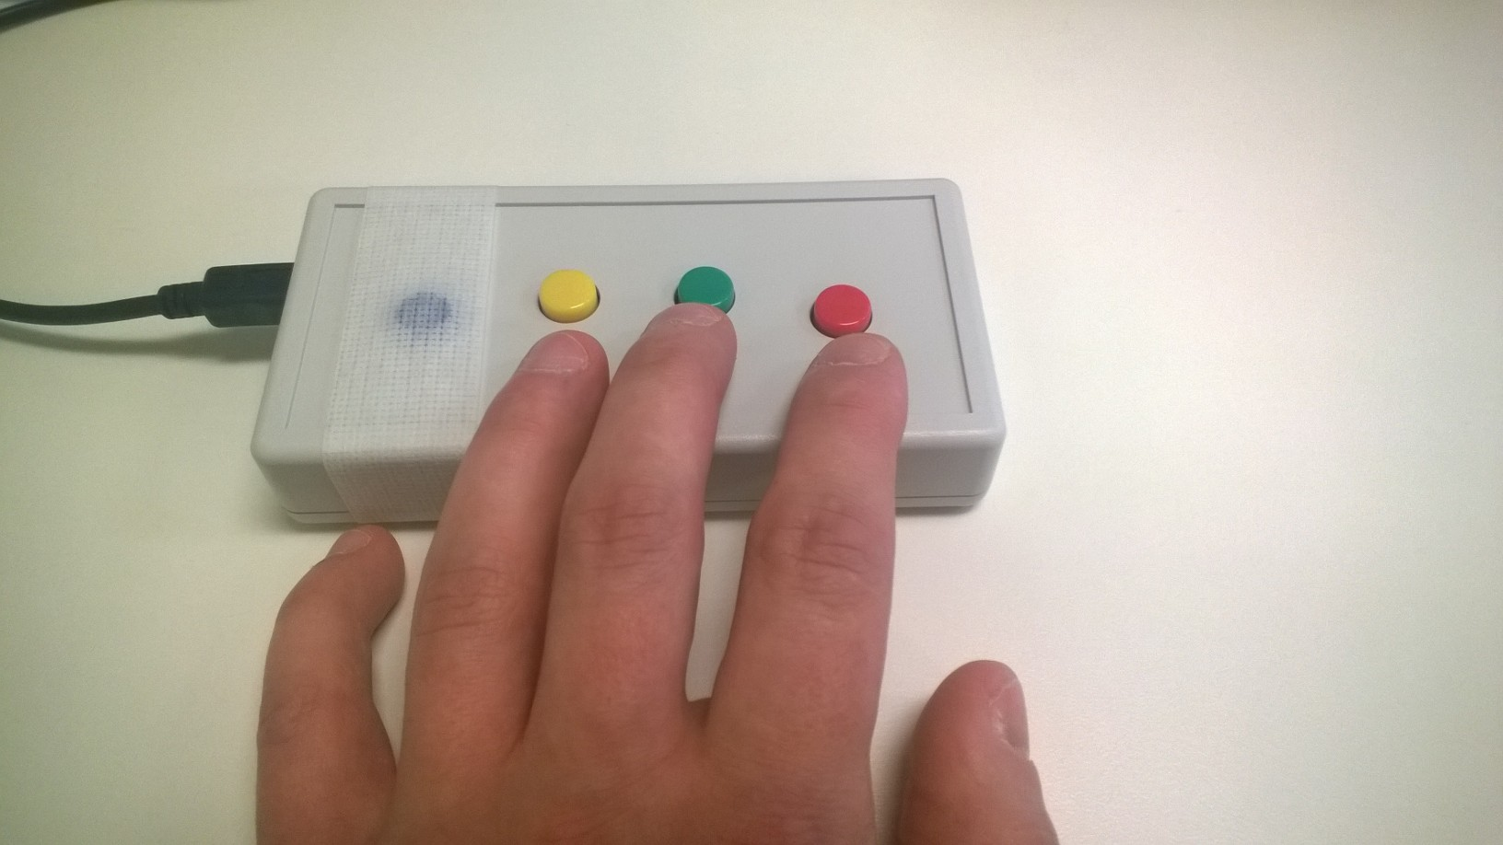
When you are asked to make a rating, use your index, middle, and ring fingers to rate the intensity of the sensations you felt or the intensity of the color change.
Select
Left
Right
PRESS THE RIGHT BUTTON TO CONTINUE

Slide 20
Press the RIGHT button when you are ready to begin
PRESS THE RIGHT BUTTON TO CONTINUE
Notes:
Inside the scanner

Slide 21
Focused Attention
PRESS THE RIGHT BUTTON TO CONTINUE
Notes:
Inside the scanner

Slide 22
Now you will complete another run of the Focused Attention task.
PRESS THE RIGHT BUTTON TO CONTINUE

Slide 23
Press the RIGHT button when you are ready to begin
PRESS THE RIGHT BUTTON TO CONTINUE
Notes:
Inside the scanner

