Slide 1
HEART

Slide 2
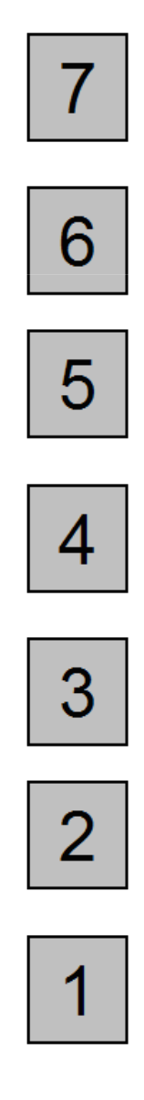
Rate the intensity of sensations from your heart.

Slide 3
STOMACH

Slide 4
Rate the intensity of sensations from your stomach.

Slide 5
TARGET

Slide 6
Rate the intensity of the color change you saw.

Slide 7
TARGET

Slide 8
TARGET

Slide 9
TARGET

Slide 10
TARGET

Slide 11
TARGET

Slide 12
TARGET

Slide 13
TARGET

Slide 14
TARGET

