Slide 1
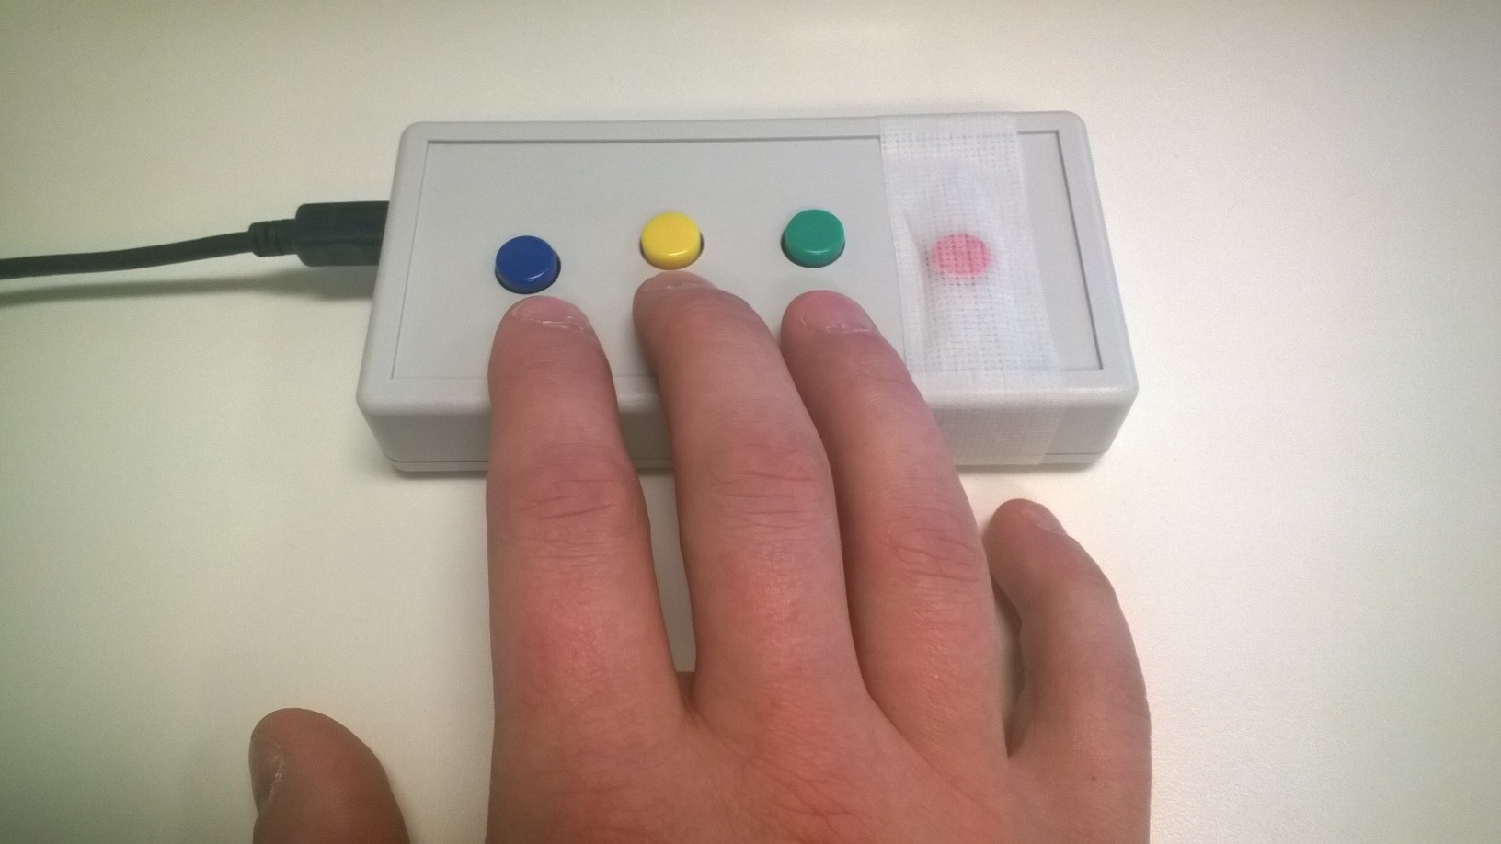
You will be using a button box like the one shown to make responses while you are in the scanner. Place your hand so that you can use your index and middle fingers to press the right and left buttons. Your ring finger will be used at times to select responses.
Please tell the experimenter if you have any questions about how to use the button box.
Left
Right
Select
RIGHT
PRESS THE RIGHT BUTTON TO CONTINUE

Slide 2
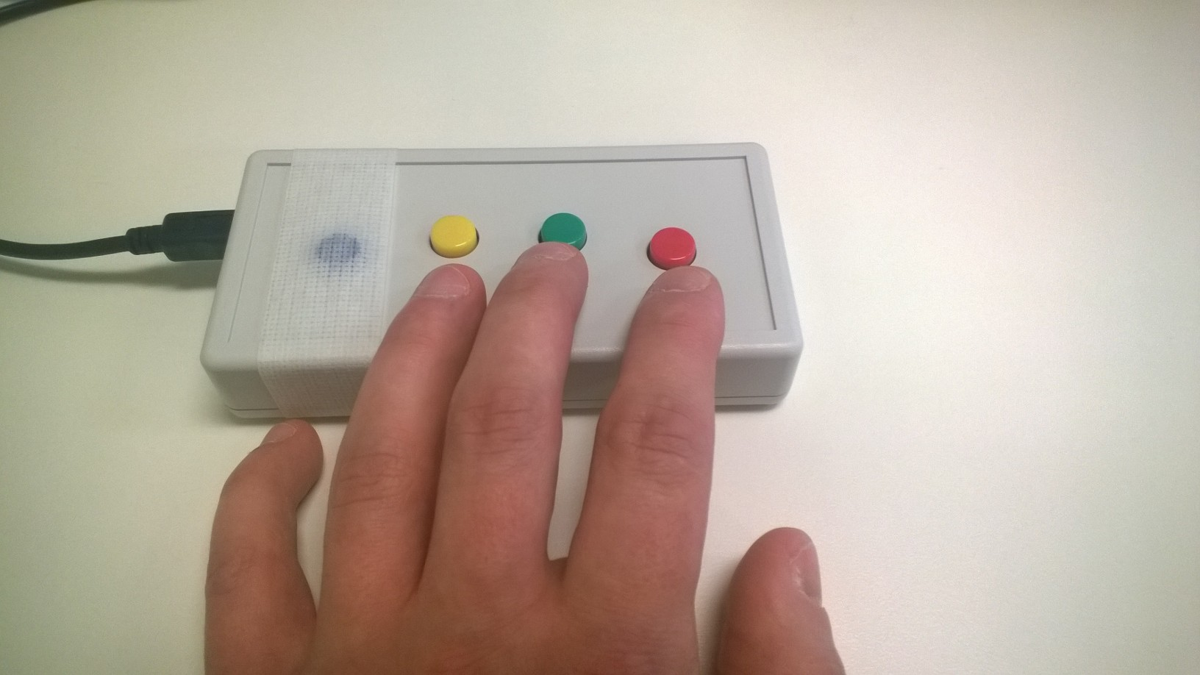
You will be using a button box like the one shown to make responses while you are in the scanner. Place your hand so that you can use your index and middle fingers to press the right and left buttons. Your ring finger will be used at times to select responses.
Please tell the experimenter if you have any questions about how to use the button box.
Left
Select
Right
RIGHT
PRESS THE RIGHT BUTTON TO CONTINUE

Slide 3
Focused Attention
RIGHT
PRESS THE RIGHT BUTTON TO CONTINUE
Notes:
Inside the scanner

Slide 4
This task will have three types of trials:
heart attention, head attention, and target attention.
Each trial lasts 10 seconds.
LEFT
RIGHT
PRESS THE RIGHT BUTTON TO CONTINUE

Slide 5
When you see “HEART”: focus your attention on the sensation of your heart in your chest.
When you see “HEAD”: focus your attention on the sensations from your head.
During these trials, do not focus your attention on a different part of the body.
LEFT
RIGHT
PRESS THE RIGHT BUTTON TO CONTINUE

Slide 6
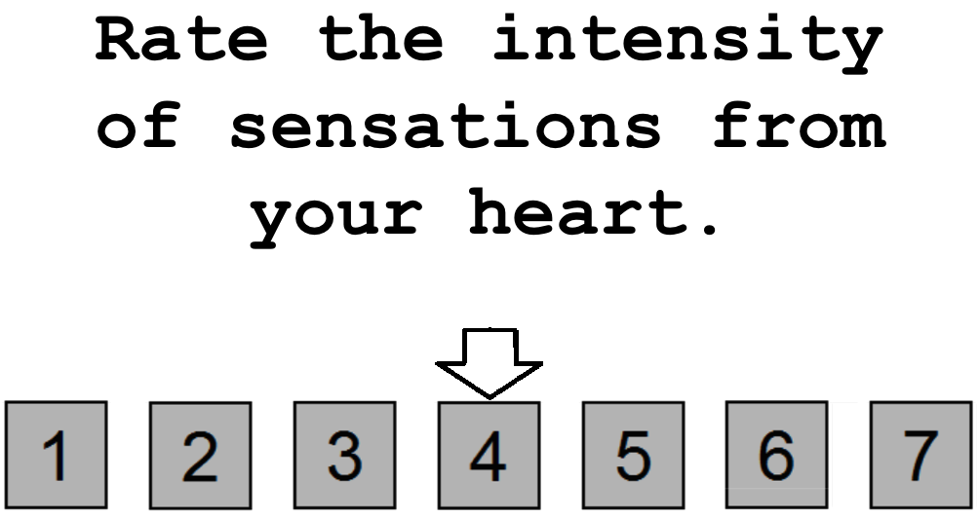
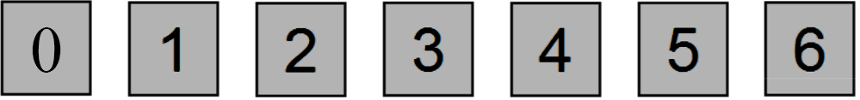
Occasionally, you will be asked to rate on a scale of 0 to 6 your experience. For example, you might see the word “HEART” for 10 seconds, during which time you would focus your attention on the sensations of your heart in your chest. Afterward, you might see the screen shown below
LEFT
RIGHT
PRESS THE RIGHT BUTTON TO CONTINUE
Notes:
NOTE: change rating scale from (1 to 7) to (0 to 6)

Slide 7
You would then use a button box to indicate your rating on the 0-to-6 scale; 0 = no sensation, 3 = moderate sensation, and 6 = extreme sensation.
Use your index and middle fingers to move the arrow, and your ring finger to make a selection.
LEFT
RIGHT
PRESS THE RIGHT BUTTON TO CONTINUE
Notes:
NOTE: also change rating scale from (1 to 7) to (0 to 6)

Slide 8
Note that you might be very aware of your heartbeat when it beats quickly, or even slowly. If you were extremely aware of your heartbeat, you might provide a rating of 6. In contrast, if you experienced no sensation from your heart during the preceding 10 seconds, you might provide a rating of 0.
You will have 5 seconds to make your response. If you fail to respond in the 5 seconds, don’t worry about it. Just get ready for the next trial.
LEFT
RIGHT
PRESS THE RIGHT BUTTON TO CONTINUE
Notes:
NOTE: also change rating scale from (1 to 7) to (0 to 6)

Slide 9
Similarly, if you were extremely aware of sensations coming form your head, you might provide a rating of 6. In contrast, if you experienced no sensation from your head during the preceding 10 seconds, you might provide a rating of 0.
LEFT
RIGHT
PRESS THE RIGHT BUTTON TO CONTINUE
Notes:
NOTE: also change rating scale from (1 to 7) to (0 to 6)

Slide 10
During the target detection trials, you will see the word “TARGET” appear in the middle of the screen. At fixed intervals, the color of the word “TARGET” will briefly change to a lighter shade of gray. Your job will be to focus your attention on these color changes and notice how intensely the color changes over the ten-second interval. In short, notice how much brighter the word becomes during these color changes. After approximately half of the target detection trials you will make a rating on a scale of 0 to 6 to indicate the intensity of the color change you saw. You will have 5 seconds to make your response. If you fail to respond in the 5 seconds, don’t worry about it. Just get ready for the next trial.
LEFT
RIGHT
PRESS THE RIGHT BUTTON TO CONTINUE

Slide 11

Here is an example of what a target detection trial may look like.
LEFT
Notes:
Add screenshot.

Slide 12

Here is an example of what a target detection trial may look like.
LEFT
Notes:
Add screenshot.

Slide 13
Here is an example of what a target detection trial may look like.
LEFT
Notes:
Add screenshot.

Slide 14
Here is an example of what a target detection trial may look like.
LEFT
RIGHT
PRESS THE RIGHT BUTTON TO CONTINUE
Notes:
Add screenshot.

Slide 15
The time between trials will be variable. Between trials you will see a “+” in the center of the screen. Whenever you see the “+” simply do your best to clear your mind and prepare for the next trial.
LEFT
RIGHT
PRESS THE RIGHT BUTTON TO CONTINUE

Slide 16
Now you will complete a practice run of the Focused Attention Task.
LEFT
RIGHT
PRESS THE RIGHT BUTTON TO CONTINUE

Slide 17
Press the RIGHT button when you are ready to begin
LEFT
RIGHT
PRESS THE RIGHT BUTTON TO CONTINUE
Notes:
Inside the scanner

Slide 18
Focused Attention
PRESS THE RIGHT BUTTON TO CONTINUE
Notes:
Inside the scanner

Slide 19
Now you will complete the Focused Attention Task.
Remember, when you see the words HEART or HEAD, focus your attention on sensations coming from that part of your body.
When you see the word TARGET, focus your attention on how intensely it changes colors
PRESS THE RIGHT BUTTON TO CONTINUE

Slide 20
When you are asked to make a rating, use your index, middle, and ring fingers to rate the intensity of the sensations you felt or the intensity of the color change.
Left
Right
Select
PRESS THE RIGHT BUTTON TO CONTINUE

Slide 21
When you are asked to make a rating, use your index, middle, and ring fingers to rate the intensity of the sensations you felt or the intensity of the color change.
Select
Left
Right
PRESS THE RIGHT BUTTON TO CONTINUE

Slide 22
Press the RIGHT button when you are ready to begin
PRESS THE RIGHT BUTTON TO CONTINUE
Notes:
Inside the scanner

Slide 23
Focused Attention
PRESS THE RIGHT BUTTON TO CONTINUE
Notes:
Inside the scanner

Slide 24
Now you will complete another run of the Focused Attention task.
PRESS THE RIGHT BUTTON TO CONTINUE

Slide 25
Press the RIGHT button when you are ready to begin
PRESS THE RIGHT BUTTON TO CONTINUE
Notes:
Inside the scanner

