Slide 1
MOCK Scan Session
RIGHT
PRESS THE RIGHT BUTTON TO CONTINUE

Slide 2
We will first introduce you to the tasks we will have you do and the questions we will have you answer during this part of the study.
On each of the following screens, I will read the instructions out loud. Then you will be given time to read them over yourself and ask questions until you feel like you understand them.
Once you indicate that you are ready, we will then move to the next slide, and this will continue until we have explained everything about this part of the study.
On each instruction slide, please press the right button when you feel that you understand and are ready to continue.
RIGHT
PRESS THE RIGHT BUTTON TO CONTINUE

Slide 3
In the following task, you will breathe through a breathing circuit at your own normal speed and depth of breathing.
Later, a resistor will be added to the breathing circuit, which will make your breathing more difficult.
After 1 minute of loaded breathing, the resistor will be removed and you will breathe normally.
RIGHT
PRESS THE RIGHT BUTTON TO CONTINUE

Slide 4
Another resistor will be added after you have breathed normally for about a minute while we ask you some questions.
There will be different resistors, which vary in how difficult they make your breathing. For example, sometimes your breathing might feel slightly difficult and sometimes your breathing might feel very difficult.
We will ask you to rate how your breathing felt after each loaded breathing, after the resistance has been removed.
RIGHT
PRESS THE RIGHT BUTTON TO CONTINUE

Slide 5
On each test, we want you to rate:
How much fear you felt
How difficult it felt to breathe
How unpleasant it felt to breath.
RIGHT
PRESS THE RIGHT BUTTON TO CONTINUE

Slide 6
To clarify, Difficulty is not an emotional measure. It doesn’t involve how pleasant or unpleasant it felt to breathe. For the question about difficulty, we are only asking about how much force it felt like you needed to apply when breathing or how hard it felt to get enough air
RIGHT
PRESS THE RIGHT BUTTON TO CONTINUE

Slide 7
Unpleasantness instead expresses the emotional aspect of the breathing sensation, regardless of whether the difficulty is high or low.
Unpleasantness describes how much you emotionally dislike something or feel terrified by it.
A low unpleasantness indicates that the perceived breathing difficulty did not feel bad. A high unpleasantness signifies that the breathing difficulty felt very bad or terrifying regardless of whether the difficulty is high or low.
RIGHT
PRESS THE RIGHT BUTTON TO CONTINUE

Slide 8
This is the scale we will use for asking how much fear you felt while breathing.
10 is the maximal fear that you could tolerate
0 1 2 3 4 5 6 7 8 9 10
5 means that your fear level was strong
0 means that you felt no fear
RIGHT
PRESS THE RIGHT BUTTON TO CONTINUE

Slide 9
This is the scale we will use for asking how difficult your breathing was.
10 is the maximal breathing difficulty that you could tolerate
0 1 2 3 4 5 6 7 8 9 10
5 means that your breathing difficulty was strong
0 means that your breathing was not difficult at all
RIGHT
PRESS THE RIGHT BUTTON TO CONTINUE

Slide 10
This is the scale we will use for asking how unpleasant your breathing was.
10 is the maximal unpleasantness you could tolerate
0 1 2 3 4 5 6 7 8 9 10
5 means that the unpleasantness you felt was strong
0 means that your breathing difficulty was not unpleasant at all
RIGHT
PRESS THE RIGHT BUTTON TO CONTINUE

Slide 11
We will also ask you during the test about your level of calmness, happiness, and anxiety.
RIGHT
PRESS THE RIGHT BUTTON TO CONTINUE

Slide 12
To ask about levels of calmness, happiness, and anxiety, we will show you the following screens
You do not need to answer these questions right now. We‘re just showing you what they look like.
RIGHT
PRESS THE RIGHT BUTTON TO CONTINUE

Slide 13
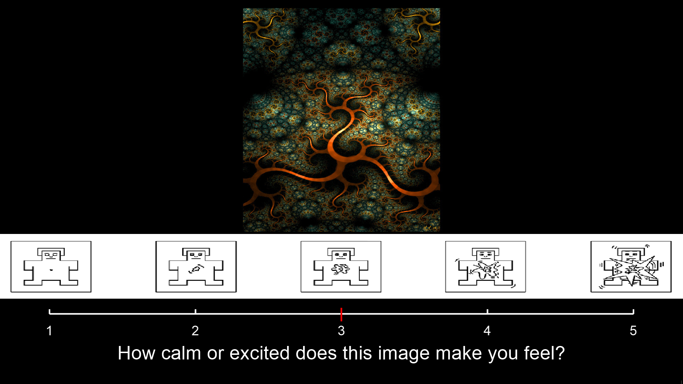
How calm or excited did you feel?
To clarify, “excited” does not involve feeling GOOD or BAD. It simply means how strong your bodily sensations felt. For example, being highly “excited” could indicate feeling very tense or feeling a strong or fast heartbeat (among others).
RIGHT
PRESS THE RIGHT BUTTON TO CONTINUE

Slide 14
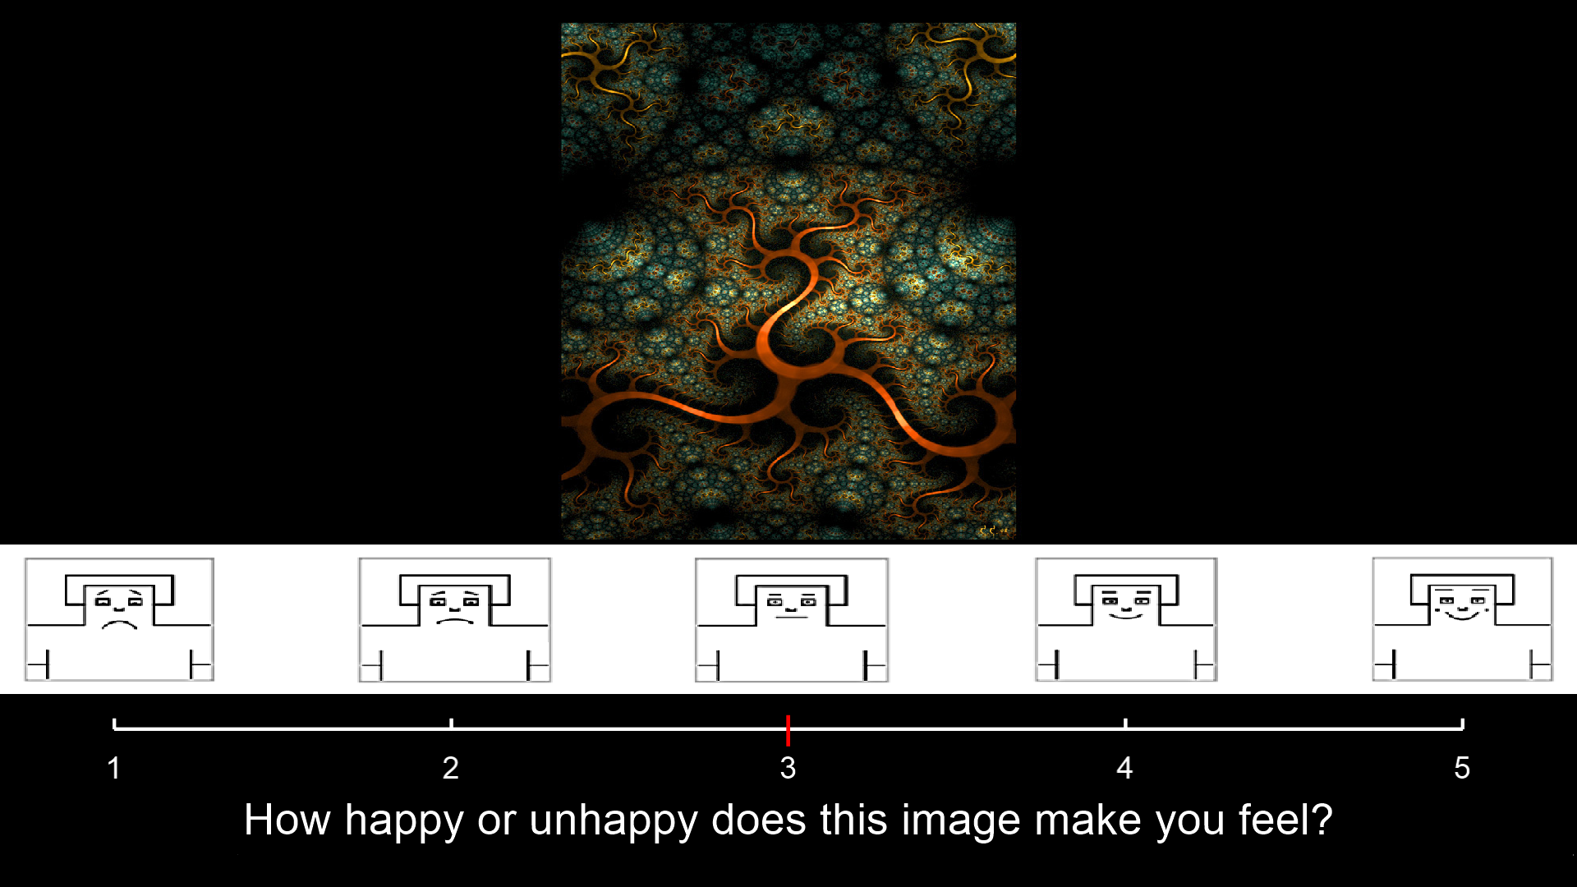
How happy or unhappy did you feel?
RIGHT
PRESS THE RIGHT BUTTON TO CONTINUE

Slide 15
Please indicate how much anxiety you felt while breathing
(0 = no anxiety, 10 = maximum possible anxiety)
0 1 2 3 4 5 6 7 8 9 10
RIGHT
PRESS THE RIGHT BUTTON TO CONTINUE

Slide 16
We will also ask you these questions about your experiences later while you are performing decision-making tasks
RIGHT
PRESS THE RIGHT BUTTON TO CONTINUE

Slide 17
Any questions so far?
RIGHT
PRESS THE RIGHT BUTTON TO CONTINUE

Slide 18
We will now practice the procedure a bit by asking you how your breathing has felt so far.
RIGHT
PRESS THE RIGHT BUTTON TO CONTINUE

Slide 19
Breathing period
PRESS THE B BUTTON
TO START TIMER

Slide 20
ASK Question:
How much fear did you feel while breathing?

Slide 21
ASK Question:
How difficult did it feel to breath?

Slide 22
ASK Question:
How unpleasant did it feel to breathe?

Slide 23
How calm or excited did you feel?
To clarify, “excited” does not involve feeling GOOD or BAD. It simply means how strong your bodily sensations felt. As two examples, being highly “excited” could indicate feeling very tense or feeling a strong or fast heart beats (among others).

Slide 24
How happy or unhappy did you feel?

Slide 25
Please indicate what your anxiety level was while breathing from 0 – 10
(0 = no anxiety, 10 = maximum possible anxiety)
0 1 2 3 4 5 6 7 8 9 10

Slide 26
Run 1
RIGHT
PRESS THE RIGHT BUTTON TO CONTINUE
Notes:
Run 1 = Load 10

Slide 27
Run 2
RIGHT
PRESS THE RIGHT BUTTON TO CONTINUE
Notes:
Run 2 = Load 20

Slide 28
Run 3
RIGHT
PRESS THE RIGHT BUTTON TO CONTINUE
Notes:
Run 3 = Load 40

Slide 29
Run 4
RIGHT
PRESS THE RIGHT BUTTON TO CONTINUE
Notes:
Run 4 = Load 60

Slide 30
Run 5
RIGHT
PRESS THE RIGHT BUTTON TO CONTINUE
Notes:
Run 4 = Load 80

Slide 31
We will now start the test.
Please breathe normally through the breathing circuit.
RIGHT
PRESS THE RIGHT BUTTON TO CONTINUE

Slide 32
We will now start the test.
Please breathe normally through the breathing circuit.
RIGHT
PRESS THE RIGHT BUTTON TO CONTINUE

Slide 33
(In order, loads will be: 10, 20, 40, 60, 80)

Slide 34
Breathing trial
(1 minutes)

Slide 35
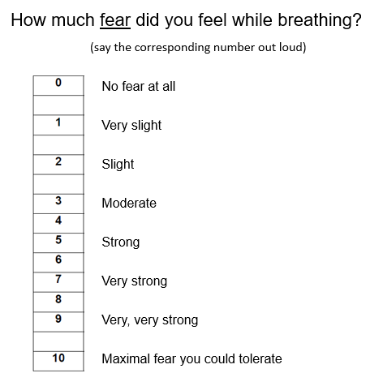

Slide 36
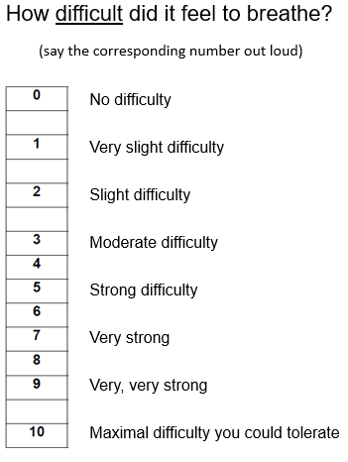

Slide 37
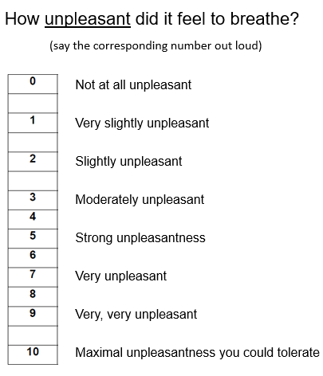

Slide 38
How happy or unhappy did you feel during loaded breathing?
(state the corresponding number out loud)

Slide 39
How calm or excited did you feel during loaded breathing?
(state the corresponding number out loud)

Slide 40
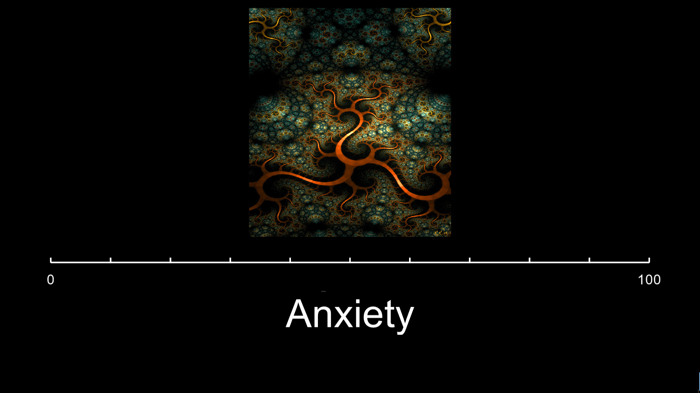
Please indicate your anxiety level during loaded breathing from 0-100 by stating a
number out loud
(0 = no anxiety, 100 = maximum possible anxiety)

Slide 41
Please describe how you were feeling during loaded breathing in your own words

Slide 42
Resting period
(1 minute)

Slide 43
Will now start the test again with a different breathing resistance.
Are you ready to begin?

Slide 44
Return to top for next breathing trial
(in order, loads will be: 10, 20, 40, 60, 80)

Slide 45
You will now complete a decision-making task while breathing through the breathing circuit
You will perform the task 2 times. Each time will last approximately 18 minutes.

Slide 46
In this task you will be offered a certain amount of money on each trial.
You will have the choice to accept the offer or wait for a better offer in the future.
If you choose to wait, the offer could stay the same or a better offer may appear.
However, there is also a chance that the offer will be revoked, and you will win no money for that trial.
In each trial, you will be given the choice to wait at either 4 or 8 timepoints, where each time you wait the offer could get bigger or go away.
The amount of times you could choose to wait will be indicated by the number of boxes (either 4 or 8) on the top of the screen. With each choice, the boxes will turn gray moving from left to right, indicating how many timepoints in the trial have gone by.
You will be paid additional money at the end of the day based on how much you win on the task, which you will perform here as well as in the MRI scanner later today (up to $10 additional dollars).

Slide 47
Any questions?

Slide 48
How much fear do you feel right now?
(say the corresponding number out loud)

Slide 49
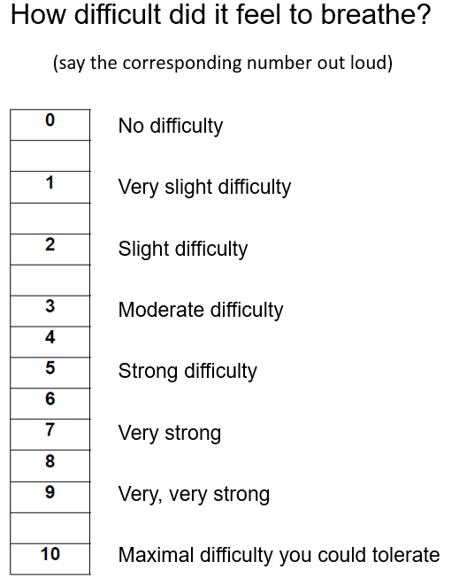
How difficult does it feel to breathe right now?
(say the corresponding number out loud)

Slide 50
How unpleasant does it feel to breathe right now?
How unpleasant is your current breathing difficulty?
(Just state a number out loud)
(say the corresponding number out loud)

Slide 51
How happy or unhappy do you feel?
(state the corresponding number out loud)

Slide 52
How calm or excited do you feel?
(state the corresponding number out loud)

Slide 53
Please indicate your current anxiety level from 0-100 by stating a number out loud
(0 = no anxiety, 100 = maximum possible anxiety)

Slide 54
Please describe in your own words how you are feeling right now?

Slide 55
Task run #1

Slide 56
How much fear did you feel during the task?
(say the corresponding number out loud)

Slide 57
How difficult did it feel to breathe during the task?
(say the corresponding number out loud)

Slide 58
How unpleasant did it feel to breath during the task?
(say the corresponding number out loud)

Slide 59
How happy or unhappy did you feel while performing the task?
(state the corresponding number out loud)

Slide 60
How calm or excited did you feel while performing the task?
(state the corresponding number out loud)

Slide 61
Please indicate your anxiety level while performing the task from 0-100 by stating a
number out loud
(0 = no anxiety, 100 = maximum possible anxiety)

Slide 62
Please describe in your own words how you were feeling during the task?

Slide 63
Resting period

Slide 64
Task run #2

Slide 65
How much fear did you feel during the task?
(say the corresponding number out loud)

Slide 66
How difficult did it feel to breathe during the task?
(say the corresponding number out loud)

Slide 67
How unpleasant did it feel to breath during the task?
(say the corresponding number out loud)

Slide 68
How happy or unhappy did you feel while performing the task?
(state the corresponding number out loud)

Slide 69
How calm or excited did you feel while performing the task?
(state the corresponding number out loud)

Slide 70
Please indicate your anxiety level while performing the task from 0-100 by stating a
number out loud
(0 = no anxiety, 100 = maximum possible anxiety)

Slide 71
Please describe in your own words how you were feeling during the task?

