Slide 1
Runway Task
RIGHT
PRESS THE RIGHT BUTTON TO CONTINUE
Notes:
Do we need to label this differently for the subject’s purpose?

Slide 2
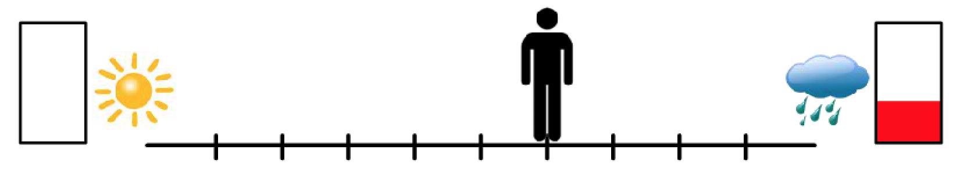
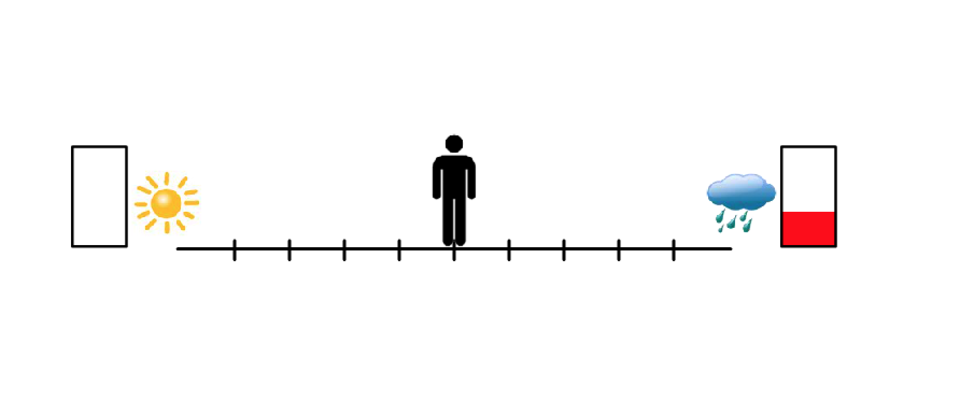
For this next task, you will see a runway on the screen,
just like that shown below.
There will be two potential outcomes, represented with
pictures on each side of the runway.
LEFT
RIGHT
PRESS THE RIGHT BUTTON TO CONTINUE

Slide 3
The rectangle represents the amount of money
to be rewarded for that outcome.
If there is no red in the rectangle, that equals 0 cents.
The more red, the more money is awarded for that outcome.
If the outcome associated
with this side occurred,
you would get 0 cents
If the outcome associated
with this side occurred,
you would get a few cents.
LEFT
RIGHT
PRESS THE RIGHT BUTTON TO CONTINUE
Notes:
On these – Teresa would just read the top part. But then leave the slide up for several seconds after she is done reading to give them time to study the image.

Slide 4
The sun and clouds represent the type of image
you will be shown before you are awarded the money indicated by the corresponding red bar.
If there is a sun, you would see a positive picture and sound.
If there is a cloud, you will be shown a negative picture and sound.
If the outcome associated with this side occurred, you would see a positive picture but would receive 0 cents.
If the outcome associated
with this side occurred, you would see a negative picture but would get a few cents.
LEFT
RIGHT
PRESS THE RIGHT BUTTON TO CONTINUE

Slide 5
For each trial, you are to move the figure on the screen
using 3 buttons – the left button, the right button, and the select button.
The left button moves the figure to the left,
the right button moves the figure to the right,
and the select button locks in your answer.
LEFT
RIGHT
PRESS THE RIGHT BUTTON TO CONTINUE

Slide 6
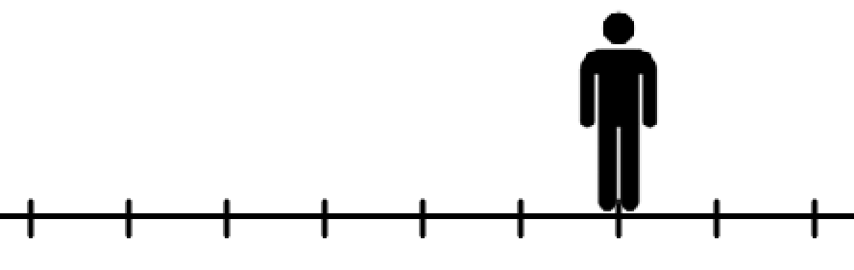
You will move the figure to indicate how much
you want each of the two possible outcomes.
For example, if you think you might want the outcome
on the right just a little more than the outcome on the left, then you may move the figure slightly
to the right of the center mark like shown below.
LEFT
RIGHT
PRESS THE RIGHT BUTTON TO CONTINUE

Slide 7
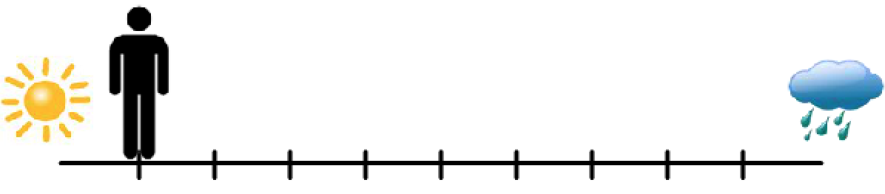
If you absolutely want the left outcome much more
than the right outcome, you may move the figure
all the way to the left like shown below.
LEFT
RIGHT
PRESS THE RIGHT BUTTON TO CONTINUE
Notes:
Automatically move on to the next slide

Slide 8
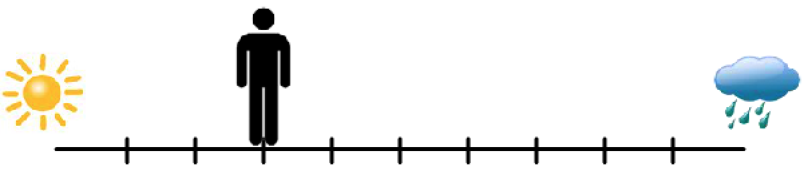
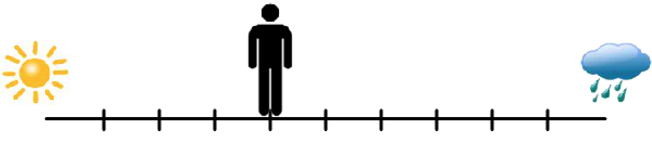
If you are completely unsure which one you want to
happen more, you may place the figure in the very middle, like shown below.
LEFT
RIGHT
PRESS THE RIGHT BUTTON TO CONTINUE

Slide 9
The closer you are to one side, the more likely that outcome will be to happen; and likewise, the further away you are from one side, the less likely that outcome will be to happen.
So, for example, if you moved all the way to one side (like shown), you would have a 90% chance of the nearest outcome occurring; but still a 10% chance of the other outcome occurring.
90% chance that this outcome would occur
10% chance that this outcome would occur
LEFT
RIGHT
PRESS THE RIGHT BUTTON TO CONTINUE

Slide 10
You will have 4 seconds to move the
figure to the location you want it.
Be prepared that the figure may start out in different positions;
it may sometimes start in the middle of the runway,
while at other times, it may start all the way to one side.
No matter what, you still only have 4 seconds
to move the figure to the location where you want it.
LEFT
RIGHT
PRESS THE RIGHT BUTTON TO CONTINUE

Slide 11
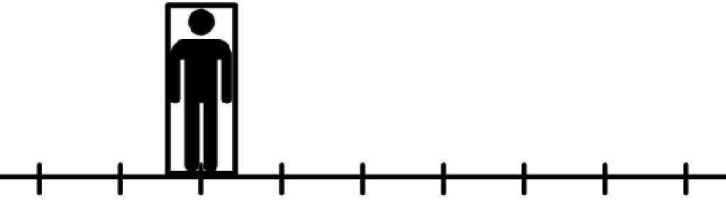
As soon as you have the figure where you want,
lock in your answer using the select button. However, realize
that once you lock in your answer you can no longer move the figure.
If you have not locked in your answer within 4 seconds,
the location of the figure at the end of the 4 seconds
will be taken as your final answer.
When your answer is locked in your figure will look like below.
LEFT
RIGHT
PRESS THE RIGHT BUTTON TO CONTINUE

Slide 12
Again, for each trial we want you to place the figure in a way
that indicates how much you want each of the 2 outcomes.
At the end of the task, you will see how much money
you’ve won.
It is completely up to you what decision you make on
each trial. So, on each trial, you should consider whether
you want the money that is offered or whether you would
rather view a positive picture. It is completely up to you.
LEFT
RIGHT
PRESS THE RIGHT BUTTON TO CONTINUE

Slide 13
I will now show you an example of each type of outcome,
positive and negative.
First is an example of what you would see for the left outcome of this trial, which includes a positive picture, sound and no reward money.
Press the right button to see this example.
LEFT
RIGHT
PRESS THE RIGHT BUTTON TO CONTINUE

Slide 14

Notes:
sounds/IADSPA/812_Choir.mp3

Slide 15
YOU MADE 0 CENTS
TOTAL: 4
Notes:
sounds/IADSPA/812_Choir.mp3

Slide 16
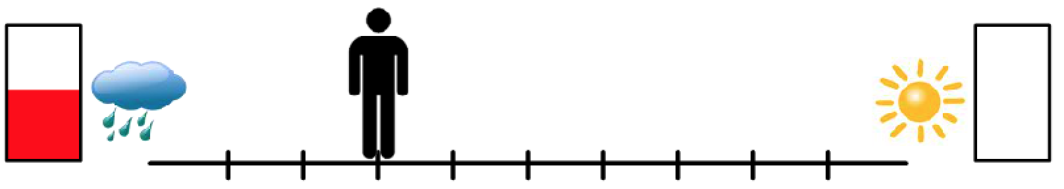
Now I will show you what would happen if the left outcome
of this trial (shown below) occurred, which includes a
negative picture, sound, and some reward money.
Please be warned that the negative pictures and sounds are very negative and may include such things as blood, combat, and dead bodies. You have no way of knowing HOW bad the picture will be for each trial…you will just know that it is going to be negative.
During the task, you will have some control over how likely and how often you see the negative pictures, but we want to give you an example here so that you will know what to expect.
Press the right button to see this example.
LEFT
RIGHT
PRESS THE RIGHT BUTTON TO CONTINUE
Notes:
Have backspace go back to before the example images were shown.

Slide 17
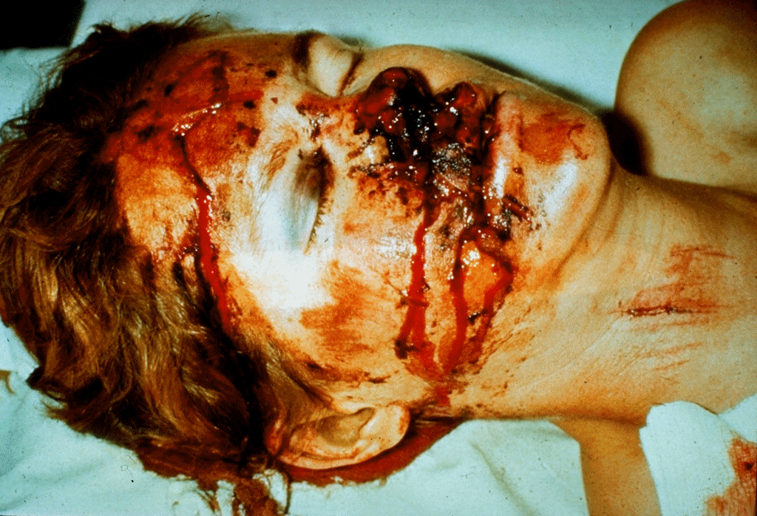
Notes:
sounds/IADSNA/698_RagingFire.mp3

Slide 18
YOU MADE 6 CENTS
TOTAL: 10
Notes:
sounds/IADSNA/698_RagingFire.mp3

Slide 19
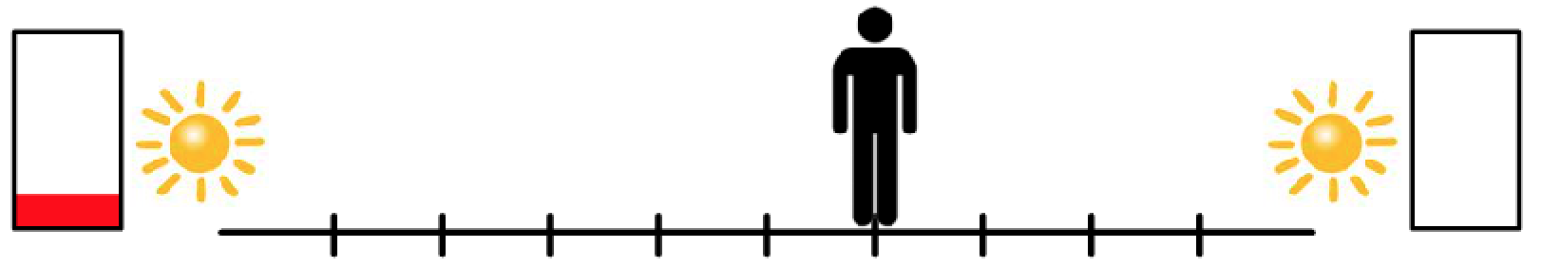
Note that some of the trials may look like that shown below, where there is no risk of seeing a negative picture and both choices are associated with a positive picture.
In these instances, there really is no reason
not to go towards the money.
These types of trials make sure you are
paying attention the entire task.
LEFT
RIGHT
PRESS THE RIGHT BUTTON TO CONTINUE
Notes:
Have backspace go back to before the example images were shown.

Slide 20
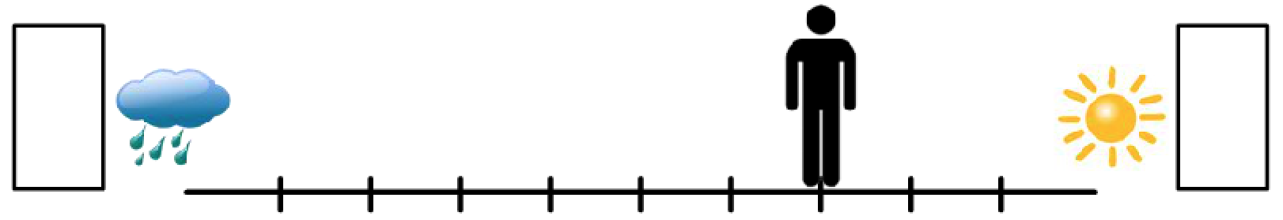
Also note that some of the trials may look like this, where there is no reward money offered for either outcome.
In these instances, there is no reason not to go towards the sun unless you are really wanting to see the negative picture.
LEFT
RIGHT
PRESS THE RIGHT BUTTON TO CONTINUE

Slide 21
Remember, for each trial, we want you to indicate how strongly you want each possible outcome, given the potential reward money as well as the potential images and sounds you would have to see in order to get the money.
Note that between each trial will be an X. The amount of time this X is on the screen will vary throughout the task.
LEFT
RIGHT
PRESS THE RIGHT BUTTON TO CONTINUE

Slide 22
Please let the administrator know now if
you have any questions on this task.
Now we will try a few example trials,
just so you can practice.
You will not win money based on this practice session, but you will be paid based on the amount you win inside the scanner.
LEFT
RIGHT
PRESS THE RIGHT BUTTON TO CONTINUE

Slide 23
Press the RIGHT button when you are ready to begin.
LEFT
RIGHT
PRESS THE RIGHT BUTTON TO CONTINUE
Notes:
Outside the scanner

Slide 24
Runway Task
PRESS THE RIGHT BUTTON TO CONTINUE
Notes:
Do we need to label this differently for the subject’s purpose?

Slide 25
For each runway, there will be two potential outcomes.
Each of the two outcomes include:
a positive or negative image, represented by a sun or cloud.
reward cents, represented by the amount of red in the rectangle.
If the outcome associated with this side occurred, you would see a positive picture but would get 0 cents.
If the outcome associated
with this side occurred, you would see a negative picture but would get a few cents
PRESS THE RIGHT BUTTON TO CONTINUE

Slide 26
For each trial, you will have 4 seconds to move the figure on the screen using the button box.
As soon as you have the figure where you want,
lock in your answer using the select button.
PRESS THE RIGHT BUTTON TO CONTINUE

Slide 27
It is completely up to you what decision you make on
each trial. So, on each trial, you should consider whether
you want the cents that are offered or whether you would
rather view a positive picture. It is completely up to you.
PRESS THE RIGHT BUTTON TO CONTINUE

Slide 28
Note that between trials there will be an X. Keep your focus on this X when it appears.
PRESS THE RIGHT BUTTON TO CONTINUE

Slide 29
Press the RIGHT button when you are ready to begin
PRESS THE RIGHT BUTTON TO CONTINUE
Notes:
Inside the scanner

Slide 30
Runway Task
PRESS THE RIGHT BUTTON TO CONTINUE
Notes:
Do we need to label this differently for the subject’s purpose?

Slide 31
Now you will complete another run of the Runway Task.
PRESS THE RIGHT BUTTON TO CONTINUE

Slide 32
Press the RIGHT button when you are ready to begin
PRESS THE RIGHT BUTTON TO CONTINUE
Notes:
Inside the scanner

