Slide 1
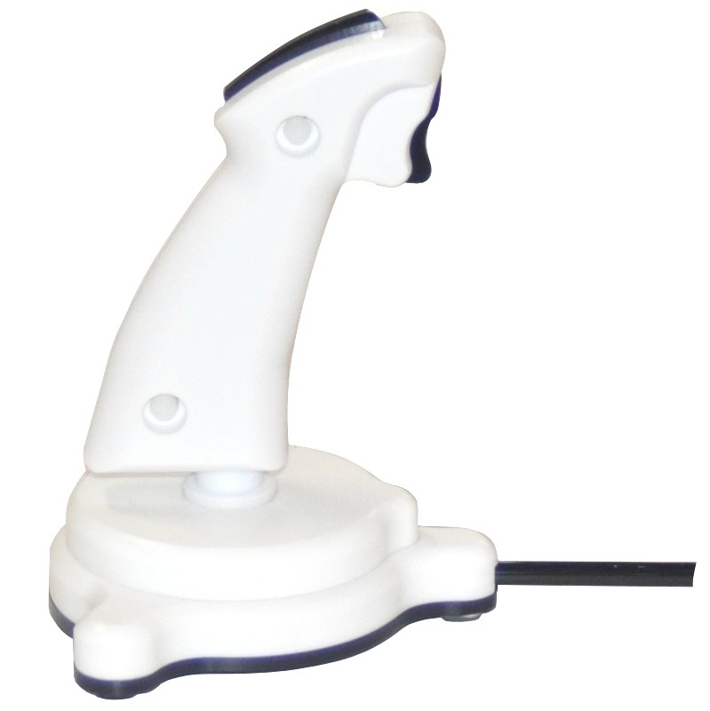
Run 2 out of 7 Runway Task (1/3) You will be completing this task 3 times
Trigger Button
Top Button
TRIGGER
PRESS THE TRIGGER BUTTON TO CONTINUE
Notes:
Do we need to label this differently for the subject’s purpose?

Slide 2
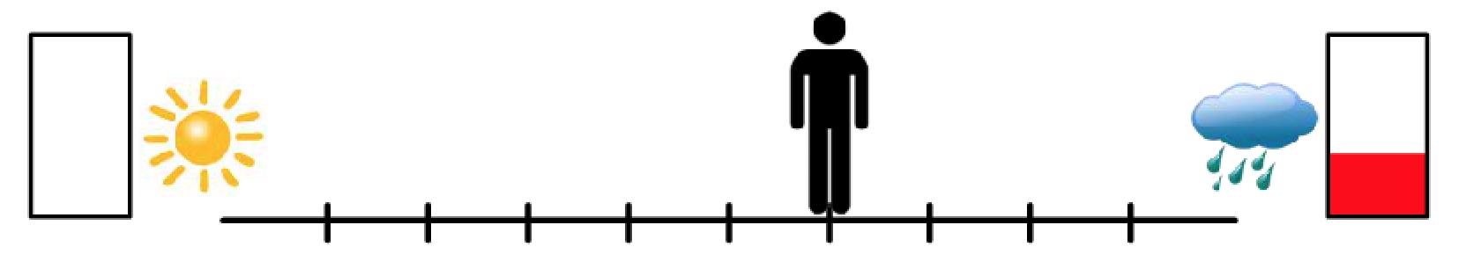
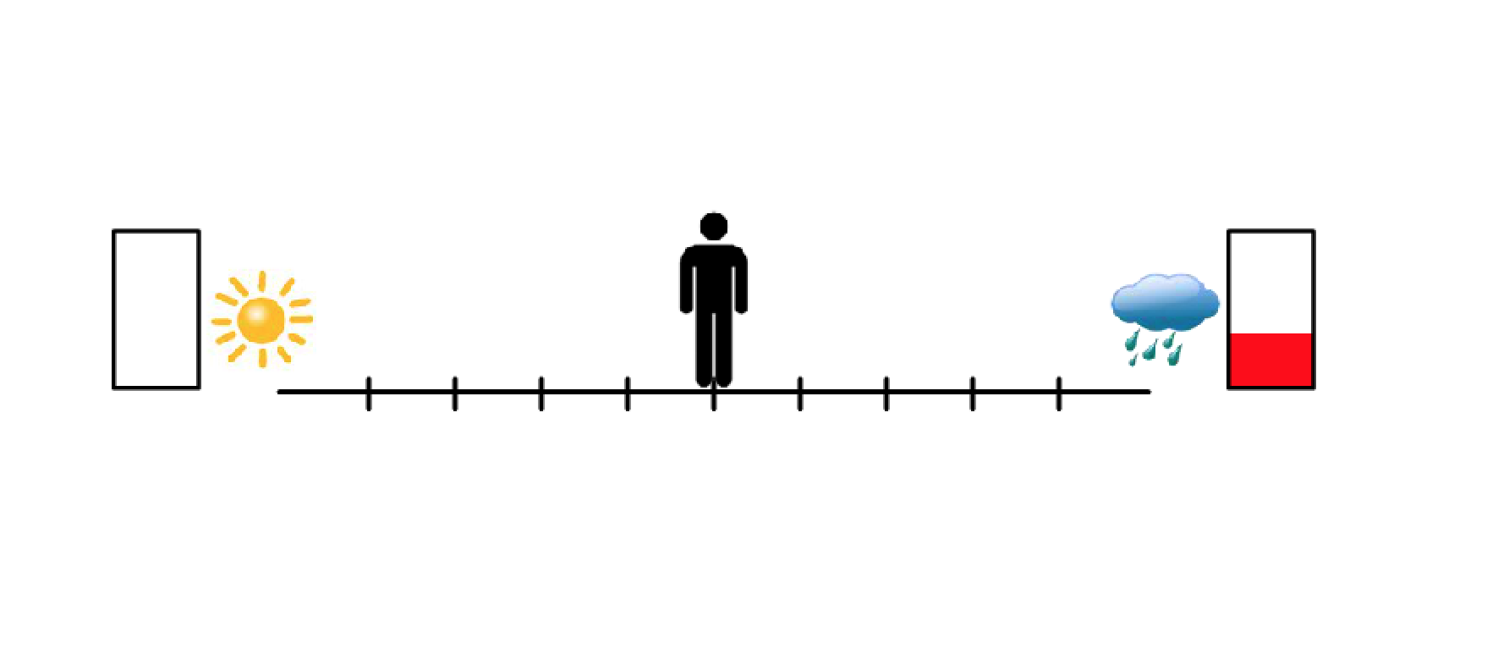
For each runway, there will be two potential outcomes.
Each of the two outcomes include:
a positive or negative image, represented by a sun or cloud.
reward cents, represented by the amount of red in the rectangle.
If the outcome associated with this side occurred, you would see a positive picture but would get 0 cents.
If the outcome associated
with this side occurred, you would see a negative picture but would get a few cents
TOP
TRIGGER
PRESS THE TRIGGER BUTTON TO CONTINUE

Slide 3
For each trial, you will have 4 seconds to move the figure on the screen using the joystick.
As soon as you have the figure where you want,
lock in your answer using the trigger button.
TOP
TRIGGER
PRESS THE TRIGGER BUTTON TO CONTINUE

Slide 4
It is completely up to you what decision you make on
each trial. So, on each trial, you should consider whether
you want the cents that are offered or whether you would
rather view a positive picture. It is completely up to you.
TOP
TRIGGER
PRESS THE TRIGGER BUTTON TO CONTINUE

Slide 5
Note that between each trial will be a cross “+”. Keep your focus on this cross when it appears.
Please let the administrator know now if
you have any questions on this task.
Otherwise press the trigger button
when you are ready to begin.
TOP
TRIGGER
PRESS THE TRIGGER BUTTON TO CONTINUE

Slide 6
Run 3 out of 7 Runway Task (2/3)
Trigger Button
Top Button
TRIGGER
PRESS THE TRIGGER BUTTON TO CONTINUE
Notes:
Do we need to label this differently for the subject’s purpose?

Slide 7
Please let the administrator know now if
you have any questions.
Otherwise press the trigger button when you are ready to begin.
TOP
TRIGGER
PRESS THE TRIGGER BUTTON TO CONTINUE

Slide 8
Run 4 out of 7 Runway Task (3/3)
Trigger Button
Top Button
TRIGGER
PRESS THE TRIGGER BUTTON TO CONTINUE
Notes:
Do we need to label this differently for the subject’s purpose?

Slide 9
Please let the administrator know now if
you have any questions.
Otherwise press the trigger button when you are ready to begin.
TOP
TRIGGER
PRESS THE TRIGGER BUTTON TO CONTINUE

Slide 10
Runway Task
Trigger Button
Top Button
TRIGGER
PRESS THE TRIGGER BUTTON TO CONTINUE
Notes:
Do we need to label this differently for the subject’s purpose?

Slide 11
This is run 6 of 8
Note that between each trial will be a cross “+”. Keep your focus on this cross when it appears.
Please let the administrator know now if
you have any questions.
Otherwise press the trigger button when you are ready to begin.
TOP
TRIGGER
PRESS THE TRIGGER BUTTON TO CONTINUE

Slide 12
This is run 7 of 8
Please let the administrator know now if
you have any questions.
Otherwise press the trigger button when you are ready to begin.
TOP
TRIGGER
PRESS THE TRIGGER BUTTON TO CONTINUE

Slide 13
This is run 8 of 8
Please let the administrator know now if
you have any questions.
Otherwise press the trigger button when you are ready to begin.
TOP
TRIGGER
PRESS THE TRIGGER BUTTON TO CONTINUE

