Slide 1
Sound Check
RIGHT
PRESS THE RIGHT BUTTON TO CONTINUE
Notes:
Do we need to label this differently for the subject’s purpose?

Slide 2
For the next task we need you to select what
volume feels most comfortable for you.
LEFT
RIGHT
PRESS THE RIGHT BUTTON TO CONTINUE

Slide 3
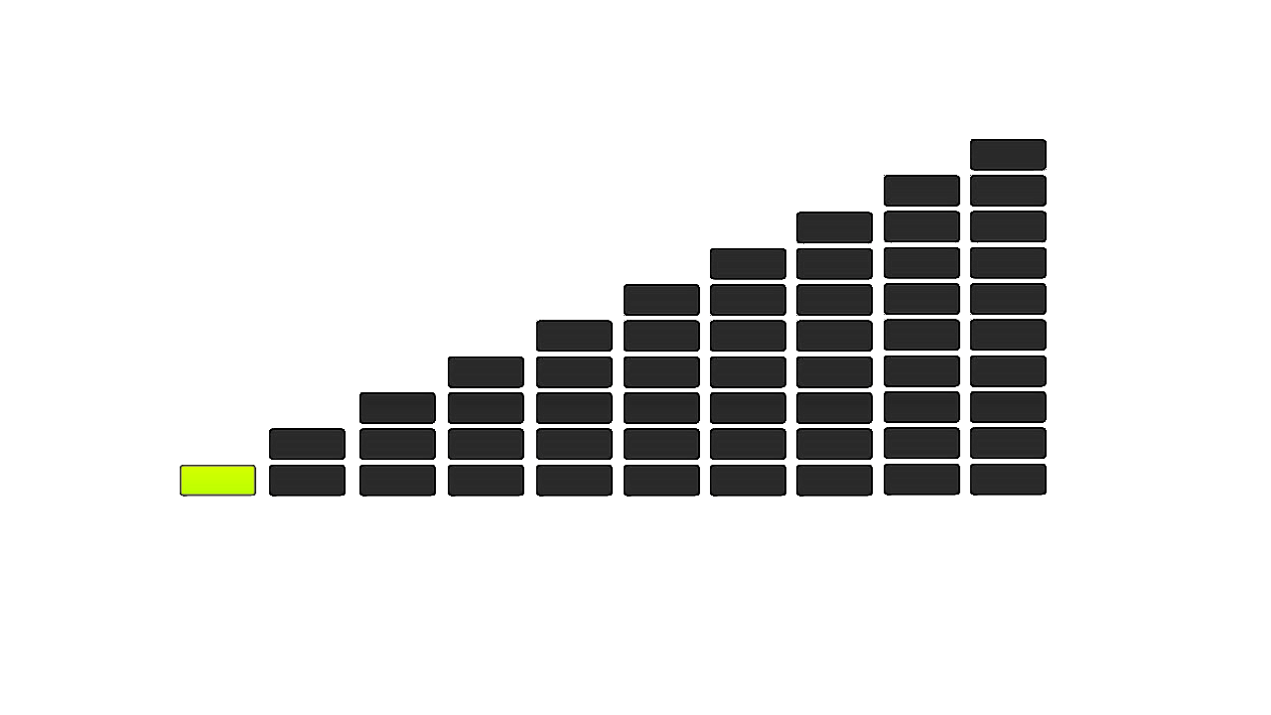
When the sound check begins you will hear the sound of a baby laughing and shown the following image.
LEFT
RIGHT
PRESS THE RIGHT BUTTON TO CONTINUE

Slide 4
To increase the volume, press the right button.
To decrease the volume, press the left button.
To select the volume, press the select button.
LEFT
RIGHT
PRESS THE RIGHT BUTTON TO CONTINUE

Slide 5
Press the RIGHT button when you are ready to begin.
LEFT
RIGHT
PRESS THE RIGHT BUTTON TO CONTINUE
Notes:
Outside the scanner

Slide 6
Sound Check
RIGHT
PRESS THE RIGHT BUTTON TO CONTINUE
Notes:
Do we need to label this differently for the subject’s purpose?

Slide 7
For the next task we need you to select what
volume you can hear comfortably over the scanner.
RIGHT
PRESS THE RIGHT BUTTON TO CONTINUE

Slide 8
When the sound check begins, the scanner will start and you will hear the sound of a baby laughing and shown the following image.
RIGHT
PRESS THE RIGHT BUTTON TO CONTINUE

Slide 9
To increase the volume, press the right button.
To decrease the volume, press the left button.
To select the volume, press the select button.
RIGHT
PRESS THE RIGHT BUTTON TO CONTINUE

Slide 10
Press the RIGHT button when you are ready to begin.
RIGHT
PRESS THE RIGHT BUTTON TO CONTINUE
Notes:
Outside the scanner

