Slide 1

Limited Offer Task
RIGHT
PRESS THE RIGHT BUTTON TO CONTINUE
Notes:
Outside the scanner

Slide 2
Welcome!
In this task you will be offered a certain amount of money on each trial.
You will have the choice to accept the offer or wait for a better offer in the future.
RIGHT
PRESS THE RIGHT BUTTON TO CONTINUE
Notes:
.

Slide 3
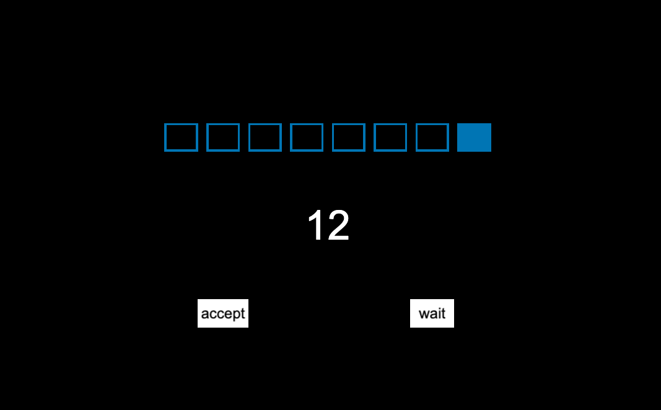
The offer will be displayed under pictures of several boxes, like shown below (in this case, an offer of 12 points).
12 points
RIGHT
PRESS THE RIGHT BUTTON TO CONTINUE

Slide 4
The boxes represent the number of timepoints in each trial. In the example trial below, there would be 8 timepoints (8 boxes).
12 points
RIGHT
PRESS THE RIGHT BUTTON TO CONTINUE

Slide 5
In other trials there will be 4 timepoints as shown below. For each timepoint, you will be given the choice to accept the offer or wait, where each time you wait the offer could get bigger or go away.
12 points
RIGHT
PRESS THE RIGHT BUTTON TO CONTINUE

Slide 6
Once you see the white “accept” or “wait” options, you will have 1 second to either accept the current offer or wait.
12 points
RIGHT
PRESS THE RIGHT BUTTON TO CONTINUE

Slide 7
Use the LEFT Button to ACCEPT the offer.
Use the RIGHT Button to WAIT.
12 points
RIGHT
PRESS THE RIGHT BUTTON TO CONTINUE

Slide 8
If you choose to wait, the offer could stay the same or a better offer may appear. For example, the 12 below might be replaced by a 70. However, there is also a chance that the original offer will be revoked, and you will win no money for that trial.
12 points
RIGHT
PRESS THE RIGHT BUTTON TO CONTINUE

Slide 9
After each timepoint, the boxes will turn blue, moving from left to right, indicating how many timepoints in the trial have gone by.
12 points
RIGHT
PRESS THE RIGHT BUTTON TO CONTINUE

Slide 10
If you choose to accept the current offer, then that is the amount of money you receive for that trial and you will proceed to the next trial.
12 points
RIGHT
PRESS THE RIGHT BUTTON TO CONTINUE

Slide 11
If you respond too late, or if the offer is revoked after you choose to wait, then you will win nothing for that trial.
You will then proceed to the next trial.
RIGHT
PRESS THE RIGHT BUTTON TO CONTINUE

Slide 12
You will receive payment based on the number of points you win.
For every 100 points you win, you will receive 10 cents.
100 points = 10 cents
RIGHT
PRESS THE RIGHT BUTTON TO CONTINUE

Slide 13
You will be paid additional money for your participation in the study based on how much you win on this task .
RIGHT
PRESS THE RIGHT BUTTON TO CONTINUE

