Slide 1


Horizon Task
Turn up the volume to hear instructions.
RUN 1
RIGHT
PRESS THE RIGHT BUTTON TO CONTINUE
Notes:
Outside the scanner

Slide 2
Welcome!
Thank you for volunteering for this experiment.
In this experiment, we would like you to choose between 2 slot machines of the sort you might find in a casino.
RIGHT
PRESS THE RIGHT BUTTON TO CONTINUE

Slide 3
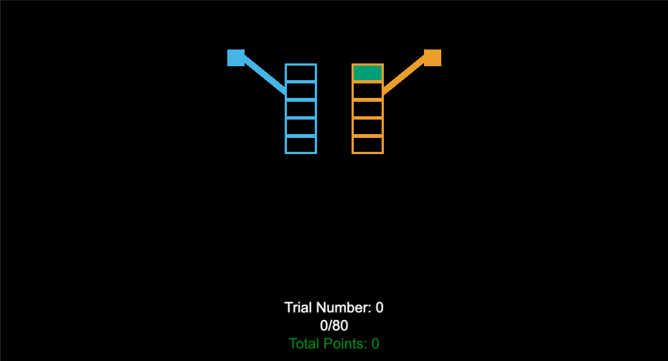
The slot machines will look like this :
RIGHT
PRESS THE RIGHT BUTTON TO CONTINUE
Notes:
Add screenshots of an X and an O screen – like a timeline of screenshots.

Slide 4
Every time you choose to play a particular slot machine, the lever will be pulled down. For example, if you chose the left slot machine, it would look like this:
RIGHT
PRESS THE RIGHT BUTTON TO CONTINUE
Notes:
Add screenshots of an X and an O screen – like a timeline of screenshots.

Slide 5
The points you win will be shown like this. For example, in this case the left slot machine was chosen and gave 77 points. XXs will be shown for the slot machine that wasn’t chosen. So you will not know how many points you would have won if you chose the other slot machine instead.
77
XX
RIGHT
PRESS THE RIGHT BUTTON TO CONTINUE
Notes:
Add screenshots of an X and an O screen – like a timeline of screenshots.

Slide 6
You job is to maximize the total points you get. Try your best to get as many points as you can!
77
XX
RIGHT
PRESS THE RIGHT BUTTON TO CONTINUE
Notes:
Add screenshots of an X and an O screen – like a timeline of screenshots.

Slide 7
During one game, each slot machine will have a different average “pay out”. For example, one of the machines may pay out an average of 45 points while the other averages 52 points. However, the specific amount awarded on any given choice will vary.”
RIGHT
PRESS THE RIGHT BUTTON TO CONTINUE
Notes:
Add screenshots of an X and an O screen – like a timeline of screenshots.

Slide 8
For example, the average reward for the slot machine on the right might be 50 points, but on the first choice, you might see a reward of 52 points. This is because the exact reward on any given choice will vary around the average of 50 points.”
XX
52
RIGHT
PRESS THE RIGHT BUTTON TO CONTINUE
Notes:
Add screenshots of an X and an O screen – like a timeline of screenshots.

Slide 9
On the second play you might get 56 points
XX
52
XX
56
RIGHT
PRESS THE RIGHT BUTTON TO CONTINUE
Notes:
Add screenshots of an X and an O screen – like a timeline of screenshots.

Slide 10
On the 3rd play on the right you might get 45 points this time.
XX
52
XX
56
XX
45
RIGHT
PRESS THE RIGHT BUTTON TO CONTINUE
Notes:
Add screenshots of an X and an O screen – like a timeline of screenshots.

Slide 11
And so on, such that if you were to play the right slot machine 5 times in a row you might see these rewards.
XX
52
XX
56
XX
45
XX
60
XX
51
RIGHT
PRESS THE RIGHT BUTTON TO CONTINUE
Notes:
Add screenshots of an X and an O screen – like a timeline of screenshots.

Slide 12
The pay outs will vary in the same way for both slot machines, and the level in which they vary will stay the same throughout the experiment. It is just the average pay out that will change for each slot machine.
XX
52
XX
56
31
XX
27
XX
RIGHT
PRESS THE RIGHT BUTTON TO CONTINUE
Notes:
Add screenshots of an X and an O screen – like a timeline of screenshots.

Slide 13
During each game, one of the slot machines will have a higher average reward and will therefore be the best choice during that game. However, the same slot machine will not always be the best for all games.
70
XX
XX
56
76
XX
80
XX
RIGHT
PRESS THE RIGHT BUTTON TO CONTINUE
Notes:
Add screenshots of an X and an O screen – like a timeline of screenshots.

Slide 14
To make your choice:
Press the < BUTTON to play the left slot machine.
Press the > BUTTON to play the right slot machine.
RIGHT
PRESS THE RIGHT BUTTON TO CONTINUE
Notes:
Add screenshots of an X and an O screen – like a timeline of screenshots.

Slide 15
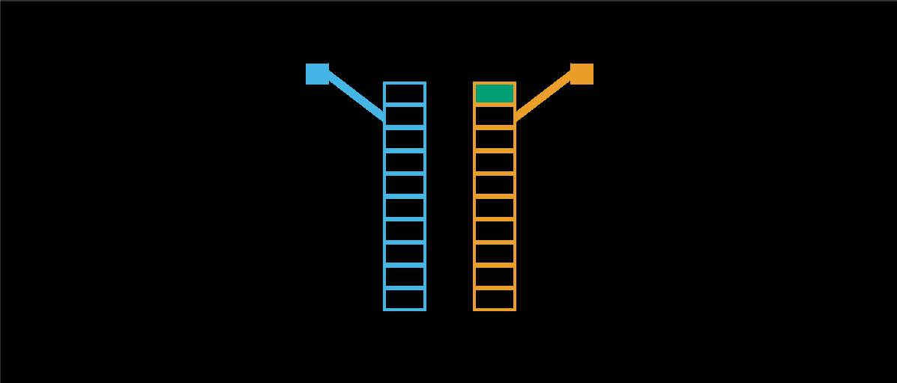
For any one choice, you can only play one slot machine. The number of choices in each game is determined by the height of the slot machine. For example, when the slot machines are 10 boxes high, you will have 10 choices in that game. Once you make those 10 choices, that game is over and you will start a new one.
RIGHT
PRESS THE RIGHT BUTTON TO CONTINUE
Notes:
Add screenshots of an X and an O screen – like a timeline of screenshots.

Slide 16
When the stacks are 5 boxes high, there are only 5 choices in that game.
RIGHT
PRESS THE RIGHT BUTTON TO CONTINUE
Notes:
Add screenshots of an X and an O screen – like a timeline of screenshots.

Slide 17
In addition, the first 4 choices in each game are “forced choices” where we will choose an option for you. This will give you some experience with each option before you make your first free choice between the two slot machines.”
RIGHT
PRESS THE RIGHT BUTTON TO CONTINUE
Notes:
Add screenshots of an X and an O screen – like a timeline of screenshots.

Slide 18
“These “forced choices” will be indicated by a red square inside the box we want you to open. You must press the button to choose this option in order to see the reward and move on to the next choice in the game.
For example, if you are instructed to choose the left box for your first choice, you will see this.
RIGHT
PRESS THE RIGHT BUTTON TO CONTINUE
Notes:
Add screenshots of an X and an O screen – like a timeline of screenshots.

Slide 19
If you are instructed to choose the right box on the third trial, you will see this:
30
XX
25
XX
RIGHT
PRESS THE RIGHT BUTTON TO CONTINUE
Notes:
Add screenshots of an X and an O screen – like a timeline of screenshots.

Slide 20
Once these “forced choices” are complete, you will have a free choice between the two stacks that is indicated by two green squares inside the two boxes you are choosing between.
30
XX
25
XX
XX
70
XX
65
RIGHT
PRESS THE RIGHT BUTTON TO CONTINUE
Notes:
Add screenshots of an X and an O screen – like a timeline of screenshots.

Slide 21
You will receive payment based on the number of points you win.
For every 100 points you win, you will receive 10 cents.
100 points = 10 cents
RIGHT
PRESS THE RIGHT BUTTON TO CONTINUE
Notes:
Add screenshots of an X and an O screen – like a timeline of screenshots.

Slide 22
You will receive payment based on the number of points you win.
For every 1000 points you win, you will receive 10 cents.
1000 points = 10 cents
RIGHT
PRESS THE RIGHT BUTTON TO CONTINUE
Notes:
Add screenshots of an X and an O screen – like a timeline of screenshots.

Slide 23
So to be sure that everything makes sense let’s work through a few example games.
Press the < BUTTON to play the left slot machine.
Press the > BUTTON to play the right slot machine.
RIGHT
PRESS THE RIGHT BUTTON TO CONTINUE

Slide 24
Good Job!
Now you know how to play this game.
Once you are ready to start playing the actual game to win points, please press the RIGHT BUTTON.

Slide 25
Horizon Task
RUN 2
RIGHT
PRESS THE RIGHT BUTTON TO CONTINUE
Notes:
Outside the scanner

Slide 26
To make your choice:
Press the < BUTTON to play the left slot machine.
Press the > BUTTON to play the right slot machine.
RIGHT
PRESS THE RIGHT BUTTON TO CONTINUE

