Slide 1

Horizon Task
RIGHT
PRESS THE RIGHT BUTTON TO CONTINUE
Notes:
Outside the scanner

Slide 2
Welcome!
Thank you for volunteering for this experiment.
In this experiment, we would like you to choose between 2 slot machines of the sort you might find in a casino.
RIGHT
PRESS THE RIGHT BUTTON TO CONTINUE
Notes:
Add screenshots of an X and an O screen – like a timeline of screenshots.

Slide 3
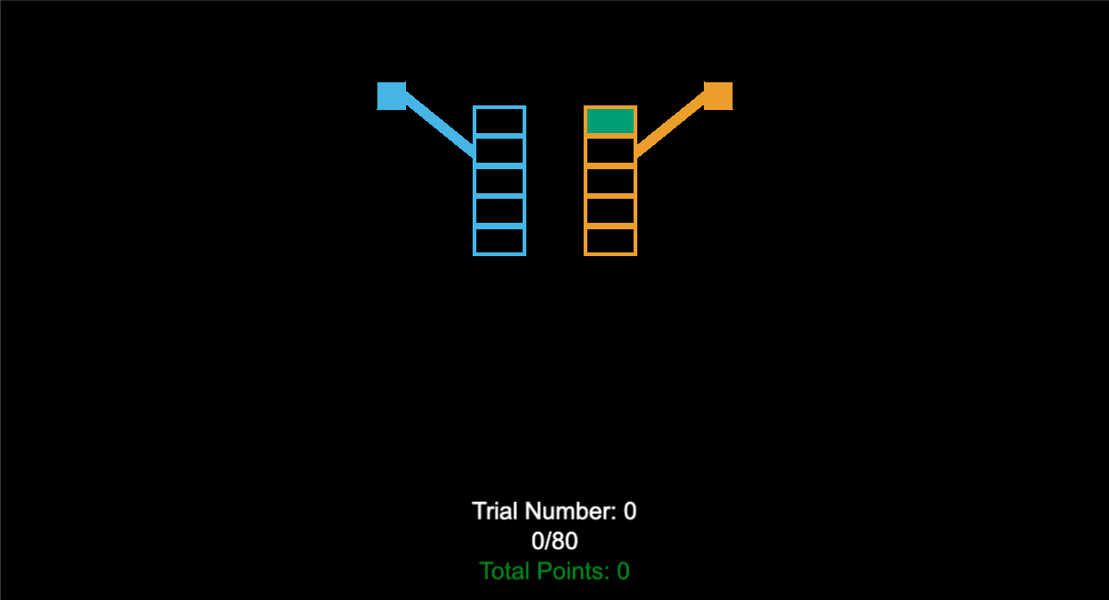
The slot machines will be represented like this:
RIGHT
PRESS THE RIGHT BUTTON TO CONTINUE
Notes:
Add screenshots of an X and an O screen – like a timeline of screenshots.

Slide 4
Every time you choose to play a particular slot machine, the lever will be pulled down. For example, if you chose the left slot machine, it would look like this:
RIGHT
PRESS THE RIGHT BUTTON TO CONTINUE
Notes:
Add screenshots of an X and an O screen – like a timeline of screenshots.

Slide 5
The points you win will be shown like this. For example, in this case the left slot machine was chosen and gave 77 points. XXs will be shown for the slot machine that wasn’t chosen. So you will not know how many points you would have won if you chose the other slot machine instead.
77
XX
RIGHT
PRESS THE RIGHT BUTTON TO CONTINUE
Notes:
Add screenshots of an X and an O screen – like a timeline of screenshots.

Slide 6
You job is to maximize the total points you get. Try your best to get as many points as you can!
77
XX
RIGHT
PRESS THE RIGHT BUTTON TO CONTINUE
Notes:
Add screenshots of an X and an O screen – like a timeline of screenshots.

Slide 7
During one game, a slot machine will tend to pay out about the same amount on average, but there is variability in the reward on any given choice.
RIGHT
PRESS THE RIGHT BUTTON TO CONTINUE
Notes:
Add screenshots of an X and an O screen – like a timeline of screenshots.

Slide 8
For example, the average reward for the slot machine on the right might be 50 points, but on the first play you might see a reward of 52 points because of the variability.
XX
52
RIGHT
PRESS THE RIGHT BUTTON TO CONTINUE
Notes:
Add screenshots of an X and an O screen – like a timeline of screenshots.

Slide 9
On the second play you might get 56 points
XX
52
XX
56
RIGHT
PRESS THE RIGHT BUTTON TO CONTINUE
Notes:
Add screenshots of an X and an O screen – like a timeline of screenshots.

Slide 10
On the 3rd box on the right you might get 45 points this time.
XX
52
XX
56
XX
45
RIGHT
PRESS THE RIGHT BUTTON TO CONTINUE
Notes:
Add screenshots of an X and an O screen – like a timeline of screenshots.

Slide 11
And so on, such that if you were to play the right slot machine 5 times in a row you might see these rewards.
XX
52
XX
56
XX
45
XX
60
XX
51
RIGHT
PRESS THE RIGHT BUTTON TO CONTINUE
Notes:
Add screenshots of an X and an O screen – like a timeline of screenshots.

Slide 12
Both slot machines will have the same kind of variability, and this variability will stay constant throughout the experiment.
XX
52
XX
56
31
XX
27
XX
RIGHT
PRESS THE RIGHT BUTTON TO CONTINUE
Notes:
Add screenshots of an X and an O screen – like a timeline of screenshots.

Slide 13
During each game, one of the slot machines will always have a higher average reward and hence is the better option to choose on average. However, the same slot machine will not always be best for all games.
70
XX
XX
56
76
XX
80
XX
RIGHT
PRESS THE RIGHT BUTTON TO CONTINUE
Notes:
Add screenshots of an X and an O screen – like a timeline of screenshots.

Slide 14
To make your choice:
Press the LEFT BUTTON to play the left slot machine.
Press the RIGHT BUTTON to play the right slot machine.
RIGHT
PRESS THE RIGHT BUTTON TO CONTINUE
Notes:
Add screenshots of an X and an O screen – like a timeline of screenshots.

Slide 15
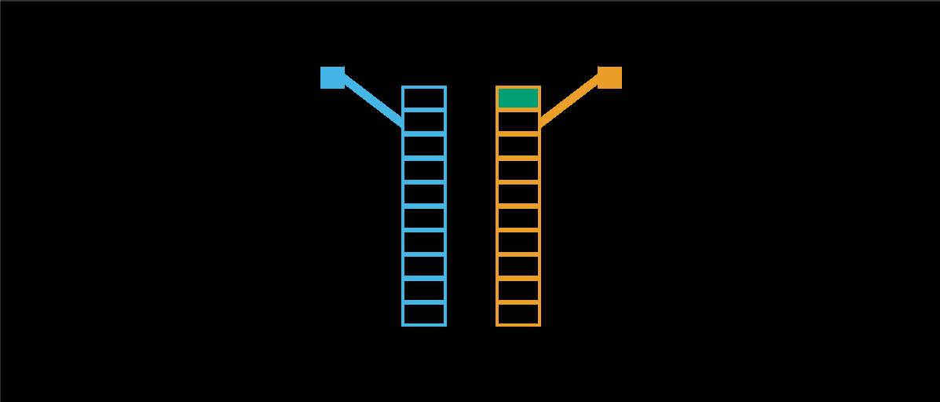
On any trial you can only play one slot machine and the number of trials in each game is determined by the height of the slot machine. For example, when the slot machines are 10 boxes high, there are 10 trials in each game.
RIGHT
PRESS THE RIGHT BUTTON TO CONTINUE
Notes:
Add screenshots of an X and an O screen – like a timeline of screenshots.

Slide 16
When the stacks are 5 boxes high there are only 5 trials in each game.
RIGHT
PRESS THE RIGHT BUTTON TO CONTINUE
Notes:
Add screenshots of an X and an O screen – like a timeline of screenshots.

Slide 17
In addition, the first 4 choices in each game are instructed trials where we will choose an option for you. This will give you some experience with each option before you make your first choice between the two slot machines.
RIGHT
PRESS THE RIGHT BUTTON TO CONTINUE
Notes:
Add screenshots of an X and an O screen – like a timeline of screenshots.

Slide 18
These instructed trials will be indicated by a red square inside the box we want you to open. You must press the button to choose this option in order to see the reward and move on to the next trial.
For example, if you are instructed to choose the left box on the first trial, you will see this:
RIGHT
PRESS THE RIGHT BUTTON TO CONTINUE
Notes:
Add screenshots of an X and an O screen – like a timeline of screenshots.

Slide 19
If you are instructed to choose the right box on the third trial, you will see this:
30
XX
25
XX
RIGHT
PRESS THE RIGHT BUTTON TO CONTINUE
Notes:
Add screenshots of an X and an O screen – like a timeline of screenshots.

Slide 20
Once these instructed trials are complete, you will have a free choice between the two stacks that is indicated by two green squares inside the two boxes you are choosing between.
30
XX
25
XX
XX
70
XX
65
RIGHT
PRESS THE RIGHT BUTTON TO CONTINUE
Notes:
Add screenshots of an X and an O screen – like a timeline of screenshots.

Slide 21
So to be sure that everything makes sense let’s work through a few example games.
Press the LEFT BUTTON to play the left slot machine.
Press the RIGHT BUTTON to play the right machine.
RIGHT
PRESS THE RIGHT BUTTON TO CONTINUE
Notes:
Add screenshots of an X and an O screen – like a timeline of screenshots.

Slide 22
Good Job!
Now you know how to play this game.
Once you are ready to start playing the actual game to win points, please press the RIGHT BUTTON.
Notes:
Add screenshots of an X and an O screen – like a timeline of screenshots.

Slide 23
Horizon Task
RUN 2
RIGHT
PRESS THE RIGHT BUTTON TO CONTINUE
Notes:
Outside the scanner

Slide 24
This is run 2.
Same instructions as Run 1
RIGHT
PRESS THE RIGHT BUTTON TO CONTINUE
Notes:
Add screenshots of an X and an O screen – like a timeline of screenshots.

