Slide 1

Social Media Task
Turn up the volume to hear instructions.
RIGHT
PRESS THE RIGHT BUTTON TO CONTINUE
Notes:
Outside the scanner

Slide 2
Welcome!
Thank you for volunteering for this experiment.
In this experiment, we would like you to play a game where you participate in an online social media platform. You will choose different topics to post about.
Your goal is to maximize the number of likes you receive from the other people online.
LEFT
RIGHT
PRESS THE RIGHT BUTTON TO CONTINUE

Slide 3
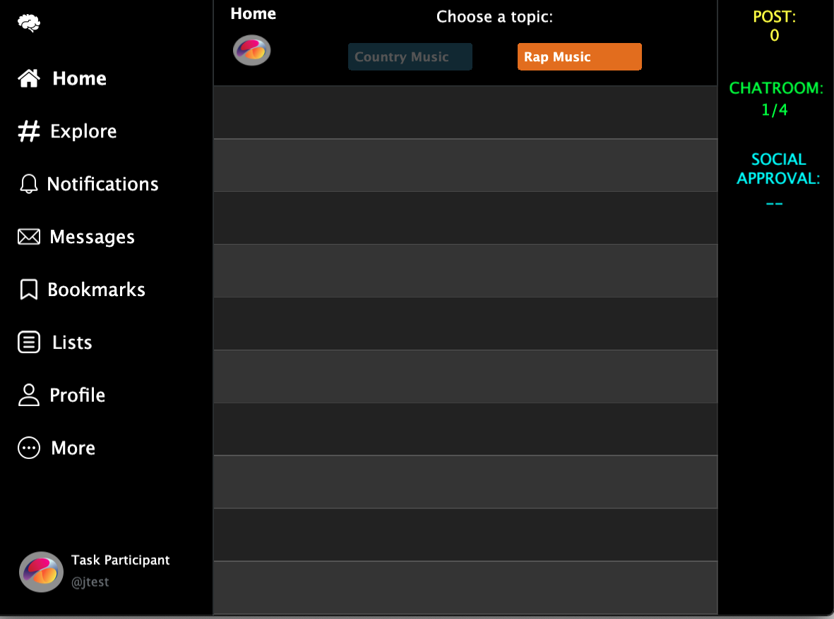
The social media platform will start with an empty chatroom that looks like this:
LEFT
RIGHT
PRESS THE RIGHT BUTTON TO CONTINUE
Notes:
Add screenshots of an X and an O screen – like a timeline of screenshots.

Slide 4
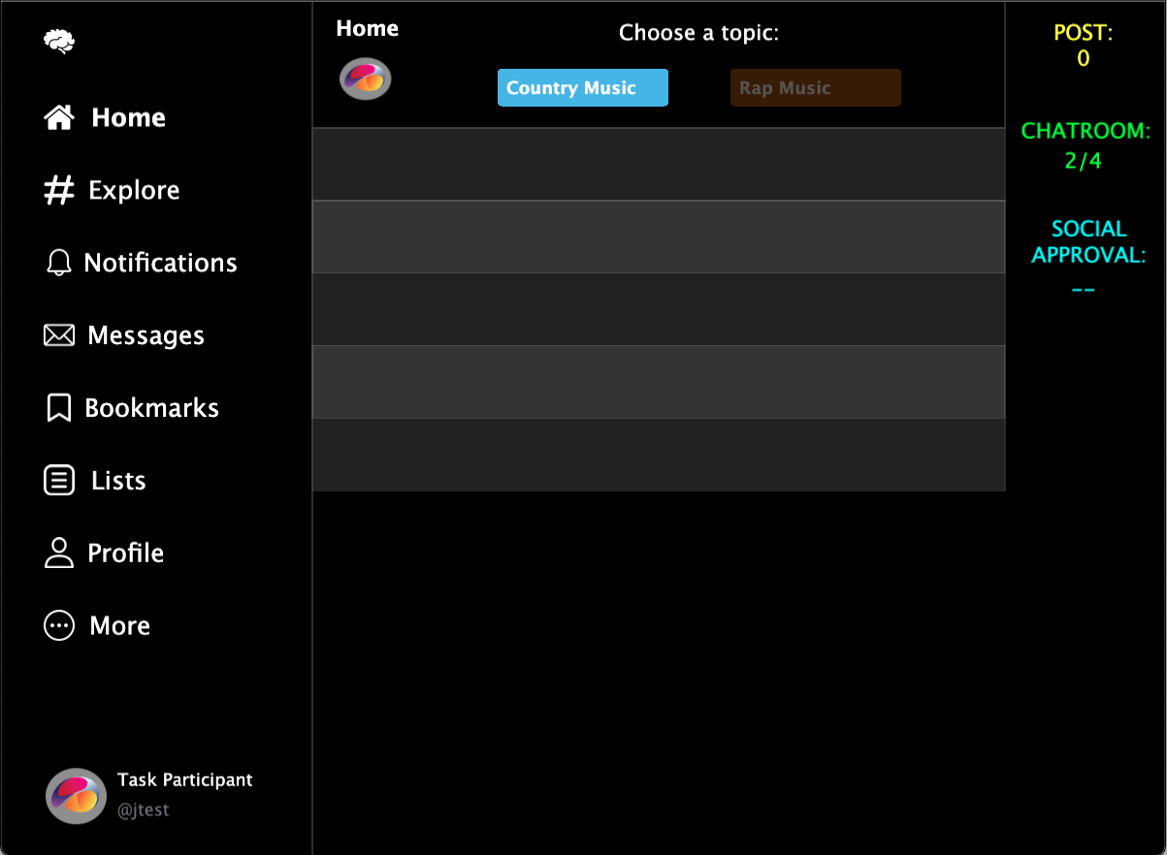
Throughout this game, you will enter 80 chatrooms.
In some chatrooms, you will be able to make 5 posts.
In other chatrooms, you will be able to make 10 posts.
LEFT
RIGHT
PRESS THE RIGHT BUTTON TO CONTINUE
Notes:
Add screenshots of an X and an O screen – like a timeline of screenshots.

Slide 5

In each chatroom, there will be 100 people. At the top of the screen, you will see two topics you can post about.
Every time you choose a topic, a post about that topic will appear in the chat. Note that you will not be writing the posts.
The posts will be generated for you based on the topics you choose.
LEFT
RIGHT
PRESS THE RIGHT BUTTON TO CONTINUE
Notes:
Add screenshots of an X and an O screen – like a timeline of screenshots.

Slide 6
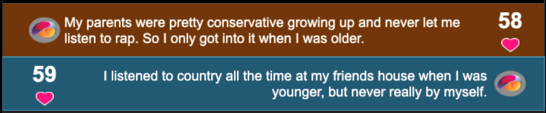
Each person in the chatroom has already had the chance to see each possible post and decide if they like it.
So, the number of likes will appear immediately after you make a choice.
Right Topic
60
52
Left Topic
LEFT
RIGHT
PRESS THE RIGHT BUTTON TO CONTINUE
Notes:
Add screenshots of an X and an O screen – like a timeline of screenshots.

Slide 7
The number of likes will appear on either the left or right side of your post.
It will appear on the left if you chose the topic on the left, or on the right if you chose the topic on the right.
For example, here’s what it might look like after making a right post and then a left post.
Right Topic
60
52
Left Topic
LEFT
RIGHT
PRESS THE RIGHT BUTTON TO CONTINUE
Notes:
Add screenshots of an X and an O screen – like a timeline of screenshots.

Slide 8
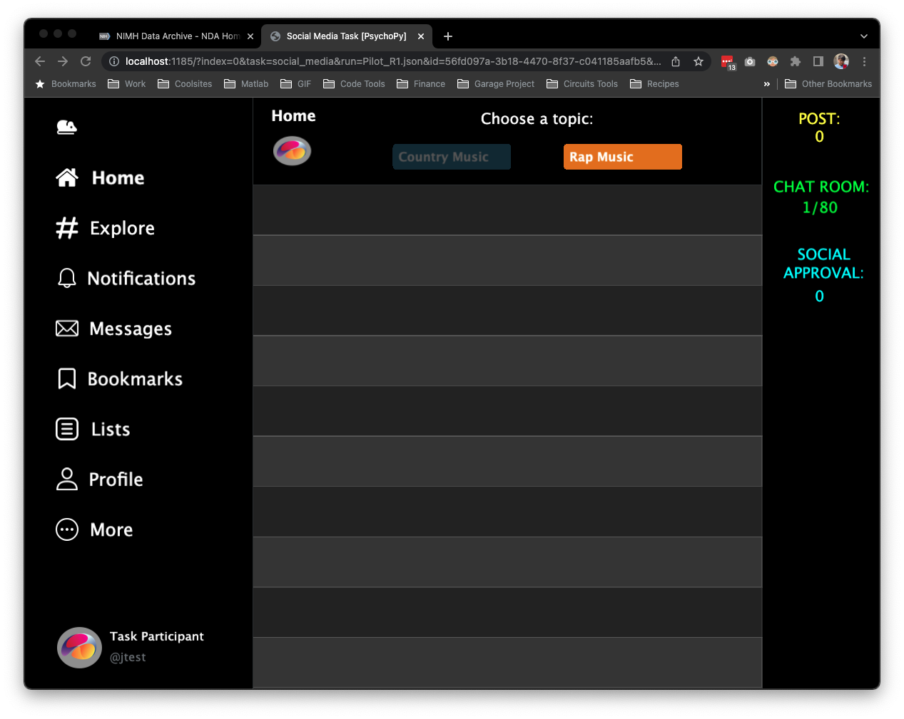
You job is to figure out what the people in the chatroom like most.
Try your best to get as many likes as you can!
We will also calculate an overall “Social Approval” score as you go through the chatrooms. This will indicate the percentage of likes you have received out of the maximum possible number likes across all chatrooms.
60
52
30%
LEFT
RIGHT
PRESS THE RIGHT BUTTON TO CONTINUE
Notes:
Add the Social Approval. In % form

Slide 9
In each chatroom, more people have been included that prefer one of the topics over the other.
For example, 60 people might tend to like posts about one topic, while only 52 people might tend to like posts about another topic.
However, the exact number of likes you get for each post will vary.
60
52
30%
LEFT
RIGHT
PRESS THE RIGHT BUTTON TO CONTINUE
Notes:
Add screenshots of an X and an O screen – like a timeline of screenshots.

Slide 10
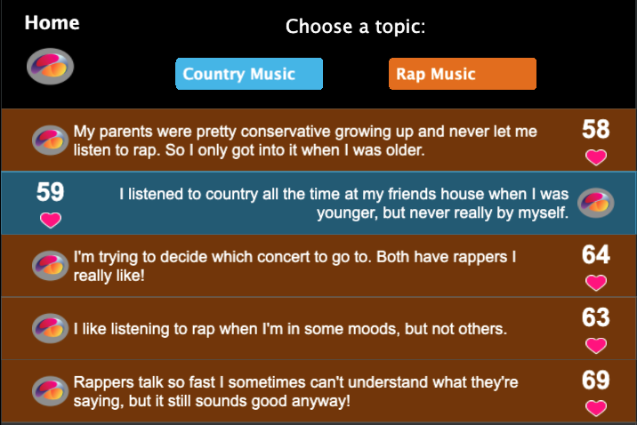
For example, 50 people in a chatroom might like one topic on average.
However, as shown below, 52 people may like the first post.
This is because the exact number of people that like each post will vary around the average of 50.
52
LEFT
RIGHT
PRESS THE RIGHT BUTTON TO CONTINUE
Notes:
Add screenshots of an X and an O screen – like a timeline of screenshots.

Slide 11
On the second play you might get 56 likes if you chose the same topic again.
52
I'm trying to decide which concert to go to. Both have rappers I really like!
56
LEFT
RIGHT
PRESS THE RIGHT BUTTON TO CONTINUE
Notes:
Add screenshots of an X and an O screen – like a timeline of screenshots.

Slide 12
If you chose the same topic a third time, you might get 45 likes.
52
I'm trying to decide which concert to go to. Both have rappers I really like!
56
I like listening to rap when I'm in some moods, but not others.
45
LEFT
RIGHT
PRESS THE RIGHT BUTTON TO CONTINUE
Notes:
Add screenshots of an X and an O screen – like a timeline of screenshots.

Slide 13
And so on, such that if you were to pick the topic on the right 5 times in a row, you might see chatroom responses like this:
52
I'm trying to decide which concert to go to. Both have rappers
I really like!
56
I like listening to rap when I'm in some moods, but not others.
45
Rappers talk so fast I sometimes can't understand what they're saying, but it still sounds good anyway!
49
I can't believe they cancelled the concert. Good rap artists never come do shows here anymore!
51
LEFT
RIGHT
PRESS THE RIGHT BUTTON TO CONTINUE
Notes:
Add screenshots of an X and an O screen – like a timeline of screenshots.

Slide 14
Within each chatroom, people will tend to like one of the topics more than the other.
That topic will therefore be the better one for getting the most likes.
However, because there will be a new set of people in each chatroom, the same topic will not always be the one that is liked most.
LEFT
RIGHT
PRESS THE RIGHT BUTTON TO CONTINUE
Notes:
Add screenshots of an X and an O screen – like a timeline of screenshots.

Slide 15
In our experience, the number of people that like each post tend to show a similar range of likes around the average for both topics, and this range also tends to stay the same from one chatroom to the next. ​
​
For example, if the average number of people that like posts for the left topic in a chatroom were 50, some posts might get 40 likes on the low end and 60 likes on the high end.
The topic on the right might instead have an average of 55 likes, with 45 likes on the low end and 65 likes on the high end. ​
LEFT
RIGHT
PRESS THE RIGHT BUTTON TO CONTINUE
Notes:
Add screenshots of an X and an O screen – like a timeline of screenshots.

Slide 16
The average number of people that like posts about each topic could change for each chatroom, because there will be a different group of people in each chatroom. ​
But, as mentioned before, people in each chatroom tend to show a similar range of likes from post to post for each topic.​
LEFT
RIGHT
PRESS THE RIGHT BUTTON TO CONTINUE
Notes:
Add screenshots of an X and an O screen – like a timeline of screenshots.

Slide 17
“<“ Key
“>“ Key
To make your choices:
Press the < KEY to post about the topic on the left.
Press the > KEY to post about the topic on the right.
LEFT
RIGHT
PRESS THE RIGHT BUTTON TO CONTINUE
Notes:
Add screenshots of an X and an O screen – like a timeline of screenshots.

Slide 18
Note that for the purposes of this game, the left panel links have been disabled.
LEFT
RIGHT
PRESS THE RIGHT BUTTON TO CONTINUE
Notes:
Add screenshots of an X and an O screen – like a timeline of screenshots.

Slide 19
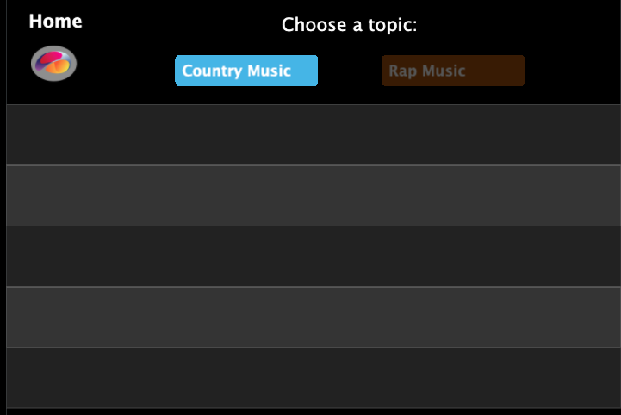
In some chatrooms, you will be able to make 5 posts.
In other chatrooms, you will be able to make 10 posts.
The number of posts you can make in each game is determined by the number of empty slots that are shown.
For example, the chatroom shown below would allow 5 posts.
Once you make those 5 posts, that round is over and you will move to the next chatroom.
LEFT
RIGHT
PRESS THE RIGHT BUTTON TO CONTINUE
Notes:
Add screenshots of an X and an O screen – like a timeline of screenshots.

Slide 20
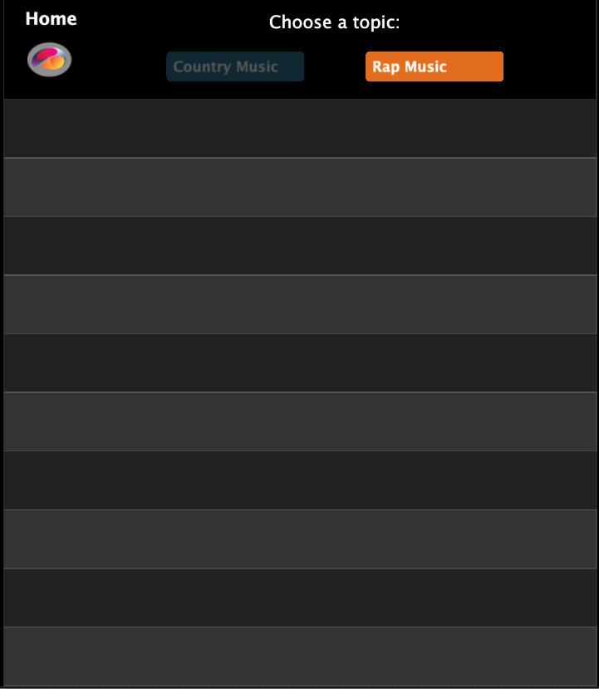
If the chatroom instead looked like this, you could make 10 posts.
LEFT
RIGHT
PRESS THE RIGHT BUTTON TO CONTINUE
Notes:
Add screenshots of an X and an O screen – like a timeline of screenshots.

Slide 21
To help you get a sense of what people in the chatroom are like, we will tell you which topic to post about for the first four posts.
After that, you can choose to post about whichever topic you’d like.
LEFT
RIGHT
PRESS THE RIGHT BUTTON TO CONTINUE
Notes:
Add screenshots of an X and an O screen – like a timeline of screenshots.

Slide 22

Therefore, for the first four posts, only one of the topics will be lit up. This indicates that you can only choose that topic.
For example, if you are instructed to choose the left topic for your first post, you will see this.
LEFT
RIGHT
PRESS THE RIGHT BUTTON TO CONTINUE
Notes:
Add screenshots of an X and an O screen – like a timeline of screenshots.

Slide 23

If you were instructed to choose the right topic on the second post, you would see this:
LEFT
RIGHT
PRESS THE RIGHT BUTTON TO CONTINUE
Notes:
Add screenshots of an X and an O screen – like a timeline of screenshots.

Slide 24
Your social approval score will not be affected by the number of likes you get on the first four posts where you can only choose one topic.
LEFT
RIGHT
PRESS THE RIGHT BUTTON TO CONTINUE
Notes:
Add screenshots of an X and an O screen – like a timeline of screenshots.

Slide 25
Once these four posts are complete, you will be free to choose between the two topics.
This is indicated by both topic options being lit up.
LEFT
RIGHT
PRESS THE RIGHT BUTTON TO CONTINUE
Notes:
Add screenshots of an X and an O screen – like a timeline of screenshots.

Slide 26
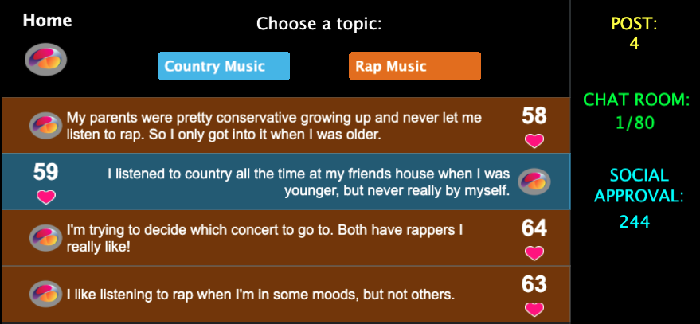
We will keep track of the total number of likes you receive across all chatrooms.
Try to get as many likes as possible.
In the upper-right corner, we will use this to calculate your overall “social approval score”, which will go up or down over time depending on how many likes you get.
LEFT
RIGHT
PRESS THE RIGHT BUTTON TO CONTINUE
Notes:
Add screenshots of an X and an O screen – like a timeline of screenshots.

Slide 27
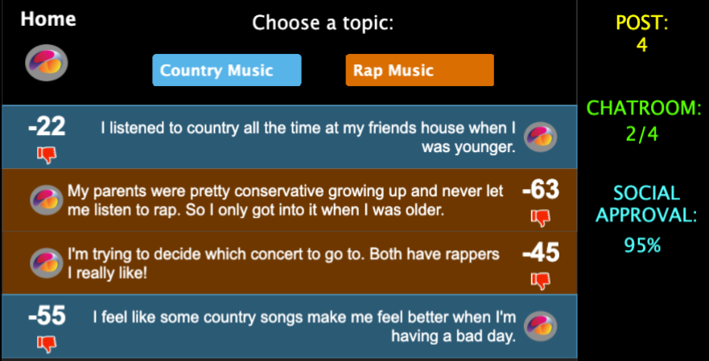
Instead of “likes”, sometimes you will also enter chatrooms where people indicate “dislikes”. The “dislikes” will be shown as negative numbers.
These numbers will be negative because every “dislike” you receive will reduce your overall “social approval score”.
For example, if you had gotten a total of 350 “likes” in the first chatroom, and then you got a -50 in the next chatroom, then you would now only have 300 total “likes”.
LEFT
RIGHT
PRESS THE RIGHT BUTTON TO CONTINUE
Notes:
Add screenshots of an X and an O screen – like a timeline of screenshots.

Slide 28
So to be sure that everything makes sense let’s work through a few example chatrooms.
“<“ Key
“>“ Key
LEFT
RIGHT
PRESS THE RIGHT BUTTON TO CONTINUE

Slide 29
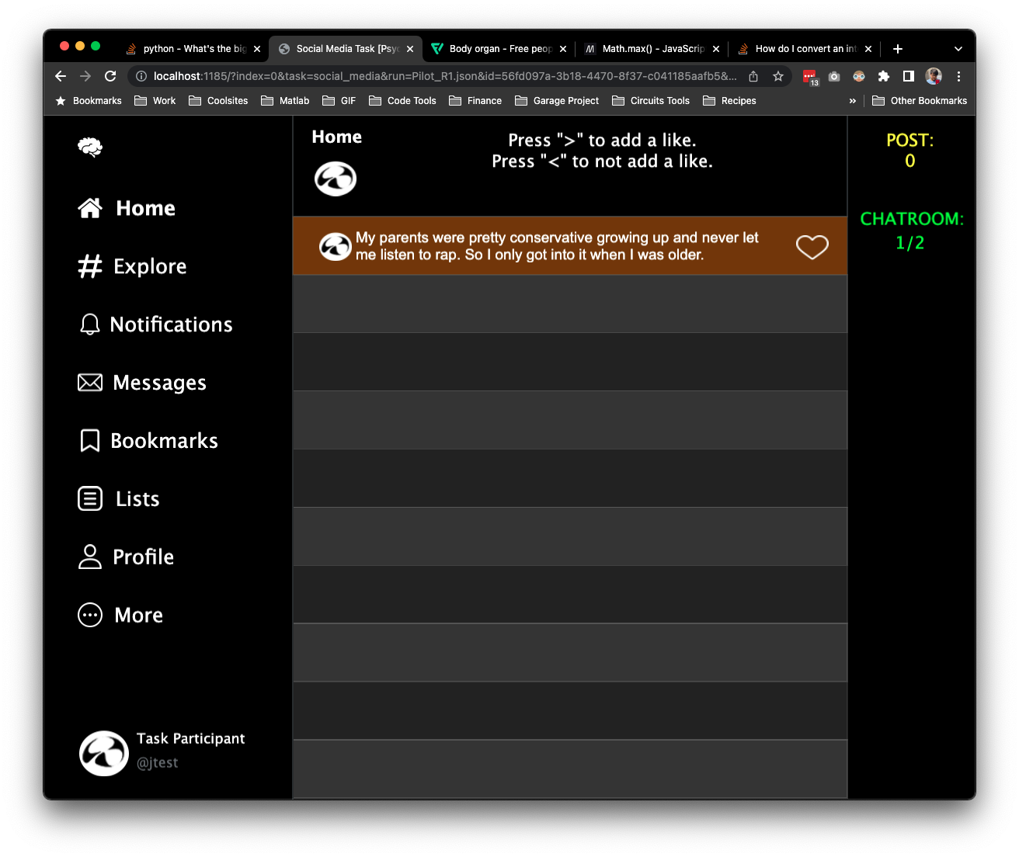
Before you start playing as the person choosing posts, we'd also like you to help as a chatroom member reading some other players' posts.
RIGHT
PRESS THE RIGHT BUTTON TO CONTINUE
Notes:
Add screen shot

Slide 30
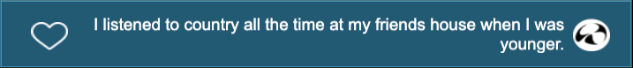
For each post you see:
Press the ‘>’ KEY to ADD a like.
Press the ‘<‘ KEY if you don’t want to add a like.
LEFT
RIGHT
PRESS THE RIGHT BUTTON TO CONTINUE

Slide 31
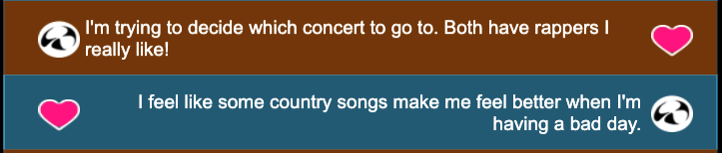
We will just have you do this for two chatrooms before you start playing as the one posting.
LEFT
RIGHT
PRESS THE RIGHT BUTTON TO CONTINUE

Slide 32
Good Job!
Now you know how to play this game.
Remember, to make your choices:
Press the < KEY to post about the topic on the left.
Press the > KEY to post about the topic on the right.
PRESS THE RIGHT BUTTON TO BEGIN
Notes:
Add screenshots of an X and an O screen – like a timeline of screenshots.

