Slide 1

Limited Offer Task
RIGHT
PRESS THE RIGHT BUTTON TO CONTINUE
Notes:
Outside the scanner

Slide 2
Welcome!
In this task you will be offered a certain amount of money on each trial.
You will have the choice to accept the offer or wait for a better offer in the future.
RIGHT
PRESS THE RIGHT BUTTON TO CONTINUE
Notes:
.

Slide 3
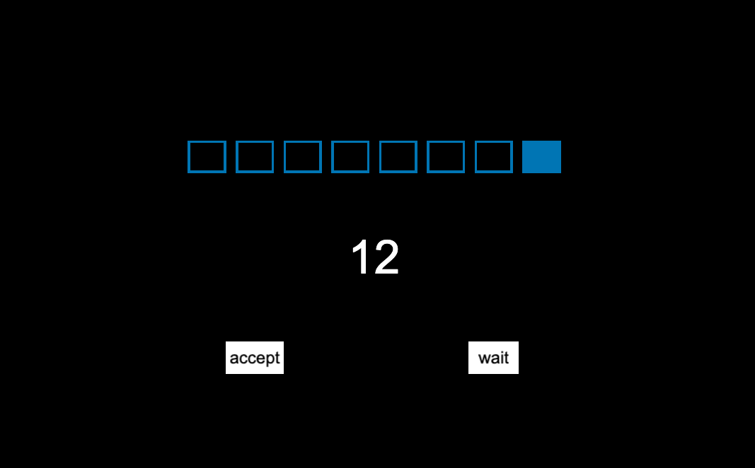
The offer will be displayed like below.
RIGHT
PRESS THE RIGHT BUTTON TO CONTINUE

Slide 4
The boxes represents the number of timepoints per each trial.
There will be either 8 timepoints per trial …
RIGHT
PRESS THE RIGHT BUTTON TO CONTINUE

Slide 5
… or 4 timepoints.
In each trial, you will be given the choice to wait, where each time you wait the offer could get bigger or go away.
RIGHT
PRESS THE RIGHT BUTTON TO CONTINUE

Slide 6
Once you see the “accept” or “wait”, you will have 1 second to either accept the current offer or wait.
RIGHT
PRESS THE RIGHT BUTTON TO CONTINUE

Slide 7
Use the LEFT Button to ACCEPT the offer.
Use the RIGHT Button to WAIT.
RIGHT
PRESS THE RIGHT BUTTON TO CONTINUE

Slide 8
If you choose to wait, the offer could stay the same or a better offer may appear. However, there is also a chance that the offer will be revoked, and you will win no money for that trial.
RIGHT
PRESS THE RIGHT BUTTON TO CONTINUE

Slide 9
With each choice, the boxes will turn blue moving from left to right, indicating how many timepoints in the trial have gone by.
RIGHT
PRESS THE RIGHT BUTTON TO CONTINUE

Slide 10
If you choose to accept the current offer, then that is the offer you receive for that trial.
RIGHT
PRESS THE RIGHT BUTTON TO CONTINUE

Slide 11
If you also respond too late, then you will win nothing for that trial and the offer amount will be marked by an X.
X
RIGHT
PRESS THE RIGHT BUTTON TO CONTINUE

Slide 12
You will be paid additional money at the end of the day based on how much you win on the task.
RIGHT
PRESS THE RIGHT BUTTON TO CONTINUE

Slide 13
Let’s Begin!
RIGHT
PRESS THE RIGHT BUTTON TO CONTINUE

