Slide 1

Blind Speed Dating Game
RIGHT
PRESS THE RIGHT BUTTON TO CONTINUE
Notes:
Outside the scanner

Slide 2
Welcome!
In this task, we want you to imagine that you are attending several online speed dating events to try to find a romantic partner. Before attending the first event, we will ask you some questions about what you’re looking for in a partner.
Then, during each event, we will introduce you to some people one by one and let you know how strongly they match with your preferences.
LEFT
PRESS THE RIGHT BUTTON TO CONTINUE
RIGHT
Notes:
.

Slide 3
Importantly, these are BLIND speed dating events. So you will not see or hear the person. You will only be told how well they match with what you said you’re looking for.
After being introduced to a person, you can choose to accept them as the one you’d like to go on a date with. Alternatively, you can choose to turn them down and wait to see if someone better comes along. However, if you wait, there’s a risk that all the other people at the event will be chosen and you could end up alone.
LEFT
PRESS THE RIGHT BUTTON TO CONTINUE
RIGHT
Notes:
.

Slide 4
At some of the smaller events, there will be 4 people to meet. At other larger events, there will be 8 people to meet.
But remember that you may not get to meet all of them.
Once you choose a person to go on a date with, you will not get to meet the others attending that event.
Also, if everyone else gets chosen, you will not get to meet the others and you will leave the event alone.
LEFT
PRESS THE RIGHT BUTTON TO CONTINUE
RIGHT
Notes:
.

Slide 5
To be successful at finding a romantic partner, you will want to schedule as many dates as you can.
Remember, just because a person matches what you’re looking for, this doesn’t guarantee that you match what they’re looking for.
On the other hand, while you don’t want to end up alone, you also need to consider how well each person matches your preferences.
If you’re too selective, you may not find someone who shows the same interest. But if you’re not selective enough, you might end up unsatisfied.
LEFT
PRESS THE RIGHT BUTTON TO CONTINUE
RIGHT
Notes:
.

Slide 6
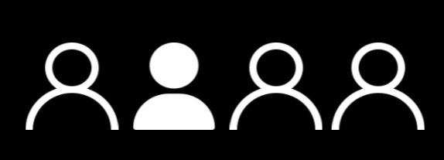
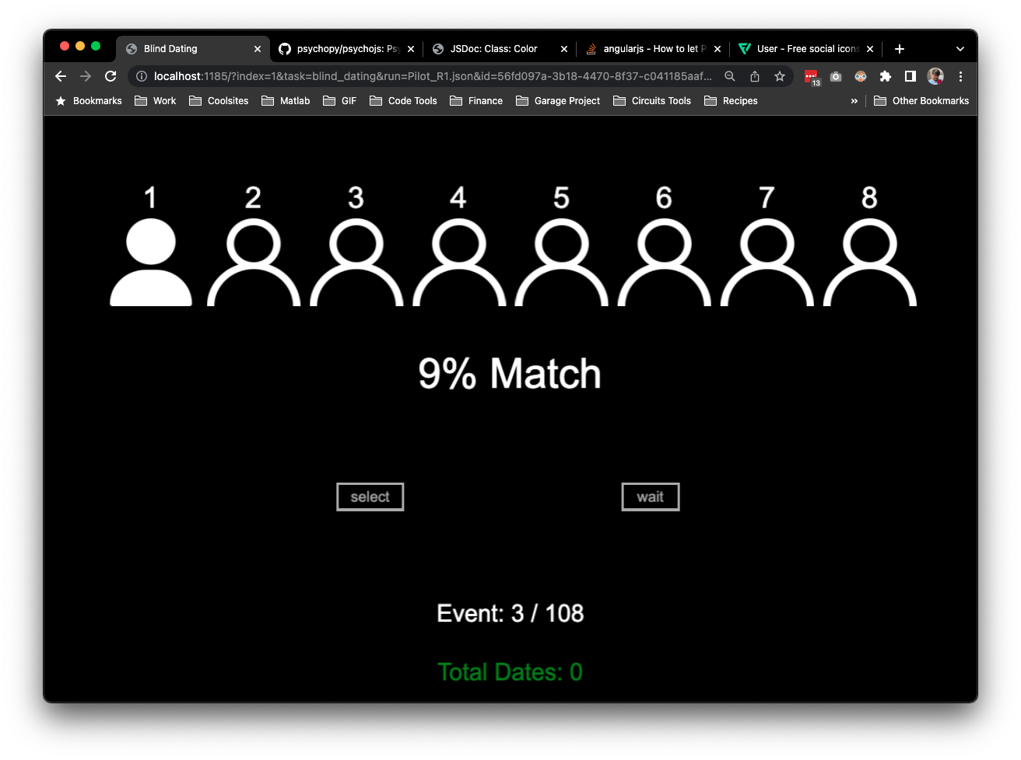

Each speed dating event will display a silhouette for every person that is attending.
For example, the event below has 4 others attending.
LEFT
PRESS THE RIGHT BUTTON TO CONTINUE
RIGHT

Slide 7
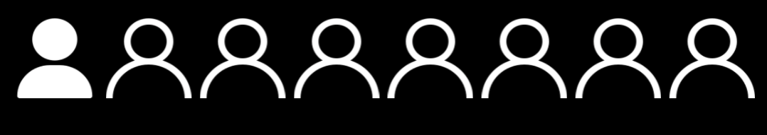
This event instead has 8 others attending.
LEFT
PRESS THE RIGHT BUTTON TO CONTINUE
RIGHT

Slide 8
When being introduced to someone, their silhouette will light up and we will tell you how well they match your preferences. People will be introduced from left to right.
30% Match
LEFT
PRESS THE RIGHT BUTTON TO CONTINUE
RIGHT

Slide 9
For example, in the 8-person event below, we are introducing you to the first person, who shows a 30% match to your preferences.
30% Match
LEFT
PRESS THE RIGHT BUTTON TO CONTINUE
RIGHT

Slide 10

And in this 4-person event, we are introducing you to the second person, who shows a 60% match to your preferences.
60% Match
LEFT
PRESS THE RIGHT BUTTON TO CONTINUE
RIGHT

Slide 11
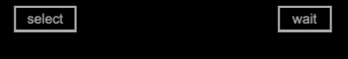
Once you see the “select” or “wait” options, you will have
5 seconds to decide to select this person for a date or to wait and see if a better match comes along.
60% Match
LEFT
PRESS THE RIGHT BUTTON TO CONTINUE
RIGHT

Slide 12
If you don’t make a choice within 5 seconds, you will be disqualified and leave the event alone.
End Up Alone
LEFT
PRESS THE RIGHT BUTTON TO CONTINUE
RIGHT

Slide 13
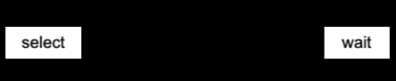
Use the LEFT Button to SELECT the person.
Use the RIGHT Button to WAIT.
LEFT
PRESS THE RIGHT BUTTON TO CONTINUE
RIGHT

Slide 14
With each choice to wait, the next silhouette will be highlighted, moving from left to right.
LEFT
PRESS THE RIGHT BUTTON TO CONTINUE
RIGHT

Slide 15
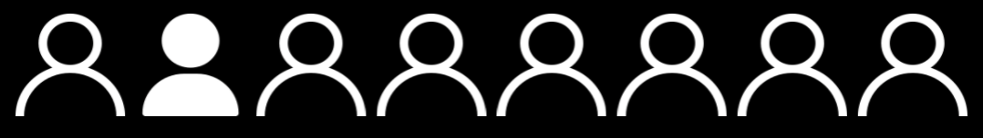
This will help you see how many times you have waited and how many people are left to meet.
LEFT
PRESS THE RIGHT BUTTON TO CONTINUE
RIGHT

Slide 16
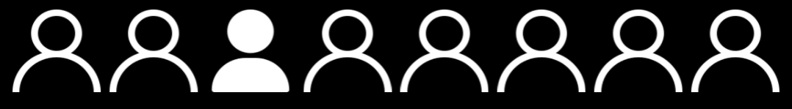
If you choose someone, the event will end.
LEFT
PRESS THE RIGHT BUTTON TO CONTINUE
RIGHT

Slide 17
Remember, if you choose to wait, you might meet someone who matches your preferences better.
You might also meet someone else who matches your preferences the same as before.
However, there is also a chance that everyone else at the event will get chosen and you will have to leave the event alone.
LEFT
PRESS THE RIGHT BUTTON TO CONTINUE
RIGHT

Slide 18
If you meet the person who is the best match at that event, the color of the letters will change to green.
Have A Date
LEFT
PRESS THE RIGHT BUTTON TO CONTINUE
RIGHT

Slide 19
If you respond too late, or if everyone else gets chosen, then the screen will indicate the you end up alone.
End Up Alone
LEFT
PRESS THE RIGHT BUTTON TO CONTINUE
RIGHT

Slide 20
Remember, not everyone you choose will also be interested in you.
So to successfully find a romantic partner, you will want to get as many dates as you can while also considering how well they match with what you’re looking for.
We will keep track of how many dates you’ve gotten and how well they match your preferences on average
LEFT
PRESS THE RIGHT BUTTON TO CONTINUE
RIGHT

Slide 21
To help you get comfortable with this task, let’s do a few practice events
RIGHT
LEFT
PRESS THE RIGHT BUTTON TO BEGIN

Slide 22
Great Job!
Let’s begin the real events!
Good luck dating!
RIGHT
PRESS THE RIGHT BUTTON TO BEGIN

