Slide 1

Blind Speed Dating Game
RIGHT
PRESS THE RIGHT BUTTON TO CONTINUE
Notes:
Outside the scanner

Slide 2
Welcome!
In this task, we want you to imagine that you are attending several online speed dating events to try to find a romantic partner. Before attending the first event, we will ask you some questions about what you’re looking for in a partner.
Then, during each event, we will introduce you to some people one by one and let you know how strongly they match with your preferences.
RIGHT
PRESS THE RIGHT BUTTON TO CONTINUE
Notes:
.

Slide 3
Importantly, these are BLIND speed dating events. So you will not see or hear the person. You will only be told how well they match with what you said you’re looking for.
RIGHT
PRESS THE RIGHT BUTTON TO CONTINUE
Notes:
.

Slide 4
For each event, after being introduced to a person, you can choose to accept them as the one you’d like to go on a date with. Alternatively, you can choose to wait and see if a second person comes along that is a better match.
If you wait, the first person may stick around to see if you still might pick them. But they may also grow impatient or offended and turn you down. If they turn you down before a better person comes along, you will leave that event alone.
RIGHT
PRESS THE RIGHT BUTTON TO CONTINUE
Notes:
.

Slide 5
At some smaller events, there will only be 4 turns to wait or pick a dating partner. At other larger events, there will be 8 turns to make a decision. But remember that there is a risk to choosing to wait. If the first person you are introduced to gets impatient or offended, they may leave before a better person could come along. If so, you will end up alone.
If you don’t want to pick the first person no matter what, you can also choose to reject them on the final turn.
RIGHT
PRESS THE RIGHT BUTTON TO CONTINUE
Notes:
.

Slide 6
To be successful at finding a romantic partner, you will want to schedule as many dates as you can. Remember, just because a person matches what you’re looking for, this doesn’t guarantee that you match what they’re looking for. So you could end up on dates with people that match your preferences well, but that will still ultimately turn you down.
RIGHT
PRESS THE RIGHT BUTTON TO CONTINUE
Notes:
.

Slide 7
On the other hand, while you probably don’t want to end up alone, you also need to consider how well each person matches your preferences. If you’re too selective, you may not find someone who will also be interested in you. But if you’re not selective enough, you might end up unsatisfied with the partner you end up with.
RIGHT
PRESS THE RIGHT BUTTON TO CONTINUE
Notes:
.

Slide 8
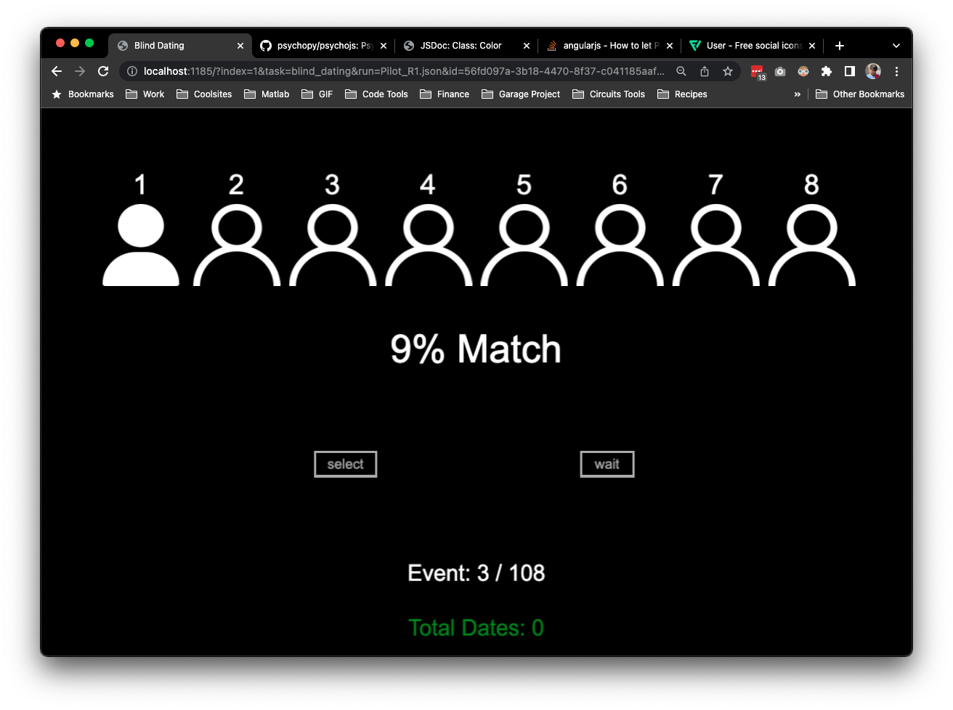

Each speed dating event will display a silhouette for every turn to make a decision.
For example, the event below has 4 turns to make a decision.
Turn
Turn
Turn
Turn
RIGHT
PRESS THE RIGHT BUTTON TO CONTINUE

Slide 9
This event instead has 8 turns to make a decision.
Turn
Turn
Turn
Turn
Turn
Turn
Turn
Turn
RIGHT
PRESS THE RIGHT BUTTON TO CONTINUE

Slide 10
When being introduced to the first person, their silhouette will light up in yellow and we will tell you how well they match your preferences. Turns will progress from left to right.
Turn
Turn
Turn
Turn
Turn
Turn
Turn
Turn
30% Match
RIGHT
PRESS THE RIGHT BUTTON TO CONTINUE

Slide 11
For example, in the 8-turn event below, we are introducing you to the first person, who shows a 30% match to your preferences.
Turn
Turn
Turn
Turn
Turn
Turn
Turn
Turn
30% Match
RIGHT
PRESS THE RIGHT BUTTON TO CONTINUE

Slide 12
If you waited on the first turn, and the person decided to wait a bit longer to see what you decide, the second silhouette would light up in yellow as follows.
Turn
Turn
Turn
Turn
Turn
Turn
Turn
Turn
30% Match
RIGHT
PRESS THE RIGHT BUTTON TO CONTINUE

Slide 13
If you select them, the event will end.
Turn
Turn
Turn
Turn
Turn
Turn
Turn
Turn
30% Match
RIGHT
PRESS THE RIGHT BUTTON TO CONTINUE

Slide 14
If a better person comes along, their silhouette will light up in green like this. The better person will always have a match of >80%. You should always accept this date, since no other person will be presented.
Turn
Turn
Turn
Turn
Turn
Turn
Turn
Turn
>80% Match
RIGHT
PRESS THE RIGHT BUTTON TO CONTINUE

Slide 15
When you accept, the event will end with the following text:
YOU HAVE A DATE!
RIGHT
PRESS THE RIGHT BUTTON TO CONTINUE

Slide 16
If the first person gets offended and leaves, the silhouette will light up in red like this.
When this happens, the event will end.
END UP ALONE
RIGHT
PRESS THE RIGHT BUTTON TO CONTINUE

Slide 17

Use the LEFT Button to Accept the person.
Use the RIGHT Button to WAIT
LEFT
PRESS THE RIGHT BUTTON TO CONTINUE
RIGHT

Slide 18

If the original person is still there on the last turn,
Use the LEFT Button to Accept the person.
Use the RIGHT Button to REJECT
them if you’re still not interested.
RIGHT
PRESS THE RIGHT BUTTON TO CONTINUE

Slide 19
Remember, if you choose to wait, you might meet someone who matches your preferences better. You might also stay with the person who matches your preferences the same as before.
However, there is also a chance that the first person will leave and you will end up alone.
RIGHT
PRESS THE RIGHT BUTTON TO CONTINUE

Slide 20
Remember, not everyone you choose will also be interested in you.
So to successfully find a romantic partner, you will want to get as many dates as you can while also considering how well they match with what you’re looking for.
We will keep track of how many dates you’ve gotten and how well they match your preferences on average.
RIGHT
PRESS THE RIGHT BUTTON TO CONTINUE

Slide 21
To help you get comfortable with this task,
let’s do a few practice events
RIGHT
PRESS THE RIGHT BUTTON TO CONTINUE

Slide 22
Great Job!
Let’s begin the real events!
Good luck dating!
RIGHT
PRESS THE RIGHT BUTTON TO BEGIN

