Slide 1

Emotional Faces
RIGHT
PRESS THE RIGHT BUTTON TO CONTINUE
Notes:
Outside the scanner

Slide 2
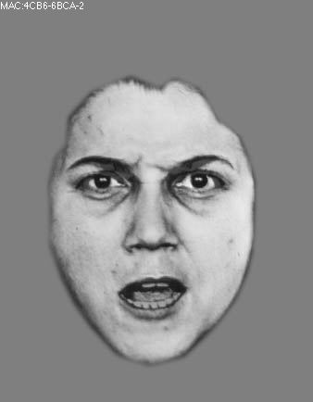
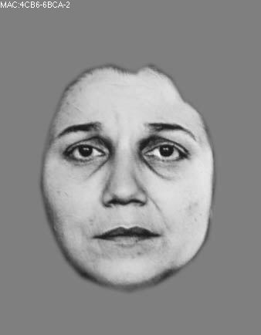
Welcome!
In this task, you will be shown pictures of the faces of several people. Each person’s face will be expressing either ANGER or SADNESS.
angry
sad
RIGHT
PRESS THE RIGHT BUTTON TO CONTINUE
Notes:
.

Slide 3
Your job in the task is to indicate whether the face you see is angry or sad.
angry
sad
RIGHT
PRESS THE RIGHT BUTTON TO CONTINUE
Notes:
.

Slide 4
The faces will only be shown briefly. Then you will press a button indicating whether the person was angry or sad.
Your job is to be as fast and accurate as possible.
Please try your best to respond on every trial.
If you take too long to respond, it will be considered incorrect. You will be told if it was too slow.
RIGHT
PRESS THE RIGHT BUTTON TO CONTINUE
Notes:
.

Slide 5
You will also hear one of two tones right before you see each face.
One of the tones will have a higher pitch than the other.
These tones will provide hints about which type of emotion you will see. However, these hints will not always be accurate.
RIGHT
PRESS THE RIGHT BUTTON TO CONTINUE
Notes:
.

Slide 6
At first, the high tone will indicate that a sad face is more likely, and the low tone will indicate that an angry face is more likely.
However, you must still pay attention to the faces because these hints could be wrong.
RIGHT
PRESS THE RIGHT BUTTON TO CONTINUE
Notes:
.

Slide 7
Also, the relationship between the tones and the emotions may change over time.
For example, even if the high tone initially predicts a sad face, it might later predict an angry face, or either face could become equally likely. These changes may also occur several times.
But you will not be told if these changes happen.
RIGHT
PRESS THE RIGHT BUTTON TO CONTINUE
Notes:
.

Slide 8
Sometimes the pictures of the faces will be easy to see and show strong emotional expressions.
Other times the pictures may be less clear and show less intense emotional expressions.
RIGHT
PRESS THE RIGHT BUTTON TO CONTINUE
Notes:
.

Slide 9
To make sure you are familiar with the faces and the emotional expressions, we will now show you each face without a time limit and ask you to indicate whether it is angry or sad.
RIGHT
PRESS THE RIGHT BUTTON TO CONTINUE
Notes:
.

Slide 10
To indicate sadness, press the RIGHT key.
To indicate anger, press the LEFT key.
RIGHT
PRESS THE RIGHT BUTTON TO CONTINUE
Notes:
.

Slide 11
You are now ready to do the task. Remember, try to be as fast and accurate as possible. Also try to respond on every trial.
To help you get comfortable with this task,
let’s do a few practice trials first.
RIGHT
PRESS THE RIGHT BUTTON TO CONTINUE

Slide 12
Great Job!
Let’s begin the task.
Remember that, at first, the high tone will indicate that a sad face is more likely, and the low tone will indicate that an angry face is more likely. But this could change over time.
Good luck!
RIGHT
PRESS THE RIGHT BUTTON TO CONTINUE

