Slide 1

Cooperation Task
This task uses audio.
Please turn up your computer volume.
RUN 1
RIGHT
PRESS THE RIGHT BUTTON TO CONTINUE
Notes:
Outside the scanner

Slide 2
CONTENT WARNING:
Some of the images shown in this task
are graphic in nature and might be disturbing to some viewers.
RIGHT
PRESS THE RIGHT BUTTON TO CONTINUE
Notes:
Outside the scanner

Slide 3
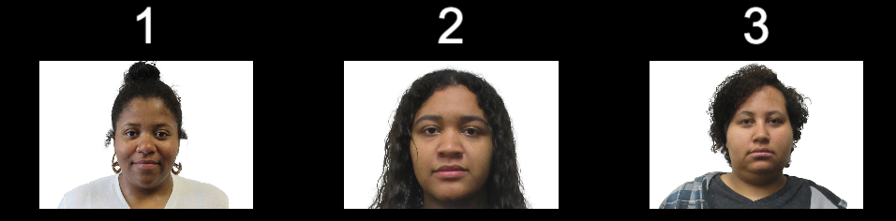
For this task, you will play several “cooperation games”. In each game, you need to repeatedly choose between three different people to ask for help.
LEFT
RIGHT
PRESS THE RIGHT KEY TO CONTINUE

Slide 4
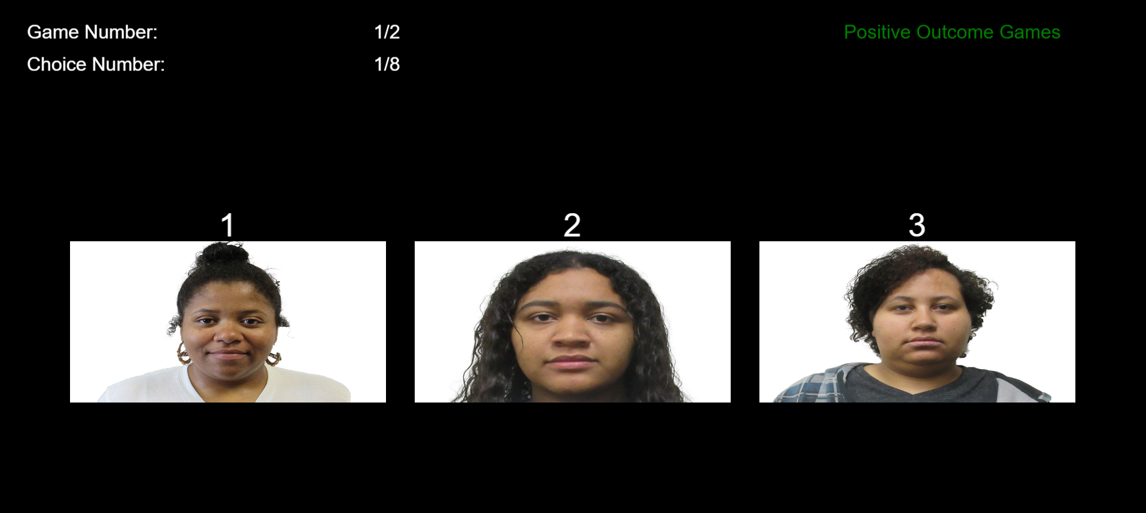
In each game, you will be able to make 16 choices in a row.
Game number: 1/20
Choice number: 1/16
LEFT
RIGHT
PRESS THE RIGHT KEY TO CONTINUE

Slide 5
In each game, images of three people you can choose from will be shown like in the example below. Each person will have a number above their picture. Either a 1, 2, or 3.
Each time you want to choose to ask one of them for help, you need to press their number on the keyboard.
LEFT
RIGHT
PRESS THE RIGHT KEY TO CONTINUE

Slide 6
For example, if you want to select the person on the left, then press the 1 KEY on the keyboard. If you decide you want to select the person in the middle, then press the 2 KEY. Pressing the 3 KEY would instead select the person on the right.
Press ’1’ key to select
Press ’2’ key to select person 2
Press ’3’ key to select person 3
LEFT
RIGHT
PRESS THE RIGHT KEY TO CONTINUE

Slide 7
When you ask someone for help, they might choose to help you, or they might choose not to help you.
Some people will tend to be more helpful than others.
But when you start each game, you will not know which of the people are more likely to help you.
LEFT
RIGHT
PRESS THE RIGHT KEY TO CONTINUE

Slide 8
There will be two different types of games: positive outcome games and negative outcome games.
In positive outcome games, you will see neutral images and sounds, unless the person decides to help you. These neutral images and sounds are not pleasant or unpleasant.
To help you, they can decide to show you a pleasant image and sound instead.
LEFT
RIGHT
PRESS THE RIGHT KEY TO CONTINUE

Slide 9
In negative outcome games, you will see unpleasant images and sounds, unless the person decides to help you.
To help you, they can decide to show you a neutral image and sound instead.
LEFT
RIGHT
PRESS THE RIGHT KEY TO CONTINUE

Slide 10
So in positive outcome games, your goal is to see as many pleasant images and sounds as possible.
In negative outcome games, your goal is to see as many neutral images and sounds as possible (avoiding the unpleasant images and sounds).
LEFT
RIGHT
PRESS THE RIGHT KEY TO CONTINUE

Slide 11
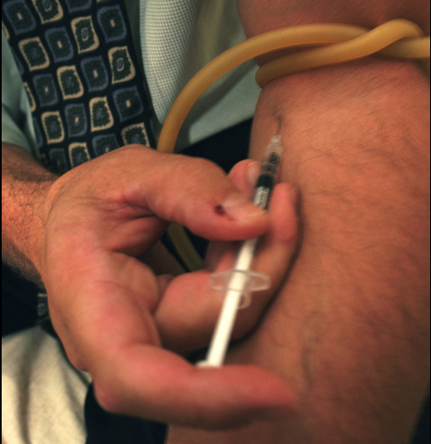

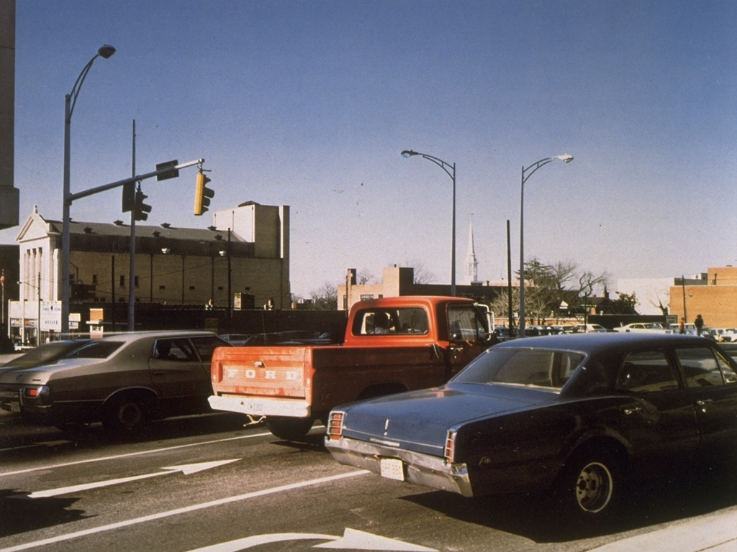
Below are examples of what the pleasant, neutral, and unpleasant images might look like:
Pleasant
Neutral
Unpleasant
LEFT
RIGHT
PRESS THE RIGHT KEY TO CONTINUE

Slide 12
More helpful people will show you the pleasant images and sounds more often in positive outcome games.
In negative outcomes games, more helpful people will show you the neutral images and sounds more often. In other words, they will prevent you from needing to see the unpleasant images and sounds.
But when you start each game, you will not know which of the three people are more likely to help you.
LEFT
RIGHT
PRESS THE RIGHT KEY TO CONTINUE

Slide 13
Each game will look as shown below. It will let you know the number of choices you have made, the number of games you have played, and how many choices/games you have left.
Here is where game type is indicated
Here, you will be reminded of your goal in this particular game.
You will be shown the neutral image unless the person you choose decides to help you.
RIGHT
PRESS THE RIGHT KEY TO CONTINUE

Slide 14
In both types of games, you should try to get help as many times as you can.
This means you would see the pleasant images and sounds as much as possible in positive outcome games, and you would avoid the unpleasant images and sounds as much as possible in negative outcome games.
RIGHT
PRESS THE RIGHT KEY TO CONTINUE

Slide 15
To help you get comfortable with this task,
let’s do a few practice games with a smaller number of choices.
RIGHT
PRESS THE RIGHT KEY TO CONTINUE

Slide 16
Great Job!
Let’s begin the real games!
Remember that some of the images might be disturbing. However please do your best not to look away or close your eyes when the images are presented.
RIGHT
PRESS THE RIGHT KEY TO BEGIN

Slide 17
Press the RIGHT KEY to BEGIN!

Slide 18
Cooperation Task
This task uses audio.
Please turn up your computer volume.
RUN 2
RIGHT
PRESS THE RIGHT BUTTON TO CONTINUE
Notes:
Outside the scanner

Slide 19
This is the same task as the one you just completed.
RIGHT
PRESS THE RIGHT BUTTON TO CONTINUE

Slide 20
You will be shown the neutral image unless the
person you choose decides to help you.

Slide 21
You will be shown the unpleasant image unless
the person you choose decides to help you.

