Slide 1

Social Media Task
Turn up the volume to hear instructions.
RIGHT
PRESS THE RIGHT BUTTON TO CONTINUE
Notes:
Outside the scanner

Slide 2
Welcome!
Thank you for volunteering for this experiment.
In this experiment, we would like you to play a game where you participate in an online social media platform. You will choose different topics to post about.
Your goal is to maximize the number of “likes” you receive from the other people online.
RIGHT
PRESS THE RIGHT BUTTON TO CONTINUE

Slide 3
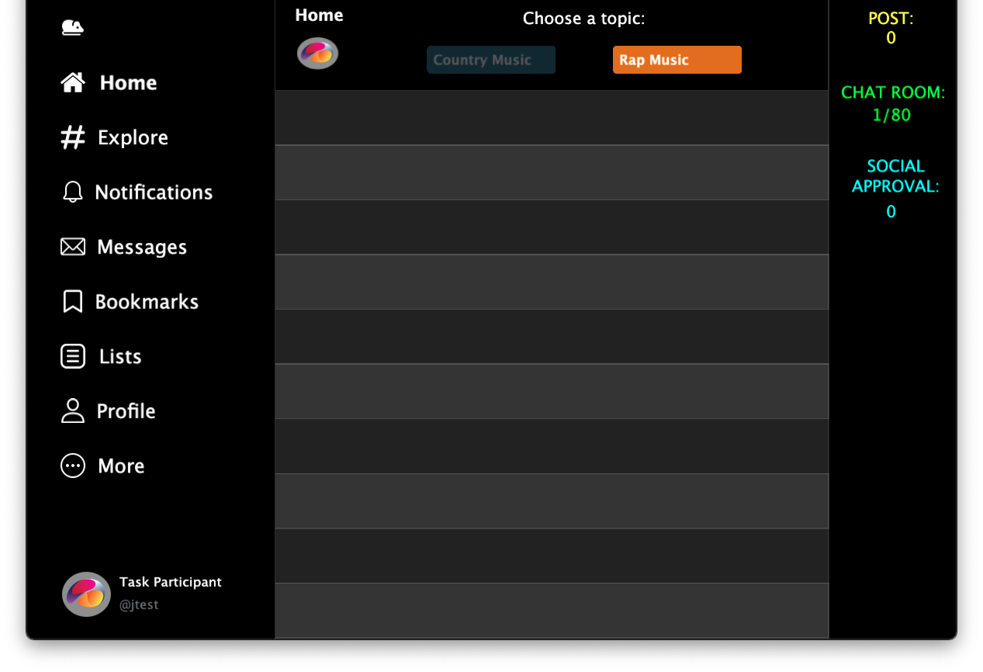
The social media platform will start with an empty chatroom that looks like this:
RIGHT
PRESS THE RIGHT BUTTON TO CONTINUE
Notes:
Add screenshots of an X and an O screen – like a timeline of screenshots.

Slide 4
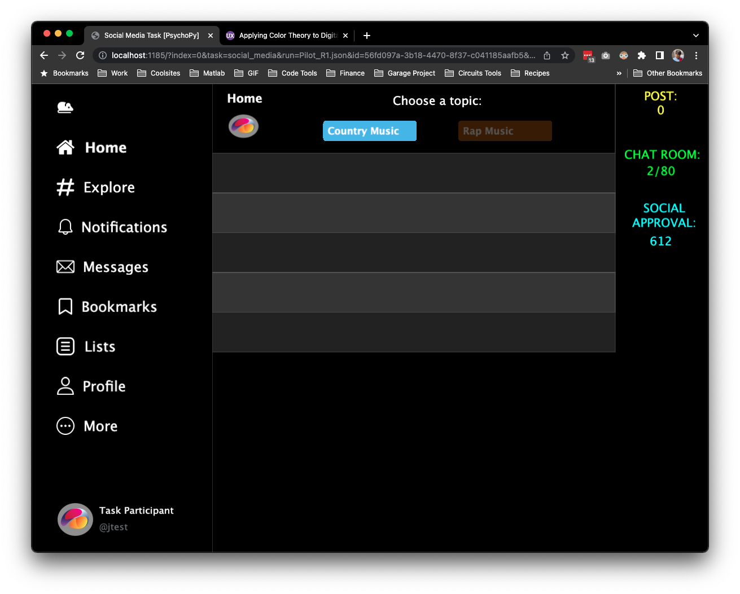
Throughout this game, you will enter 80 chatrooms.
In some chatrooms, you will be able to make 5 posts.
In other chatrooms, you will be able to make 10 posts.
RIGHT
PRESS THE RIGHT BUTTON TO CONTINUE
Notes:
Add screenshots of an X and an O screen – like a timeline of screenshots.

Slide 5

In each chatroom, there will be 100 people. At the top of the screen, you will see two topics you can post about.
Every time you choose a topic, a post about that topic will appear in the chat. The other people in the chatroom will have 3 seconds to indicate whether they like the post.
RIGHT
PRESS THE RIGHT BUTTON TO CONTINUE
Notes:
Add screenshots of an X and an O screen – like a timeline of screenshots.

Slide 6
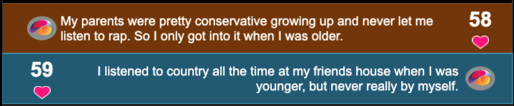
The number of likes will appear on either the left or right side of your post.
It will appear on the left if you chose the topic on the left, or on the right if you chose the topic on the right.
For example, here’s what it might look like after making a right post and then a left post.
Right Topic
60
52
Left Topic
RIGHT
PRESS THE RIGHT BUTTON TO CONTINUE
Notes:
Add screenshots of an X and an O screen – like a timeline of screenshots.

Slide 7
You job is to figure out what the people in the chatroom like most.
Try your best to get as many “likes” as you can!
The total number as you go through the chatrooms wil be on the right labeled as ”Social Approval”.
60
52
RIGHT
PRESS THE RIGHT BUTTON TO CONTINUE
Notes:
Add screenshots of an X and an O screen – like a timeline of screenshots.

Slide 8
In each chatroom, more people have been included that like one of the topics more than the other.
For example, 60 people might tend to like posts about one topic, while only 52 people might tend to like posts about another topic.
However, the exact number of “likes” you get for each post will vary.
60
52
RIGHT
PRESS THE RIGHT BUTTON TO CONTINUE
Notes:
Add screenshots of an X and an O screen – like a timeline of screenshots.

Slide 9
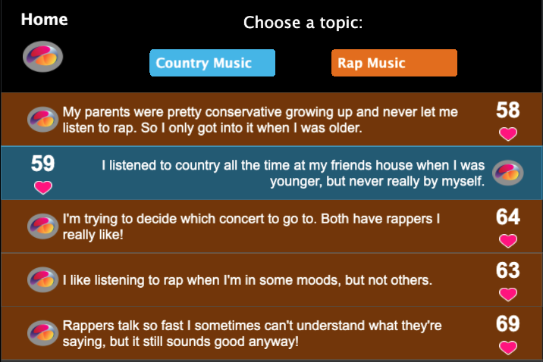
For example, 50 people in a chatroom might like one topic on average.
However, as shown below, 52 people may like the first post.
This is because the exact number of people that like each post will vary around the average of 50.
52
RIGHT
PRESS THE RIGHT BUTTON TO CONTINUE
Notes:
Add screenshots of an X and an O screen – like a timeline of screenshots.

Slide 10
On the second play you might get 56 “likes” if you chose the same topic again.
52
I'm trying to decide which concert to go to. Both have rappers I really like!
56
RIGHT
PRESS THE RIGHT BUTTON TO CONTINUE
Notes:
Add screenshots of an X and an O screen – like a timeline of screenshots.

Slide 11
If you chose the same topic a third time, you might get 45 “likes”.
52
I'm trying to decide which concert to go to. Both have rappers I really like!
56
I like listening to rap when I'm in some moods, but not others.
45
RIGHT
PRESS THE RIGHT BUTTON TO CONTINUE
Notes:
Add screenshots of an X and an O screen – like a timeline of screenshots.

Slide 12
And so on, such that if you were to pick the topic on the right 5 times in a row, you might see chatroom responses like this:
52
I'm trying to decide which concert to go to. Both have rappers
I really like!
56
I like listening to rap when I'm in some moods, but not others.
45
Rappers talk so fast I sometimes can't understand what they're saying, but it still sounds good anyway!
49
I can't believe they cancelled the concert. Good rap artists never come do shows here anymore!
51
RIGHT
PRESS THE RIGHT BUTTON TO CONTINUE
Notes:
Add screenshots of an X and an O screen – like a timeline of screenshots.

Slide 13
Within each chatroom, people will tend to like one of the topics more than the other.
That topic will therefore be the better one for getting the most “likes”.
However, because there will be a new set of people in each chatroom, the same topic will not always be the one that is liked most.
RIGHT
PRESS THE RIGHT BUTTON TO CONTINUE
Notes:
Add screenshots of an X and an O screen – like a timeline of screenshots.

Slide 14
In our experience, the number of people that like each post tend to show a similar spread of “likes” for both topics, and this also tends to stay the same from one chatroom to the next. ​
​
For example, if the average number of people that like posts for the left topic in a chatroom were 50, some posts might get 40 “likes” on the low end and 60 “likes” on the high end.
The topic on the right might instead have an average of 55 “likes”, with 45 “likes” on the low end and 65 “likes” on the high end. ​
RIGHT
PRESS THE RIGHT BUTTON TO CONTINUE
Notes:
Add screenshots of an X and an O screen – like a timeline of screenshots.

Slide 15
The average number of people that like posts about each topic could change for each chatroom, because there will be a different group of people in each chatroom. ​
But, as mentioned before, people in each chatroom tend to show a similar spread of “likes” from post to post for each topic.​
RIGHT
PRESS THE RIGHT BUTTON TO CONTINUE
Notes:
Add screenshots of an X and an O screen – like a timeline of screenshots.

Slide 16
“<“ Key
“>“ Key
To make your choices:
Press the < KEY to post about the topic on the left.
Press the > KEY to post about the topic on the right.
RIGHT
PRESS THE RIGHT BUTTON TO CONTINUE
Notes:
Add screenshots of an X and an O screen – like a timeline of screenshots.

Slide 17
In some chatrooms, you will be able to make 5 posts.
In other chatrooms, you will be able to make 10 posts.
The number of posts you can make in each game is determined by the number of empty slots that are shown.
For example, the chatroom shown below would allow 5 posts.
Once you make those 5 posts, that round is over and you will move to the next chatroom.
RIGHT
PRESS THE RIGHT BUTTON TO CONTINUE
Notes:
Add screenshots of an X and an O screen – like a timeline of screenshots.

Slide 18
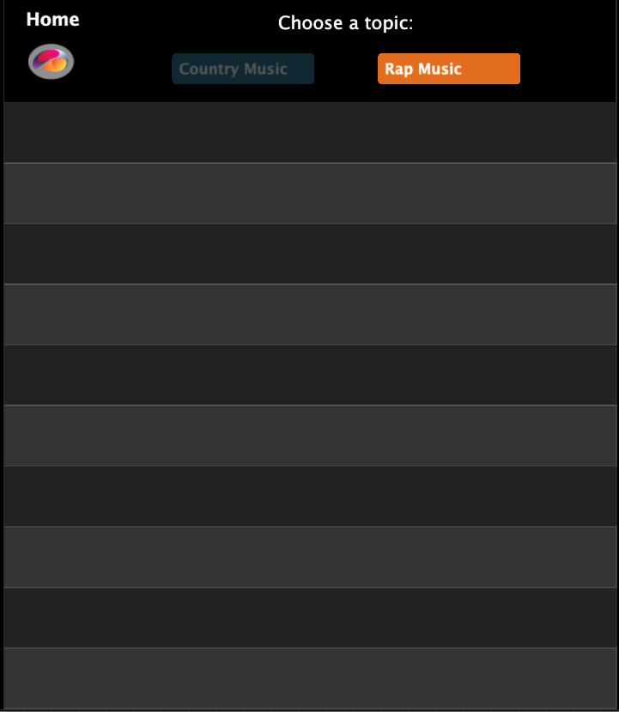
If the chatroom instead looked like this, you could make 10 posts.
RIGHT
PRESS THE RIGHT BUTTON TO CONTINUE
Notes:
Add screenshots of an X and an O screen – like a timeline of screenshots.

Slide 19
To help you get a sense of what people in the chatroom are like, we will tell you which topic to post about for the first four posts.
After that, you can choose to post about whichever topic you’d like.
RIGHT
PRESS THE RIGHT BUTTON TO CONTINUE
Notes:
Add screenshots of an X and an O screen – like a timeline of screenshots.

Slide 20

Therefore, for the first four posts, only one of the topics will be lit up. This indicates that you can only choose that topic.
For example, if you are instructed to choose the left topic for your first post, you will see this.
RIGHT
PRESS THE RIGHT BUTTON TO CONTINUE
Notes:
Add screenshots of an X and an O screen – like a timeline of screenshots.

Slide 21

If you were instructed to choose the right topic on the third post, you would see this:
RIGHT
PRESS THE RIGHT BUTTON TO CONTINUE
Notes:
Add screenshots of an X and an O screen – like a timeline of screenshots.

Slide 22
Once these four posts are complete, you will be free to choose between the two topics.
This is indicated by both topic options being lit up.
RIGHT
PRESS THE RIGHT BUTTON TO CONTINUE
Notes:
Add screenshots of an X and an O screen – like a timeline of screenshots.

Slide 23
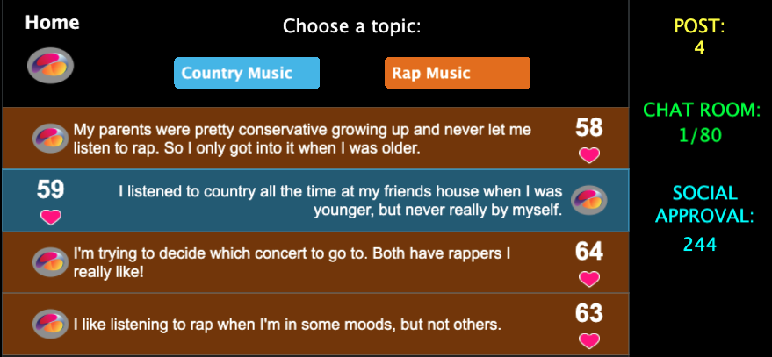
We will keep track of the total number of “likes” you receive across all chatrooms. Try to get as many “likes” as possible.
In the upper-right corner, we will use this to calculate your overall “social approval score”, which will go up or down over time depending on how many “likes” you get.
RIGHT
PRESS THE RIGHT BUTTON TO CONTINUE
Notes:
Add screenshots of an X and an O screen – like a timeline of screenshots.

Slide 24
So to be sure that everything makes sense let’s work through a few example chatrooms.
“<“ Key
“>“ Key
RIGHT
PRESS THE RIGHT BUTTON TO CONTINUE

Slide 25
Good Job!
Now you know how to play this game.
Once you are ready to start playing the actual game, please press the RIGHT BUTTON.

Slide 26
Before you start playing as the person choosing posts, we'd also like you to help as a chatroom member reading some other players' posts.
For each post you see, you will have 5 seconds to click the "like" button if you want to. We will just have you do this for two chatrooms before you start playing as the one posting.
RIGHT
PRESS THE RIGHT BUTTON TO CONTINUE

