Slide 1

Emotional Faces
RIGHT
PRESS THE RIGHT BUTTON TO CONTINUE
Notes:
Outside the scanner

Slide 2
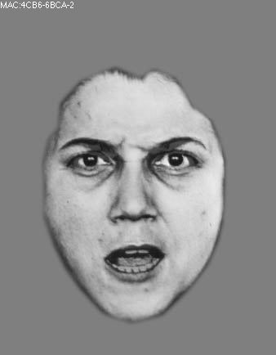
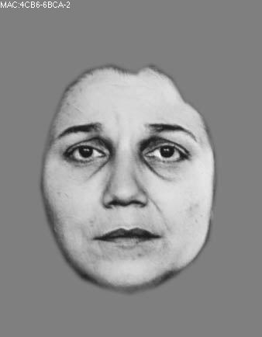
Welcome!
In this task, you will be shown pictures of the faces of several people. Each person’s face will be expressing either ANGER or SADNESS.
angry
sad
RIGHT
PRESS THE RIGHT BUTTON TO CONTINUE
Notes:
.

Slide 3
Your job in the task is to indicate whether the face you see is angry or sad.
angry
sad
RIGHT
PRESS THE RIGHT BUTTON TO CONTINUE
Notes:
.

Slide 4
The faces will only be shown briefly. Then you will press a button indicating whether the person was angry or sad.
Your job is to be as fast and accurate as possible.
Please try your best to respond on every trial.
If you take too long to respond, it will be considered incorrect. You will be told if it was too slow.
RIGHT
PRESS THE RIGHT BUTTON TO CONTINUE
Notes:
.

Slide 5
The people you see will be angry or sad because of statements they hear beforehand. You will hear one of these statements right before you see each face.
The statements you will hear are either “you’re fired” or “go away”.
One of these statements might be more likely to lead to a sad face, while the other might be more likely to lead to an angry face. But this pattern could also change over time.
RIGHT
PRESS THE RIGHT BUTTON TO CONTINUE
Notes:
.

Slide 6
Because some statements may tend to lead to specific emotions, this might give you clues and help you respond as fast and accurate as possible.
RIGHT
PRESS THE RIGHT BUTTON TO CONTINUE
Notes:
.

Slide 7
Sometimes the pictures of the faces will be easy to see and show strong emotional expressions.
Other times the pictures may be less clear and show less intense emotional expressions.
RIGHT
PRESS THE RIGHT BUTTON TO CONTINUE
Notes:
.

Slide 8
To make sure you are familiar with the faces and the emotional expressions, we will now show you each face without a time limit and ask you to indicate whether it is angry or sad.
RIGHT
PRESS THE RIGHT BUTTON TO CONTINUE
Notes:
.

Slide 9
To indicate sadness, press the RIGHT key.
To indicate anger, press the LEFT key.
RIGHT
PRESS THE RIGHT BUTTON TO CONTINUE
Notes:
.

Slide 10
You are now ready to do the task.
Remember, try to be as fast and accurate as possible.
Also try to respond on every trial.
To help you get comfortable with this task,
let’s do a few practice trials first.
RIGHT
PRESS THE RIGHT BUTTON TO CONTINUE

Slide 11
Great Job!
Let’s begin the task.
Remember that some statements may be more likely to generate sadness, while other statements may be more likely to generate anger.
This may help you answer as fast and accurate as possible.
Good luck!
RIGHT
PRESS THE RIGHT BUTTON TO CONTINUE

