Slide 1

Cooperation Task
This task uses audio.
Please turn up your computer volume.
RUN 1
RIGHT
PRESS THE RIGHT BUTTON TO CONTINUE
Notes:
Outside the scanner

Slide 2
CONTENT WARNING:
Some of the images shown in this task
are graphic in nature and might be disturbing to some viewers.
RIGHT
PRESS THE RIGHT BUTTON TO CONTINUE
Notes:
Outside the scanner

Slide 3
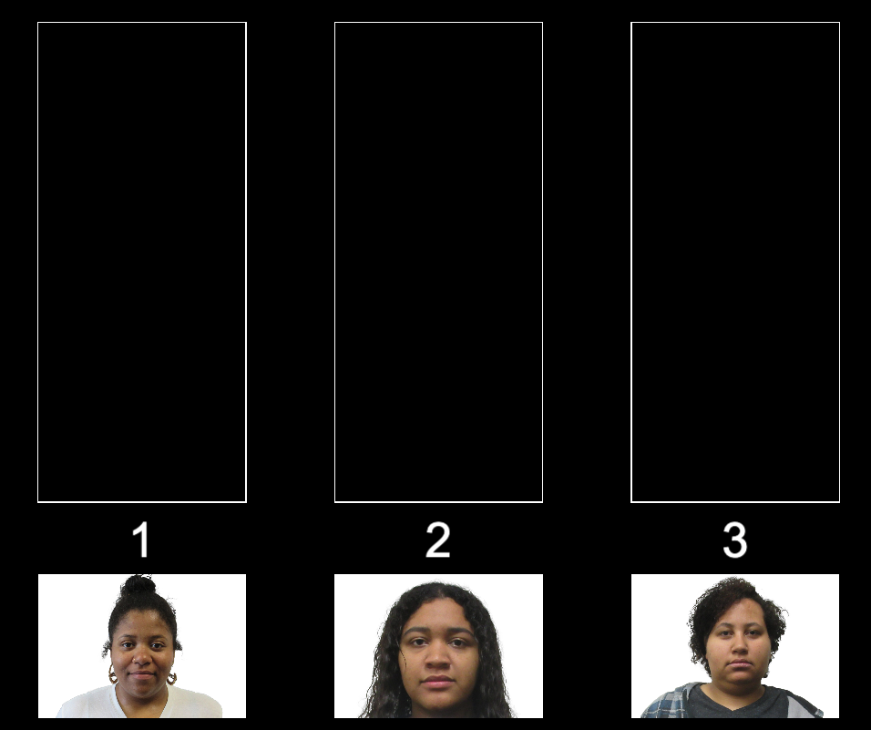
For this task, you will play several “cooperation games”. In each game, you need to repeatedly choose between three different people to ask for help.
LEFT
RIGHT
PRESS THE RIGHT KEY TO CONTINUE

Slide 4
In each game, you will be able to make 16 choices in a row.
LEFT
RIGHT
PRESS THE RIGHT KEY TO CONTINUE

Slide 5
In each game, images of three people you can choose from will be shown like in the example below. Each person will have a number above their picture. Either a 1, 2, or 3.
Each time you want to choose to ask one of them for help, you need to press their number on the keyboard.
LEFT
RIGHT
PRESS THE RIGHT KEY TO CONTINUE

Slide 6
For example, if you want to select the person on the left, then press the 1 KEY on the keyboard. If you decide you want to select the person in the middle, then press the 2 KEY. Pressing the 3 KEY would instead select the person on the right.
Press ’1’ key to select
Press ’2’ key to select person 2
Press ’3’ key to select person 3
LEFT
RIGHT
PRESS THE RIGHT KEY TO CONTINUE

Slide 7
When you ask someone for help, they might choose to help you, or they might choose not to help you.
Some people will tend to be more helpful than others.
But when you start each game, you will not know which of the people are more likely to help you.
LEFT
RIGHT
PRESS THE RIGHT KEY TO CONTINUE

Slide 8
There will be two different types of games: positive outcome games and negative outcome games.
In positive outcome games, the person you select can decide to show you a pleasant image and sound.
They can also decide to show you a meaningless image and sound instead. These meaningless images and sounds are not pleasant or unpleasant.
LEFT
RIGHT
PRESS THE RIGHT KEY TO CONTINUE

Slide 9
In negative outcome games, the person you select can decide to show you an unpleasant image and sound.
They can also decide to show you a meaningless image and sound instead.
LEFT
RIGHT
PRESS THE RIGHT KEY TO CONTINUE

Slide 10
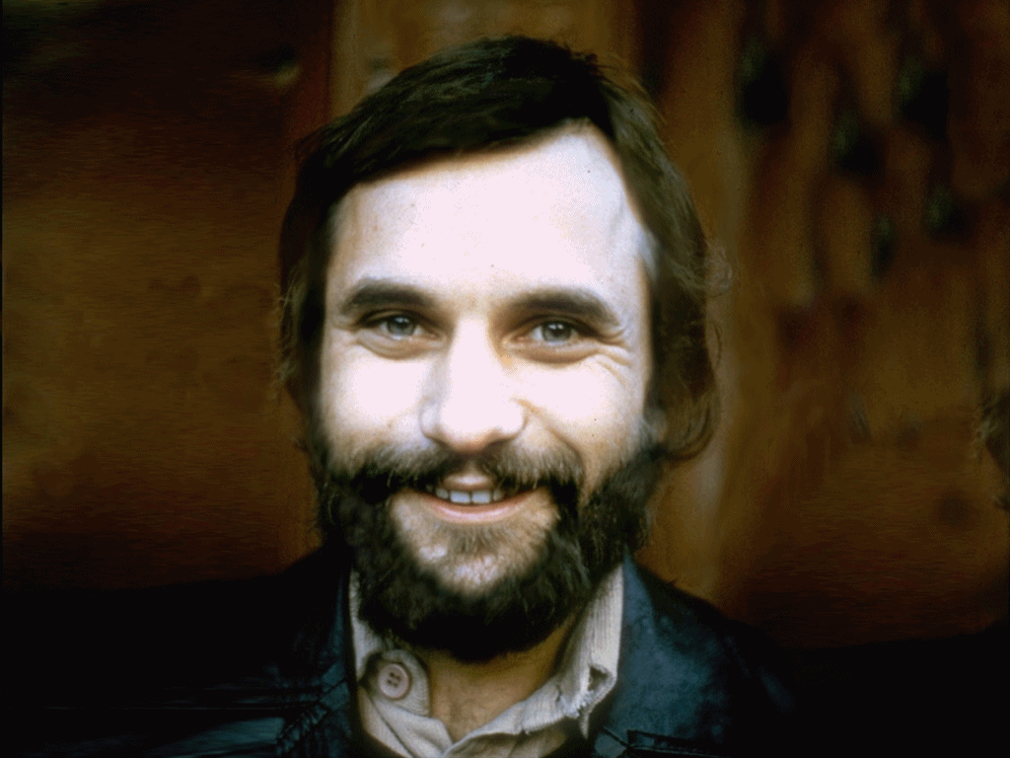

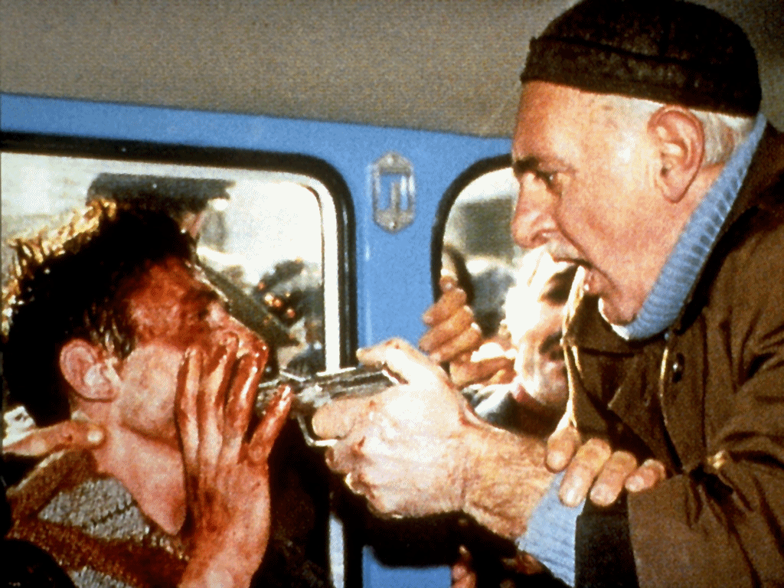
Below are examples of what the pleasant, meaningless, and unpleasant images might look like:
Pleasant
Meaningless
Unpleasant
LEFT
RIGHT
PRESS THE RIGHT KEY TO CONTINUE

Slide 11
More helpful people will show you the pleasant images and sounds more often in positive outcome games, and they will show you the unpleasant images and sounds less often in negative outcome games.
But when you start each game, you will not know which of the three people are more likely to help you.
LEFT
RIGHT
PRESS THE RIGHT KEY TO CONTINUE

Slide 12
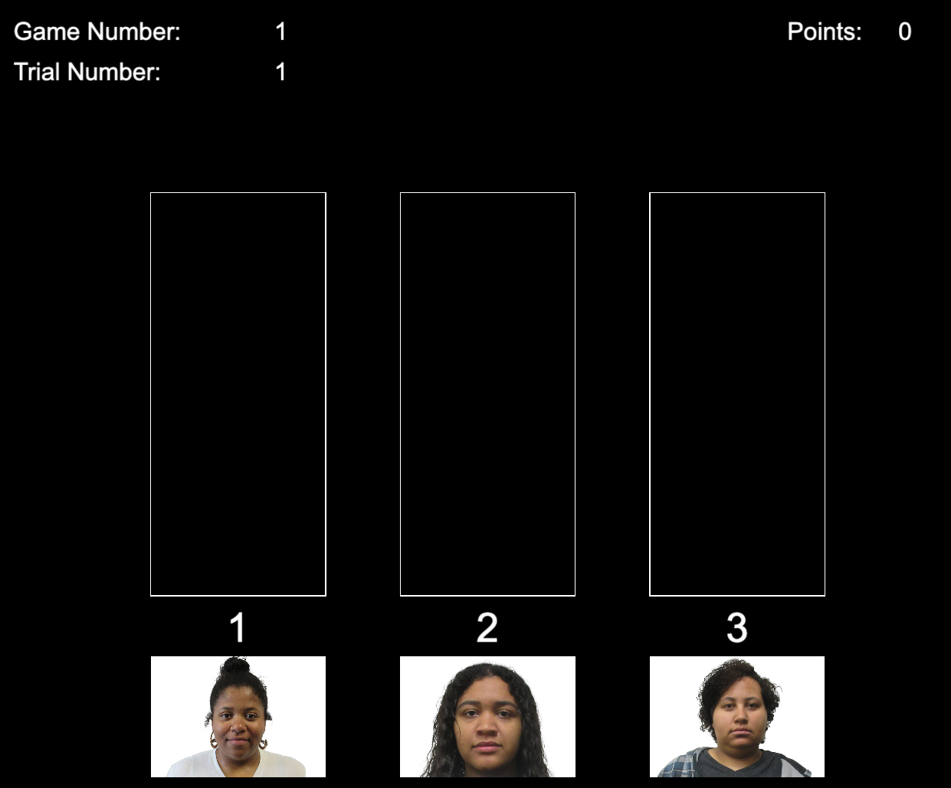
Each game will look as shown below.
RIGHT
PRESS THE RIGHT KEY TO CONTINUE

Slide 13

To help you remember what each person has done in the past, every time a person shows you the pleasant image and sound, a happy face will be added above their picture.
RIGHT
PRESS THE RIGHT KEY TO CONTINUE

Slide 14

Every time a person shows you the meaningless image and sound, a neutral face will appear above their picture.
RIGHT
PRESS THE RIGHT KEY TO CONTINUE

Slide 15

Every time a person shows you the unpleasant image and sound, a negative face will appear above their picture.
RIGHT
PRESS THE RIGHT KEY TO CONTINUE

Slide 16
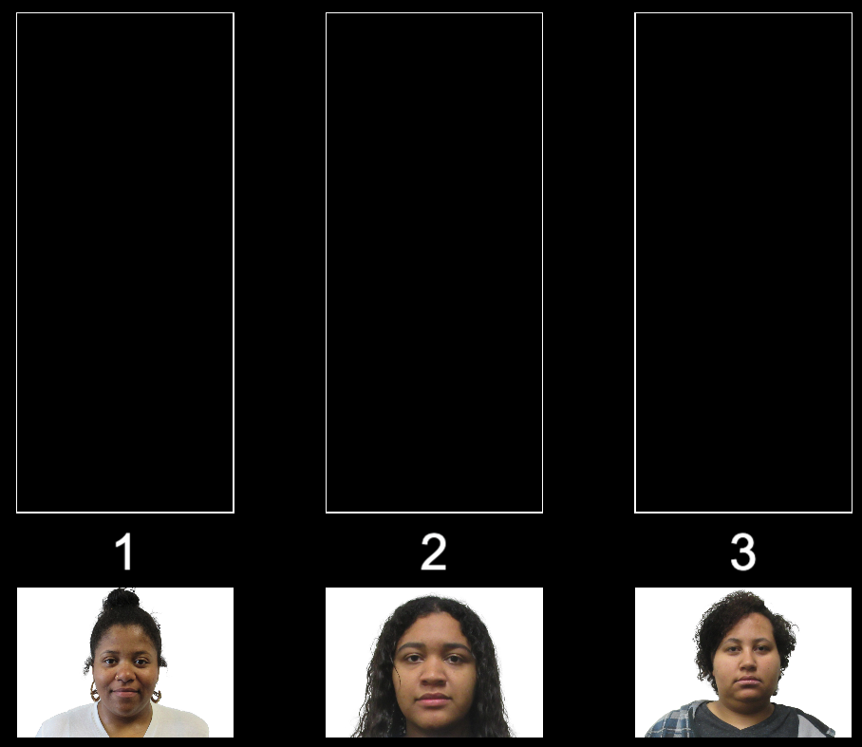
These faces will stack on top of each other to show you how many times each person has chosen what to do.
For instance, in the example game below, person #2 had so far shown you two pleasant images/sounds and one meaningless image/sound.
RIGHT
PRESS THE RIGHT KEY TO CONTINUE

Slide 17
In both types of games, you should try to get help as many times as you can.
This means you would see the pleasant outcomes as much as possible in positive outcome games, and you would avoid the unpleasant outcomes as much as possible in negative outcome games.
RIGHT
PRESS THE RIGHT KEY TO CONTINUE

Slide 18
To help you get comfortable with this task,
let’s do a few practice games
RIGHT
PRESS THE RIGHT KEY TO CONTINUE

Slide 19
Great Job!
Let’s begin the real games!
RIGHT
PRESS THE RIGHT KEY TO BEGIN

Slide 20
Press the RIGHT KEY to BEGIN!

Slide 21
Cooperation Task
This task uses audio.
Please turn up your computer volume.
RUN 2
RIGHT
PRESS THE RIGHT BUTTON TO CONTINUE
Notes:
Outside the scanner

Slide 22
This is the same task as the one you just completed.
RIGHT
PRESS THE RIGHT BUTTON TO CONTINUE

