Slide 1

Cooperation Task
RIGHT
PRESS THE RIGHT BUTTON TO CONTINUE
Notes:
Outside the scanner

Slide 2
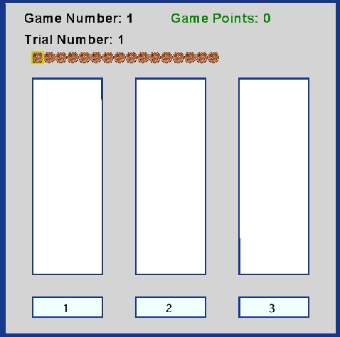
For this task, you will play 20 investment games in total. The goal is to earn as much money as possible.
LEFT
RIGHT
PRESS THE RIGHT KEY TO CONTINUE

Slide 3
In each game, you have 16 tokens (stacked in a row at the top of the screen) and 3 lotteries (the vertical white panels).
LEFT
RIGHT
PRESS THE RIGHT KEY TO CONTINUE

Slide 4
1
2
3
You are to place each token in the lottery panel of your choice. To do that, press the “1”, “2”, or “3” button that corresponds to the desired lottery panel.
LEFT
RIGHT
PRESS THE RIGHT KEY TO CONTINUE
Notes:
Replace screen shot with one where the cursor is over one of the buttons (e.g., over the 2).

Slide 5
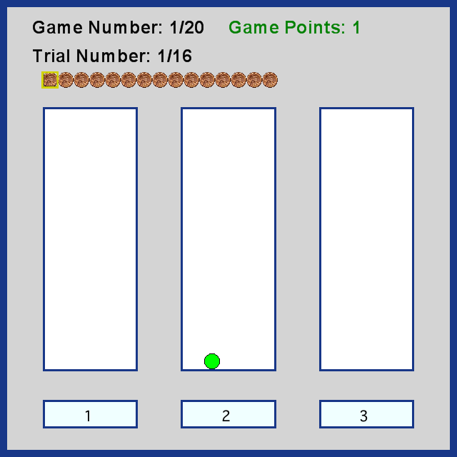
After each token placement, the token will turn green if you won (as shown). You earn 1 point for each green token.
LEFT
RIGHT
PRESS THE RIGHT KEY TO CONTINUE
Notes:
Replace screen shot with one where the button has been pressed (same button used in the last screenshot) and the result was a win…so that the token is green as indicated.

Slide 6
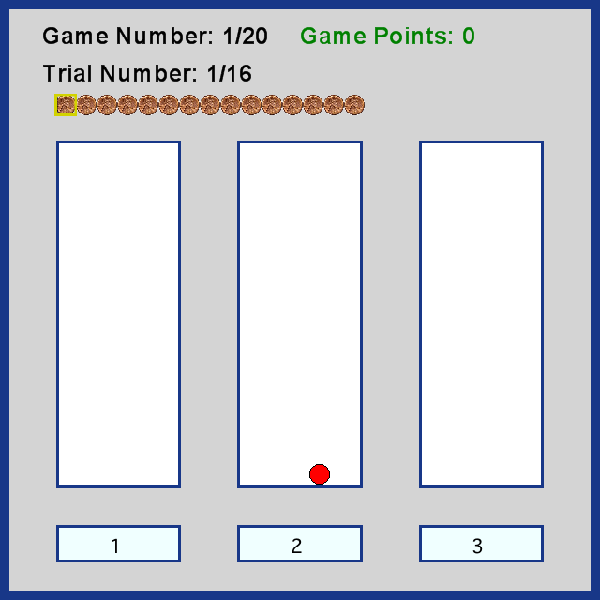
The token will turn red if you lost (as shown).
LEFT
RIGHT
PRESS THE RIGHT KEY TO CONTINUE
Notes:
Replace screen shot with one where the button has been pressed (same button used in the last screenshot) and the result was a loss…so that the token is red as indicated.

Slide 7
Some lotteries are more rewarding than others.
Each lottery will be replaced at the beginning of a new game.
LEFT
RIGHT
PRESS THE RIGHT KEY TO CONTINUE

Slide 8
Therefore, you need to get a sense of which lotteries are better for each new game.
LEFT
RIGHT
PRESS THE RIGHT KEY TO CONTINUE

Slide 9
Try to earn as many points as possible!
Remember that you will be paid
based on the total number of points you earn!
LEFT
RIGHT
PRESS THE RIGHT KEY TO CONTINUE

Slide 10
To help you get comfortable with this task,
let’s do a few practice games
RIGHT
PRESS THE RIGHT KEY TO CONTINUE

Slide 11
Great Job!
Let’s begin the real games!
RIGHT
PRESS THE RIGHT KEY TO BEGIN

