Slide 1
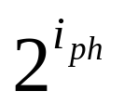
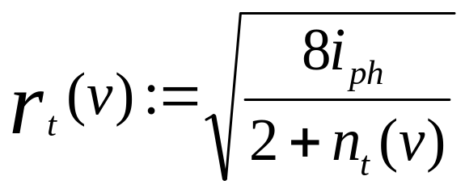
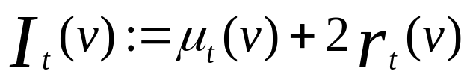
Zooming Algorithm
Multiple phases, rounds per phase
Activate a set of arms that covers the space
Play arm with maximum index.
Radius is given by:
Index is given by:
The phase number controls the ratio of exploration to exploitation.

Slide 2
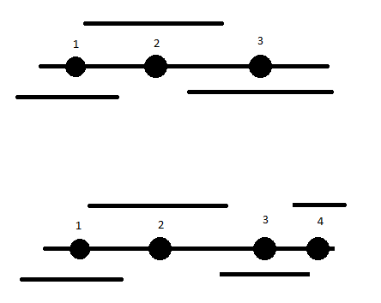
Each time an arm is played, it’s radius shrinks.
Any uncovered arms are then activated, until once again all arms are covered.
In this diagram, arm 3 is played, resulting in the addition of arm 4.

Slide 3
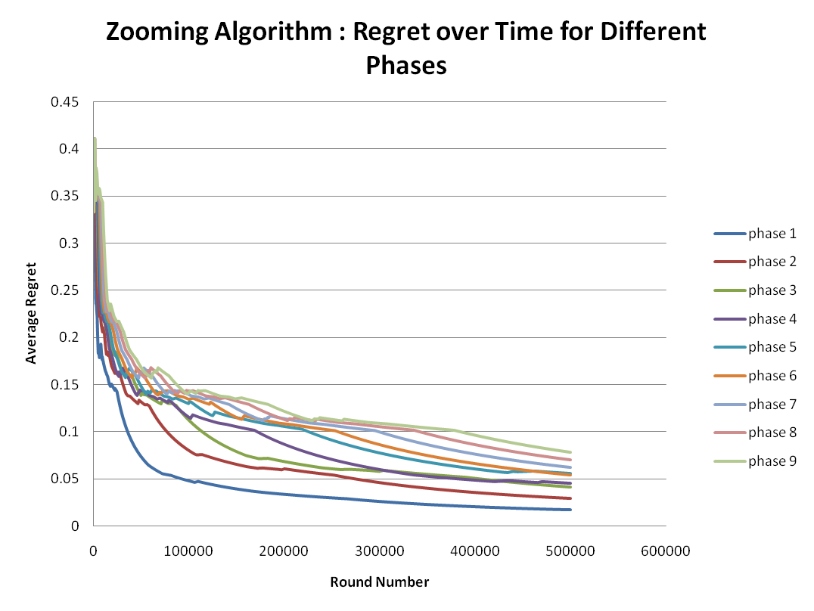
Each graph represents the zooming algorithm, run starting at a particular phase number, and staying at that phase instead of transitioning into the next phase. The algorithm was run on a 2D problem with a reward function designed to be at a maximum at a specific point, and to decrease based on the distance from that point.

