Slide 1
Infinite-Armed Bandits
Standard K-armed bandit problem: each round, pull from one of K ‘arms’, get a reward.
Infinite-armed bandit problem: each round, pull from one of an infinite number of ‘arms’, get a reward.

Slide 2

Discretization Algorithms
Simplest solution: fix a set of arms, then run a K-armed bandit algorithm.
Example discretization of [0,1] into 10 points
Implemented discretized ε-greedy, UCB1, and Exp3 algorithms.

Slide 3
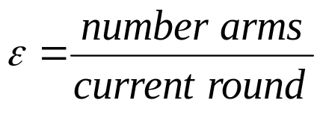
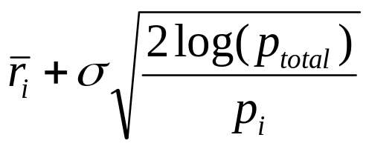
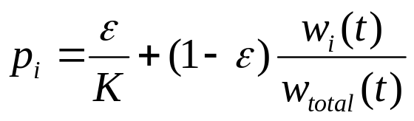
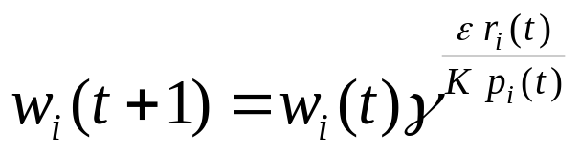
ε-greedy
Play randomly with probability ε (decreasing with time), play best arm so far otherwise.
We use
UCB1
Play arm maximizing
  σ determines amount of exploration
Exp3
Play randomly with probability
Update weights
  gamma determines amount of exploration

Slide 4
Tic-Tac-Toe Bandit
9-dimensional bandit: assign weight to each square on the board, then use weights to evaluate ‘worth’ of board.
Play against random player. Reward 1 if win, .5 if tie, 0 if lose.
One player that never loses averages .86 reward.

Slide 5
