Slide 1



-armed Bandit
Generalization of multi-armed bandit to arbitrary topological spaces.
Maintains a collection of sets which cover the space
A Covering Tree data structure holds the sets. It requires
A point (arm) is selected by descending the tree until a leaf is reached, then instantiating a new leaf representing a subset of its parent.

Slide 2
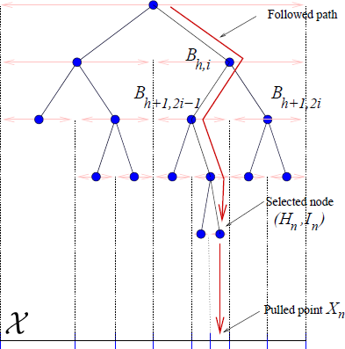
Selecting from the Cover Tree
Deterministic selection rule.
Optimistically refines promising regions
Selection is O(n)

Slide 3

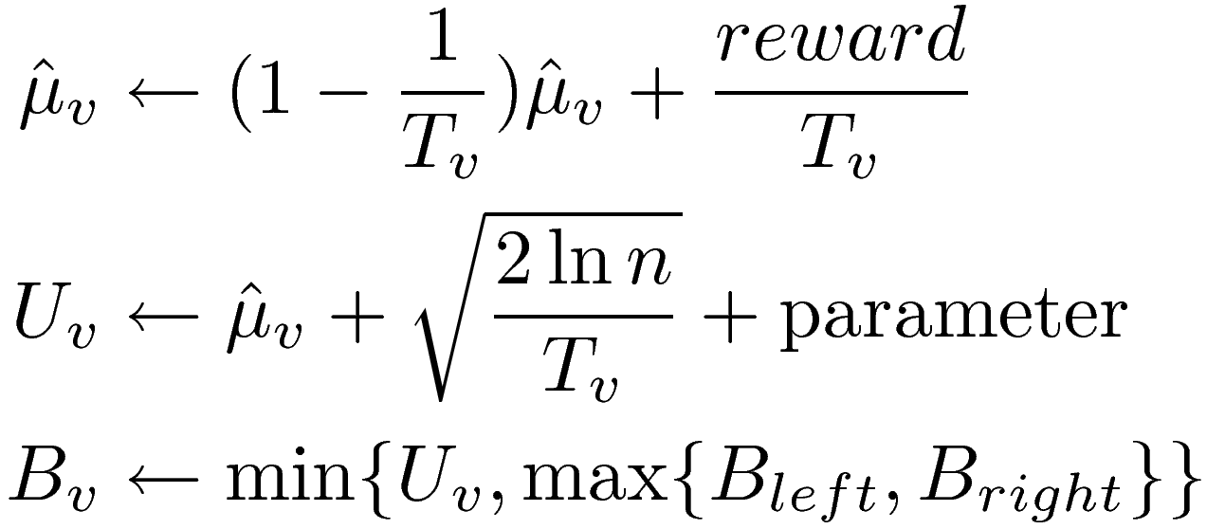
-armed Algorithm
Keep a count for the number of paths through a node v:
Select: Descend tree by taking path of higher B value until a leaf is instantiated. Select new leaf.
Update:

Slide 4
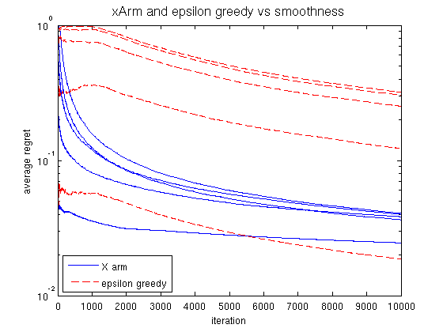
s=0.01
s=0.001
s=0.0001
s=0.1
s=0.0001
s=0.001
s=0.01
s=0.1
s=1
s=1

Slide 5
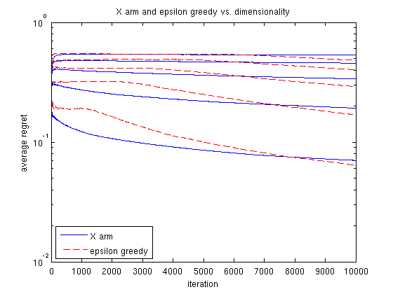
d=5
d=4
d=3
d=2
d=1

