Slide 1
Where are the jobs?
And how much do they pay?
By Davis, Dhruv, Peta, Yuijin

Slide 2
Questions We Asked
Question 1 – What is the revenue of companies compared to how many employees they have?
Question 2 – What is biggest employment sectors in each State? How many employees are in that sector? (Looking at only Fortune 1000 companies)
Question 3 – Where can we find the most successful companies? Where are computational employees paid the most? Is there a relationship between the two?
Question 4 – Is compensation of CEOs based on the value they bring to companies, or other factors?

Slide 3
Introducing the Data & Terminology
First, a definition – we are looking at the number of “Computer and Mathematical Occupations” employees (measured by the Bureau of Labor Statistics) employed across all States.
Number of Employees = the average annual number of employees in the top Fortune 1000 companies

Slide 4
Biggest Employment Sectors by State

Slide 5
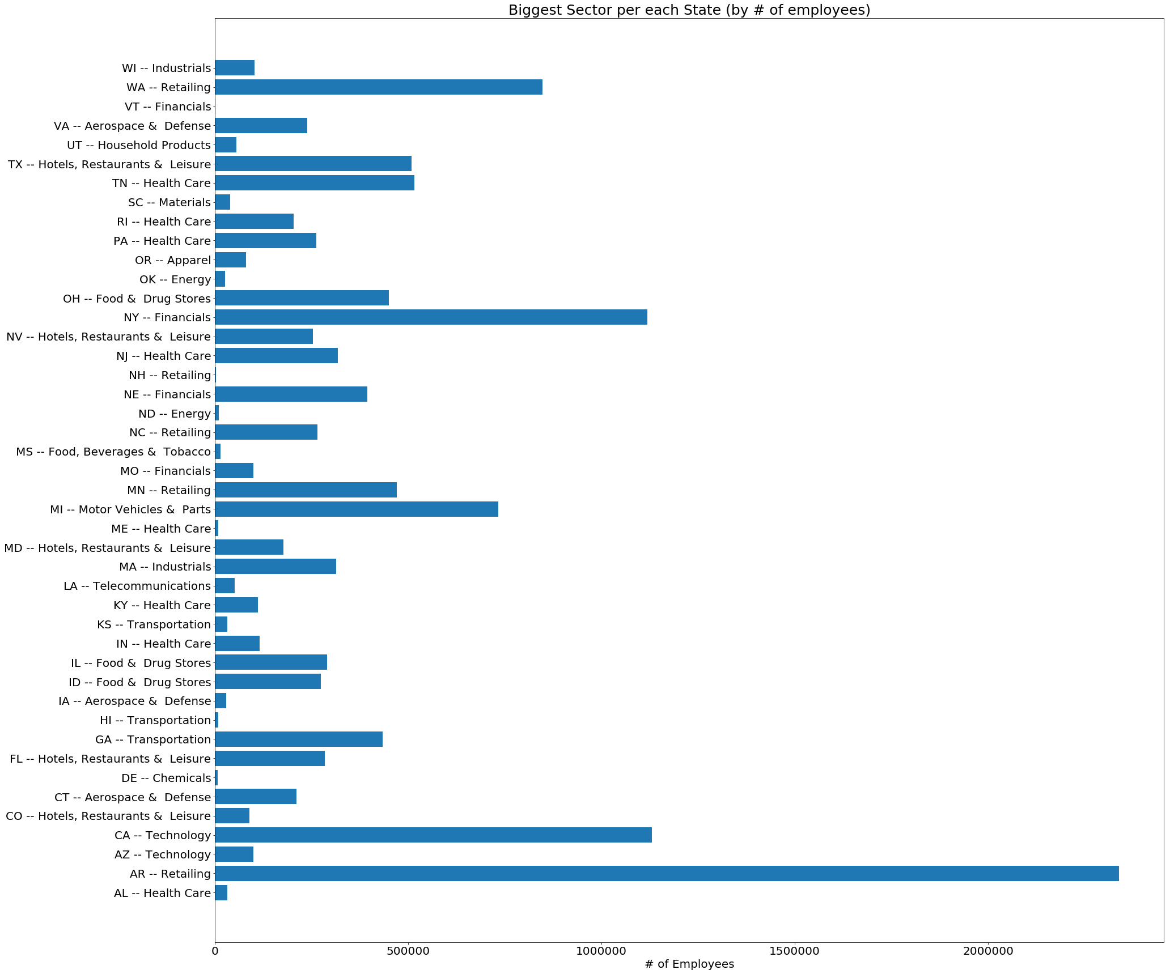
Biggest Sector in each State

Slide 6
Initial findings
Arizona is the leader in the Retail sector (solely because of Walmart)
As we expected New York has the most amount employment in the Financial Sector.
California = Technology
If you live in Michigan look for jobs within the Motor Vehicle sector.

Slide 7
Revenues of Companies vs Number of Employees

Slide 8
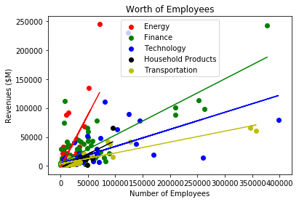
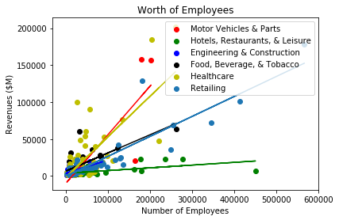
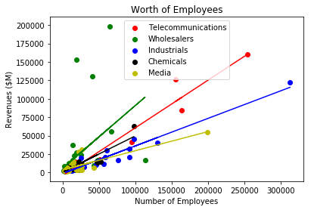
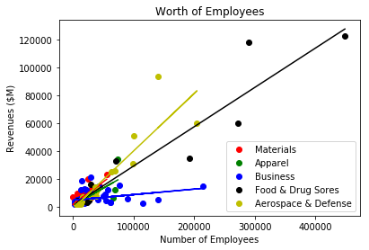

Slide 9
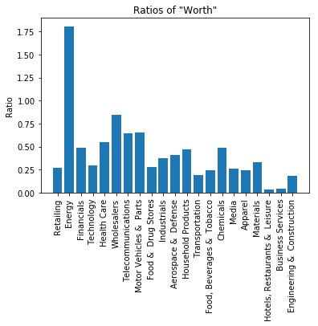

Slide 10
Conclusions
Quite a few sectors have a clear linear correlation with the amount of employees they have and how much revenue they bring in.
# 1. Companies can expect to scale in size an expect a constant return from the employees they hire this is due to a linear trend for most sectors.
# 2. "Worth" ratios were calculated by comparing the revenue of a company to the amount of employees that the companies have. The companies that have a higher ratio value employees more as their work creates more revenue. This conclusion could mean that it may be more difficult to find a job in these sectors. There is the adverse effect with the companies with a low ratio.

Slide 11
Average Wage and Number of Fortune 1000 Companies

Slide 12
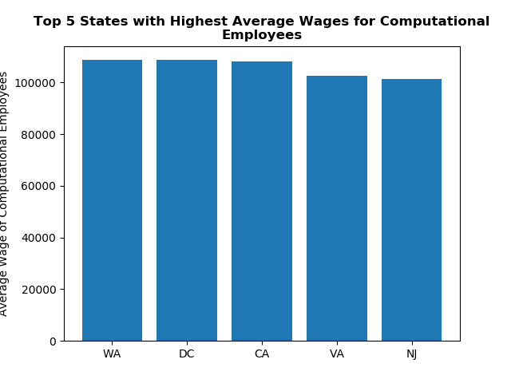
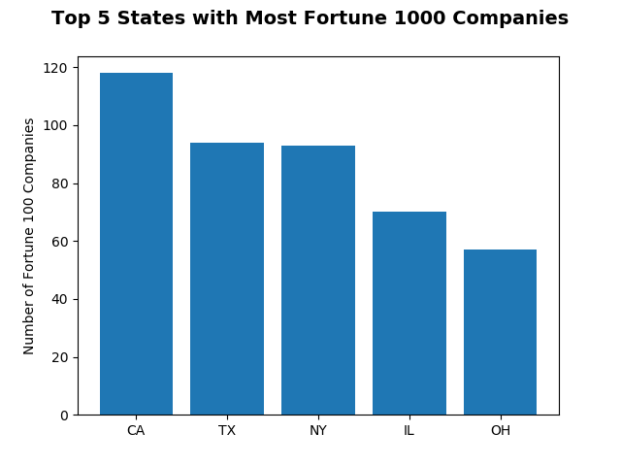
Top 5 States with Highest Average Wages &
Most Fortune 1000 Companies
Notes:
Question: Which states have the most "successful" companies?
Where are the average computational wages highest?
Is there a relationship between "success" of a state with average wages?

Slide 13
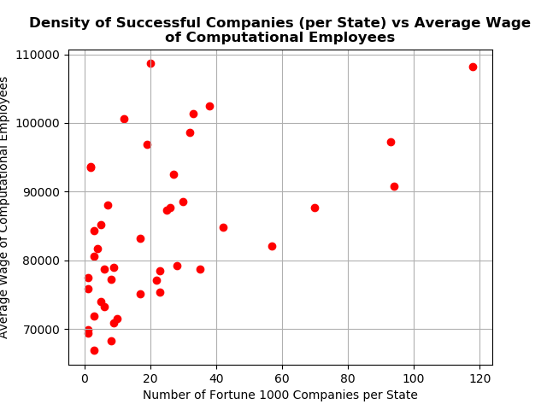

Slide 14
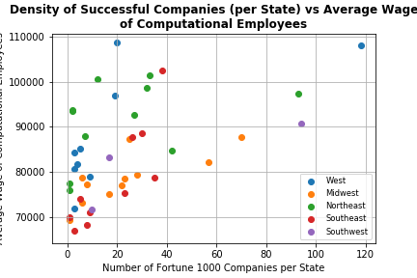

Slide 15
Conclusions
There does seem to be a general trend of average wage increasing the more Fortune 1000 companies that there are in a state. We also see that there are different trends in different regions. Success seems to matter less in the Northeast versus there being a sharp incline for the Western region of the United States.
Unfortunately, we cannot conclude for sure that this correlation indicates that “success” in an area increases average wage due to the limits of the dataset.

Slide 16
THE TOP TIER EMPLOYEES. CEO AND SALARY

Slide 17
Is CEO compensation linked to the success of a company?
To compare companies with different stock prices, and number of stocks, we used the price/earnings ratio which uses 1.stock price 2. number of shares 3. earnings.

Slide 18
What does CEO salary look like? (across 2700 companies)
Average salary is $7.4 million
Warren Buffet, Berkshire Hathaway, is paid 5% of average
Elon Musk gets paid $2.2 billion, ten times more than the second highest paid CEO , Patrick Smith
Patrick of Axxon Enterprises is paid $246 million, twice as much as 3rd highest paid CEO, David Zaslav of Discover
Jack Dorsey (Twitter, Square), Larry Page (Alphabet), Nicholas Woodman (GoPro) are paid $1

Slide 19
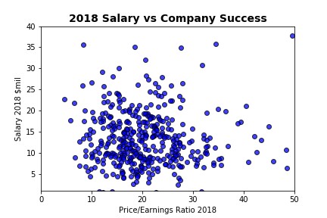

Slide 20
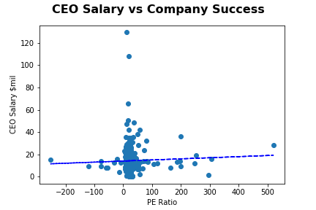

Slide 21
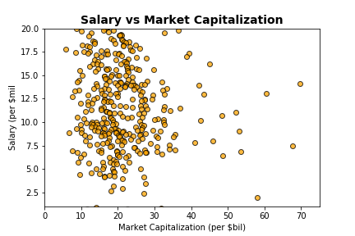

Slide 22
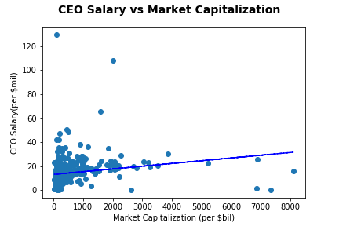

Slide 23
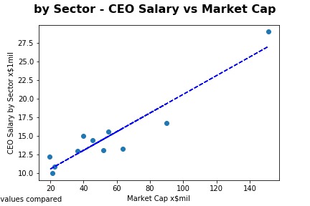

Slide 24
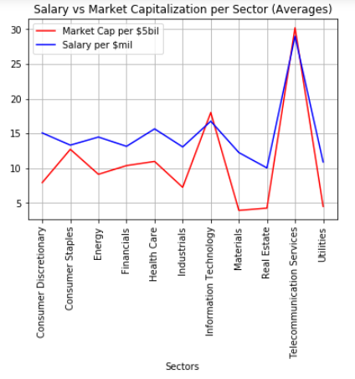

Slide 25
Conclusion
Price/Earnings ratio is not a good variable that explains CEO salaries.
Rather, market capitalization better explains CEO salaries - the bigger the company, generally the higher the salary.
And CEO salary seems to be correlated with industry sector. The ttest has a p value of 0.006, mush less than 0.05

Slide 26
Limitations on Project
Data collected for 2018, but exact periods during the year the datasets were collected do not match up
We trusted Kaggle data
Not all the data could be merged because it lacked common keys, so we are essentially referencing two datasets based on State
Although we have data on Fortune 1000 companies, CEO salary was only available for a Fortune 500 dataset
Doesn’t include government sector, small and privately held businesses
Although we found data on CEO salaries by sector, we could not find equivalent data on the number of math employees by company

Slide 27
References
Bureau of Labor Statistics, BLS
Occupational Employment and Wages, May 2018
https://www.bls.gov/oes/current/oes150000.html
For company information with PE earnings, data was from DataHub.
https://datahub.io/core/s-and-p-500-companies-financials/consituent-financials.csv
CEO Salaries
AFL-CIO Executive Paywatch data for 2018
https://aflcio.org/2018/5/22/executive-paywatch-2018-gap-between-ceo-and-worker-compensation-continues-grow
Data on Fortune 1000 companies
https://www.kaggle.com/Eruditepanda/fortune-1000-2018

