Slide 1
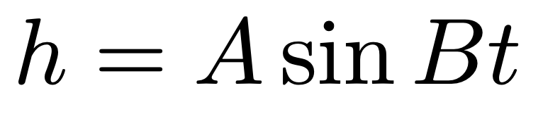
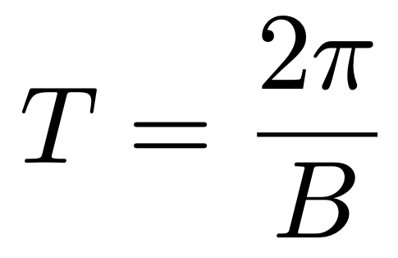
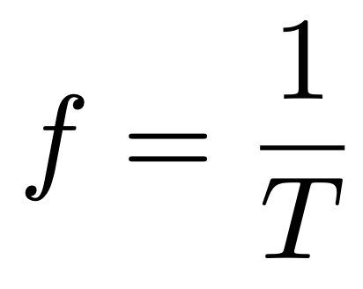
Quick Review of Day 1
LIGO data comes in the form of waves that have an amplitude and a frequency
For a wave described by the equation
the amplitude is given by A, the period is given by T, where
and the frequency is given by f, where

Slide 2
Quick Review of Day 1
The equation gives the y-value, the strain (amount of stretching of spacetime), as a function of the x-value, time
A Fourier transform takes this information and calculates a strain as a function of frequency
The transformed data will have peaks at the frequencies which contribute most to the signal

Slide 3
Quick Review of Day 2
To look at LIGO data in the time domain:
1. Get the time of the event
2. Download the data
3. Plot
To look at LIGO data in the frequency domain:
1. Get the time of the event
2. Download the data
3. Compute the PSD to get the frequencies
4. Plot

Slide 4
Quick Review of Day 3
Matched filtering involves comparing a modeled signal to actual data to make a detection
Steps:
1. Download LIGO data
2. Guess some parameters (masses, distance, etc) and create a model
3. Compare the data with the model and calculate the cross-correlation

Slide 5
Steps
1. Install packages
i. Tell it to use pylab too
2. Pick an event
i. https://gwosc.org/eventapi/html/allevents/
3. “Condition”: highpass, resample, crop
i. Make PSD, interpolate, truncate
4. Generate waveform template
i. Get masses and distance from GWOSC
ii. Resize
iii. Cyclic time shift
5. Matched filter
i. Crop
6. Plot and get peak SNR to make a detection!
7. [Optional] Plot data and model to see how well they match

Slide 6
Presentation Outline
Intro: Ryan
Waves and gravity, EM vs GR
Black holes interacting, making waves
LIGO detectors and history
Waves and gravity: Ryan
Black holes: Aaron
LIGO: Clarisa
Public data
Python programming: Joel
What is important
Why do we care: Matt
Conclusion: Matt

