Slide 1
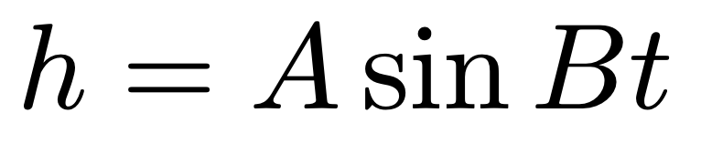
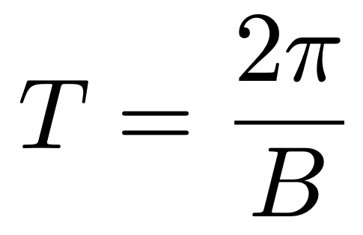
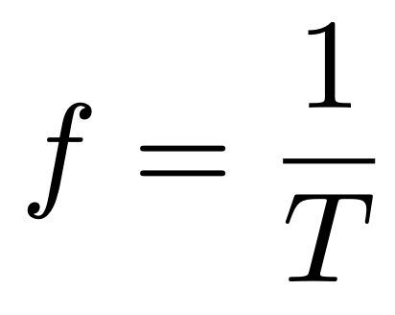
Quick Review of Day 1
LIGO data comes in the form of waves that have an amplitude and a frequency
For a wave described by the equation
the amplitude is given by A, the period is given by T, where
and the frequency is given by f, where

Slide 2
Quick Review of Day 1
The equation gives the y-value, the strain (amount of stretching of spacetime), as a function of the x-value, time
A Fourier transform takes this information and calculates a strain as a function of frequency
The transformed data will have peaks at the frequencies which contribute most to the signal

Slide 3
Quick Review of Day 2
To look at LIGO data in the time domain:
1. Get the time of the event
2. Download the data
3. Plot
To look at LIGO data in the frequency domain:
1. Get the time of the event
2. Download the data
3. Compute the PSD to get the frequencies
4. Plot

Slide 4
Quick Review of Day 3
Matched filtering involves comparing a modeled signal to actual data to make a detection
Steps:
1. Download LIGO data
2. Guess some parameters (masses, distance, etc) and create a model
3. Compare the data with the model and calculate the cross-correlation

