Slide 1


GHI Subseasonal-to-Seasonal (S2S) Forecast Subsystem
Jim Geiger¹ (presenting)
Kristi Arsenault^{1,2}, S. Mahanama^{1,2}, J. Wegiel^{1,2}, S.V. Kumar¹, A. Getirana^{1,2}, R. Zamora³, E.M. Kemp^{1,2}, Y. Yoon^{1,2}
1 NASA/GSFC, 2 SSAI, 3 Pratt&Whitney
DISTRIBUTION STATEMENT A. Approved for public release. Distribution is unlimited.
Nov-2026

Slide 2
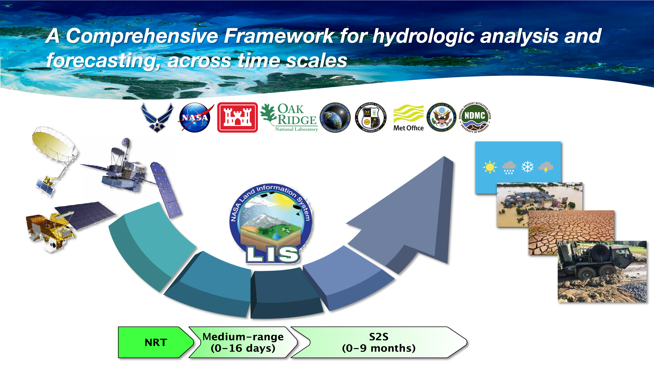
Global Hydro Information (GHI)
Spanning different timescales
GHI is a comprehensive framework for hydrological information across three operational sub-systems, each combining multiple models of physical processes and remote sensing data with visualization and decision support across a spectrum of time scales and missions:
  Near real-time (NRT; t-₁₂hours to t₀)
  Medium-range (MR; t₀ to t₁₀ days)
  Subseasonal-to-seasonal (S2S; t₀ to t₉ months)

Slide 3
GHI S2S Background
Building off the S2S efforts of the NASA Hydrological Forecasting and Analysis System (NHyFAS; Arsenault et al., 2020; Hazra et al., 2023), the globally based GHI-S2S system is:
  Geared towards supporting different U.S. government enterprises and their seasonal hydrological prediction needs
  Incorporates partners' inputs, such as from the U.S. Air Force
  Provides a range of drought and flood potential metrics, including meteorological and agricultural drought prediction indicators, occurring across the globe.

Slide 4
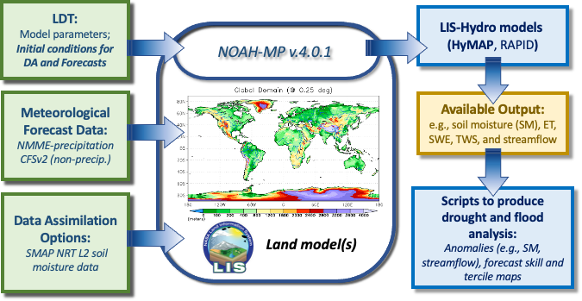
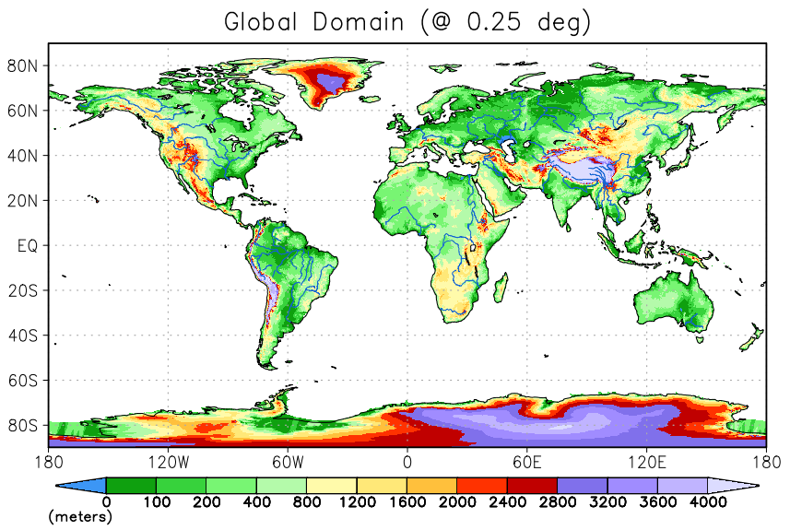
GHI-S2S system components (with LISF)

Slide 5
GHI Subsystems: Forcing Inputs
The surface meteorological forcing is a combination of the NASA – Air Force Precipitation Analysis (NAFPA; Kemp et al., 2022*), which uses a Bratseth analysis to combine precipitation from NWP as background with gauge reports and satellite estimates to produce a high-quality real-time analysis.
The NRT, MR and S2S subsystems use the above inputs for driving the land surface and hydrology models. The S2S subsystem has its forcing extended further back to Dec-1990, using MERRA2 plus CHIRPS precipitation (which are bias-corrected to the USAF+NAFPA dataset).
  NRT: t-₁₂hours to t₀ = ~10 km model resolution, 3-hourly output, NAFPA precipitation
  MR: t₀ to t₁₀ days = ~10 km model resolution, 3-hourly output, GALWEM forcing
  S2S: t₀ to t₉ months = 25 km model resolution, daily output, NMME (precip) + CFSv2 (non-precip)
  * Ref: Kemp, E, J.W. Wegiel, S.V. Kumar, J. V. Geiger, D.M. Mocko, J. Jacob, C.D. Peters-Lidard, 2022: A NASA-Air Force Precipitation Analysis for Near-Real-Time Operations, Journal of Hydrometeorology, 23(6), 965-989, doi:10.1175/JHM-D-21-0228.1

Slide 6
LISF Input Datasets
Forecast datasets:
  NOAA’s Climate Forecast System, version 2 (CFSv2; Saha et al., 2014):
  6-hourly files are used to generate the forcing ensemble members for the non-precipitation-based fields (e.g., air temperature, humidity, winds, downward radiation)
  2) The North American Multi-Model Ensemble (NMME; Kirtman et al., 2014):
  Several climate models from different centers in the U.S. and Canada
  9-lead months of multi-member precipitation forecasts from each model.
Retrospective forcing datasets: 30 years of forcing (1991-2020) blended with:
  1991-2012: NASA’s MERRA2 forcing (Gelaro et al., 2017) and CHIRPS, version 2 (Funk et al., 2015), precipitation data, which are bias-corrected to the LIS7.4 557 WW analysis dataset that includes the NASA-USAF Precipitation Analysis (NAFPA) precipitation dataset (Kemp et al., 2022).
  1-Oct-2012 to near present time: Models are driven with the USAF + NAFPA forcing data.

Slide 7
GHI Forecast Initial Conditions: Assimilated Data
Snow products from USAF-SI (USAF Snow and Ice Analysis; Yoon et al., 2022*) and soon to be from the new SNow-Ice Product (SNIP; Yang et al., 2026, in review)
Soil moisture (SM) products from NOAA’s SMOPS – ASCAT and from NASA SMAP are assimilated using CDF matching, with the observations scaled into the LSM’s climatology.
SNODEP
USAF-SI
SNIP
ASCAT SMOPS
SMAP
2007 2009 2011 2013 2015 2017 2019 2021 2023 2025 present future
  NRT: Multivariate DA with all above products
  MR: Uses the NRT DA run for MR initial conditions (ICs)
  S2S: Runs a separate analysis, since Dec-1990, with SMAP soil moisture DA, from Apr-2015
* Yoon, Y., E.M. Kemp, S.V. Kumar, J.W. Wegiel, C.M. Vuyovich, C.D. Peters-Lidard, 2022: Development of a global operational snow analysis: The US Air Force Snow and Ice Analysis, Remote Sens. Environ., 278, 113080, doi:10.1016/j.rse.2022.113080

Slide 8
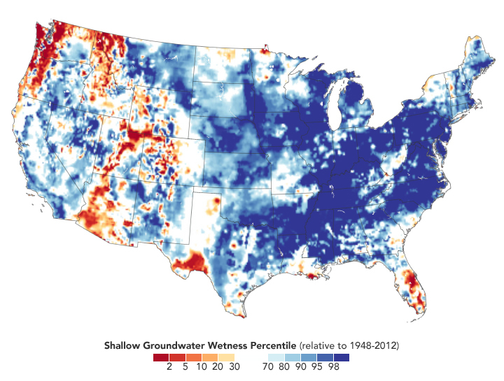
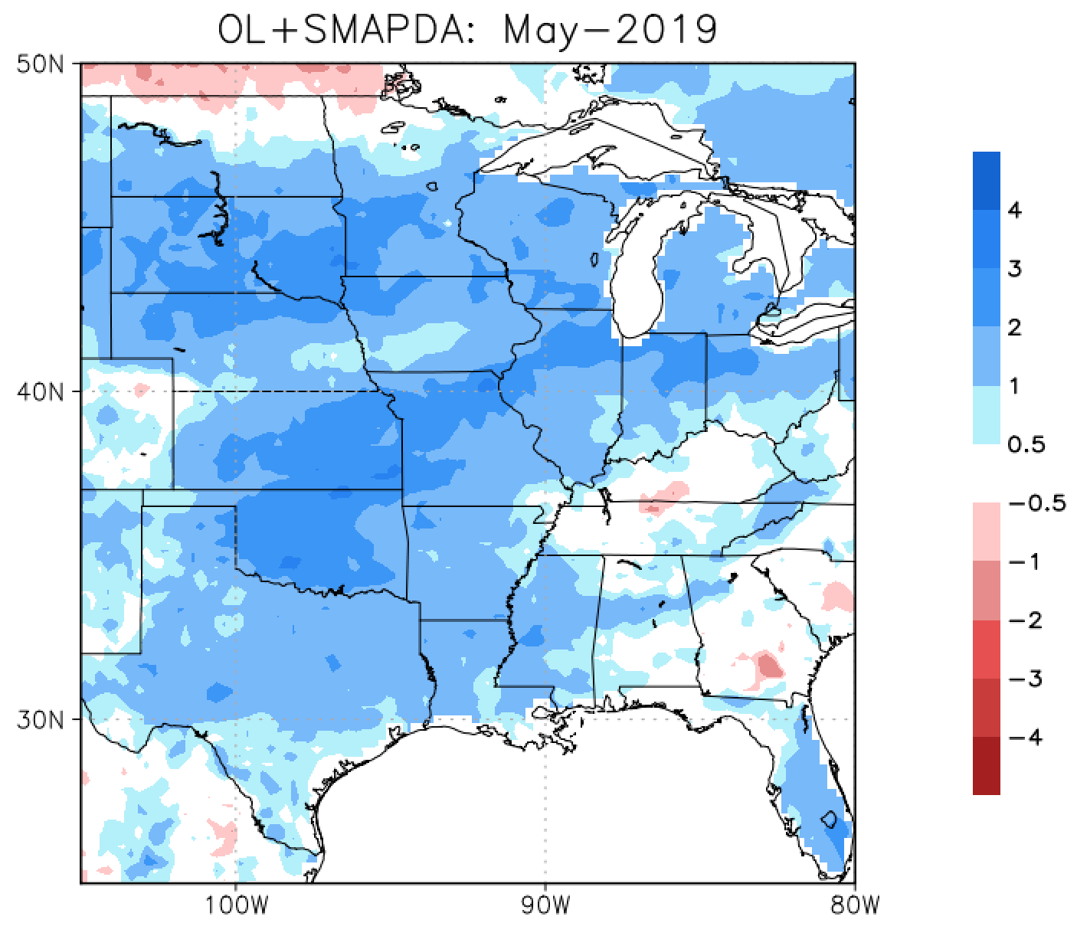
GHI Forecast Initial Conditions: Using SMAP for improved states example
Root-zone soil moisture (RZ-SM) standardized anomalies: Mississippi Floods, 2019
The Mississippi River Basin experienced some of the worst floods in 2019 (below-left). The SMAP data assimilation (DA) run (below-right) shows how the large area of RZ-SM was above average in May, 2019.
GLDAS-GRACE Assimilated Percentile: May 11-13, 2019
NASA’s SMAP soil moisture is assimilated into the GHI S2S modeling system to improve initial conditions for our seasonal forecasts.
From https://earthobservatory.nasa.gov/images/145101/record-setting-precipitation-leaves-us-soils-soggy
Data sources: https://www.weather.gov/lix/ms_flood_history; https://nasagrace.unl.edu
3-Sep-2026

Slide 9
GHI-S2S Hindcast Skill and Extreme Events
For hydrometeorological forecasts, much of the skill is derived from the S2S forecast initial conditions -- attributed to meteorological forcing analysis skill and observations (e.g., remotely sensed, in situ) assimilated into the LSM / hydrology models.
Hydrological ICs may represent an instance in time (e.g., 00Z instantaneous state values), but they carry the memory of antecedent conditions (ACs) months prior, leading up to the initialization, dependent on the type of event, region and variables.
Real-world examples are shown of GHI-S2S’ ability to incorporate antecedent atmospheric and land/hydrology conditions leading up to the S2S forecast initialization and what the combination reveal in predicting a variety of extreme, hazard-based events.

Slide 10
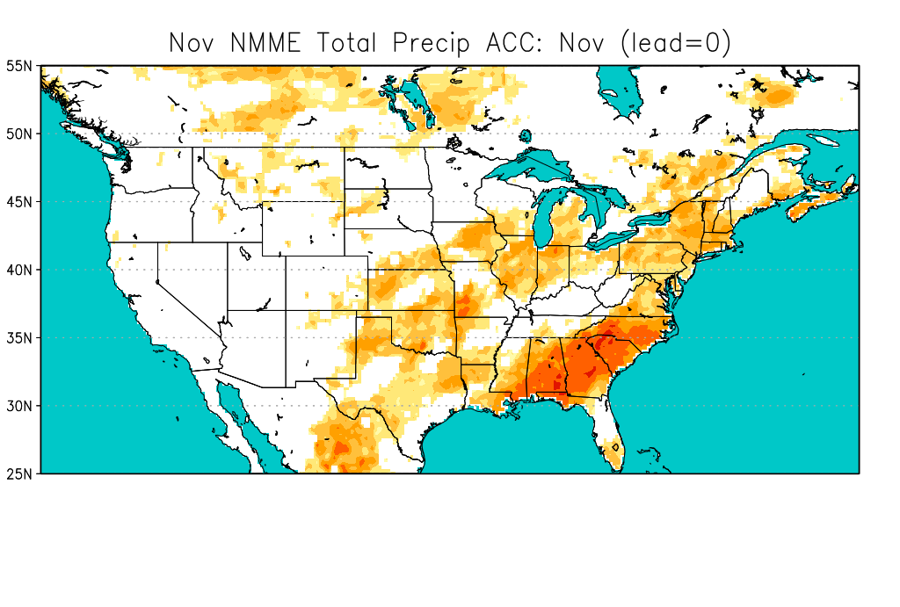
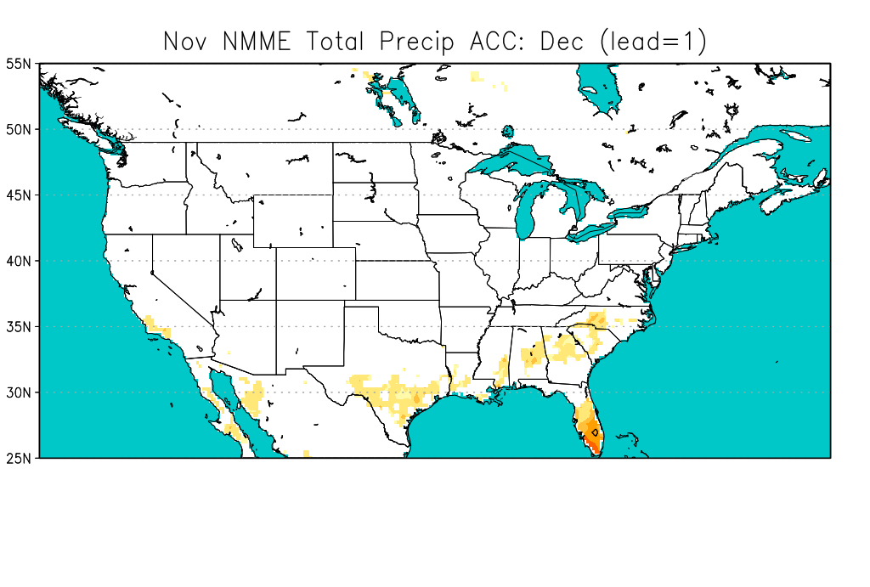
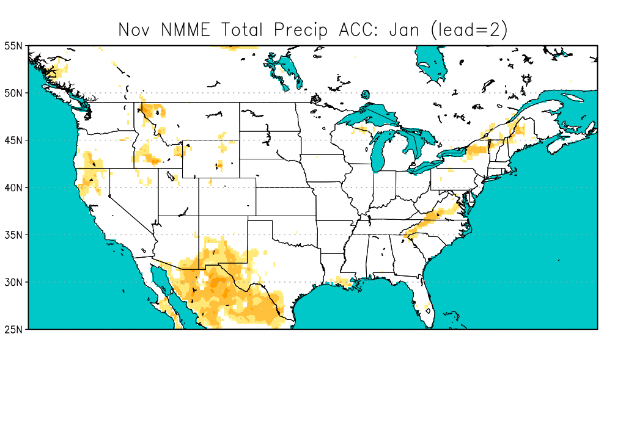
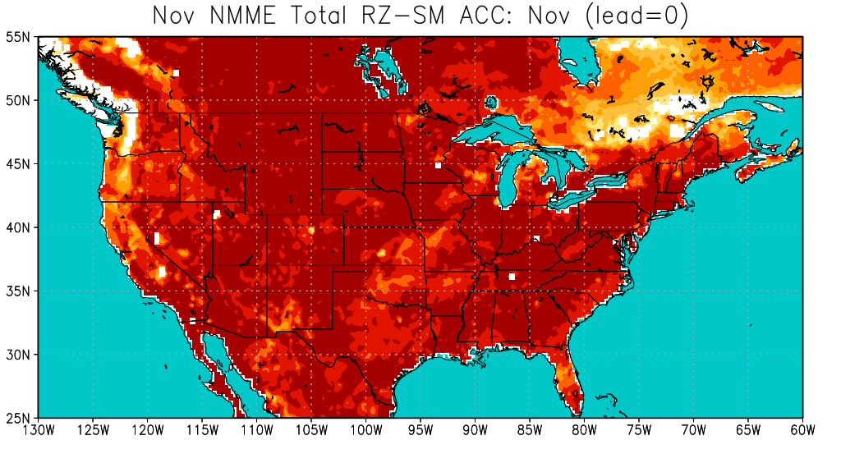
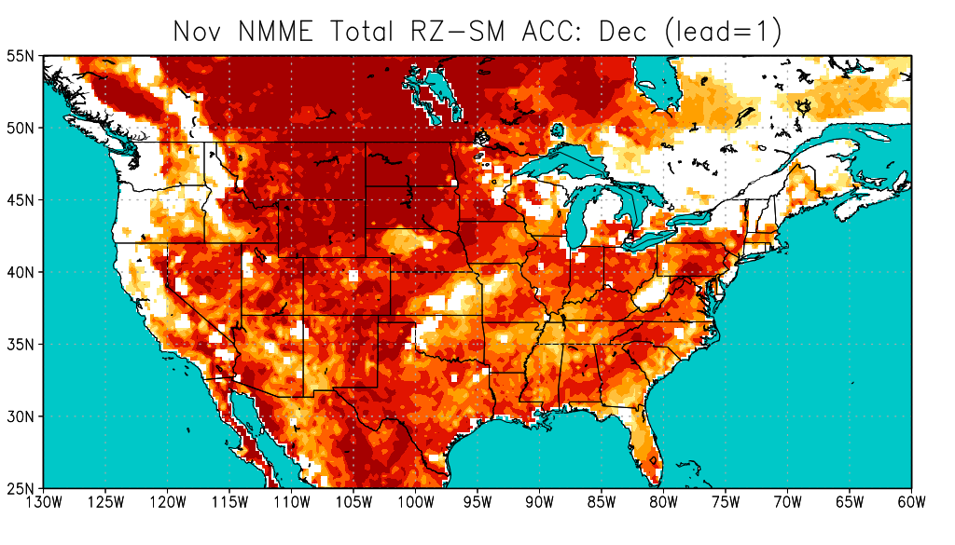
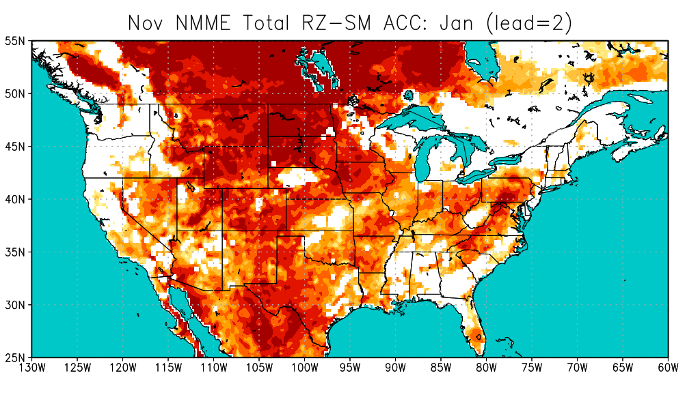
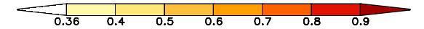
GHI S2S Hindcast Skill Example
Anomaly Correlation Coef. (ACC) Skill for GHI-S2S November Hindcasts: Total Precipitation and root-zone SM (RZ-SM)
(Period: 1991-2020)
Total Precipitation
Lead-0
Lead-1
Lead-2
RZ-SM
Lead-0
Lead-1
Lead-2
(ACC)
* Statistical significance (for S.L. @0.05) = any values >= 0.361. (dof = 28)

Slide 11
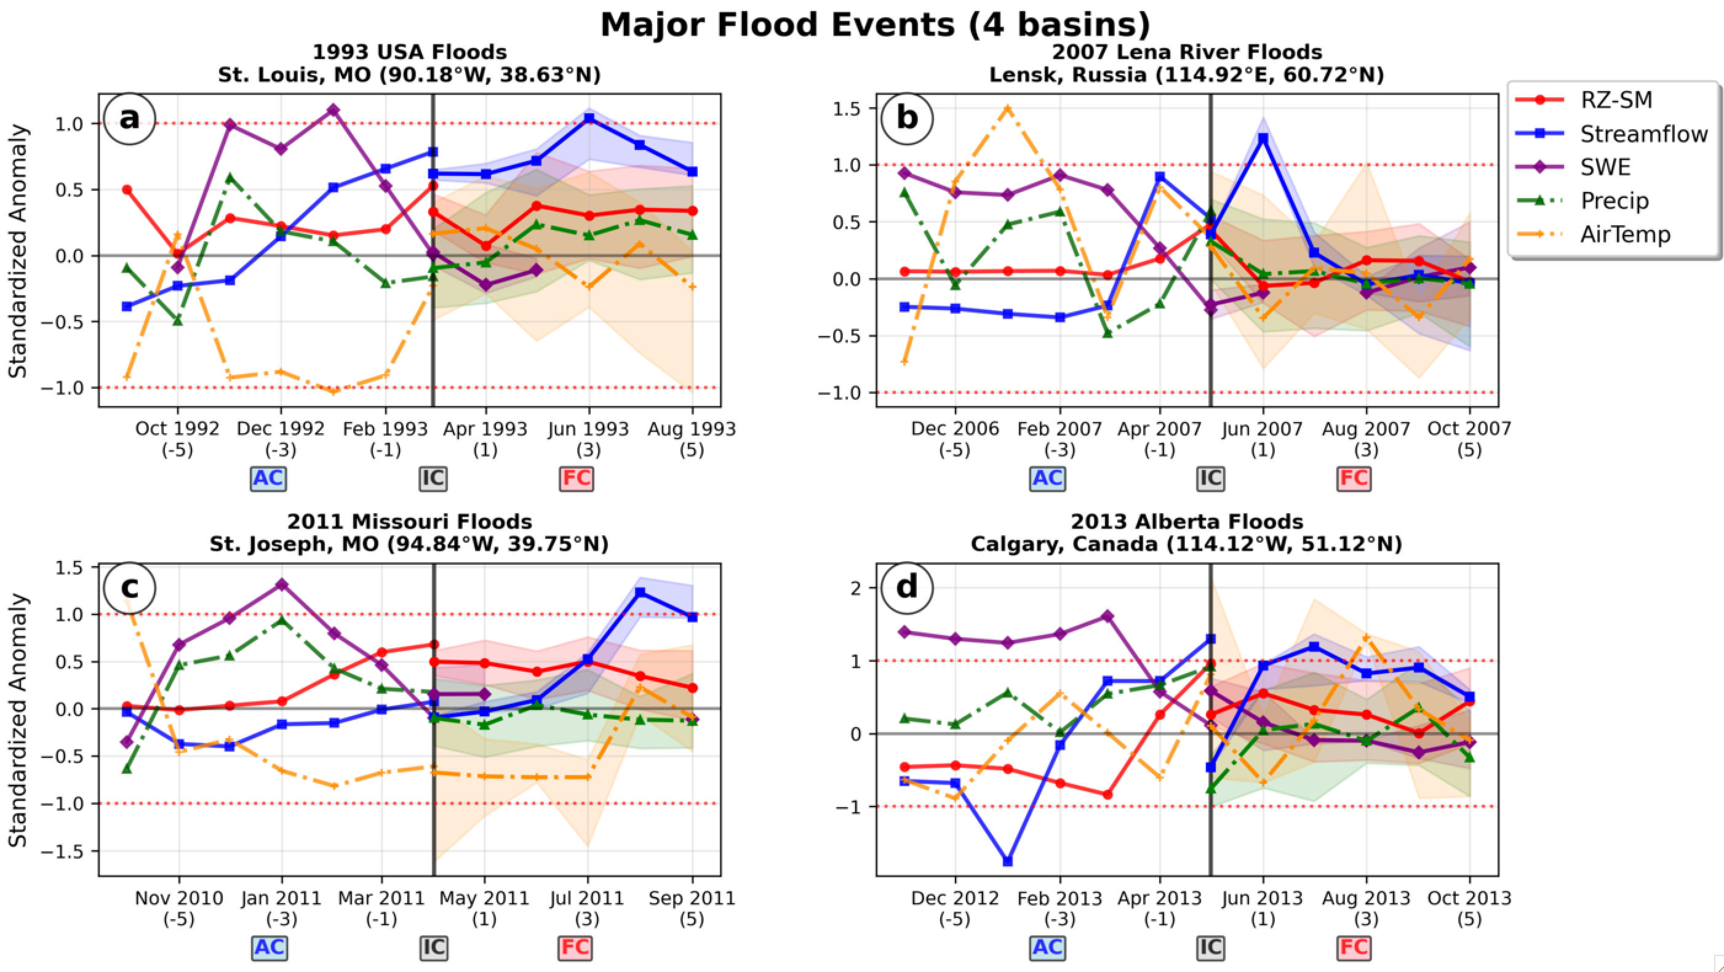
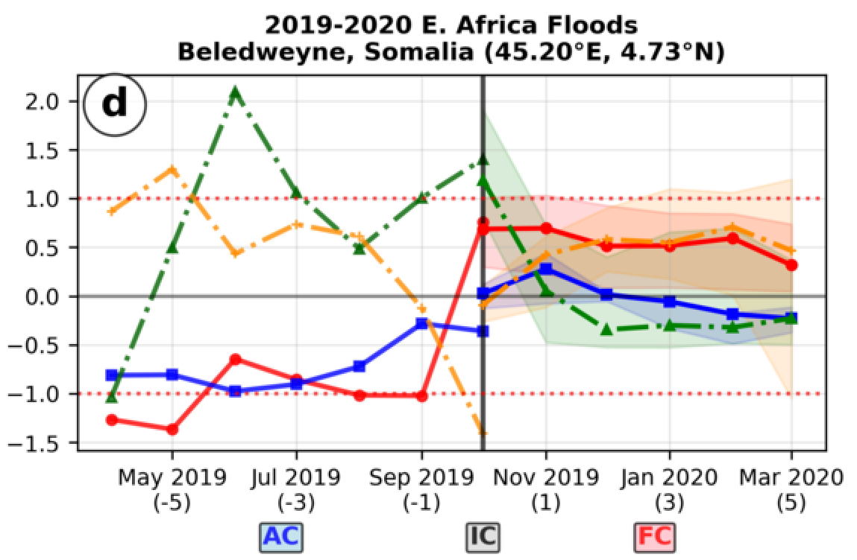
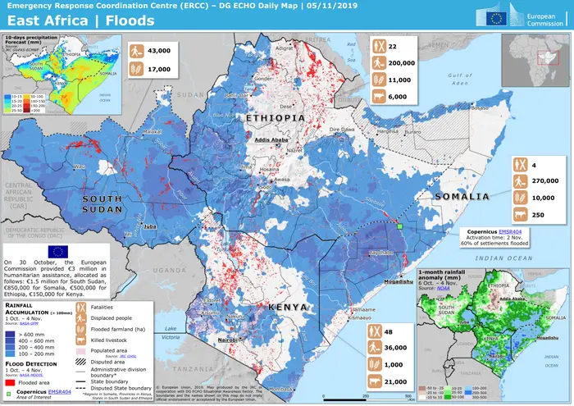
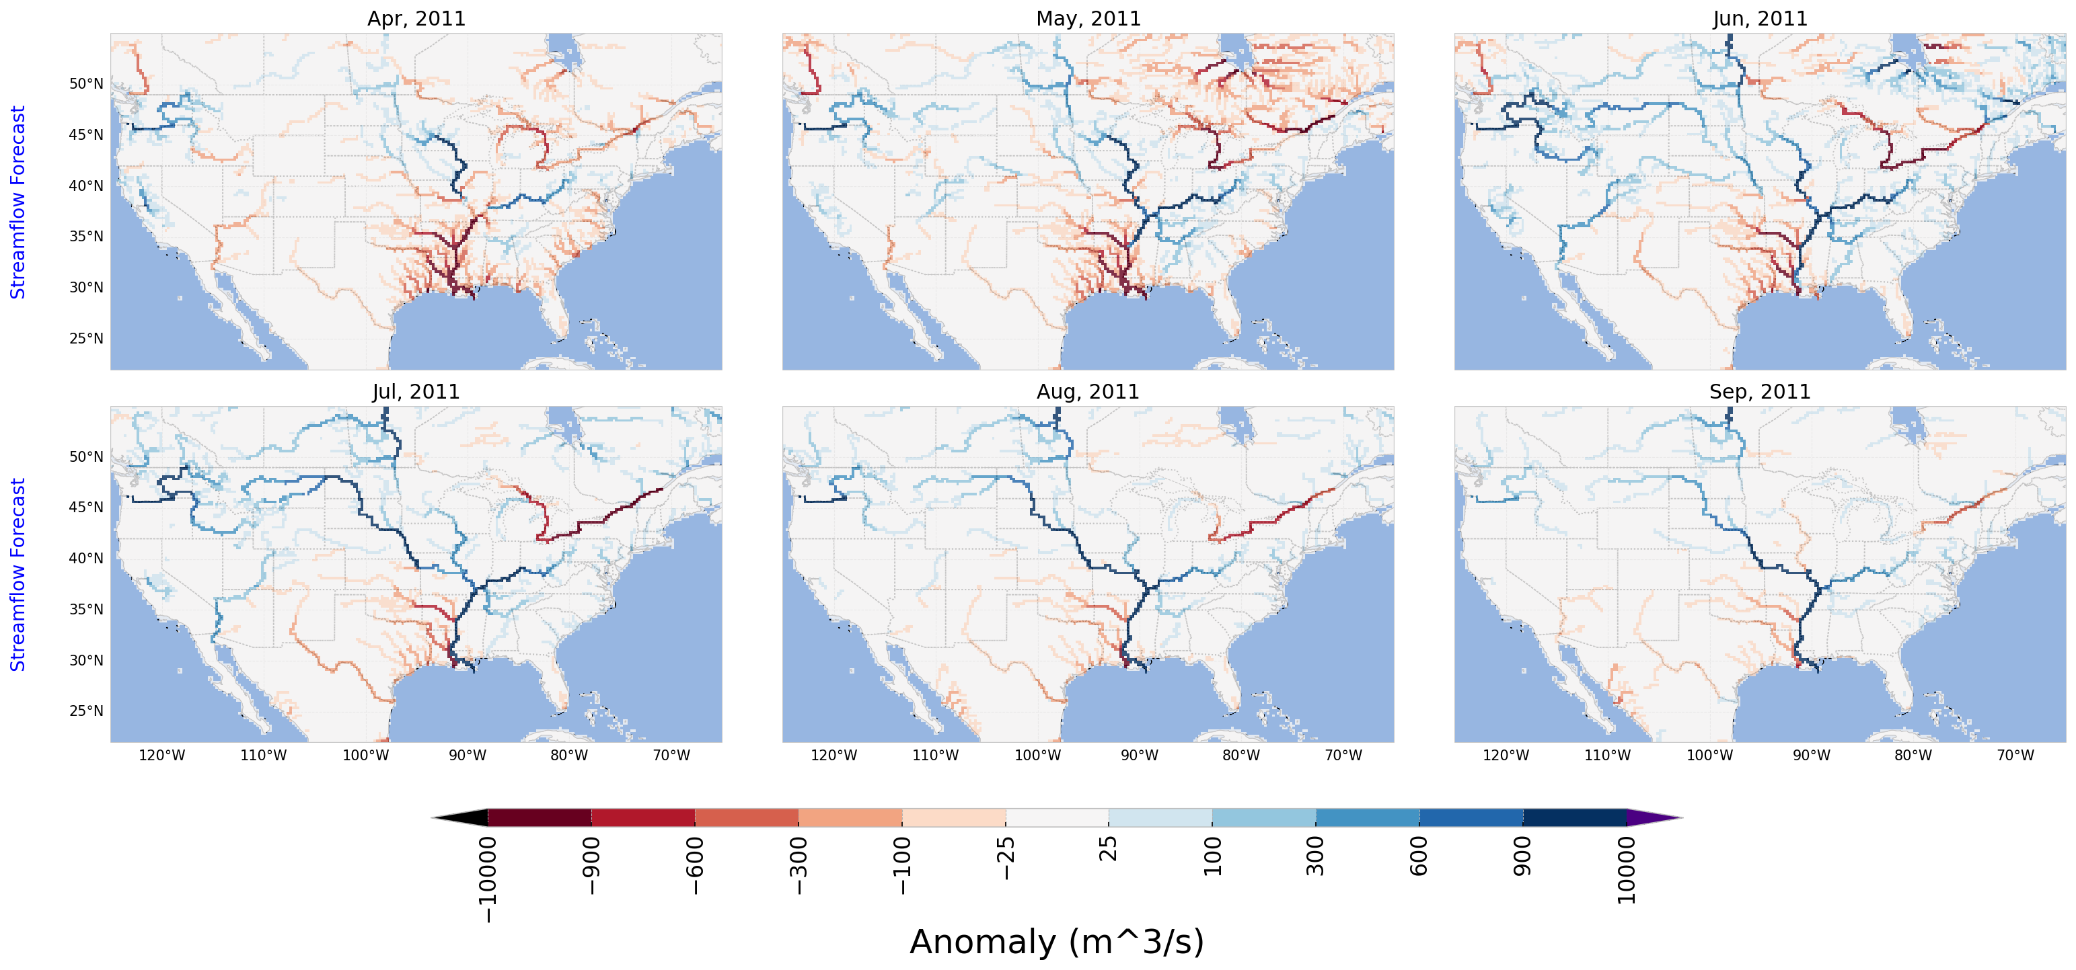
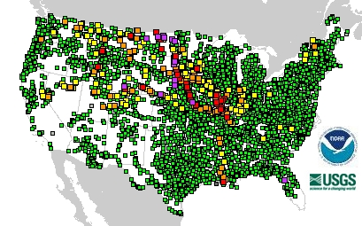
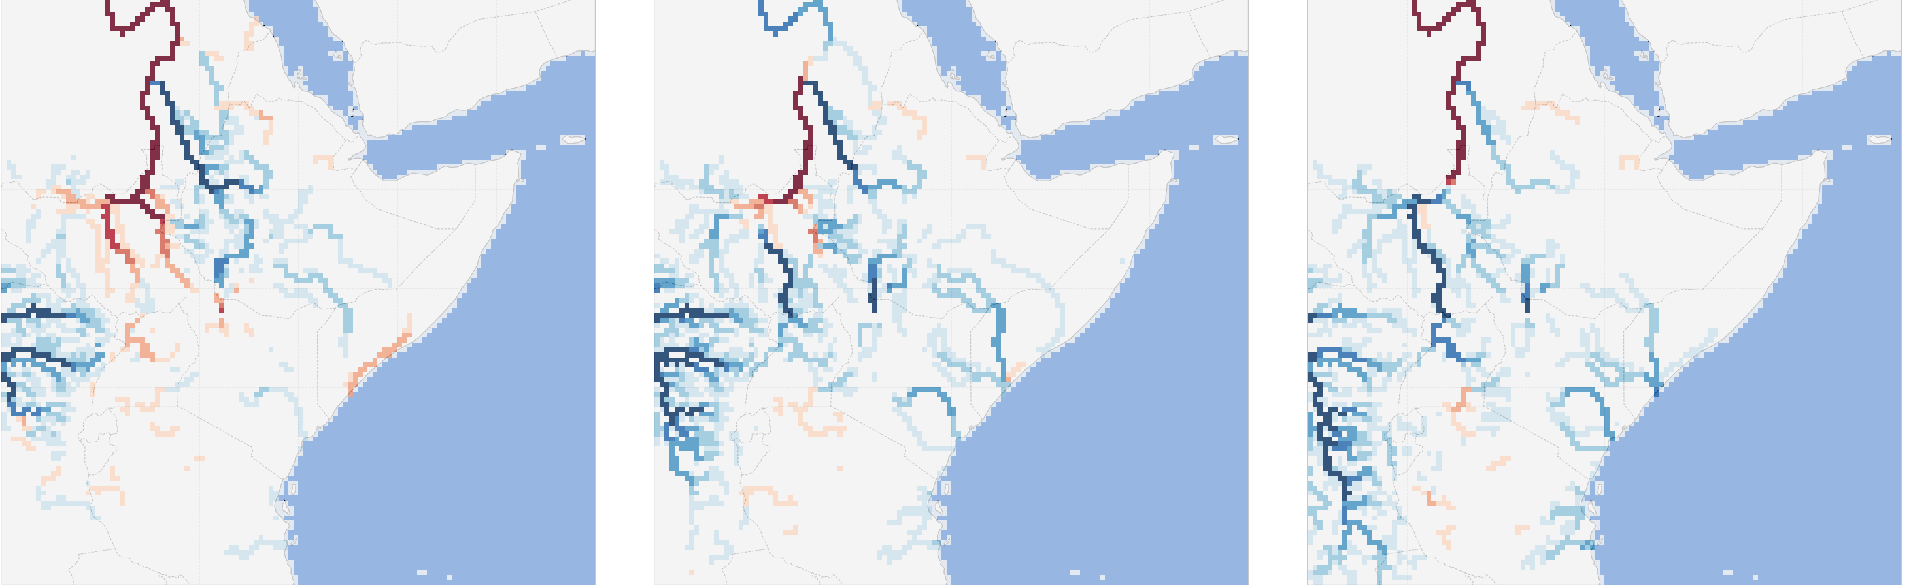
GHI S2S Flood Forecast Examples
GHI-S2S Oct-2019 IC Reforecast – Streamflow anomalies; Rain-related flood forecast of the Shabelle River, E. Africa
GHI-S2S April-2011 IC Reforecast – Streamflow anomalies; Snow-related flood forecast of the Missouri Basin
c)
Oct-2019 (leads = 0-2)
d)
Flooding areas – Nov-2019
a)
June-2011 (lead = 2)
b)
Flooding areas - June 18, 2011
Oct. Nov. Dec
https://en.wikipedia.org/wiki/2011_Missouri_River_Flood#/media/File:Missouri-flood1.jpg
https://reliefweb.int/map/somalia/east-africa-floods-dg-echo-daily-map-05112019
KEY:
AC = Antecedent condition months
IC = Initial condition date
FC = Forecast lead months
KEY:
Model states = solid lines
Atmospheric fields = dash-dot lines

Slide 12
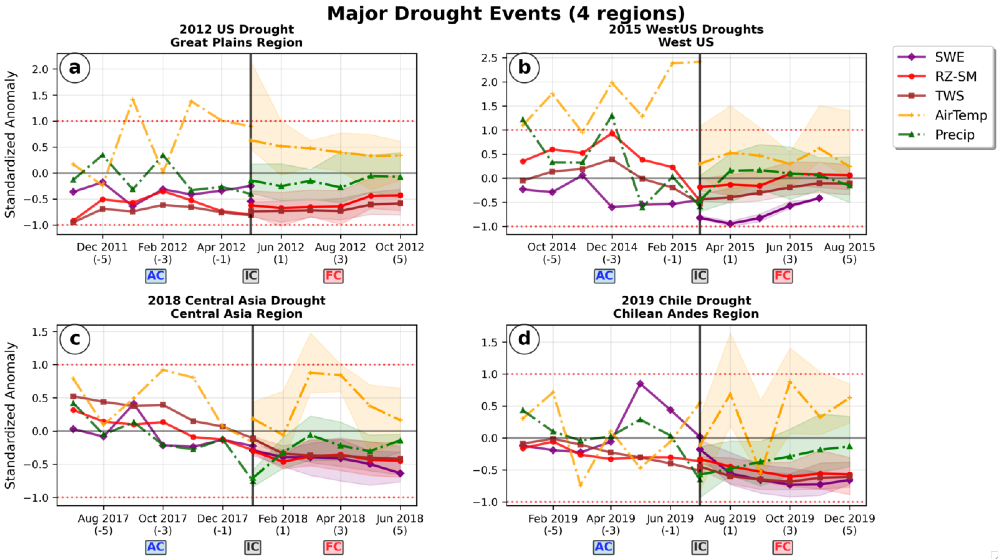
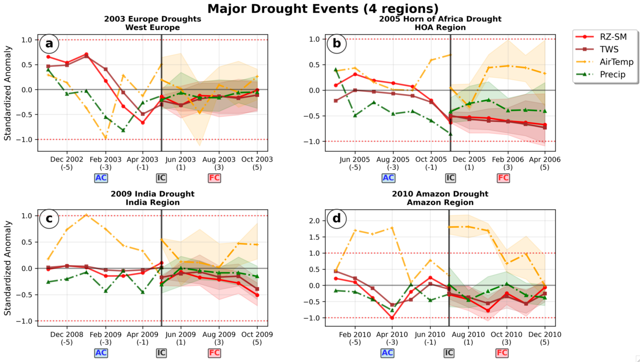
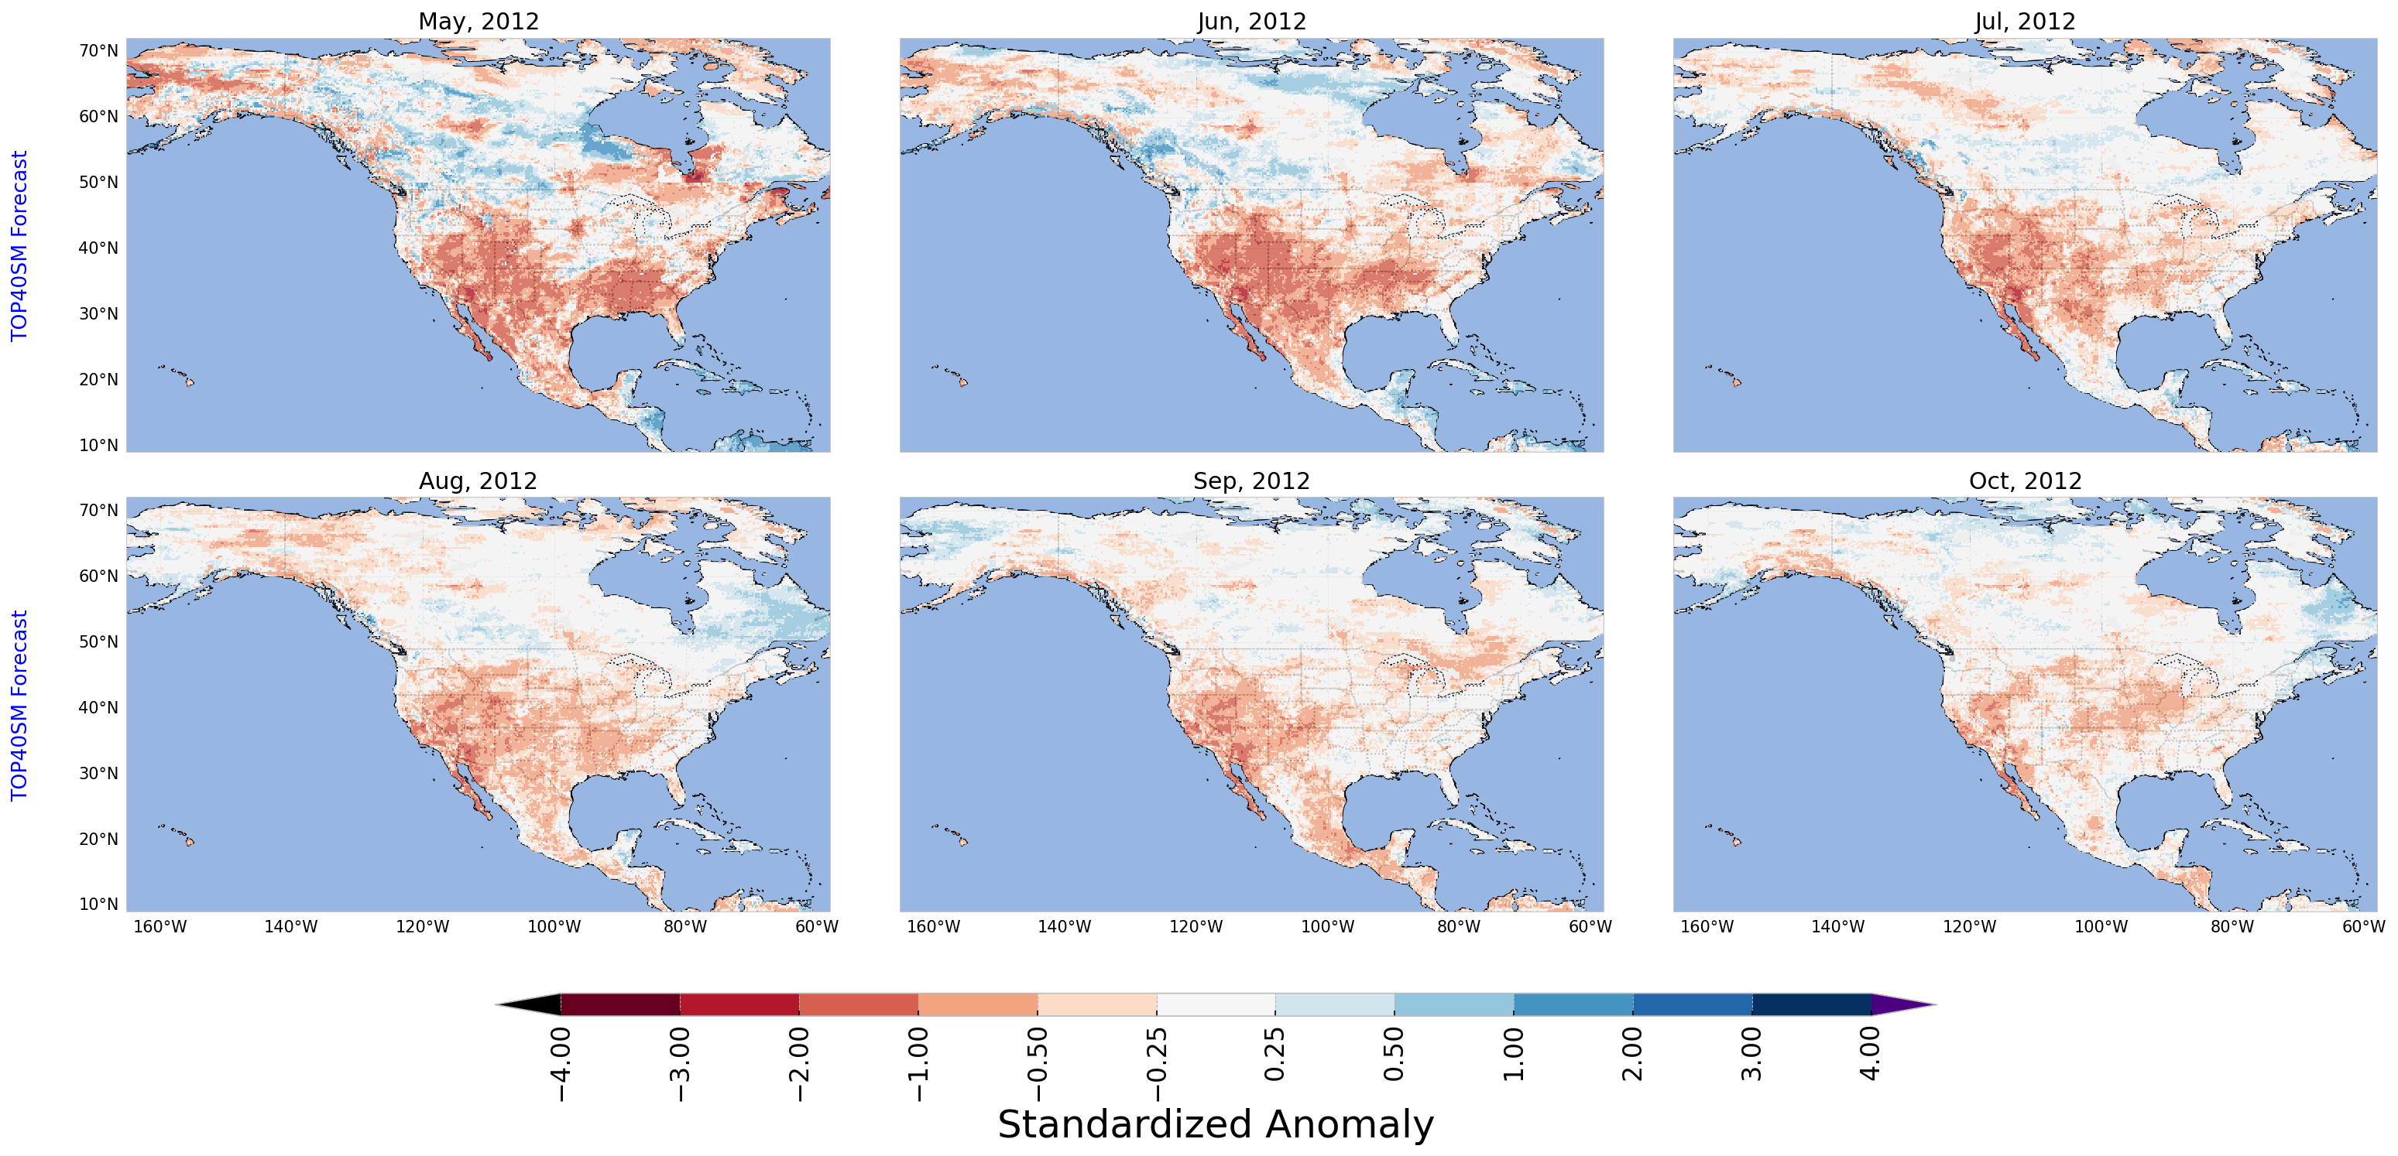
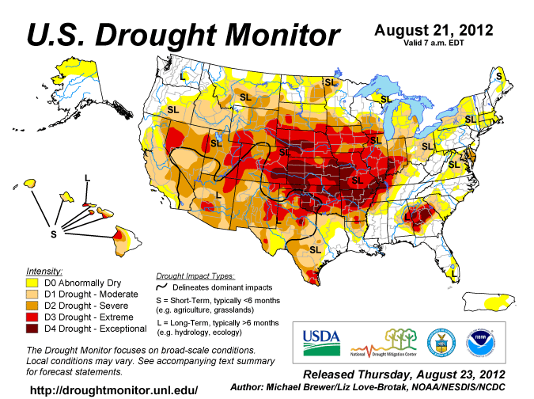
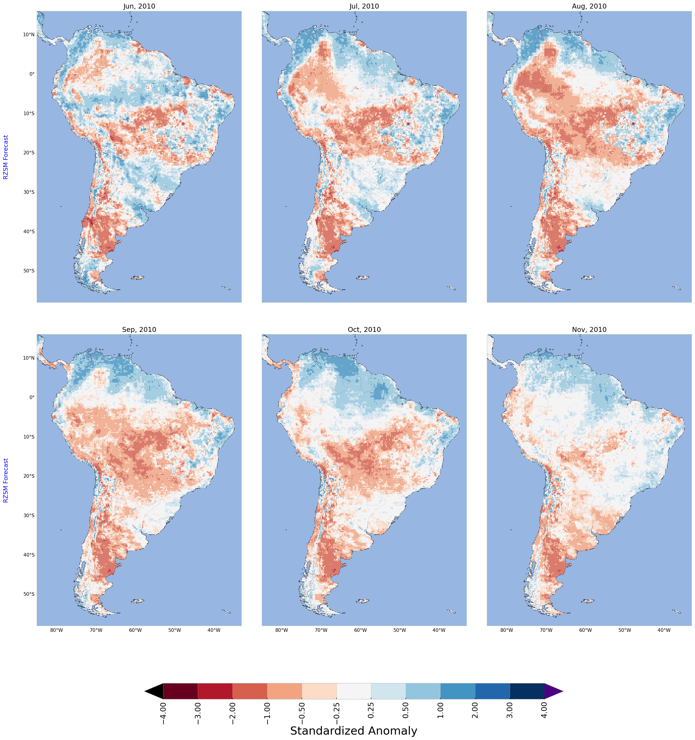
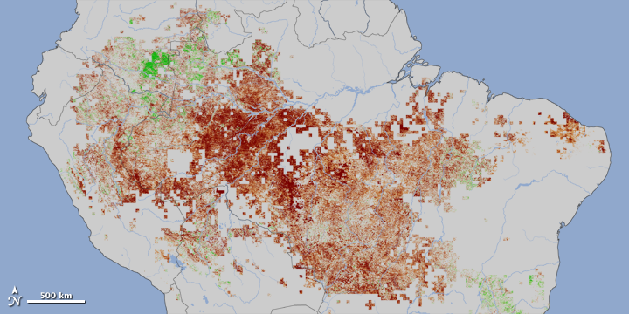
GHI S2S Drought Forecast Examples
GHI-S2S Jun-2010 IC Reforecast –
Root-zone SM anomalies; Amazon Basin Drought
GHI-S2S May-2012 IC Reforecast – Top 40-cm SM anomalies; North American Drought
May-2012 IC, Jun-Aug forecast
(leads=1-3)
Vegetation anomaly for Jul-Sep, 2010
a)
June-2010 IC, Jun-Aug forecast
(leads=0-2)
b)
c)
Top 40 cm SM
d)
US Drought Monitor – Aug 21
Root-zone SM
Jun Jul Aug
Terra/MODIS vegetation anomalies between July- Sept, 2010 compared to average conditions for same period, 2000-2009 (except for 2005, another drought year).
Jun July
Aug
https://en.wikipedia.org/wiki/2012%E2%80%932013_North_American_drought#/media/File:Current-USDM.gif
https://earthobservatory.nasa.gov/images/50136/2010-drought-in-the-amazon-forest

Slide 13
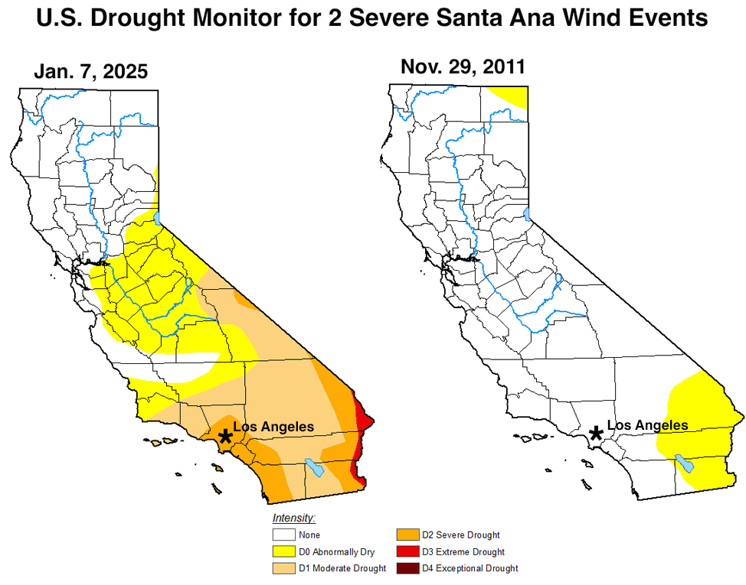
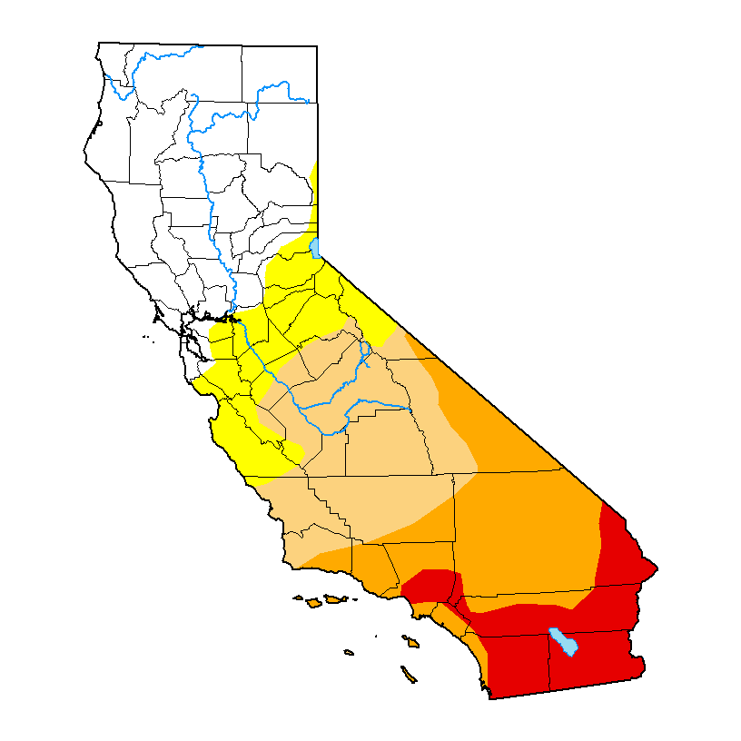
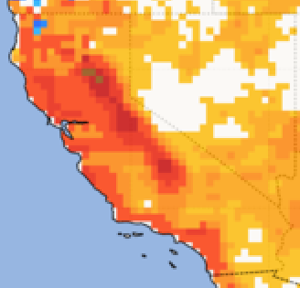
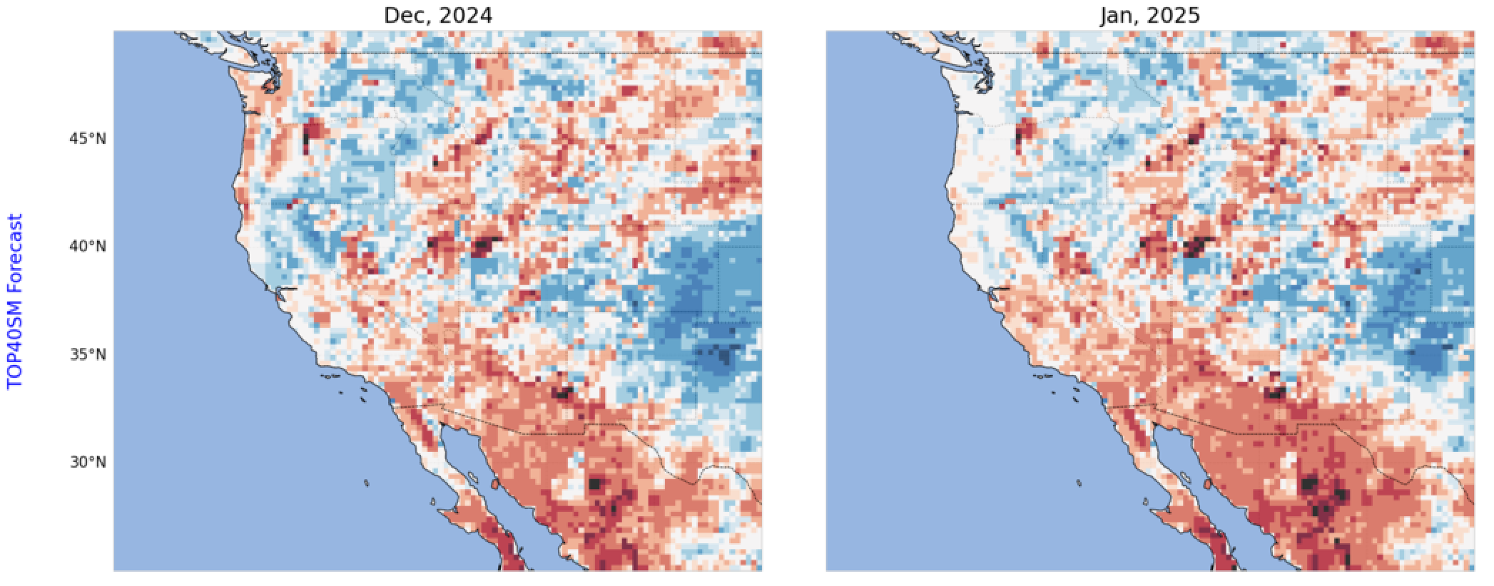
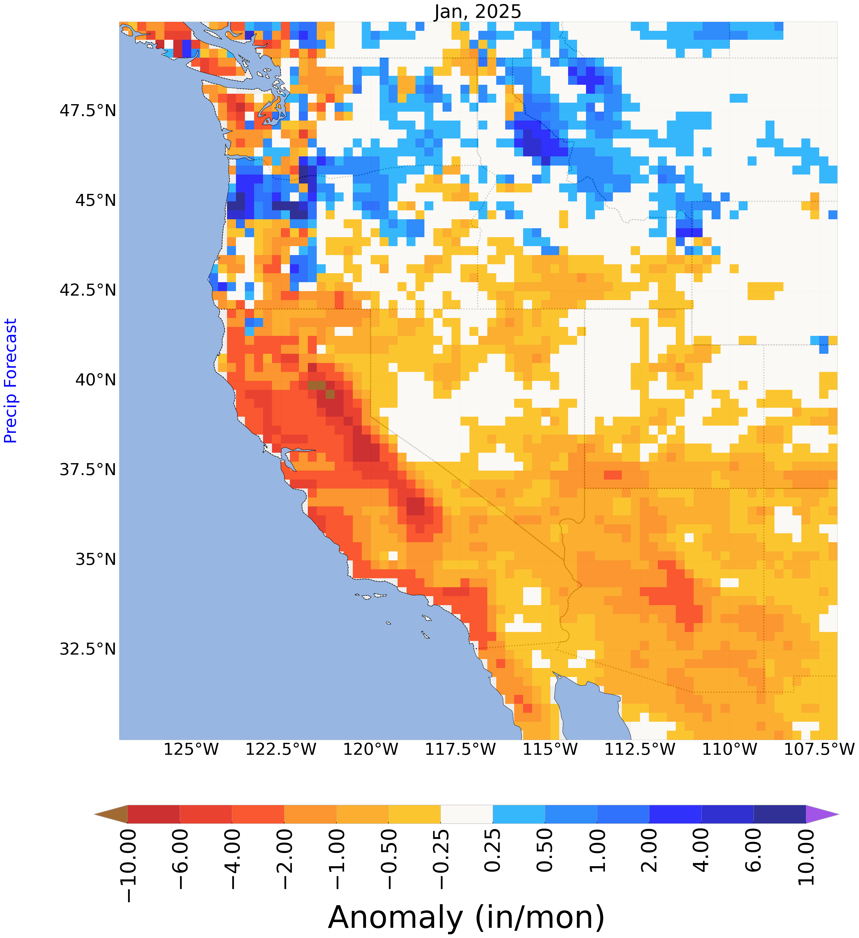
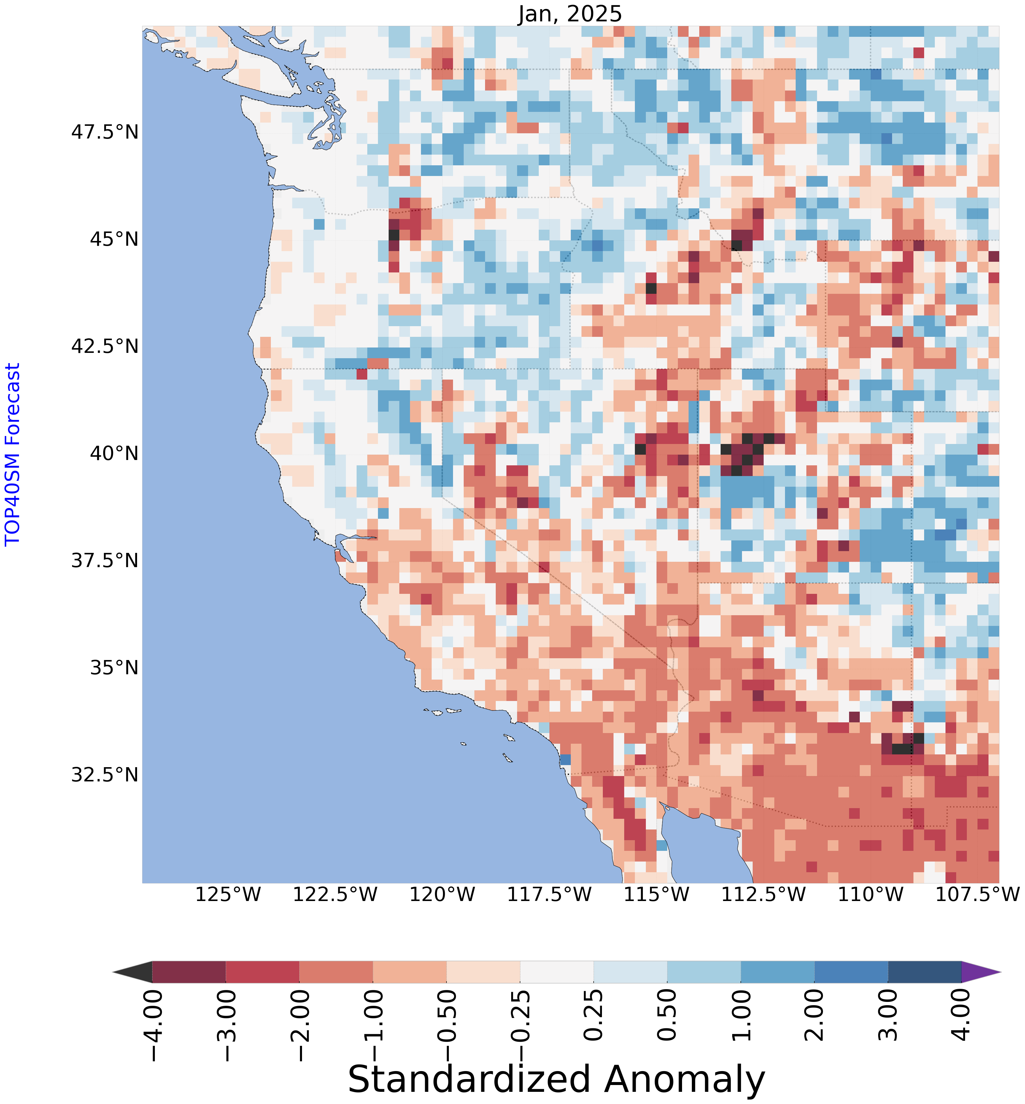
Forecasting Antecedent Conditions of Extreme Events
GHI-S2S forecasts of dry conditions for the California / LA Fires
Dec-1-2024 forecast, Lead 1(below) = Jan-2025
Forecast for Jan-2025, initialized on 1-Dec-2024
U.S. Drought Monitor
Jan 7, 2025
Jan 30, 2025
GHI Precip Anomaly
GHI Top 40-cm SM Std Anomaly
LA
LA
Lead-1
Lead-1
https://droughtmonitor.unl.edu/Maps/MapArchive.aspx

Slide 14
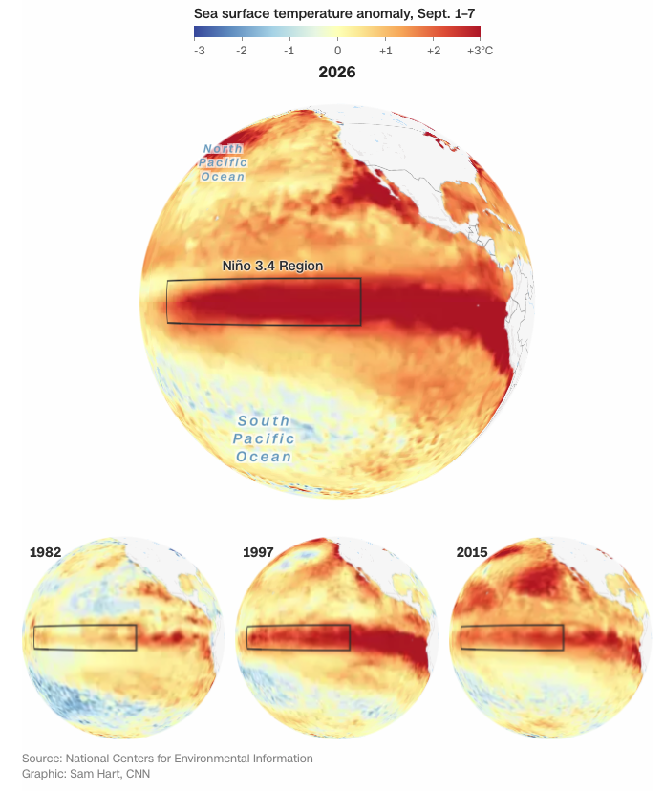
GHI-S2S Forecast Skill and Latest El Niño Event
For the past 6-months, many agencies, observations and models around the world have all pointed to what is being deemed as a “Super” El Niño event.
Recent sea surface temperature (SST) anomalies are showing the most severe positive anomalies out of the last 4 strongest events (see right figure).
Current observed conditions show extreme warmth in the Pacific Ocean … months ahead of the biggest peak ever forecasted.
Niño 3.4 Region SST Anomalies for 2026 and Past Events
Source: https://www.cnn.com/2026/09/14/weather/super-el-nino-forecast-strength-climate

Slide 15
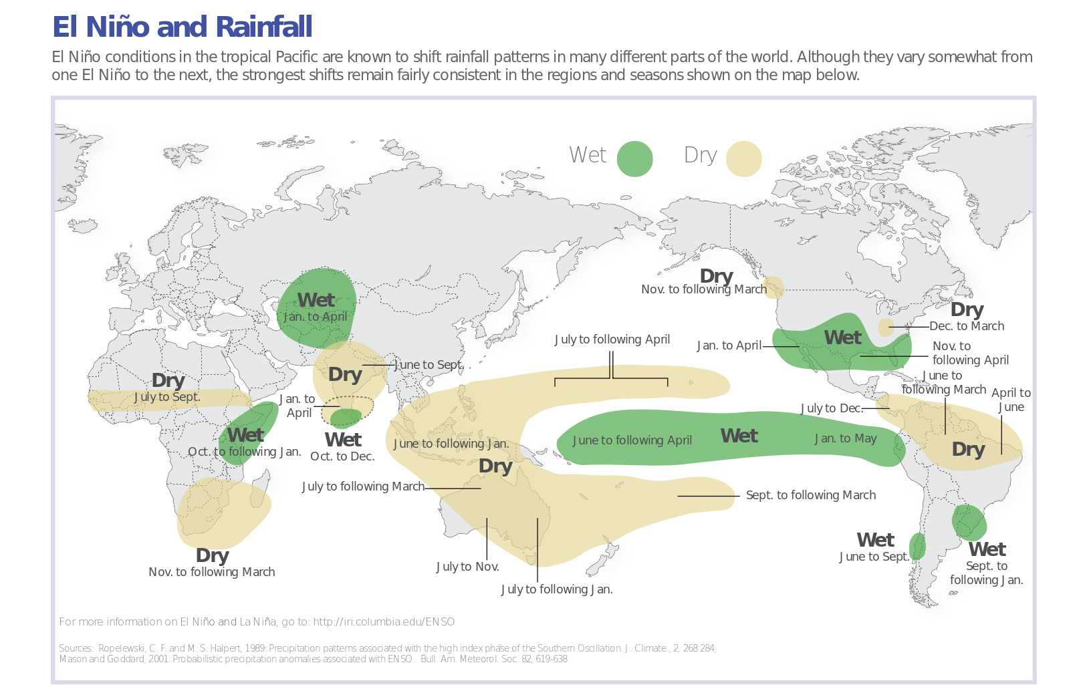
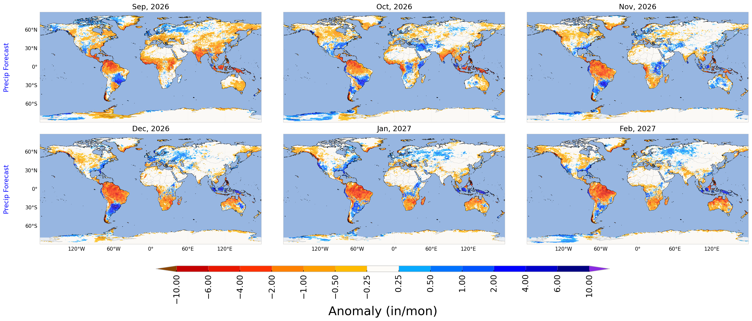
El Niño Precipitation Anomaly Patterns – GHI-S2S Forecast (Sep-1-2026 Initial Condition example)
Sep-1-2026 IC Forecast: Lead Mon = 2 (November)
Credit: IRI; downloaded from https://www.noaa.gov/understanding-el-nino

Slide 16
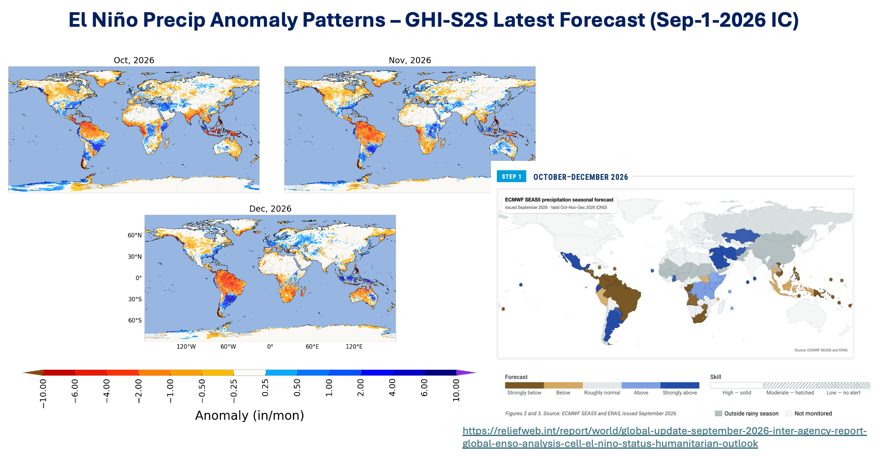
ECMWF SEAS5 – Oct-Dec Forecast for Precipitation
(Initialized in Sept-2026; Below)

Slide 17
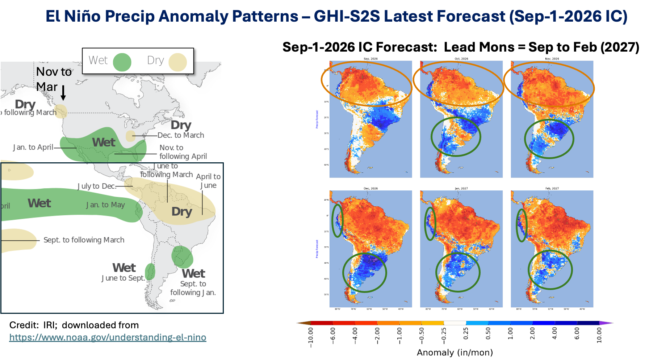
El Niño Precipitation Anomaly Patterns – GHI-S2S Forecast (Sep-1-2026 Initial Condition example)

Slide 18
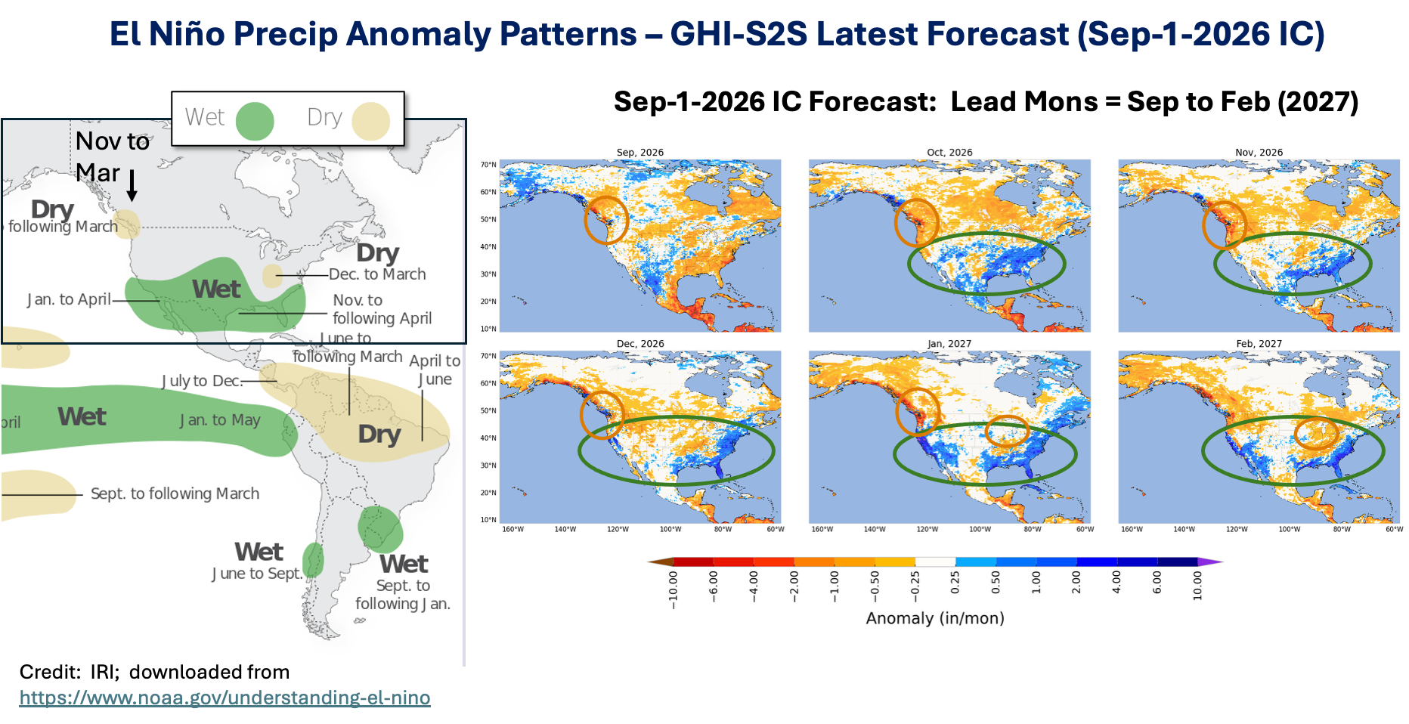
El Niño Precipitation Anomaly Patterns – GHI-S2S Forecast (Sep-1-2026 Initial Condition example)

Slide 19
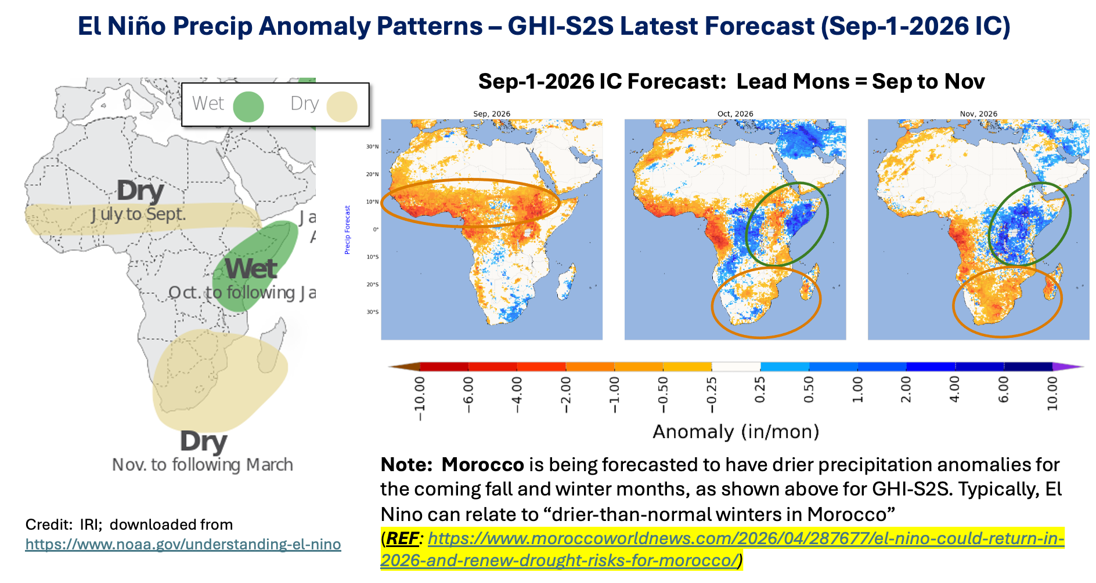
El Niño Precipitation Anomaly Patterns – GHI-S2S Forecast (Sep-1-2026 Initial Condition example)

Slide 20
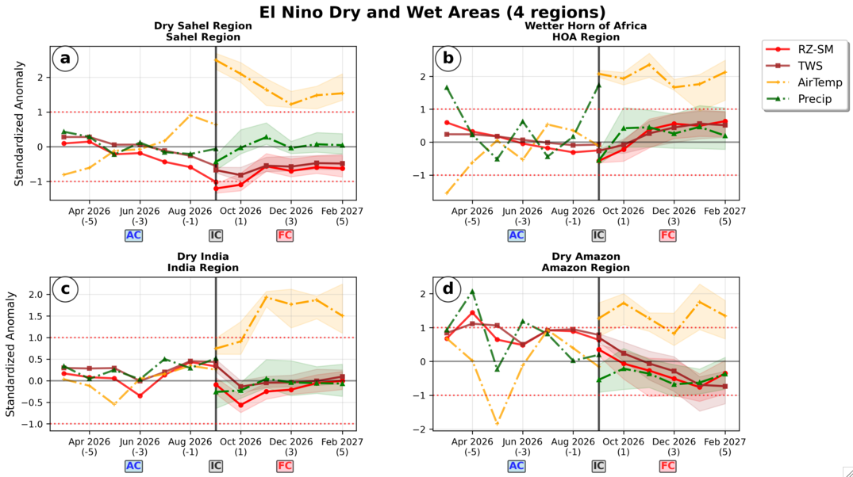

Slide 21
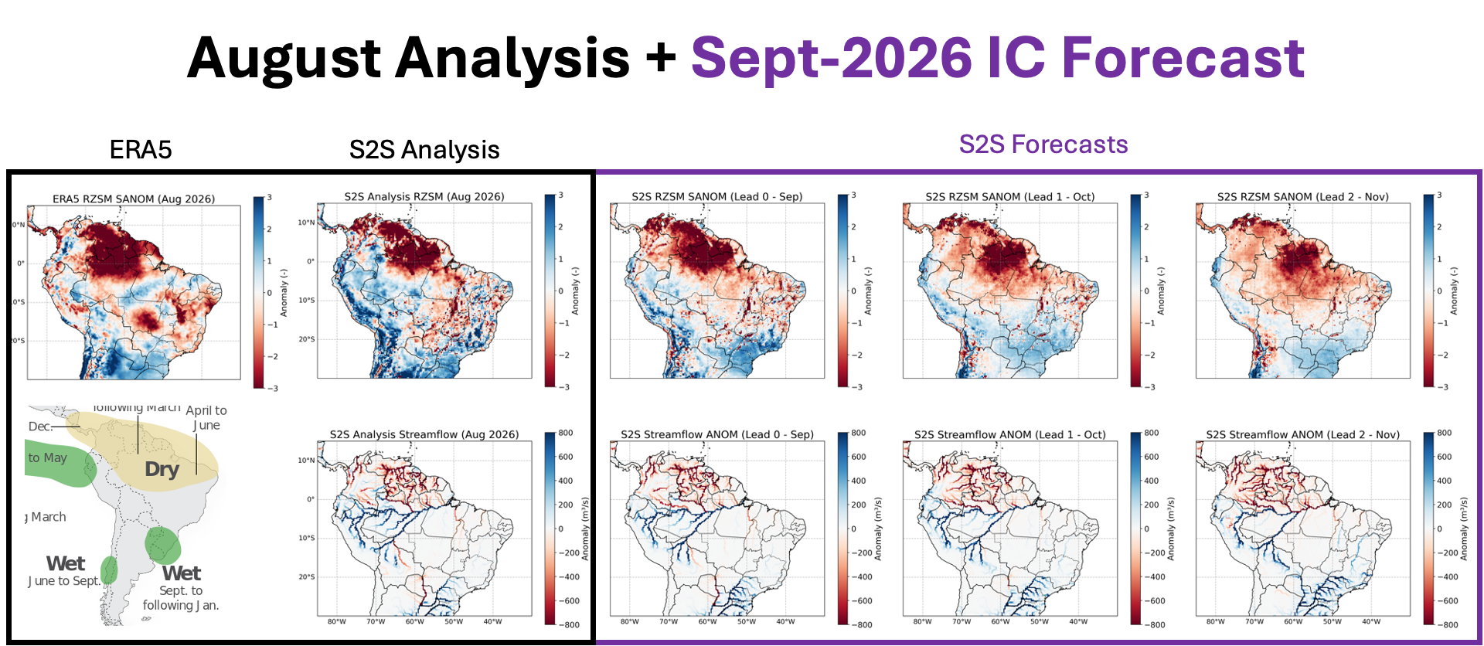

Slide 23

Acknowledgements and References
Thank you!
Financial support from the U.S. Air Force Life Cycle Management Center Weather Systems Branch (AFLCMC/HBAW).
Computing was supported by the resources at the NASA Center for Climate Simulation (NCCS) and DoD High Performance Computing Modernization Program.
NAFPA (Kemp et al., 2022): https://doi.org/10.1175/JHM-D-21-0228.1
USAF-SI (Yoon et al., 2022): https://doi.org/10.1016/j.rse.2022.113080
LIS website: https://lis.gsfc.nasa.gov/
LIS (Kumar et al., 2006): https://doi.org/10.1016/j.envsoft.2005.07.004
LDT (Arsenault et al., 2018): https://doi.org/10.5194/gmd-11-3605-2018
LVT (Kumar et al., 2012): https://doi.org/10.5194/gmd-5-869-2012
HyMAP (Getirana et al., 2012): https://doi.org/10.1175/JHM-D-12-021.1

