Slide 1
Software Installation
James Geiger
NASA/GSFC Code 535/617

Slide 2
Software Installation
Terminology
LISF is Land Information System Framework
  LISF is made of LDT, LIS, and LVT
LDT is Land Data Toolkit
  It preprocess data for LIS
LIS is Land Information System
  It performs the actual science
LVT is Land surface Verification Toolkit
  It postprocesses and analyzes results from LIS
Sometimes we say LIS when we mean LISF
Resources
  LIS website - https://lis.gsfc.nasa.gov
  GitHub site - https://github.com/NASA-LIS/LISF
  On-line documentation - https://nasa-lis.github.io/LISF
  We will discuss these resources again later in this workshop
Technical requirements
  LISF runs on Linux-based operating systems
    Ubuntu; RedHat Enterprise Linux (RHEL); SUSE Linux Enterprise Server (SLES); Cray
  Intel and AMD CPU
  GNU compilers; Intel compilers; Cray compilers
  MPI for distributed processing (MPICH, Intel MPI, Cray MPI)

Slide 3
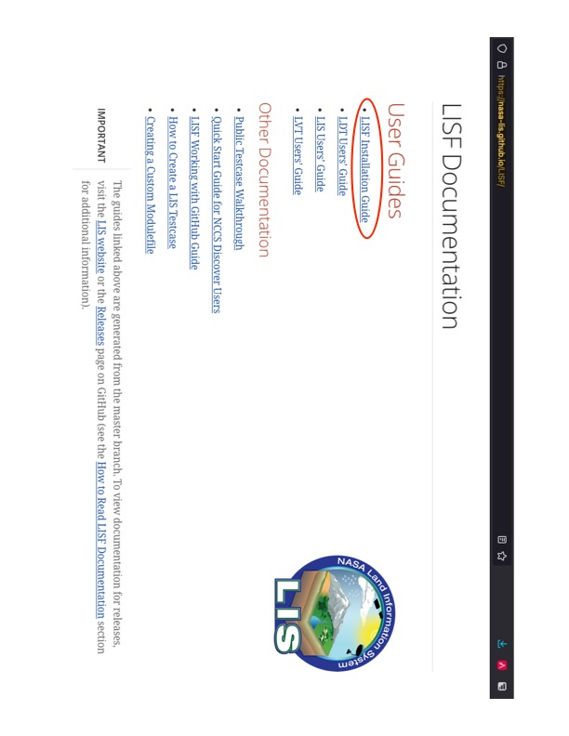
Software Installation
Notes:
The information that I will present next is explained in this document.

Slide 4
Software Installation
  Before you can compile/install LISF (LDT, LIS, and LVT), you must install several libraries. The LISF Installation Guide provides specific information regarding these libraries.
  HDF5
  NetCDF (c and Fortran)
  OpenJPEG
  ecCodes
  HDF4
  HDFEOS2
  ESMF
  SQLite
  PROJ
  libgeotiff
  GDAL
  FortranGIS
  PETSc
It is assumed that your computing system already has the MPI libraries installed.

Slide 5
Software Installation
  In general, these libraries must be installed manually, not via operating system (OS) packages nor pre-existing modules. Several reasons are:
  Packages/modules are missing Fortran support.
  Packages/modules contain incompatible Fortran support.
  Packages/modules are missing support required by LISF. For example, you must enable NetCDF support in ESMF.
  Packages/modules are not compatible with each other. For example, the HDF4 package could have NetCDF support enabled, which is old, and it conflicts with the NetCDF package.
Notes:
I am frequently asked, ”Do I have to install all these libraries manually? My computer already has X installed.” You can try to use any existing libraries on your computer, but you may encounter one of these problems. And you may not encounter any of these problems until you compile and/or run LISF.

Slide 6
Software Installation
  After all the above libraries have been installed, you must set several environment variables to compile LISF. The LDT Users Guide, LIS Users Guide, and LVT Users Guide provide specific information regarding these environment variables. In particular, see the Building the Executable section in each Users Guide.
  These environment variables are used by LISF’s build scripts find the above installed libraries.
  Compiling any of the LISF executables is a two-step process. First, you must run the configure script. This step prompts the user for configuration options and then builds a Makefile used in the second step. Second, you must run the compile script. The step performs the actual compilation, building the executable.

Slide 7
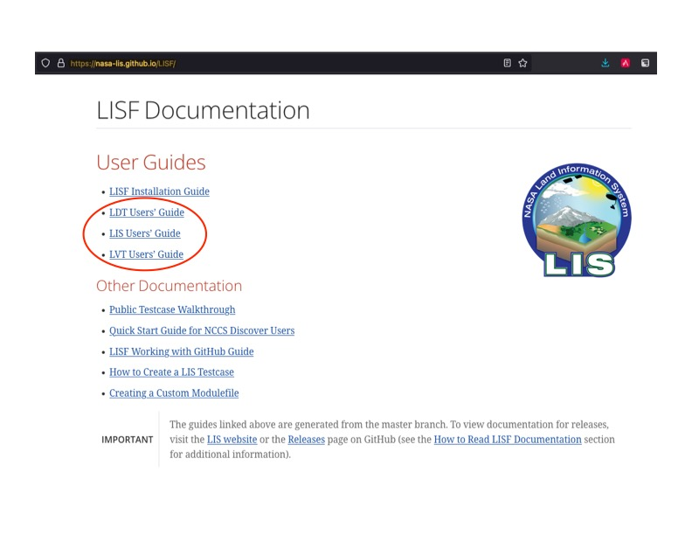
Software Installation
Notes:
The information that I will present next is explained in these documents.

Slide 8
Software Installation
  For this example, we will compile LDT. First, set these environment variables following the instructions in the LDT Users Guide.
  LDT_FC
  LDT_CC
  LDT_MODESMF
  LDT_LIBESMF
  LDT_OPENJPEG
  LDT_ECCODES
  LDT_NETCDF
  LDT_HDF4
  LDT_HDF5
  LDT_HDFEOS
  LDT_GDAL
  LDT_FORTRANGIS
  LDT_LIBGEOTIFF
  LDT_JPEG
  LDT_LIBTIFF
  LDT_LIBJBIG
  LDT_LIBLZMA
  LDT_RPC

Slide 9
Software Installation
  Next, run the configure script:
  % ./configure
  ------------------------------------------------------------------------
  Setting up configuration for LDT
  Parallelism (0-serial, 1-dmpar, default=0):
  Optimization level (-3=strict checks with warnings, -2=strict checks, -1=debug, 0,1,2,3, default=2):
  Assume little/big_endian data format (1-little, 2-big, default=2):
  Use GRIBAPI/ECCODES? (0-neither, 1-gribapi, 2-eccodes, default=2):
  NETCDF version (3 or 4, default=4)?:
  NETCDF use shuffle filter? (1-yes, 0-no, default = 1):
  NETCDF use deflate filter? (1-yes, 0-no, default = 1):
  NETCDF use deflate level? (1 to 9-yes, 0-no, default = 9):
  Use HDF4? (1-yes, 0-no, default=1):
  Use HDF5? (1-yes, 0-no, default=1):
  Use HDFEOS? (1-yes, 0-no, default=1):
  Enable GeoTIFF support? (1-yes, 0-no, default=1):
  Enable LIBGEOTIFF support? (1-yes, 0-no, default=1):
  Include date/time stamp history? (1-yes, 0-no, default=1):
  -----------------------------------------------------
  configure.ldt file generated successfully
  -----------------------------------------------------
  Settings are written to configure.ldt in the make directory.
  If you wish to change settings, please edit that file.
  To compile, run the compile script.
  ------------------------------------------------------------------------
  The LDT Users Guide provides guidance on these options.

Slide 10
Software Installation
  Finally, run the compile script:
  % ./compile
  This produces an executable named LDT. Copy this executable into your working directory. You are now ready to run LDT.
  You follow the same steps to produce the LIS and LVT executables.

Slide 11
Software Installation
  You must perform all those steps to compile LISF. This is important to learn, so you can make changes to the LISF source code, such as adding code to read and process your own data products, and then build new executables.
  If all you need is the default functionality in LISF, then you may use our AppImage-based container. This container contains all the libraries, environment variables, and executables ready to run. Please note that you must install the MPI libraries on your computing system.

Slide 12
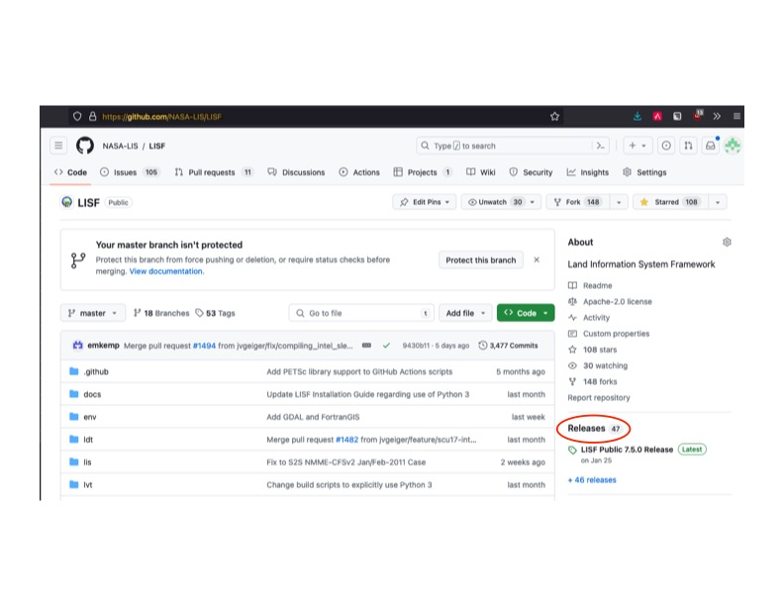
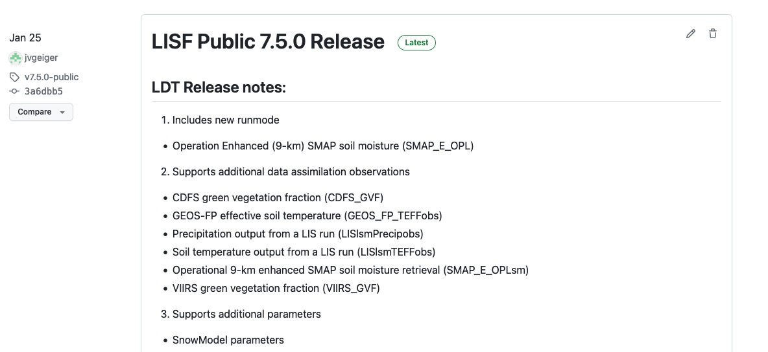
Software Installation
Notes:
AppImages are available from our GitHub site. Just follow the Releases link and look for Assets.

Slide 13
Software Installation
  Links:
  LIS web site https://lis.gsfc.nasa.gov
  GitHub site https://github.com/NASA-LIS/LISF
  LISF Installation Guide https://nasa-lis.github.io/LISF/LISF_installation_guide/LISF_installation_guide.html
  LDT Users Guide https://nasa-lis.github.io/LISF/LDT_users_guide/LDT_users_guide.html
  LIS Users Guide https://nasa-lis.github.io/LISF/LIS_users_guide/LIS_users_guide.html
  LVT Users Guide https://nasa-lis.github.io/LISF/LVT_users_guide/LVT_users_guide.html

Slide 14
Software Installation
  Thank you.

Slide 15
AWS
  IMPORTANT: Every time that you log onto your AWS instance, run
  % source /mnt/efs/fs1/Workshop/lisf.env
  This sets some environment variables that allow the LISF AppImage container to run.
  To test the LISF container, run: LISF-x86_64.AppImage -h
  % LISF-x86_64.AppImage -h
  Usage: LISF-x86_64.AppImage [options] [-- LISF options]
  where [options] are:
  -h show this help message
  -v show revision info about LISF
  -i show configuration info about LISF
  -a <LDT|LIS|LVT> specify which app to run
  where [LISF options] are options to pass to LISF;
  these must be preceeded by --
  Example LISF-x86_64.AppImage -a LIS -- --file lis.config

Slide 16
AWS
  On some computing systems running LISF-x86_64.AppImage crashes with an error like:
  % ./LISF-x86_64.AppImage -h
  dlopen(): error loading libfuse.so.2
  AppImages require FUSE to run.
  You might still be able to extract the contents of this AppImage
  if you run it with the --appimage-extract option.
  See https://github.com/AppImage/AppImageKit/wiki/FUSE
  for more information
  Your computer either is missing the FUSE library or has an incompatible version. Please see the instructions on https://github.com/NASA-LIS/LISF/releases/tag/v7.5.0-public to work around this issue.

