Slide 1
Understanding mexico city’s boroughs

Slide 2
understanding local differences helps both businesses and individuals
When establishing themselves in a new city, businesses and individuals need a way to make decisions with limited knowledge
City layout, transportation, housing, and popular venues are indicators frequently used to locate desirable parts of the city
Businesses might want to identify locations where their target audience frequents
Individuals might look for affordable housing with transportation close by

Slide 3
Data
GPS data on Mexico City boroughs and metro stop locations were taken from Mexico City’s data portal, https://datos.cdmx.gob.mx/explore.
Median housing prices were found at the Propiedades website, https://propiedades.com/.
The 15 most popular venues in each borough were scraped from Foursquare.
A dataset was created by importing boroughs, metro, and housing data as .CSV files and venues data using the Foursquare API.

Slide 4
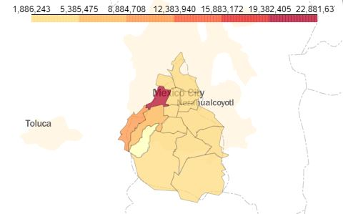
Mexico City boroughs
Mexico City has 16 boroughs, called alcaldías
Using the median housing price for each borough, I created a choropleth map
Prices are shown in Mexican pesos; the data range from a low of 1,886,243 MXN (98,297 USD) to a high of 22,881,637 MXN (1,192,430 USD)

Slide 5
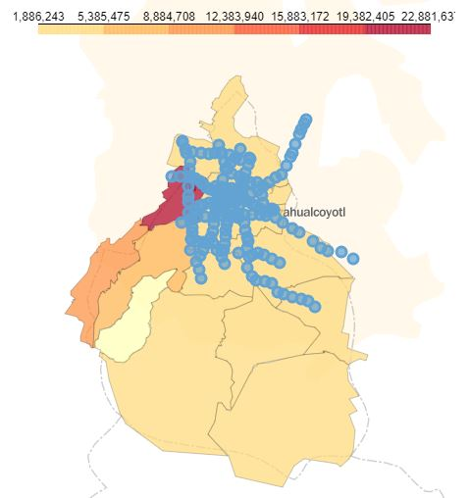
Metro data
Mexico City has an extensive metro system that is among the least expensive in the world, with the price of a one-way ticket at 5 pesos, or 25 US cents
I added GPS data on metro stops to the previous choropleth map
As we can see, the metro extends beyond the city limits, and does not reach almost the entire southern half of the city

Slide 6
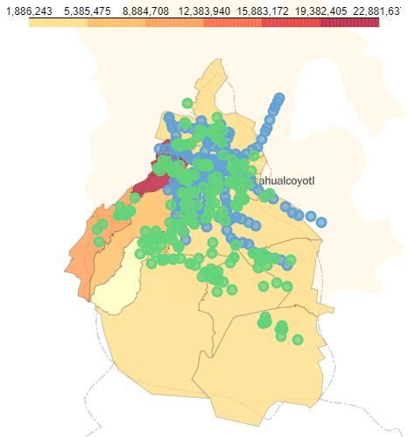
Venues data
Using Foursquare, I found the 15 most popular venues in each borough
Adding these to the map, we can see that they, too, are predominantly in the northern half of the city
Because this map is interactive, we can zoom in to see which locations are both close to public transportation and close to popular venues

Slide 7
Conclusion and suggestions
The map is useful for both businesses and individuals to understand the layout and culture of the city and each borough
As the metro data suggests, part of the larger metropolitan area lies beyond city limits. This is a major part of the city’s economy and should be included in future analysis
Roads and city parks, which might be relevant for certain audiences, are left out of the map and should be included in the future

