Slide 1
2020 NFL Big Data Bowl: Utilizing Pyspark to Predict Achieving a First Down on American Football Plays
Group 3:
Anoop Nath, Lauren O’Donnell, OC Ofoma
Notes:
Lauren

Slide 2
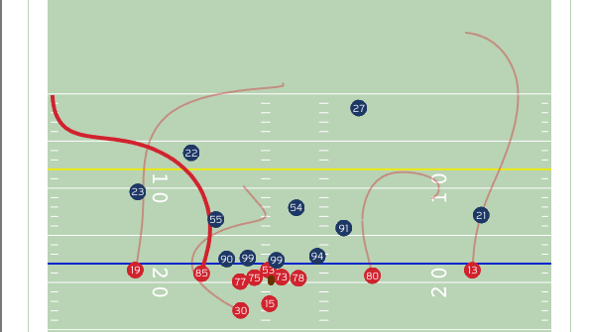
Introduction
NFL started Next Gen Stats in 2013
RFID chips in player pads and footballs
Data on all players on the field during every play of every game since 2017
Opened up possibility for more advanced data analytics to be conducted
Captures player data such as location, speed, distance traveled and acceleration at a rate of 10 times per second
NFL Big Data Bowl started in 2019 on Kaggle
Annual Competition open to the public
Notes:
Lauren

Slide 3
What model type will best predict whether a play will achieve a first down?
Notes:
Lauren

Slide 4
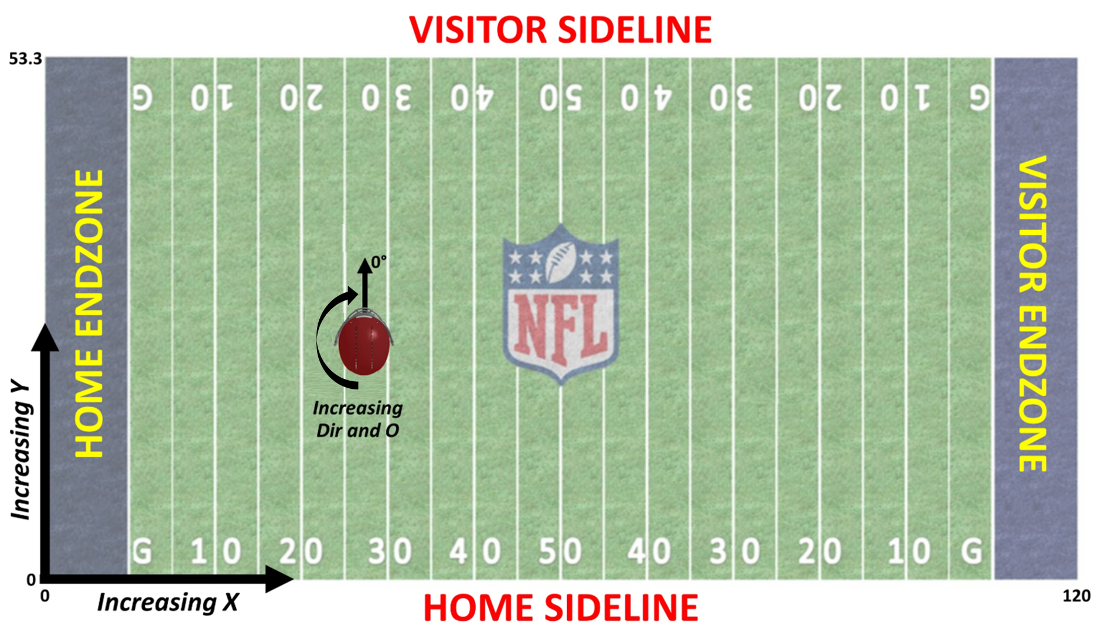
Data Introduction
Dataset:
The dataset contains Next Gen Stats tracking data for running plays in NFL games.
Grouped by 'PlayId'.
Each row corresponds to a single player's involvement in a single play.
Features:
Includes 49 features:
Player's position, speed, and acceleration.
Game identifiers, teams, quarter, down, and distance needed for a first down.
Environmental factors such as stadium, location, weather, temperature, humidity, and wind speed/direction.
Player-specific details such as name, height, weight, and college.
Notes:
Lauren

Slide 5
Data Preprocessing
Create new variables to add as features:
Distance to End Zone
Distance of Closest Defender
Create response variable:
First Down Gained
Assembled feature variable vector containing:
Distance to End Zone
Distance to Closest Defender
Number of Defenders in the Box
Down
Distance to first down
Remove rows with null values
Data was split into training, validation, and holdout datasets
Notes:
Lauren

Slide 6
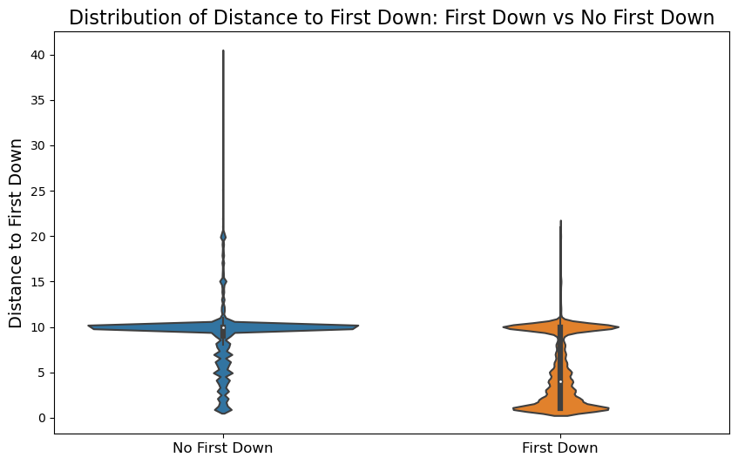
Exploratory Data Analysis
682,000 rows
31,000 rushing plays from Sep 2017 to Nov 2019
22 players per play
Response Variable = first_down_gained
21% of plays resulted in first downs
Five Feature Variables
Distance to first down was strongest
Notes:
Our dataset had 682,000 rows of data
Including 31,000 rushing plays from Sep 2017 to Nov 2019
For each play, there’s data for all 22 players on the field
Our response variable is whether a first down was gained. We found that 21% of plays resulted in first downs
In our EDA, we found that distance to first down had the strongest relationship with whether a first down was gained.
"DefendersInTheBox", "Down", 'Distance', "DistanceToTouchdown", 'ClosestDefenderDistance'

Slide 7
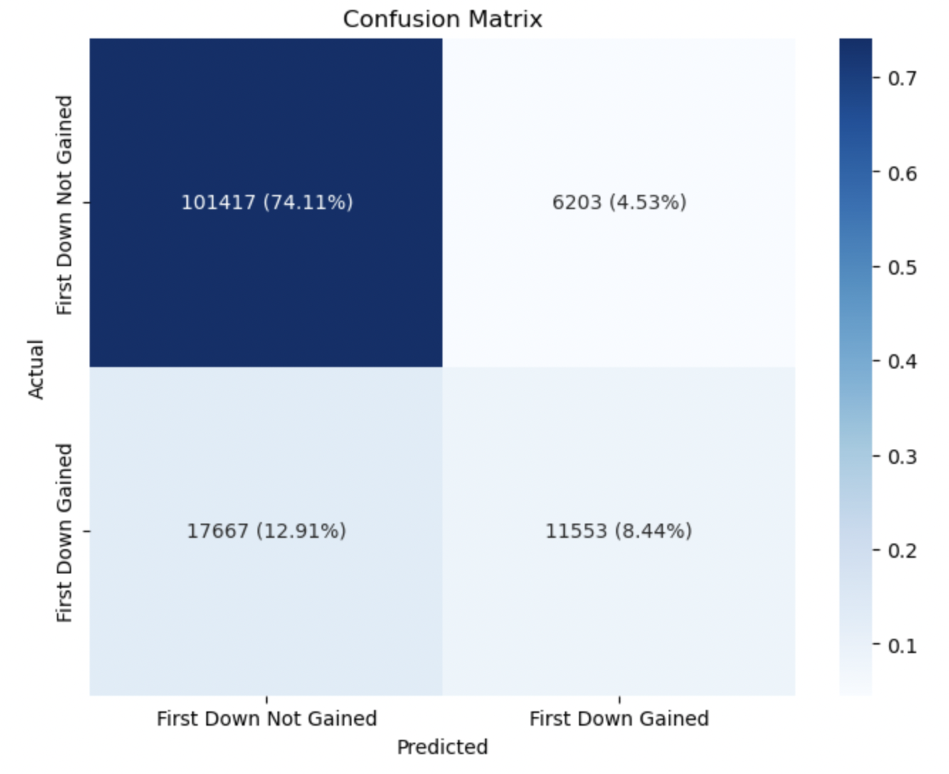
Model Performance/Evaluation
Logistic Regression (Benchmark Model)
Accuracy: 82.56%
Precision: 80.87%
Recall: 82.56%
F1 Score: 0.8087
AUC: 0.7628
Notes:
The first model we tried was a simple logistic regression model with five feature variables:
"DefendersInTheBox", "Down", 'Distance to First Down', "DistanceToTouchdown", 'ClosestDefenderDistance'
This was a good start and the model was fairly accurate with an accuracy of 82.56%. We would have liked to see AUC slightly higher.

Slide 8
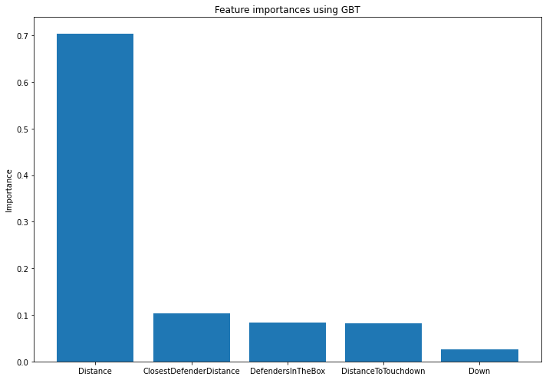
Model Performance/Evaluation
Gradient Boosting
Accuracy: 82.86%
Precision: 81.26%
Recall: 82.86%
F1 Score: 0.812
AUC: 0.7695
Notes:
The second model we tested was a gradient boosted tree. We tuned hyper-parameters such as depth and number of trees. The best performing model had a slightly higher metrics although AUC was still slightly low.
Anoop
Gradient boosting for classification works by sequentially adding decision trees to an ensemble where each new tree corrects the errors made by the combined ensemble of existing trees. At each iteration, the algorithm identifies the misclassified data points and emphasizes their correct classification in the next tree. By the end, all individual trees, which might be weak learners on their own, come together to form a strong learner that classifies the data more accurately.

Slide 9
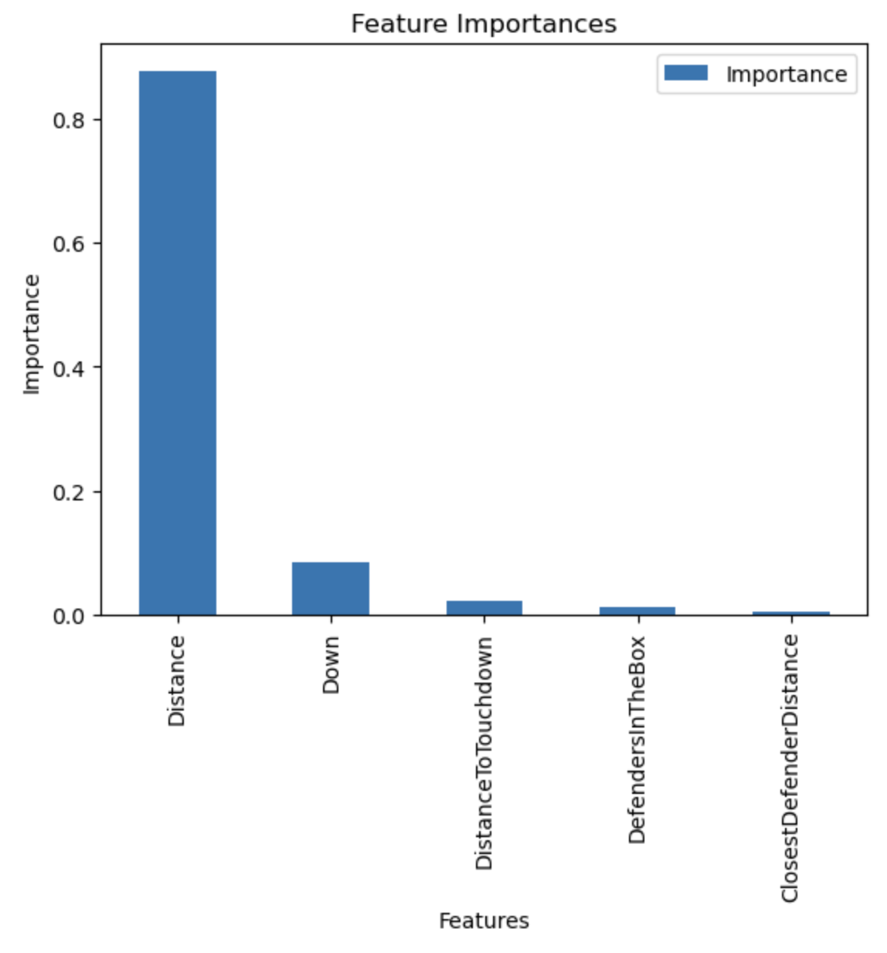
Model Performance/Evaluation
Random Forest (Champion Model)
Accuracy: 83.24%
Precision: 81.67%
Recall: 83.24%
F1 Score: 0.8166
AUC: 0.7513
Notes:
OC

Slide 10
Model Performance/Evaluation
Comparison
Model | Accuracy | Precision | Recall | F1 Score | AUC
Logistic Regression | 82.56% | 80.97% | 82.56% | 0.8087 | 0.7628
Gradient Boosting | 82.86% | 81.26% | 82.86% | 0.8122 | 0.7695
Random Forest | 83.24% | 81.67% | 83.24% | 0.8166 | 0.7513
Notes:
OC

Slide 11
Conclusions and Future Research
The Random Forest performed the strongest of the three models.
Future research:
How other environmental factors impact play, i.e., sun positioning, time of day, stadium altitude, etc.
Deep Learning Techniques
Investigate further relationships between variables to explore modifications to fitting simple models
Notes:
OC

