Slide 1
GlobalAgRisk Geographic Information Systems
Lauren Oldham

Slide 2
Monthly Agriculture Insurance Calendar
Data collected through Global Agro-Ecological Zones/FAO and EarthStat
GAEZ: 27 crop start days
EarthStat: 25 crop production values
End result requires data to be processed through geographic information systems
Raster files -> monthly crop calendars
How?

Slide 3
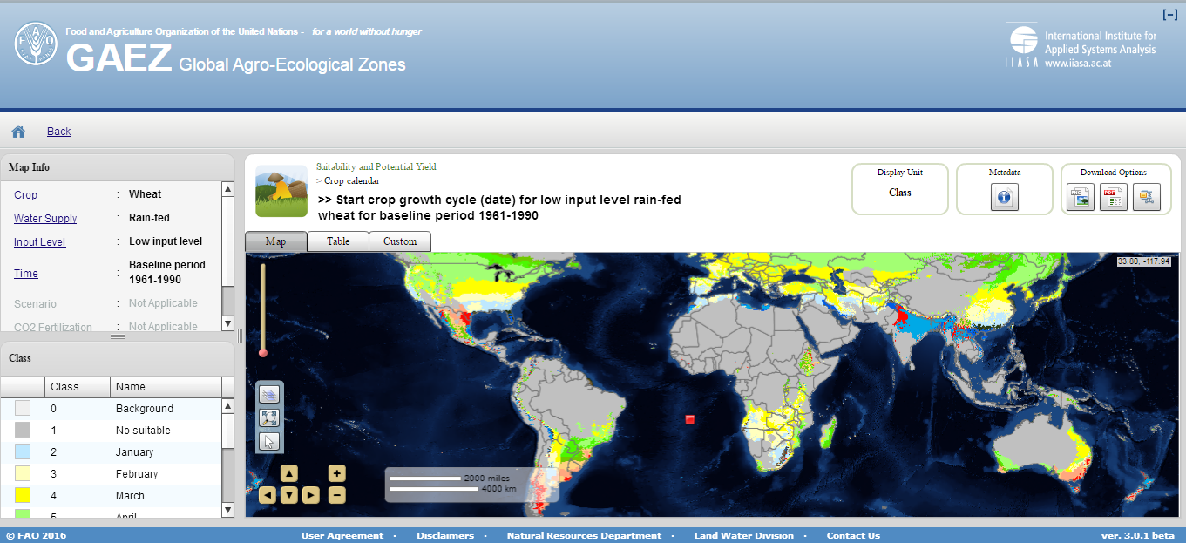
GAEZ Data Selection/UI
27 crops | Rain-fed | Low-input level | Baseline Period 1961-1990

Slide 4
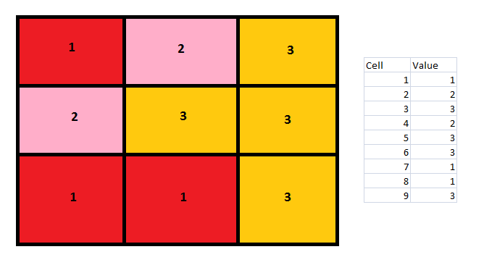
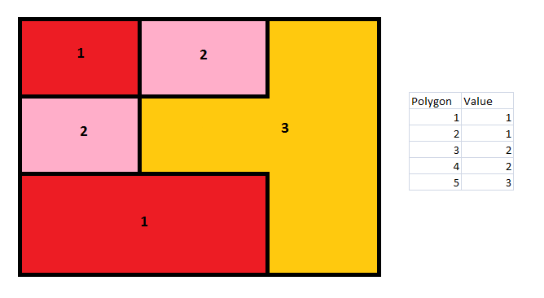
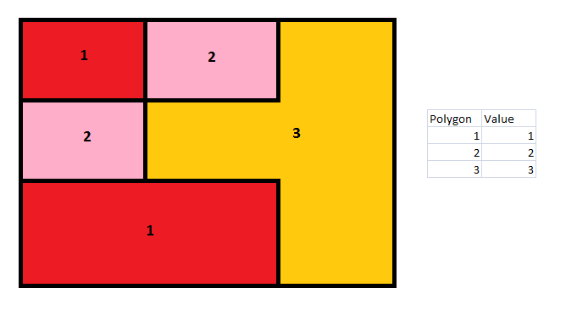
Raster Grids/Cells
Polygonized Raster
Dissolved Polygons

Slide 5
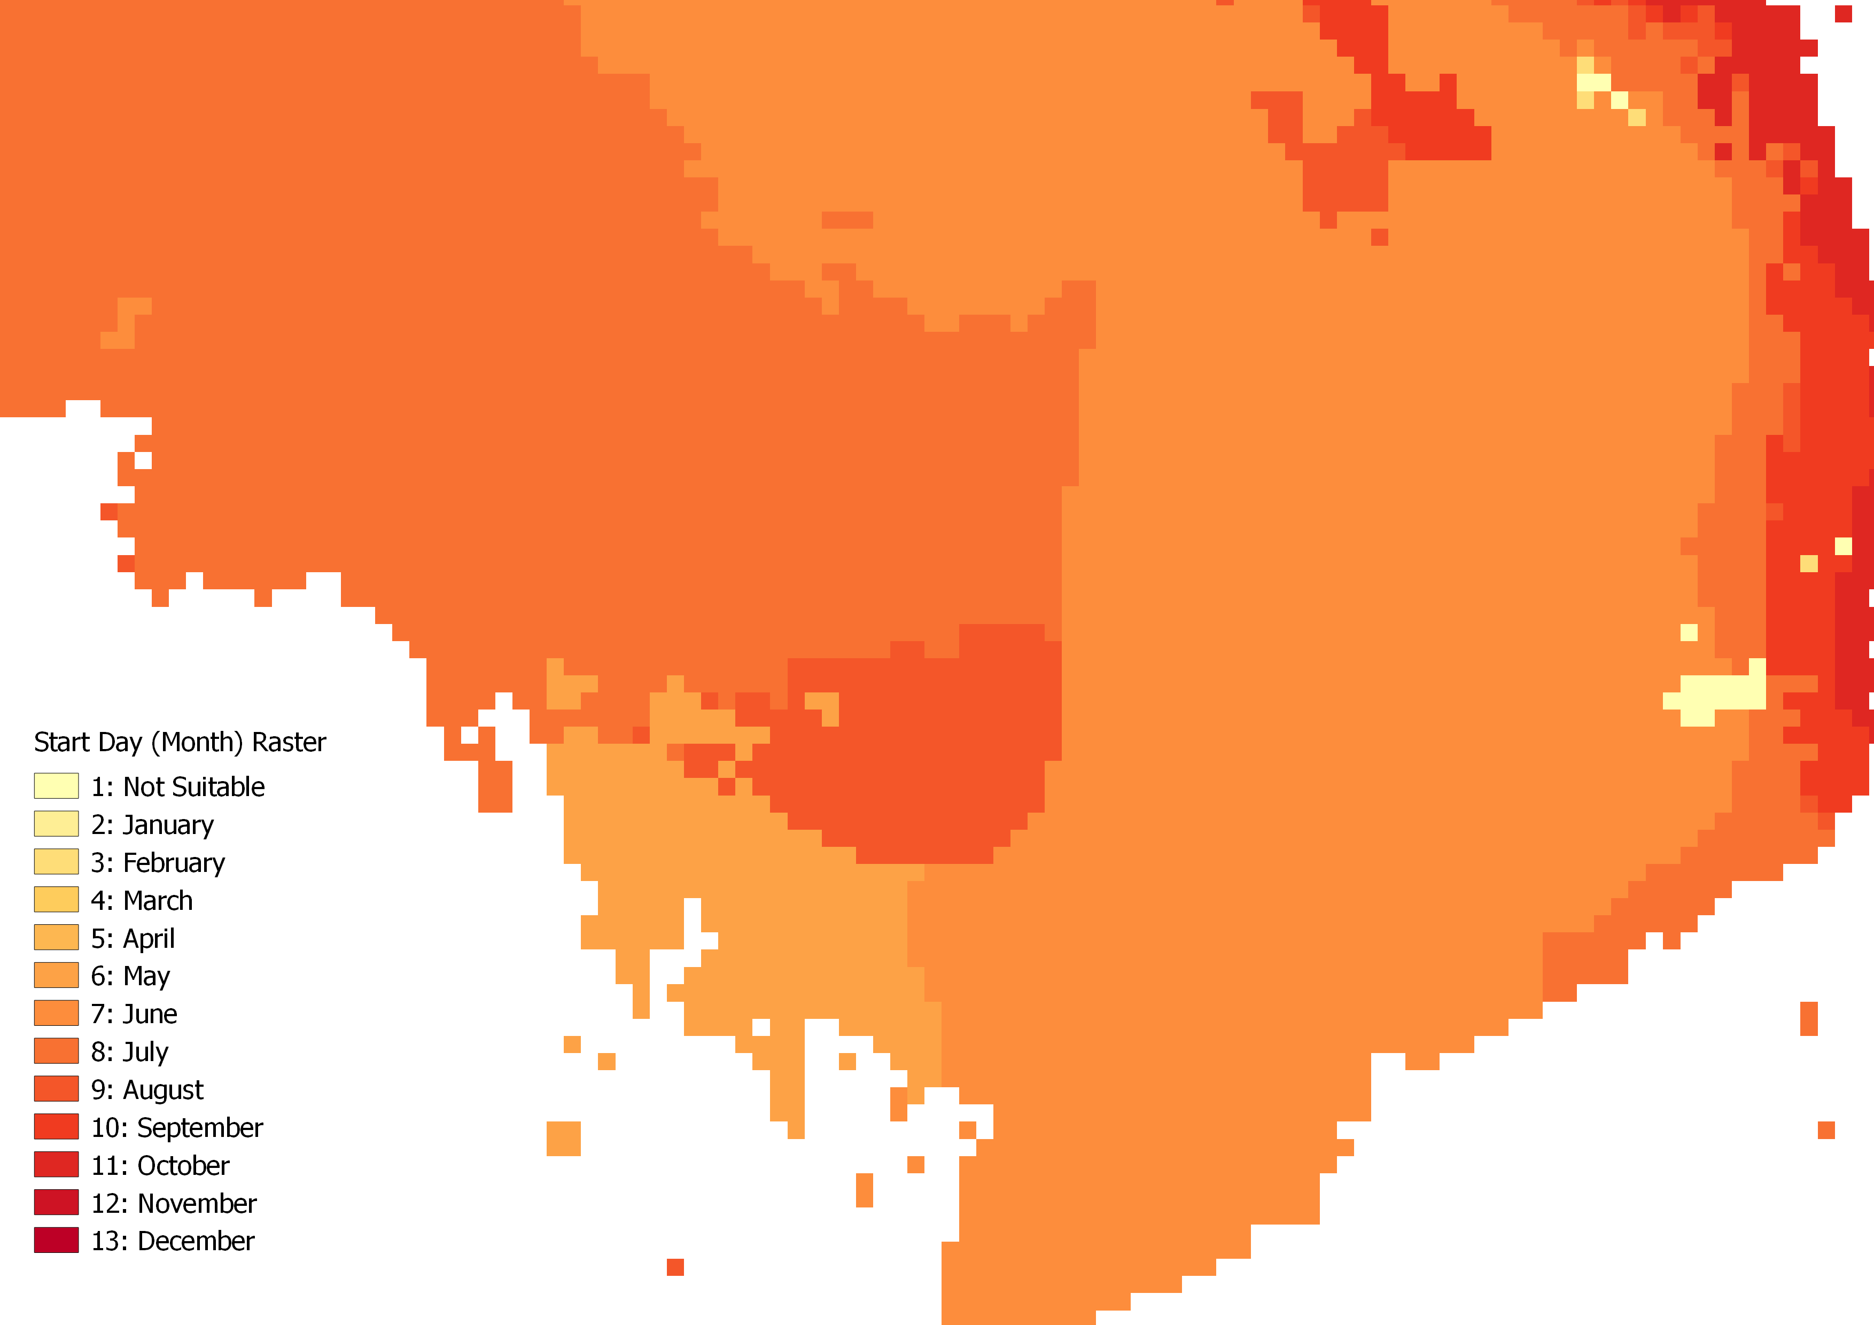
Raster – Wetland Rice in Cambodia

Slide 6
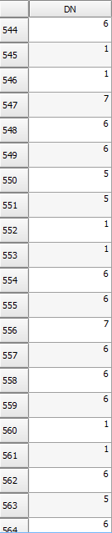
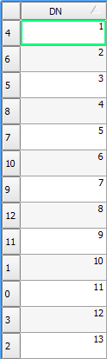
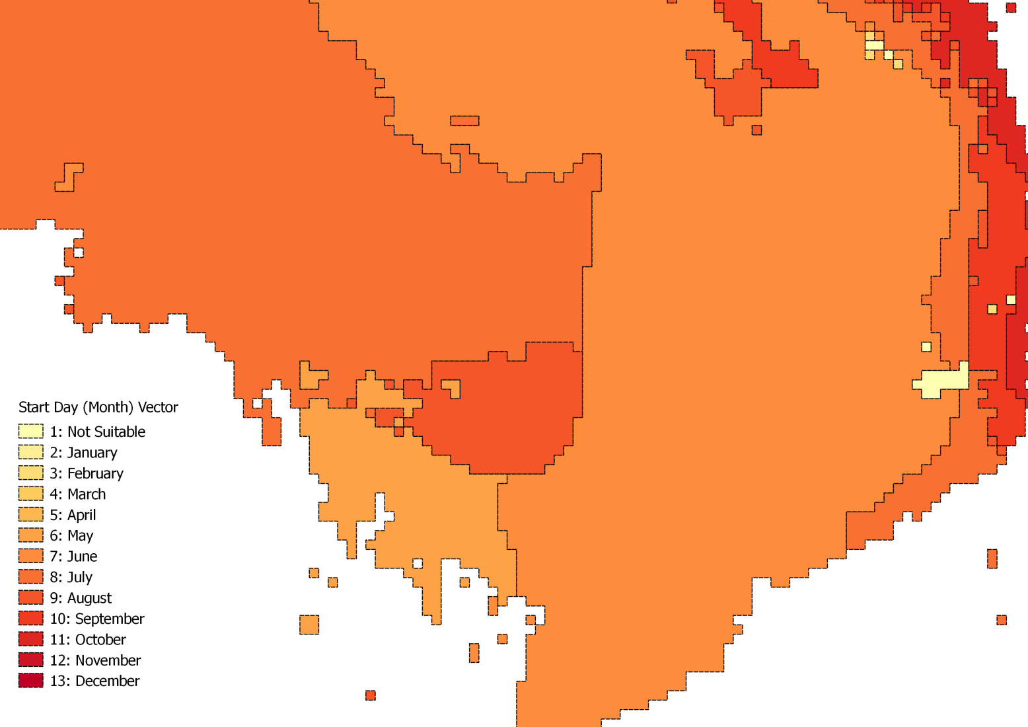
Vector – Wetland Rice in Cambodia

Slide 7
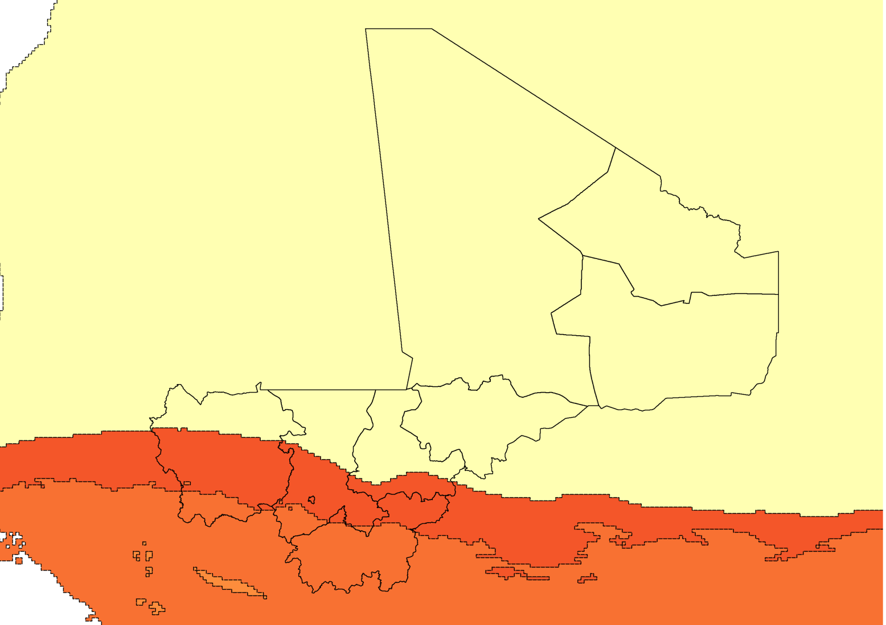
Intersection

Slide 8
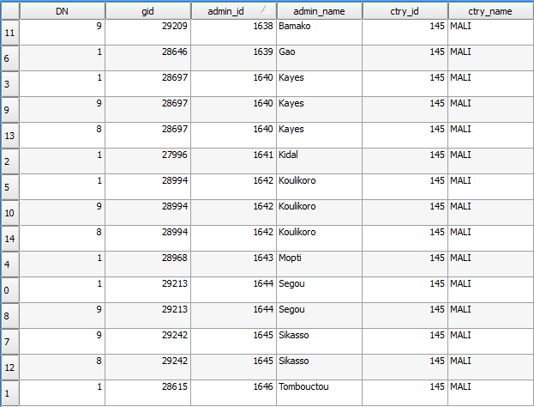
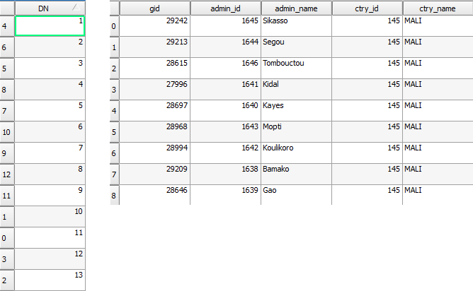
Intersected Attributes

Slide 9
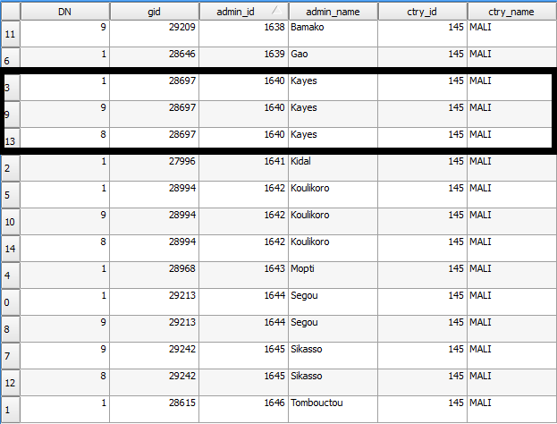

Intersection

Slide 10
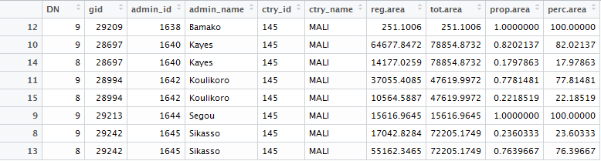
Area Calculations

Slide 11
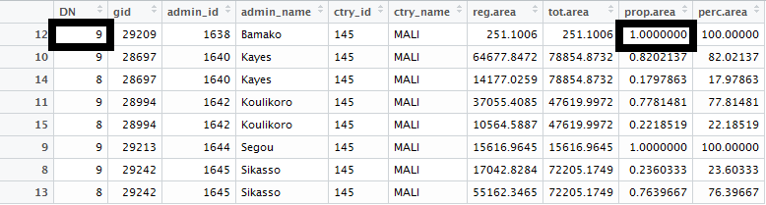
Area Calculations
For each row (admin unit):
IF DN = 9 (August), then return the proportional area
IF DN !=9, return 0

Slide 12
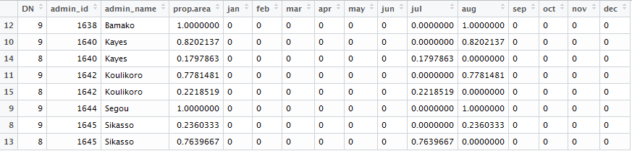
Raw Crop Calendar

Slide 13
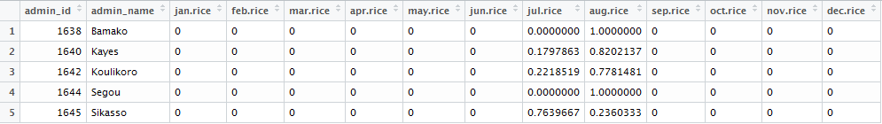
Collapsed Crop Calendar
End Result:
Every admin unit (467 total) for 24 countries of interest has its own crop calendar (January-December) for each of the 27 crops from GAEZ

Slide 14
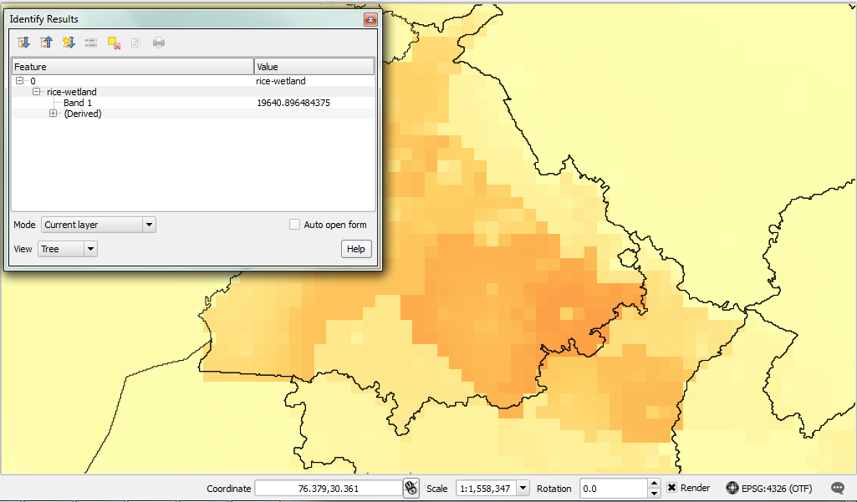
GAEZ Production Values

