Slide 1
Diabetes predictive analysis
Holt Jones, Paulette Petracco, Lauren Ables-Torres

Slide 2
Important terms
Diabetes: a chronic metabolic disorder characterized by elevated levels of blood sugar
BMI: body mass index (proportion of weight to height in meters)
HbA1c: blood test that shows the average blood sugar over the past 2-3 months
Shows what percentage of hemoglobin (protein in RBCs) is coated with glucose
Blood glucose level: blood test that measures the amount of sugar (glucose) at the time of the test

Slide 3
WHAT FACTORS INFLUENCE THE DEVELOPMENT OF DIABETES AND OTHER health conditions, and how do those factors interact?

Slide 4


Agenda
-Dataset = "diabetes_prediction_dataset"
-Sample of 99,982 citizens ages ranging one month old to 80 years old,
-Dataset shows gender, age, hypertension status, smoking status, bmi, HbA1c_level, blood_glucose, diabetes

Slide 5
Hypothesis Test
-
-Mean BMI for diabetes patients in the US ~ 32
-90-95% of diabetes cases in the US are type II
Null Hypothesis: There is no relationship between BMI and a citizen's propensity for a diabetes diagnosis
Alternative Hypothesis: People with bmi’s of 32 or higher will be disproportionately affected by diabetes compared to those with bmi’s between 18-25 (rough range of healthy BMI)

Slide 6

Key Metrics from Data Set
Mean Age in the study = 41.885856
Males = 41430
Females = 58552
Number of Patients with BMI 32 or higher- 17289
BMI 32 or higher and Diabetic - 3419
Percent Diabetic BMI > 32 - 19.776%
Number of Patients BMI 18 to 25 - 23399
BMI 18 to 25 and Diabetic- 877
Percent Diabetic BMI 18 to 25- 3.748%
Two sample t test
p value- 7.970758922549957e-128

Slide 7
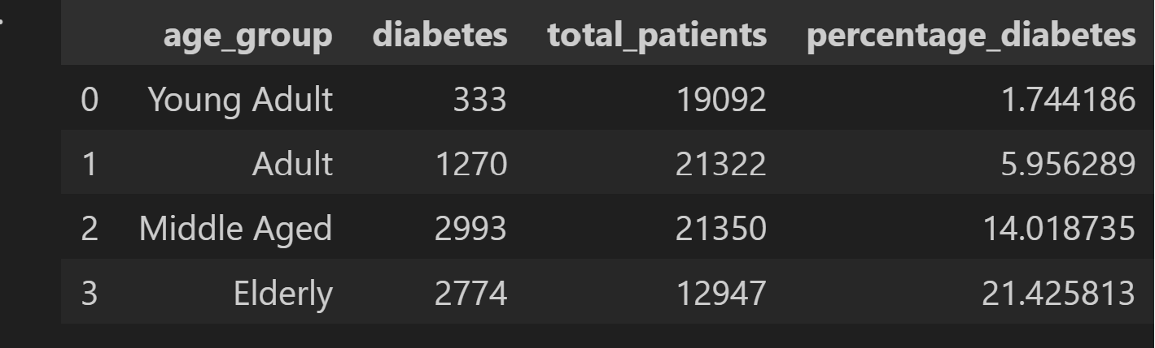
Diabetes by AGe
20-35- "YOUNG ADULT", 35-50- "ADULT", 50-65- "MIDDLE AGED, 65+ - "ELDERLY

Slide 8
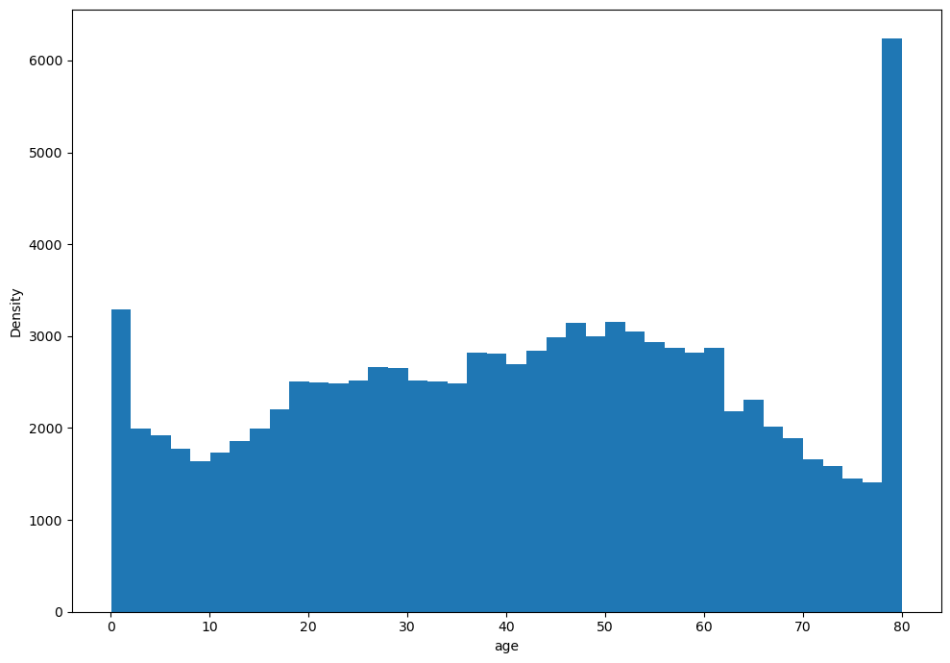
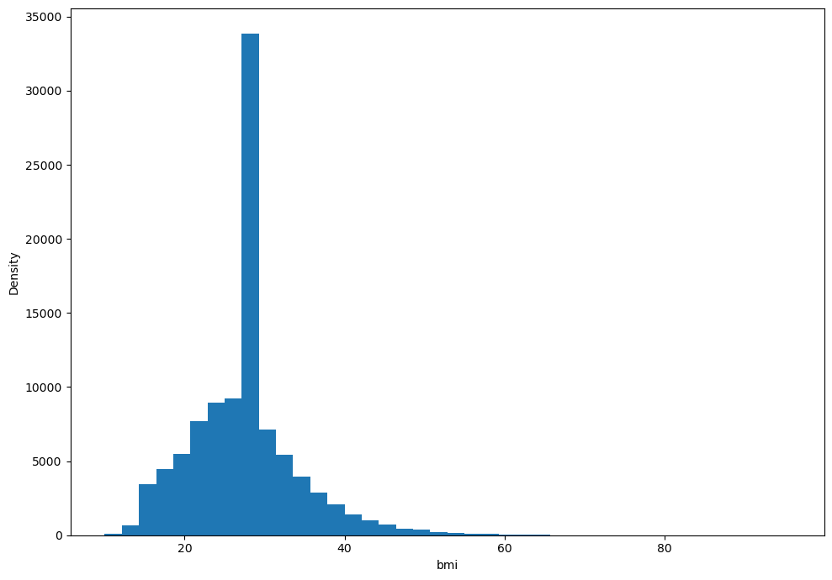
Density for Age and BMI

Slide 9
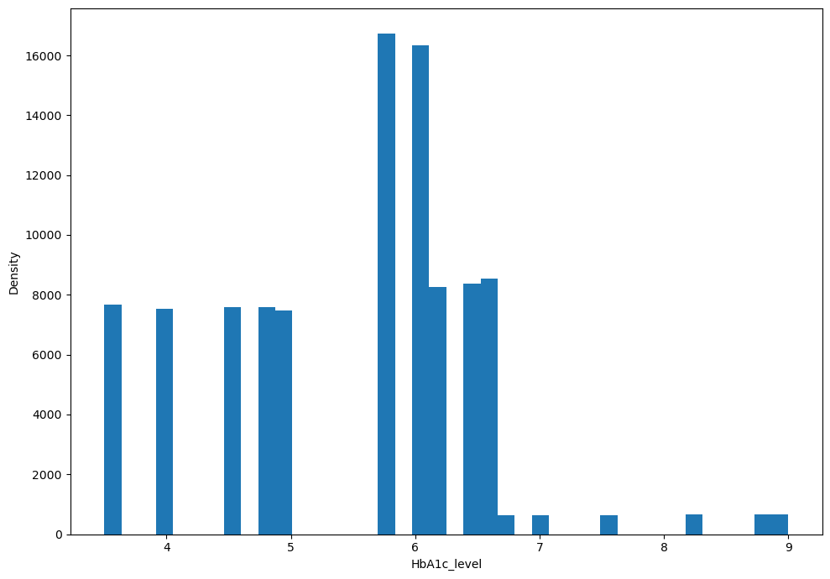
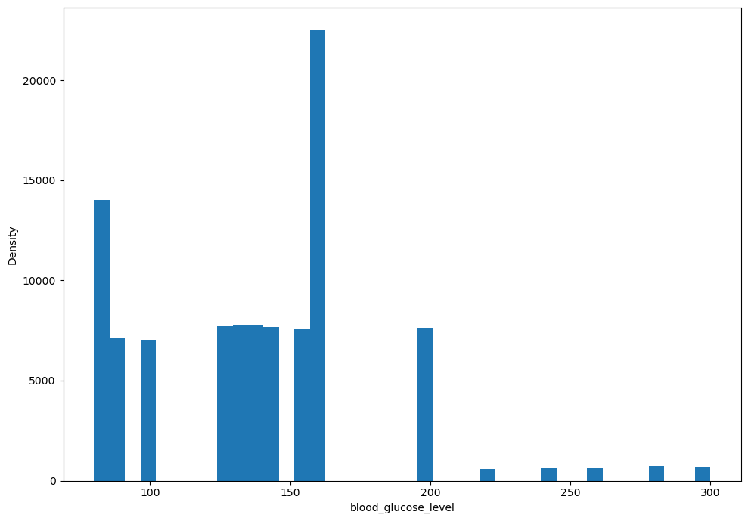
Density for HbA1c and Blood Glucose Level

Slide 10
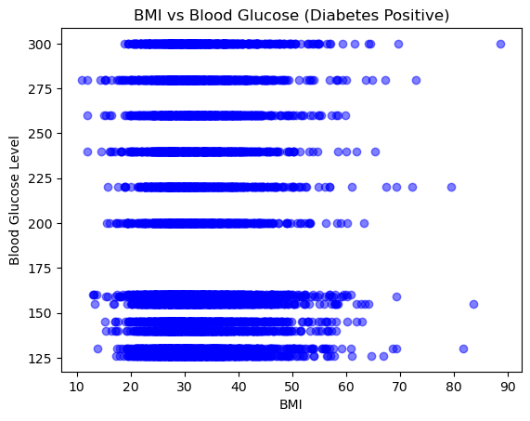
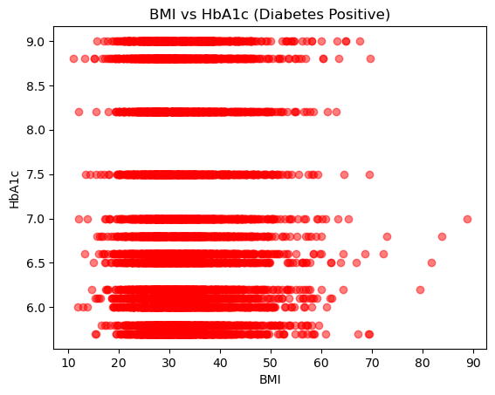
BMI vs Blood Glucose and Hba1c with positive diabetes

Slide 11
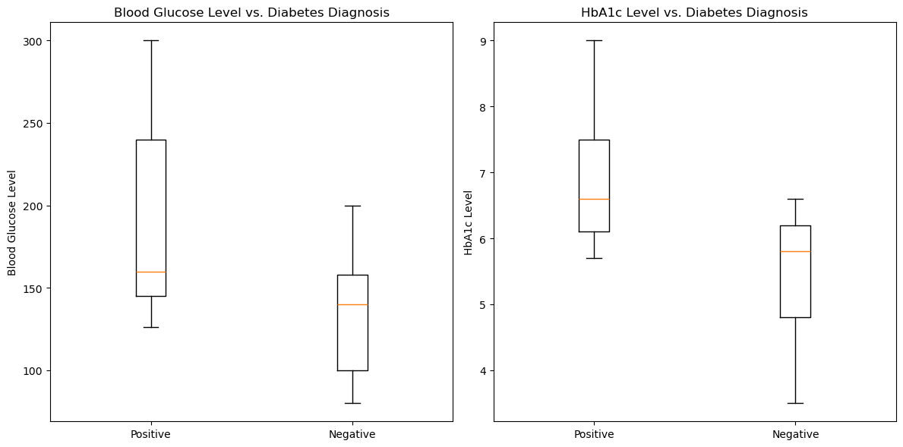
Blood Glucose and Hba1c with a positive and negative diabetes diagnosis

Slide 12
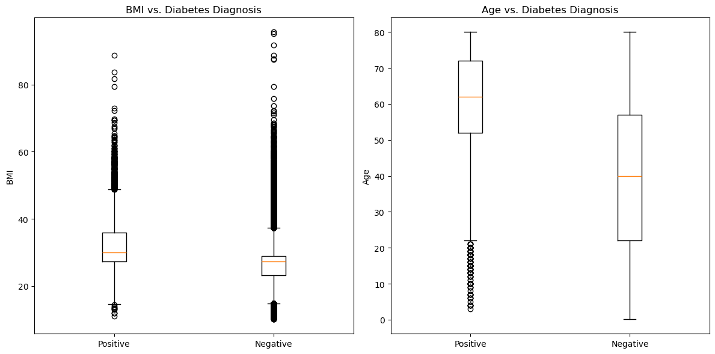
BMI AND Age WITH A POSITIVE AND NEGATIVE DIABETES DIAGNOSIS

Slide 13
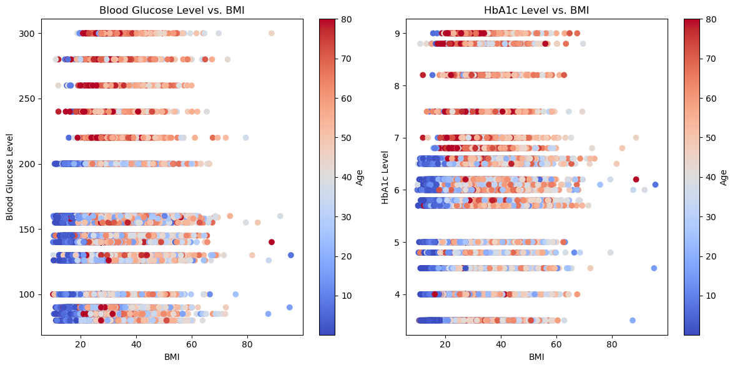
Blood Glucose and Hba1c vs BMI and age

Slide 14
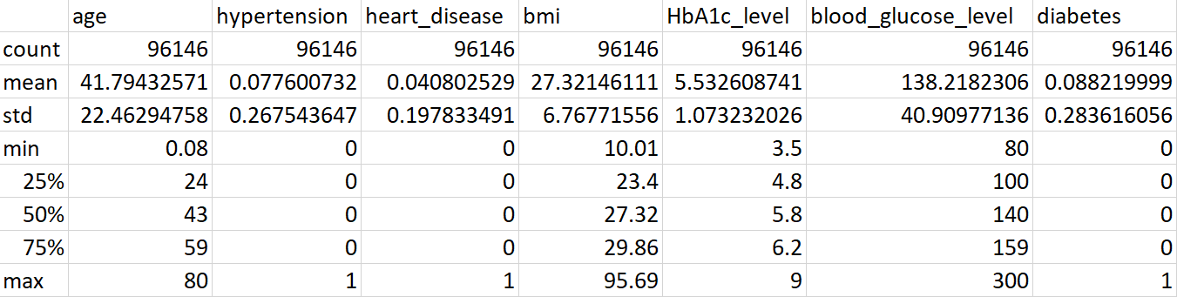
Investigating other variables in the dataset

Slide 15
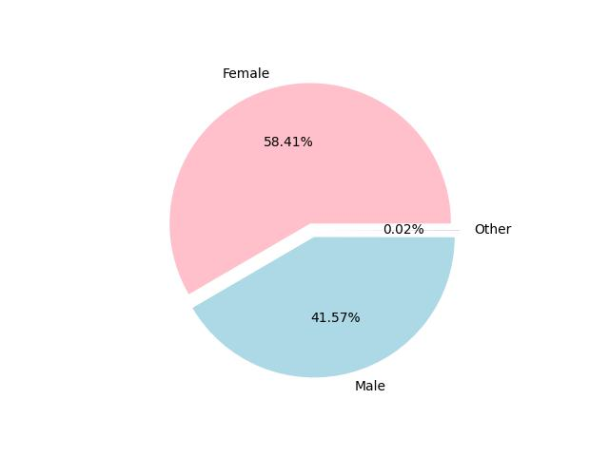
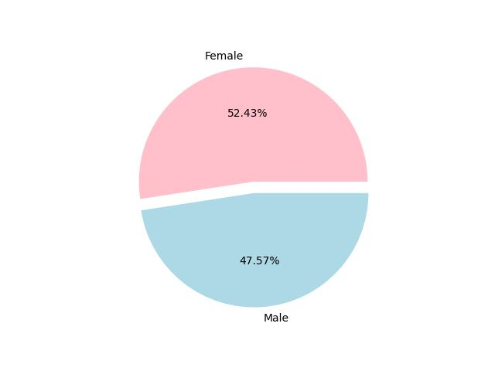
gender
Gender makeup for all data
Gender makeup for all diabetes positive

Slide 16
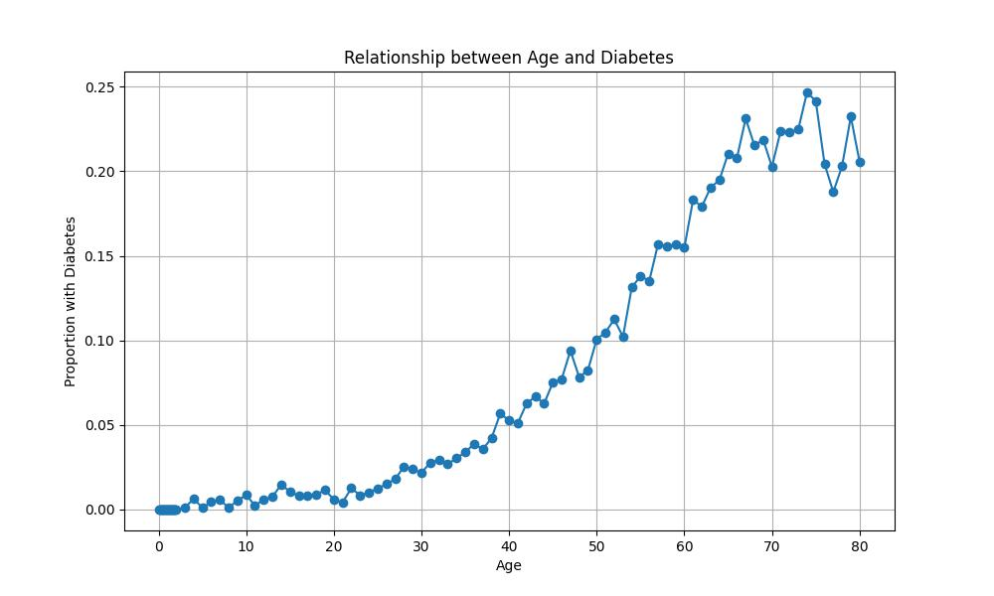
AGE
R² = .265

Slide 17
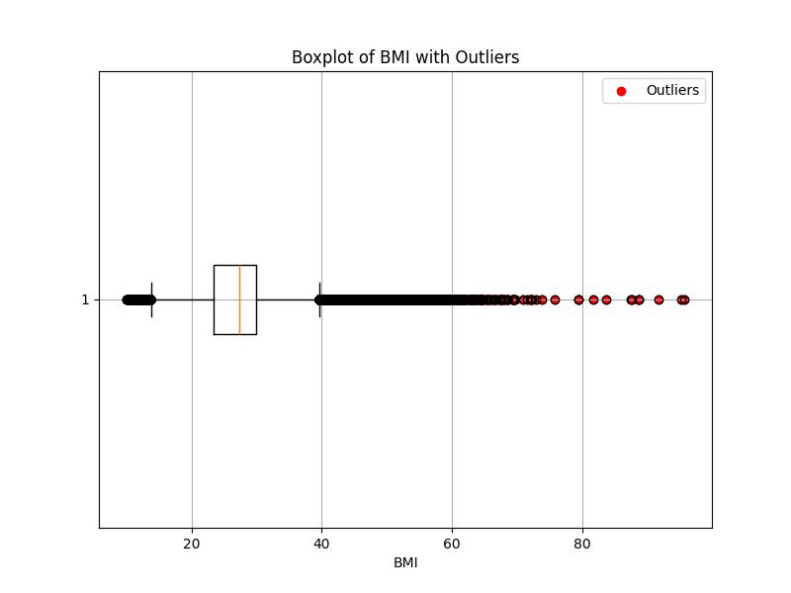
Bmi
There are outliers in BMI
BMI minimum = 10.01
BMI maximum = 95.69
Average BMI = 27.321
Lower bound = 13.7
Upper bound = 39.6

Slide 18
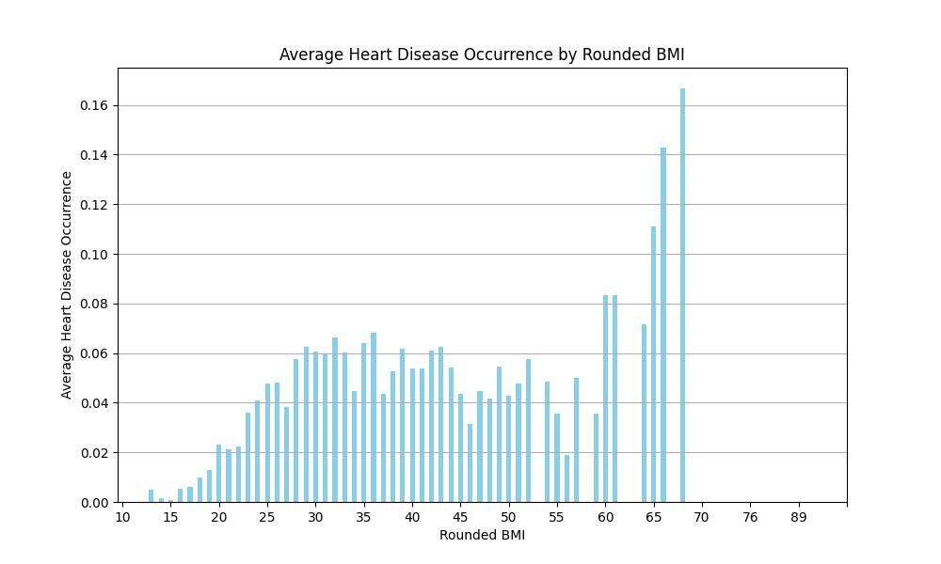
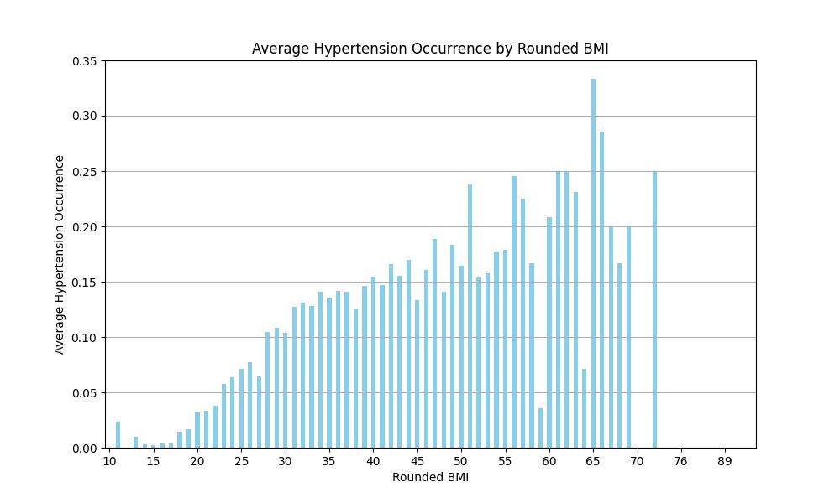
BMI
BMI's correlation to Heart Disease; R² = .06
BMI's correlation to Hypertension; R² = .148

Slide 19
Thank you!
Sources:
https://www.cdc.gov/healthyweight/assessing/bmi/index.html
https://medlineplus.gov/lab-tests/hemoglobin-a1c-hba1c-test/
https://www.mountsinai.org/health-library/tests/blood-sugar-test-blood#:~:text=Normal%20Results,mmol%2FL)%20or%20lower.
https://www.who.int/health-topics/diabetes#tab=tab_1

