Slide 1

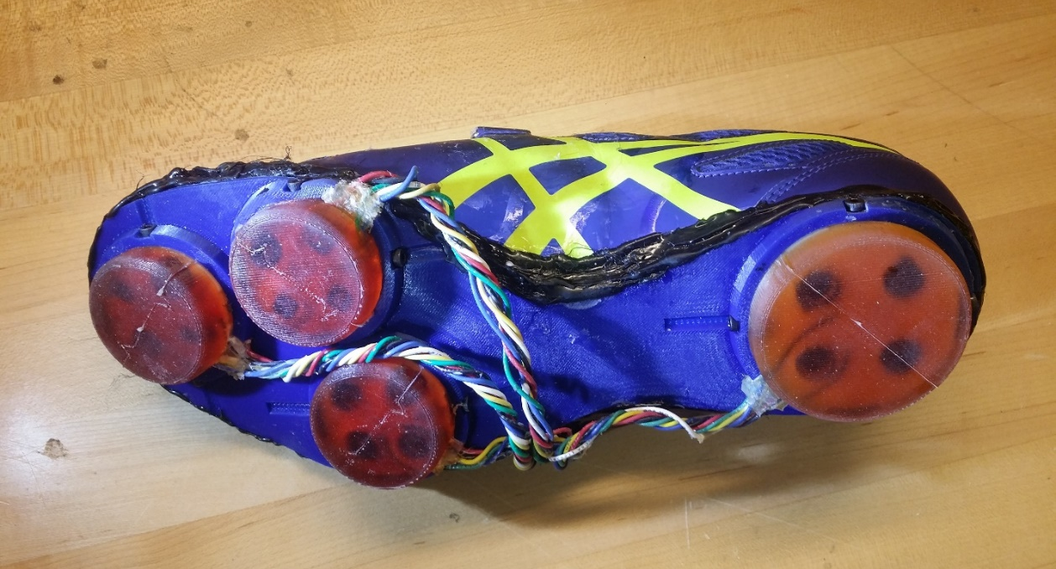
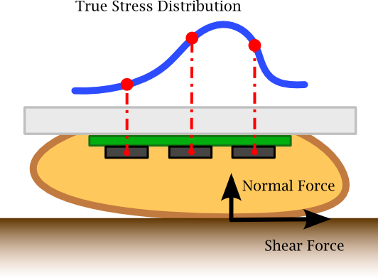
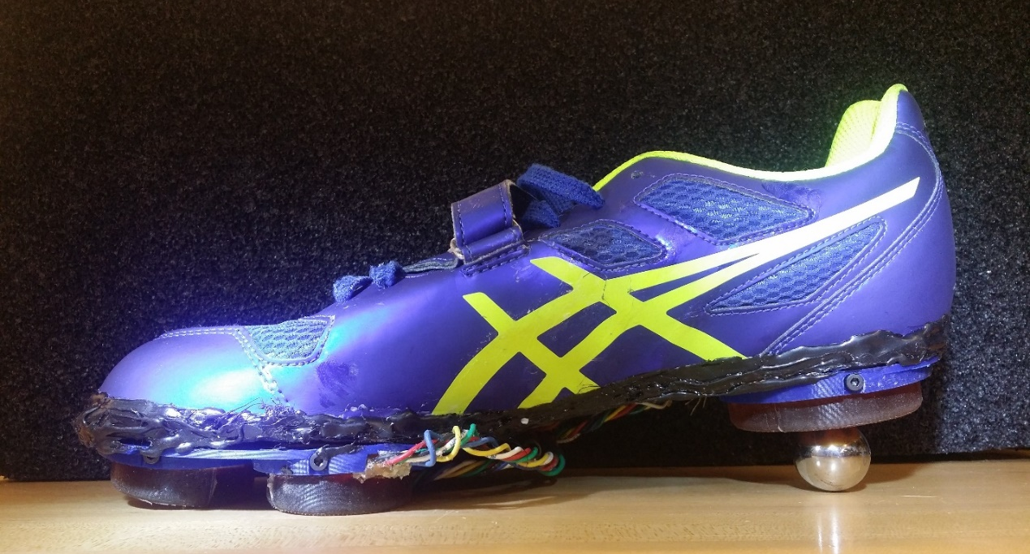
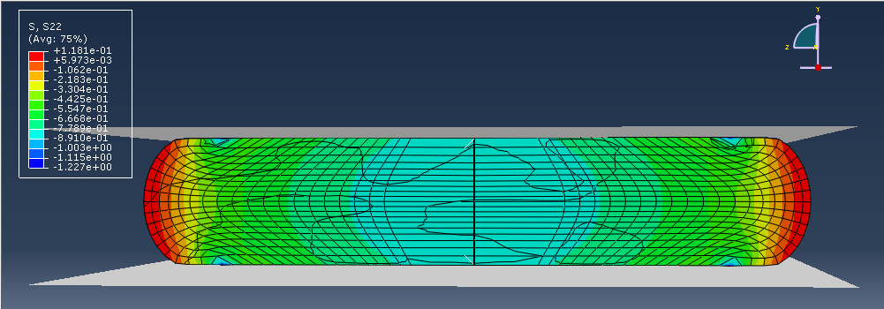
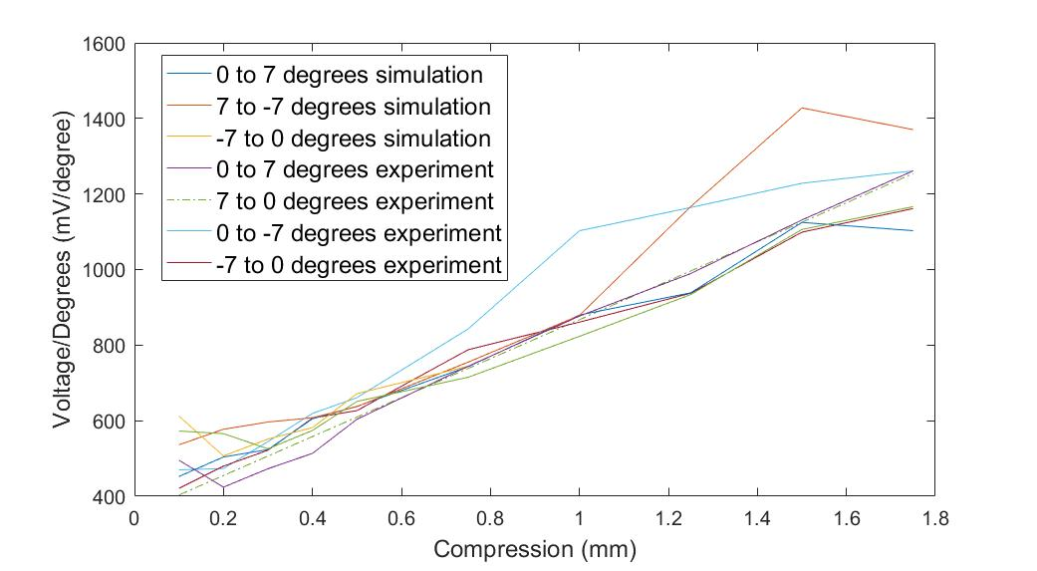
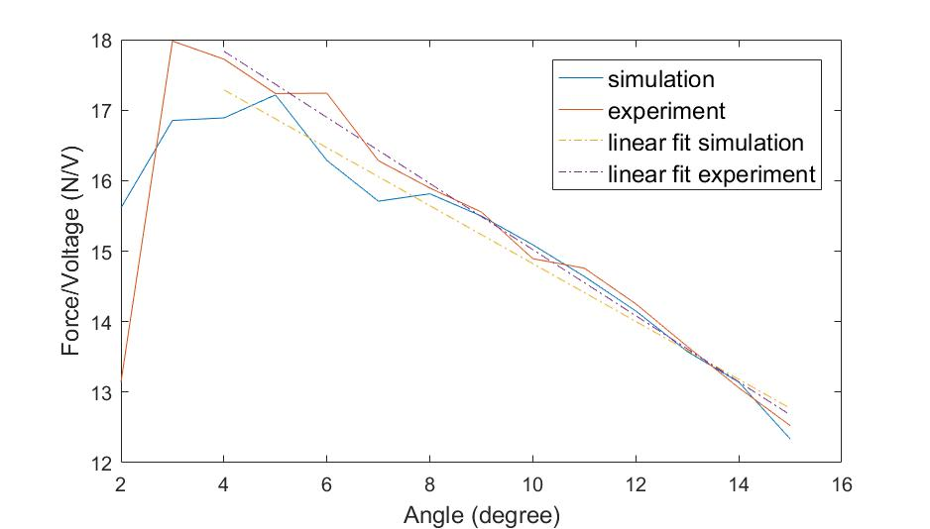
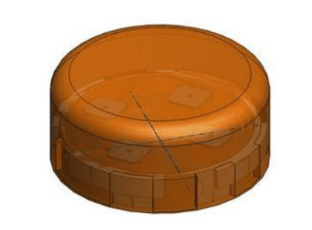
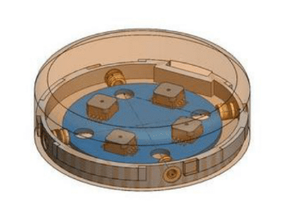
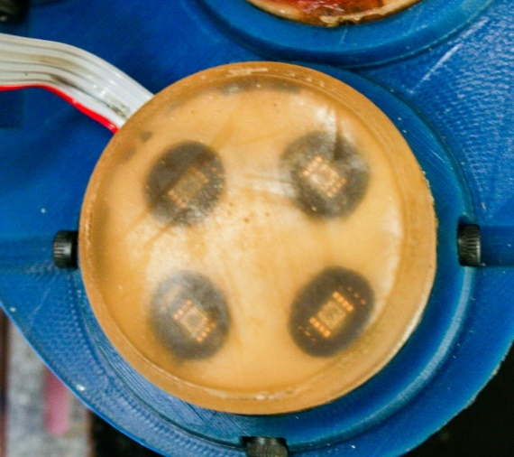
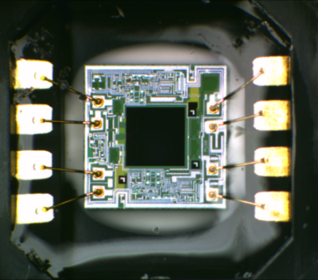
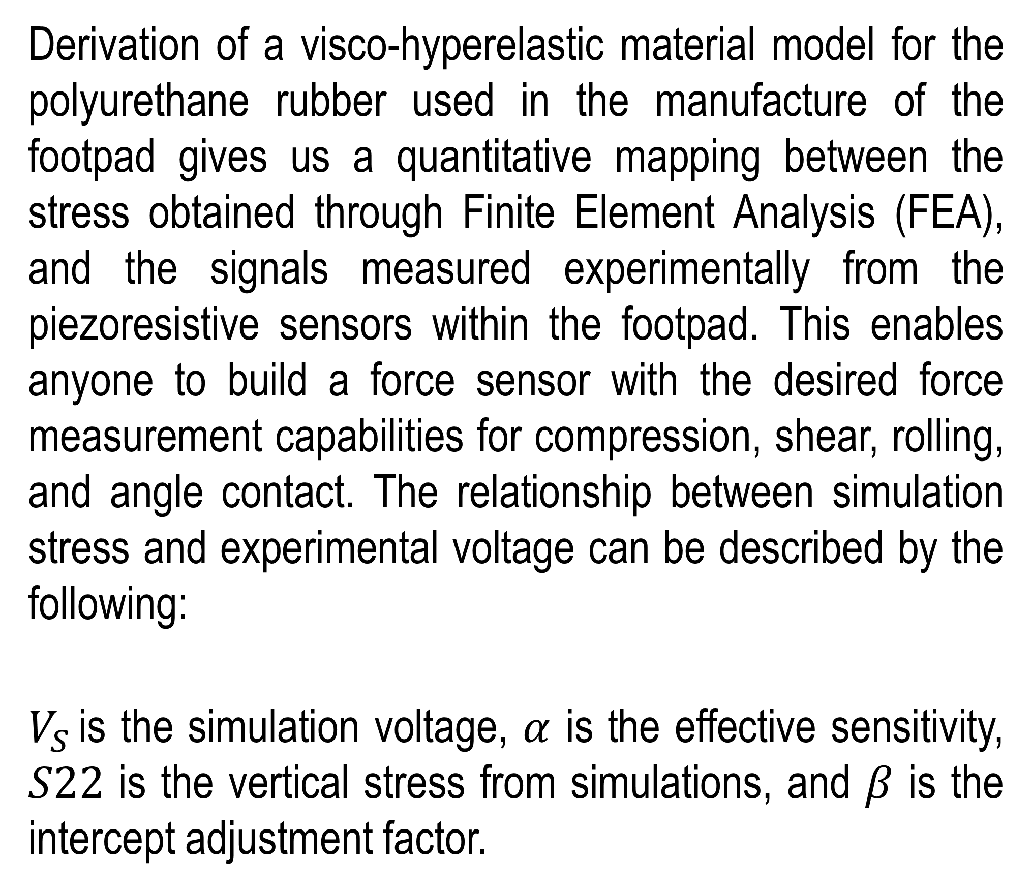
Design Principles and Material Characterization of Smart Force Sensor for Use in Human Locomotion
Iris Huang, Wendy Ma, Lauren Luo, Michael Chuah, and Prof. Sangbae Kim
Abstract
Material Modeling
Design Principles
Current force sensing technologies are inadequate for the task of addressing the unique demands of legged locomotion, especially in application for sports analytics and gait analysis. Using new design principles and methodologies, we developed a low cost, robust footpad sensor designed for legged locomotion. This approach, called ‘Stress Distribution Sampling’, maps the local sampling of stress inside an elastomeric footpad to forces in both normal and shear directions. This is achieved through a combination of using hyperelastic and viscoelastic material models.
Derivation of a visco-hyperelastic material model for the polyurethane rubber used in the manufacture of the footpad gives us a quantitative mapping between the stress obtained through Finite Element Analysis (FEA), and the signals measured experimentally from the piezoresistive sensors within the footpad. This enables anyone to build a force sensor with the desired force measurement capabilities for compression, shear, rolling, and angle contact. The relationship between simulation stress and experimental voltage can be described by the following:
$V_{S }$is the simulation voltage, $α$ is the effective sensitivity, $S22$ is the vertical stress from simulations, and $β$ is the intercept adjustment factor.
Material modeling allows us to not only predict the reaction forces associated with compression, shear, and angle contact, but also understand how the footpad sensor design influences the sensitivity for detecting range of motions and forces. Designers can customize force sensor for different sports shoes or other applications such as VR.
Design Factors: Sensitivity for Shear, Rolling, and Angle Contact
$$V_{S}=1000αS22+β$$
Figure 3. Big footpad sensor (left) is capable of detecting a wider range of shear reaction force compared with small footpad sensor (right).
Footpad Sensor
Figure 1. FEA simulation illustrates the varying stress of the plyurethane rubber during compression depicted by change in color.
The footpad sensor is a monolithic composite structure composed of a piezoresistive sensor array completely embedded in a protective polyurethane rubber layer. This composite architecture allows for compliance and traction during ground contact while deformation alters the measured stress distribution. By the way of this fabrication method, the footpad sensor becomes dust-tight, waterproof, and robust to inertial noise.
Figure 4 (Left). The effect of change in rolling angle on the change in voltage is dependent on the compression level.
Figure 5 (Right). There is a distinct correlation between the angle of contact and the force and voltage output.
Future Work
Future applications of the simple models derived from footpad sensors can be used to further analyze human gait. With these results, we can help elderly and disabled to detect, predict, and mitigate possible slipping and falling. It can also help elderly detect neurologic gait abnormalities, and facilitate earlier treatment.
Figure 2. As shown by experimental and simulation results, there is a positive correlation between compression displacement and voltage. The increases in shear displacement have little effect on voltage, but it relates to the increases in shear reaction force on sensor.
Small Sensor Diameter: 44.45 mm
Thickness: 12.00mm
Big Sensor
Diameter: 63.50mm
Thickness: 12.00mm
MIT Biomimetic Robotics Lab website: biomimetics.mit.edu

