Slide 1
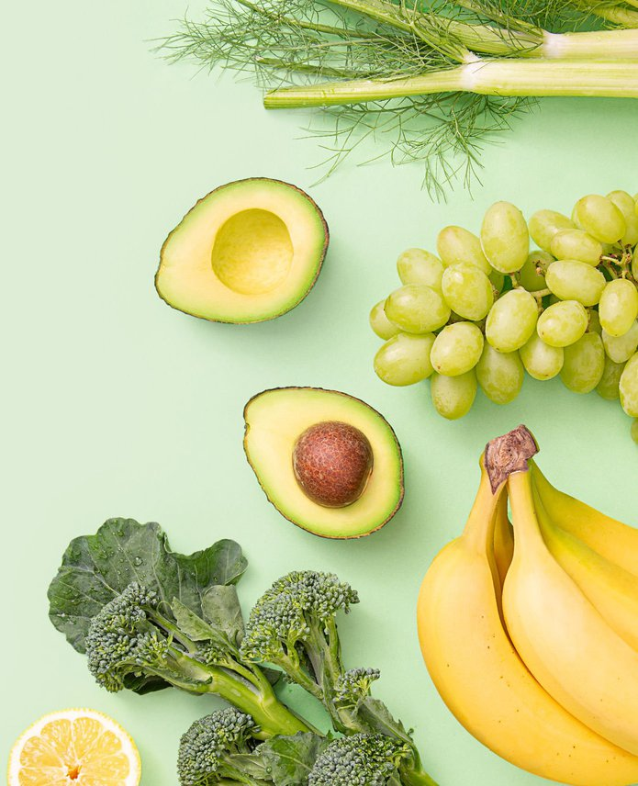
InstaFresh
A Customized Grocery Delivery Service
Group 7

Slide 2

What is InstaCart?
InstaCart is a grocery delivery service, allowing customers to shop at local grocery stores via the mobile app or website.

Slide 3



What is HelloFresh?
HelloFresh is a meal-kit provider that delivers pre-portioned fresh ingredients for customer-selected recipes directly to their doorstep.

Slide 4
What is InstaFresh?
InstaFresh is the pairing of HelloFresh and InstaCart to select gourmet recipes and deliver all the necessary fresh ingredients right to your doorstep from local grocery stores.

Slide 5
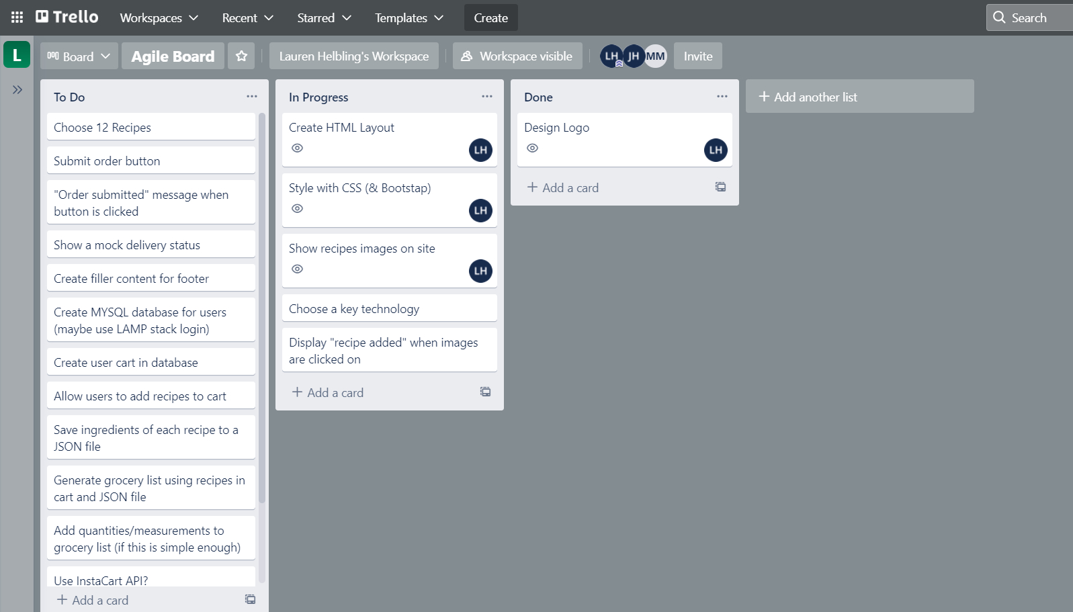
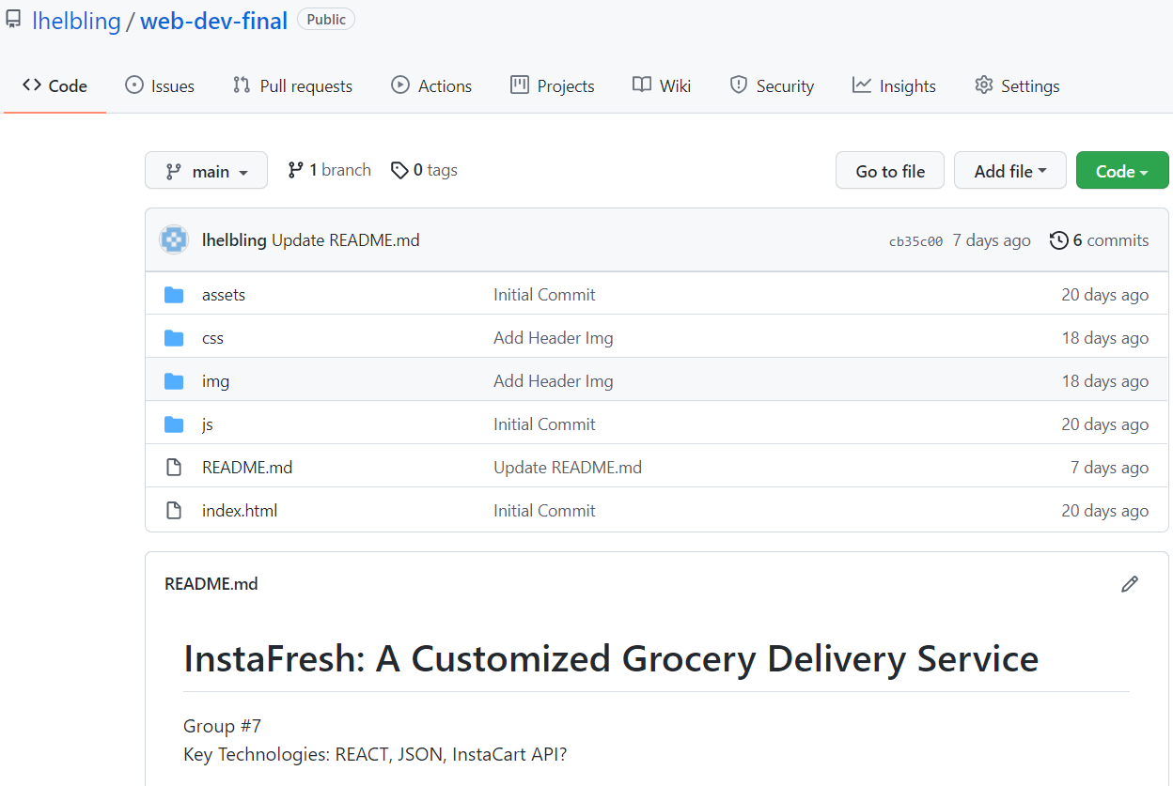
Project Management
Trello:
Agile-style board to assign project tasks and track progress
Git and GitHub:
-Version control for project

Slide 6






Logo Design
*We also considered HelloCart as an alternative

Slide 7
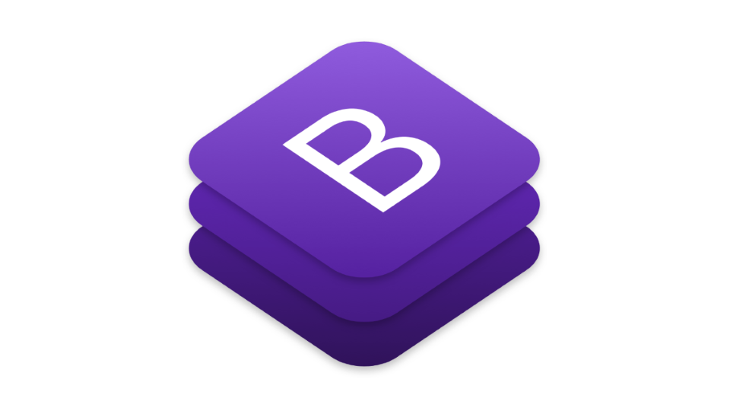
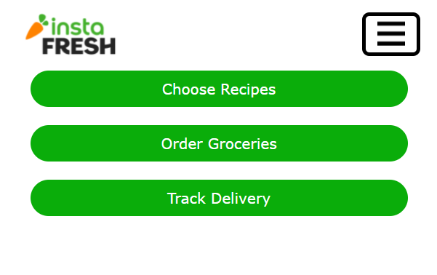


Front-End Design
Utilized Adobe Illustrator to create logo, icon, and color palette
Utilized bootstrap to style general page layout
Created a collapsed menu for mobile devices

Slide 8
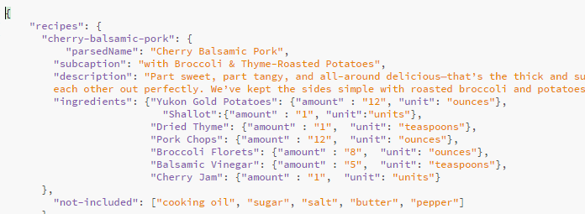
JSON File for Recipes
Notes:
http://localhost/wed-dev-final/

Slide 9
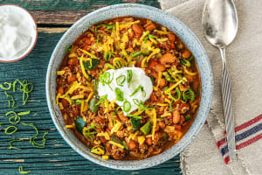
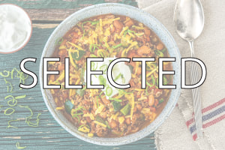
JavaScript Grocery List Builder
Select/Unselect Desired Recipes
Generate Grocery List
Submit Grocery List
Important Considerations:
Some recipes have repeat ingredients, so we must add or subtract ingredient amounts
If no selections are made, you can not submit an order

Slide 10
Demo
Proof of Concept Website:
https://csci331.cs.montana.edu/~n16b756/instafresh/
Recipe Card Design:
https://csci331.cs.montana.edu/~n16b756/recipes/

Slide 11

Roadblocks
InstaCart API
Messy code with no framework
Implementing new recipes is a pain

Slide 12

Next Steps
Port prototype to MERN stack
Add/remove ingredients
Delivery status
“What you’ll receive” list
Reimplement recipes cards
User login
Payment processing
Dealing with Cease and Desists

