Slide 1
CUDA Grids, Blocks, and Threads
These notes will introduce:
One dimensional and multidimensional grids and blocks
How the grid and block structures are defined in CUDA
Predefined CUDA variables
Adding vectors using one-dimensional structures
Adding/multiplying arrays using 2-dimensional structures
ITCS 6/8010 CUDA Programming, UNC-Charlotte, B. Wilkinson, Jan 21, 2011

Slide 2
Grids, Blocks, and Threads
NVIDIA GPUs consist of an array of execution cores each of which can support a large number of threads, many more than the number of cores
Threads grouped into “blocks”
Blocks can be 1, 2, or 3 dimensional
Each kernel call uses a “grid” of blocks
Grids can be 1 or 2 dimensional
Programmer will specify the grid/block organization on each kernel call, within limits set by the GPU

Slide 3
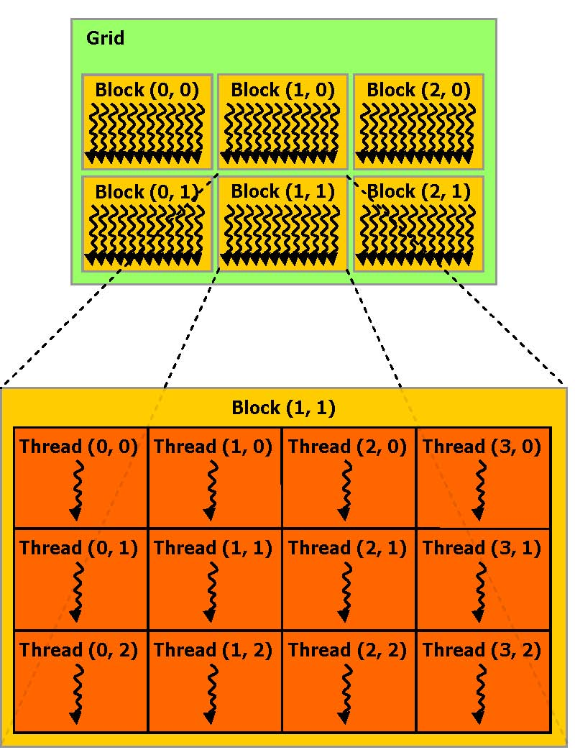
CUDA SIMT Thread Structure
Allows flexibility and efficiency in processing 1D, 2-D, and 3-D data on GPU.
Linked to internal organization
Threads in one block execute together.
Can be 1 or 2 dimensions
Can be 1, 2 or 3 dimensions
CUDA C programming guide, v 3.2, 2010, NVIDIA

Slide 4
Device characteristics -- some limitations
NVIDIA defines “compute capabilities”, 1.0, 1.1, … with these limits and features supported.
Compute capability 1.0
Maximum number of threads per block = 512
Maximum sizes of x- and y- dimension
of thread block = 512
Maximum size of each dimension of grid
of thread blocks = 65535

Slide 5
Defining Grid/Block Structure
Need to provide each kernel call with values for two key structures:
  Number of blocks in each dimension
  Threads per block in each dimension
myKernel<<< B, T >>>(arg1, … );
B – a structure that defines the number of blocks in grid in each dimension (1D or 2D).
T – a structure that defines the number of threads in a block in each dimension (1D, 2D, or 3D).

Slide 6
1-D grid and/or 1-D blocks
If want a 1-D structure, can use a integer for B and T in:
myKernel<<< B, T >>>(arg1, … );
B – An integer would define a 1D grid of that size
T –An integer would define a 1D block of that size
Example
myKernel<<< 1, 100 >>>(arg1, … );

Slide 7
CUDA Built-in Variables
for a 1-D grid and 1-D block
threadIdx.x -- “thread index” within block in “x” dimension
blockIdx.x -- “block index” within grid in “x” dimension
blockDim.x -- “block dimension” in “x” dimension
(i.e. number of threads in a block in the x dimension)
Full global thread ID in x dimension can be computed by:
x = blockIdx.x * blockDim.x + threadIdx.x;

Slide 8
Example -- x direction
A 1-D grid and 1-D block
4 blocks, each having 8 threads
Global ID 26
threadIdx.x
threadIdx.x
threadIdx.x
threadIdx.x
0
1
2
3
4
5
6
7
0
1
2
3
4
5
6
7
0
1
2
3
4
5
6
7
0
1
2
3
4
5
6
7
blockIdx.x = 0
blockIdx.x = 1
blockIdx.x = 2
blockIdx.x = 3
gridDim = 4 x 1
blockDim = 8 x 1
Global thread ID = blockIdx.x * blockDim.x + threadIdx.x
= 3 * 8 + 2 = thread 26 with linear global addressing
Derived from Jason Sanders, "Introduction to CUDA C" GPU technology conference, Sept. 20, 2010.

Slide 9
Code example with a 1-D grid and blocks
Vector addition
#define N 2048 // size of vectors
#define T 256 // number of threads per block
__global__ void vecAdd(int *A, int *B, int *C) {
int i = blockIdx.x*blockDim.x + threadIdx.x;
C[i] = A[i] + B[i];
}
int main (int argc, char **argv ) {
…
vecAdd<<<N/T, T>>>(devA, devB, devC); // assumes N/T is an integer
…
return (0);
}
Note: __global__ CUDA function qualifier.
__ is two underscores
__global__ must return a void
Number of blocks to map each vector across grid, one element of each vector per thread

Slide 10
If T/N not necessarily an integer:
#define N 2048 // size of vectors
#define T 240 // number of threads per block
__global__ void vecAdd(int *A, int *B, int *C) {
int i = blockIdx.x*blockDim.x + threadIdx.x;
if (i < N) C[i] = A[i] + B[i]; // allows for more threads than vector elements
// some unused
}
int main (int argc, char **argv ) {
int blocks = (N + T - 1) / T; // efficient way of rounding to next integer
…
vecAdd<<<blocks, T>>>(devA, devB, devC);
…
return (0);
}

Slide 11
Higher dimensional grids/blocks
1-D grid and 1-D block suitable for processing one dimensional data
Higher dimensional grids and blocks convenient for higher dimensional data:
Processing 2-D arrays might use a two dimensional grid and two dimensional block
Might need higher dimensions because of limitation on sizes of block in each dimension
CUDA provided with built-in variables and structures to define number of blocks in grid in each dimension and number of threads in a block in each dimension.

Slide 12
Built-in CUDA data types and structures
CUDA Vector Types/Structures
unit3 and dim3 – can be considered essentially as CUDA-defined structures of unsigned integers: x, y, z, i.e.
struct unit3 { x; y; z; };
struct dim3 { x; y; z; };
Used to define grid of blocks and threads, see next.
Unassigned structure components automatically set to 1.
There are other CUDA vector types.

Slide 13
Built-in Variables for Grid/Block Sizes
dim3 gridDim -- Grid dimensions, x and y (z not used).
Number of blocks in grid = gridDim.x * gridDim.y
dim3 blockDim -- Size of block dimensions x, y, and z.
Number of threads in a block =
blockDim.x * blockDim.y * blockDim.z

Slide 14
Example Initializing Values
To set dimensions, use for example:
dim3 grid(16, 16); // Grid -- 16 x 16 blocks
dim3 block(32, 32); // Block -- 32 x 32 threads
myKernel<<<grid, block>>>(...);
which sets:
gridDim.x = 16
gridDim.y = 16
blockDim.x = 32
blockDim.y = 32
blockDim.z = 1
(although you do not initial CUDA structure elements that way)

Slide 15
CUDA Built-in Variables
for Grid/Block Indices
uint3 blockIdx -- block index within grid:
blockIdx.x, blockIdx.y (z not used)
uint3 threadIdx -- thread index within block:
blockIdx.x, blockIdx.y, blockId.z
Full global thread ID in x and y dimensions can be computed by:
x = blockIdx.x * blockDim.x + threadIdx.x;
y = blockIdx.y * blockDim.y + threadIdx.y;
CUDA structures

Slide 16
2-D Grids and 2-D blocks
blockIdx.y * blockDim.y + threadIdx.y
threadID.x
threadID.y
blockIdx.x * blockDim.x + threadIdx.x
Thread

Slide 17
Flattening arrays onto linear memory
Generally memory allocated dynamically on device (GPU) and we cannot not use two-dimensional indices (e.g. A[row][column]) to access array as we might otherwise. (Why?)
We will need to know how the array is laid out in memory and then compute the distance from the beginning of the array.
C uses row-major order --- rows are stored one after the other in memory, i.e. row 0 then row 1 etc.

Slide 18
Flattening an array
Number of columns, N
column
0
N-1
0
Array element
a[row][column] = a[offset]
offset = column + row * N
where N is number of column in array
row
row * number of columns

Slide 19
Using CUDA variables
int col = blockIdx.x*blockDim.x+threadIdx.x;
int row = blockIdx.y*blockDim.y+threadIdx.y;
int index = col + row * N;
A[index] = …

Slide 20
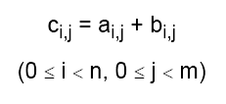
Example using 2-D grid and 2-D blocks
Adding two arrays
Corresponding elements of each array added together to form element of third array

Slide 21
CUDA version using 2-D grid and 2-D blocks
Adding two arrays
#define N 2048 // size of arrays
__global__void addMatrix (int *a, int *b, int *c) {
int col = blockIdx.x*blockDim.x+threadIdx.x;
int row =blockIdx.y*blockDim.y+threadIdx.y;
int index = col + row * N;
if ( col < N && row < N) c[index]= a[index] + b[index];
}
int main() {
...
dim3 dimBlock (16,16);
dim3 dimGrid (N/dimBlock.x, N/dimBlock.y);
addMatrix<<<dimGrid, dimBlock>>>(devA, devB, devC);
…
}

Slide 22
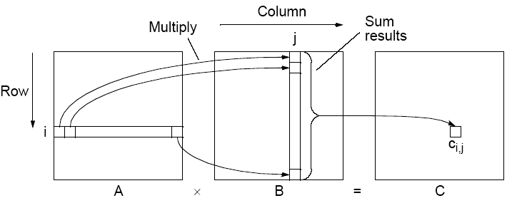

Example using 2-D grid and 2-D blocks
Multiplying two arrays
Matrix multiplication, C = A x B

Slide 23
Implementing Matrix Multiplication
Sequential Code
Assume matrices square (N x N matrices).
for (i = 0; i < N; i++)
for (j = 0; j < N; j++) {
c[i][j] = 0;
for (k = 0; k < N; k++)
c[i][j] = c[i][j] + a[i][k] * b[k][j];
}
Requires n³ multiplications and n³ additions
Sequential time complexity of O(n³). Very easy to parallelize.

Slide 24
Example using 2-D grid and 2-D blocks
Multiplying two arrays
__global__ void gpu_matrixmult(int *a, int *b, int *c, int N) {
int k, sum = 0;
int col = threadIdx.x + blockDim.x * blockIdx.x;
int row = threadIdx.y + blockDim.y * blockIdx.y;
if(col < N && row < N) {
for (k = 0; k < N; k++)
sum += a[row * N + k] * b[k * N + col];
c[row * N + col] = sum;
}
}
Question: Would this work with 1-D grid and 1-D blocks?

Slide 25
Questions

