Slide 1
An Introduction to FOSS
COMP8440: FOSSD
Lecture 1

Slide 2
What is FOSS?
Free and Open Source Software
    What does 'free' mean?
    Does providing source make it Open Source?
    Who makes FOSS? Why do they do it?
    Is FOSS just for fanatics and hobbyists?
    Can you make money with FOSS?
    Does FOSS make for better software?
Notes:
- introduce the concept of FOSS
- give an idea of the scope and scale of FOSS, number of projects,
number of users, number of developers etc
- introduce the many facets of FOSS
- meritocracy
- very brief information on FOSS history
- introduce the concept of 'the FOSS community'
- not a panacea

Slide 3
The many facets of FOSS
FOSS is different things to different people
    Some see it as a resource
    Some see it as an ethical choice
    Some see it as a technical choice
    Some see it as the enemy
    Some see it as just another type of software
What is FOSS to you?

Slide 4
Free as in Freedom
  "Free software" is a matter of liberty, not price. To understand the concept, you should think of "free" as in "free speech," not as in "free beer"
  (Richard Stallman, The Free Software Definition)

Slide 5
The Four Freedoms
* The freedom to run the program, for any purpose (freedom 0).
* The freedom to study how the program works, and adapt it to your needs (freedom 1). Access to the source code is a precondition for this.
* The freedom to redistribute copies so you can help your neighbor (freedom 2).
* The freedom to improve the program, and release your improvements (and modified versions in general) to the public, so that the whole community benefits (freedom 3). Access to the source code is a precondition for this.
    (Richard Stallman, The Free Software Definition)

Slide 6
Open Source
Open Source definition
    Open Source Initiative holds Open Source trademark
    Stewards of the Open Source Definition
    Similar in spirit to the four freedoms, but different emphasis
Let's have a look at the Open Source Definition:
http://www.opensource.org/

Slide 7
How big is FOSS?
How many projects?
    Certainly in 100s of thousands
    Over 230,000 projects registered on one site alone (sourceforge.net)
    Similar number of developers?
How many users?
    Depends on what you call a 'user' !
    Certainly many millions
What types of products?
    Not just for servers and desktops
    Huge presence in embedded market

Slide 8
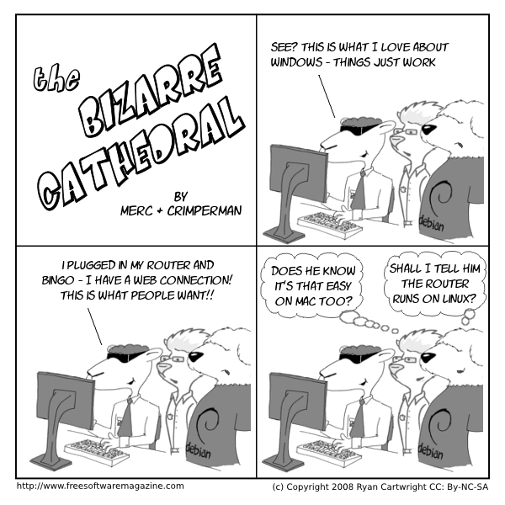

Slide 9
FOSS Community
Developer community
    Each FOSS project develops its own sub-culture
    Most have common elements
Some common factors
    Strong leaning towards meritocracy
    Right to fork, but reluctance to fork
    Technical focus
    Openness in communication

Slide 10
First Lab - a2ps
Download, compile, install
    Look carefully at the project while working with it
    Who wrote it? Who supports it?
    How do the docs differ from a proprietary app?
    How would you submit a bug report?
    How would you get help?
    How many people use a2ps?
    How active is development?
Lab docs
    make sure you read the lab work docs!
    especially look at the 'build tips' page

