Slide 1

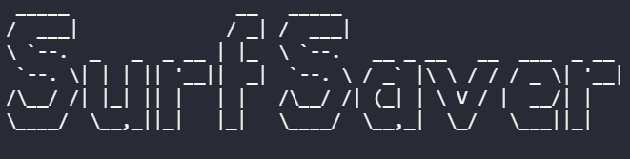
Portfolio – T1a3
LaurenceTuchin_T1A3

Slide 2
Use Case
Keep track of surfing sessions
Returns points to encourage surfing

Slide 3
Why I made it?
I got lazy and out of shape in lockdown
Needed a way to create more accountability
Easy way to track progress

Slide 4
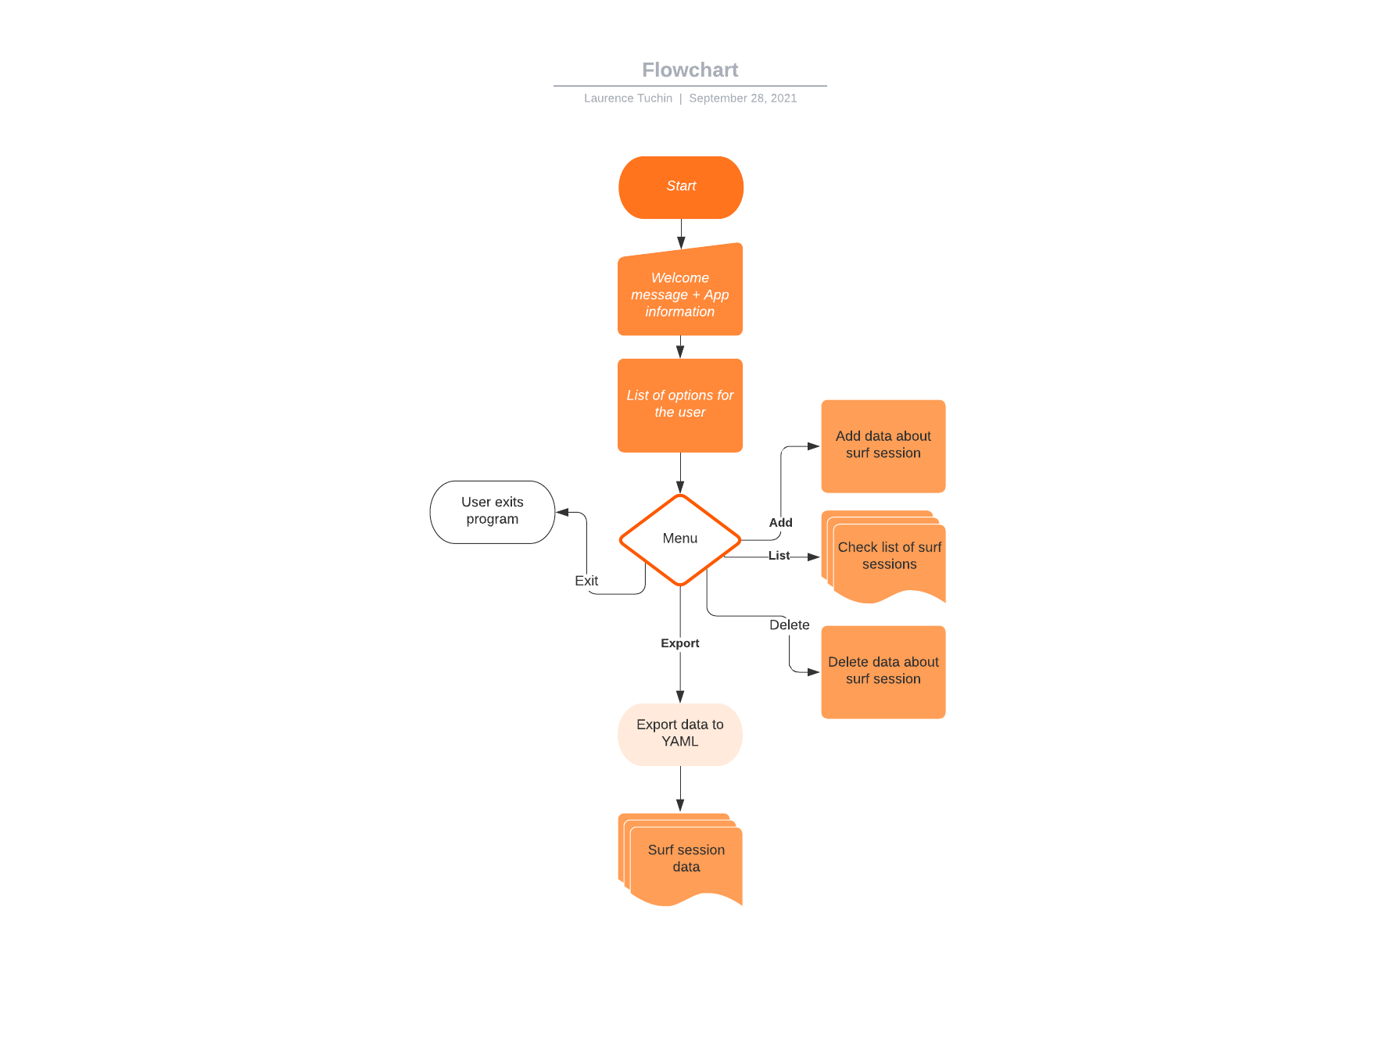
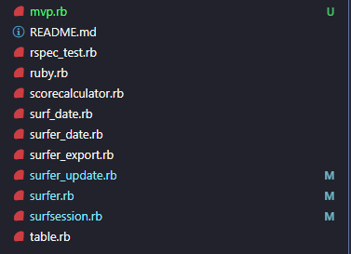
Flow Diagram

Slide 5
Interaction
Tty-prompt to handle user selection
Tty-font to create engaging text / logo
Colorize to highlight important text in relevant scenarios e.g. error handling in red
Tty-progress bar to compare to a goal score

Slide 6
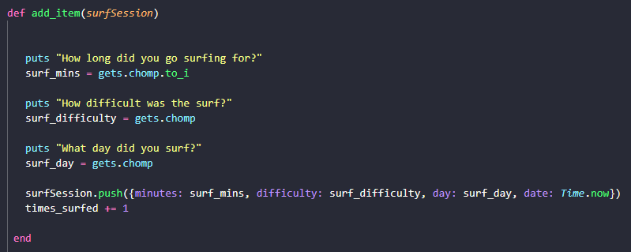
Feature 1
Tracking surf sessions
Add
Edit
Delete
Show

Slide 7

Feature 2
Export score to YAML

Slide 8
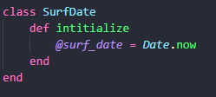
Feature 3
Tracks date user surfed
Will be useful for returning user info on last surf session
Future graph data on surf frequency
Easy to visualize data

Slide 9

Feature 4
Point score to encourage frequent activity
Rewards bonus points for surfing on weekdays
Points multiplier for level of conditions difficulty

Slide 10
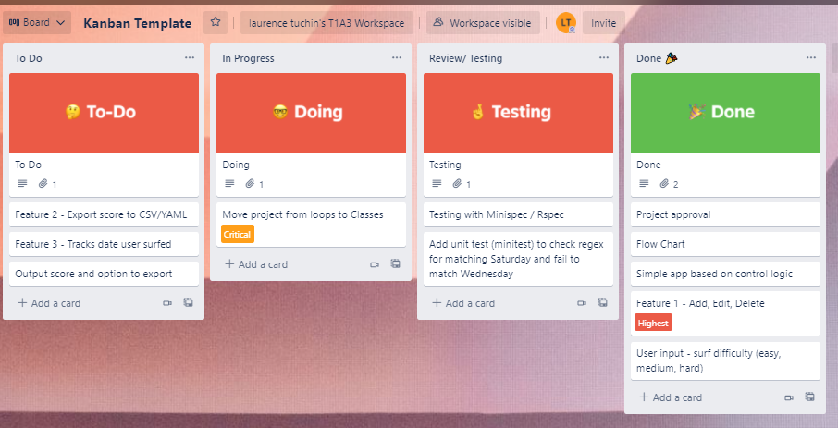
Development process

Slide 11
Build process
Build flow diagram to understand the structure
Start writing readme docs
Started with a simpler version of ruby file
Currently converting simpler build into classes
Testing

Slide 12
Challenges
How to get started
Using Classes to integrate data
Getting user input to work with classes
Understanding how to use some of the ruby gems

Slide 13
Ethical issues
Not relying on Youtube tutorials
Understanding how other users projects are built on Github
Source of learning materials
Collecting user data
Securely storing user data

Slide 14
Favorite parts
Understanding how to create an app from scratch
Learning how to integrate ruby gems
Writing out the code in simple loops then changing it over to classes

Slide 15
questions?

