Slide 1


Notes:
Hello judges and welcome to our pitch for GoldenHack 2020 - VirtuShop

Slide 2
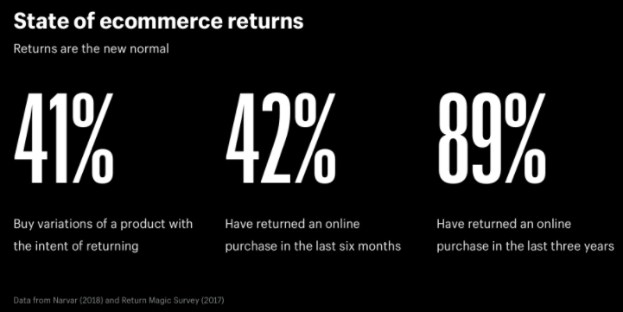
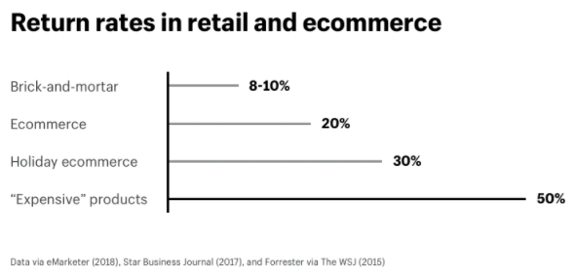
Problem Statement E-Commerce
The E-commerce Plague
Return rates as a threat to businesses
Notes:
Our problem statement is that as e-commerce has grown over time, so have return rates which pose a threat to businesses as they target profit margins and conversion rates. Returns are largely due to products not meeting expectations in the fit or look of products in real life versus what they saw online.

Slide 3
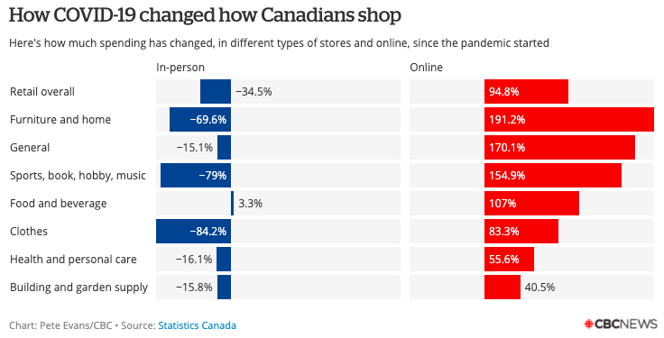
Problem Statement COVID-19
Economic Impact
E-commerce has been a recent trend, but has spiked during the pandemic
Psychological Effects
Loneliness
Adventure/Experience
Notes:
Recently, due to the COVID-19 pandemic, there has been a spike in online shopping trafic, as shown in the figure on the right. Consumers are now relying on e-commerce platforms for their daily spending in efforts to stay home safely, which has influenced businesses to follow. This pandemic’s psychological effect has caused consumers to crave adventure amidst isolation

Slide 4
Solution VirtuShop
Mobile AR Personal Shopping App
“Bringing the Shopping to You”
Browsing
Virtual dressing room
AI assistant
Addressing the Problem
Reducing the return rate
Uplifting small businesses
Keeping people safe at home
Providing entertainment/adventure for consumers
Notes:
Our solution is VirtuShop - a mobile AR personal shopping app that brings the shopping experience home to you. VirtuShop allows you to access stores at the tips of your fingers - browse through items, add products to your basket, try things on, and checkout. There is even an AI assistant to help enrich your shopping experience!

Slide 5


Prototype/Demo
Businesses will register via website to be included on the app
Users will download the app on their respective app store
Notes:
Now we present our prototype or demo of the application. For businesses, they will mainly interact with our website to register and become a member of the application. The website also includes info about our product and what we’re all about. For users, they will be asked to register and scan a 360 view of their environment, then choose a store to enter. The environment captured will be transformed into the store’s physical layout creating a virtual store through augmented reality. Users can turn their cameras to look through items, walk up to items, and also swipe through “filters” (similar to Snapchat filters) to checkout various sections such as the women’s department or the clearance rack. When users click on a specific item, they have the option to add to their basket where they may customize the color or size before purchasing or try it on. To try on something, the user will have selected a mannequin size corresponding to their size, and the item’s size will match the mannequin and displayed on the mannequin. The last feature of this app is a customizable virtual bot assistant. This AI character would replace the retail salespeople, and will appear at the touch of a button to assist the consumer with their shopping experience.

Slide 6

Business Model
Key Partners
Sponsorships
Key Activities
Mobile/AR development
Marketing
R&D
Customer Segments
Free users
Retailers
Channels
Social media
App store
Cost Structure
Development, marketing, R&D
Revenue Streams
Retailers’ yearly subscription
Discount price for small/local businesses
In-app purchases
Key Resources
Mobile/AR developers
Value Proposition
Shopping experience from home
Customer Relationships
Self service application
Notes:
Here, we have our business model. The key components to note here are the cost structure, which are costs for our key activities, as well as our revenue streams, which come from the yearly subscription charged for retailer members of the app. These prices are also discounted for small local businesses. A future revenue stream will be in-app purchases by consumers

Slide 7

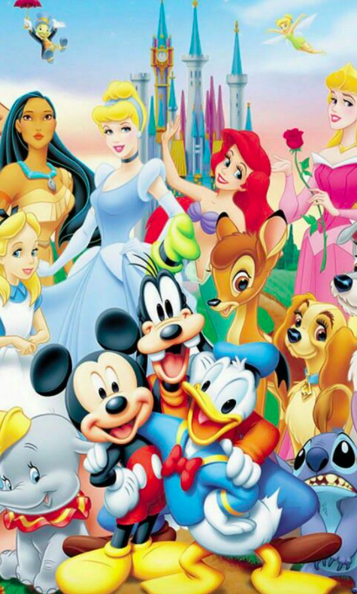
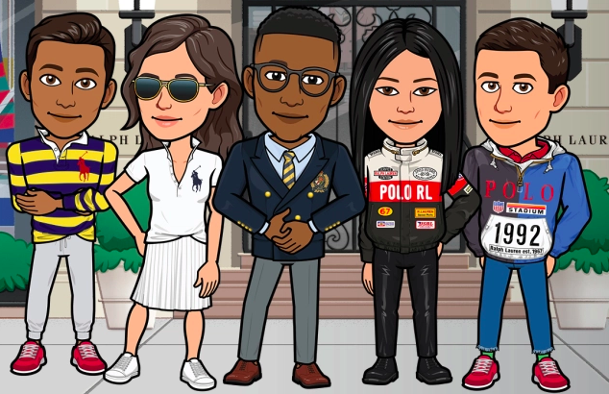
Next Steps - Future Growth
Development
Hire mobile/AR developers to follow through on design
Corporate
Reach out and obtain businesses to include on the app - ongoing
Marketing
Hire marketers to start campaigning
Ex. Partnerships with influencers via social media
Future Features
In-app purchases
Customizable character AI assistants
Create your own avatar to try on products
Notes:
Finally, we talk about the next steps. First, we would need to hire developers to actually develop it. Second, we’d need to reach out to get our initial businesses on board. Third, we’d need to hire marketers to campaign. Lastly, once we have acquired some profit, we would implement new features such as being able to customize your AI assistant to be any character from Disney to Harry Potter to any other companies that we may be able to purchase permission from to use their characters - this would be an in-app purchase to help drive revenue. Another feature allows consumers to create their own avatars, similarly to Snapchat’s bitmojis, to try on products instead of a standard mannequin.

Slide 8

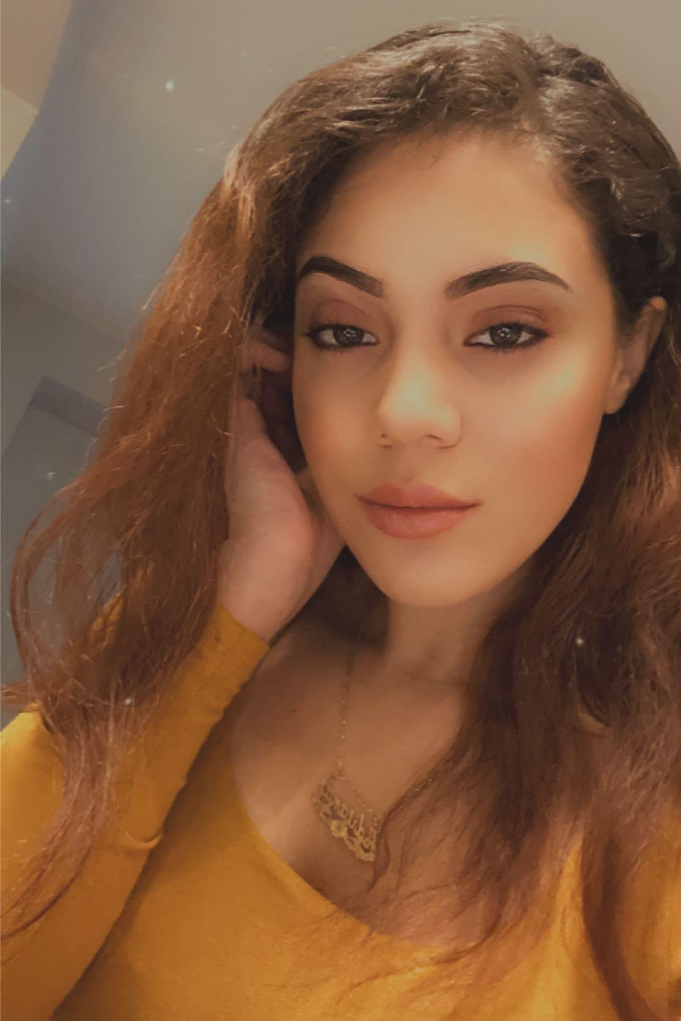
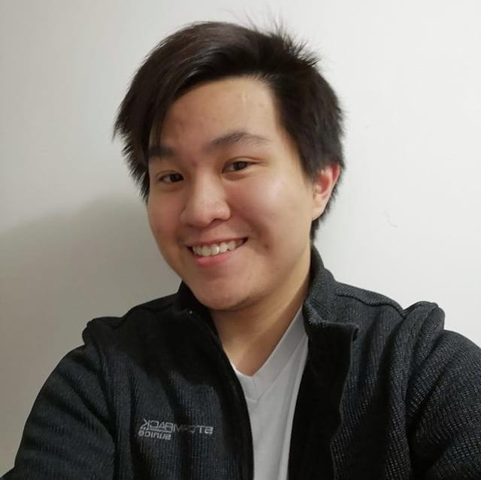

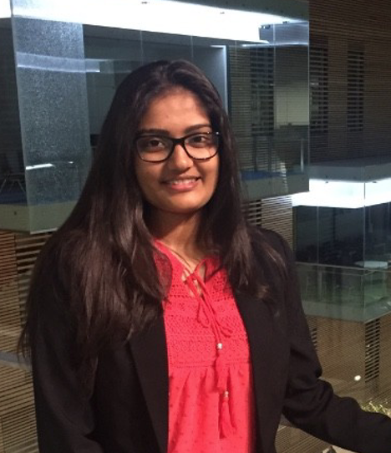
Our VirtuTeam
Steven Tran
4th Year Computer Science
Lauren Chae
4th Year Computer Science/
Business
Hitanshi Shroff
4th Year Computer Science/
Business
Adriana Abella
4th Year Computer Science
Notes:
The last slide contains some sources, feel free to check them out! And that’s the pitch! On behalf of the VirtuTeam, thank you for your time and consideration. We hope you stay safe and healthy during these unprecedented times. Thank you!

Slide 9


Appendix - Research Sources
Shoppertainment
https://techwireasia.com/2020/03/shoppertainment-the-secret-to-e-commerce-success-right-now/
E-Commerce
https://www.cbc.ca/news/business/online-shopping-covid-19-1.5661818
Augmented Reality Shopping
https://www.macleans.ca/economy/what-will-shopping-in-canada-look-like-in-the-aftermath-of-coronavirus/

