Slide 1
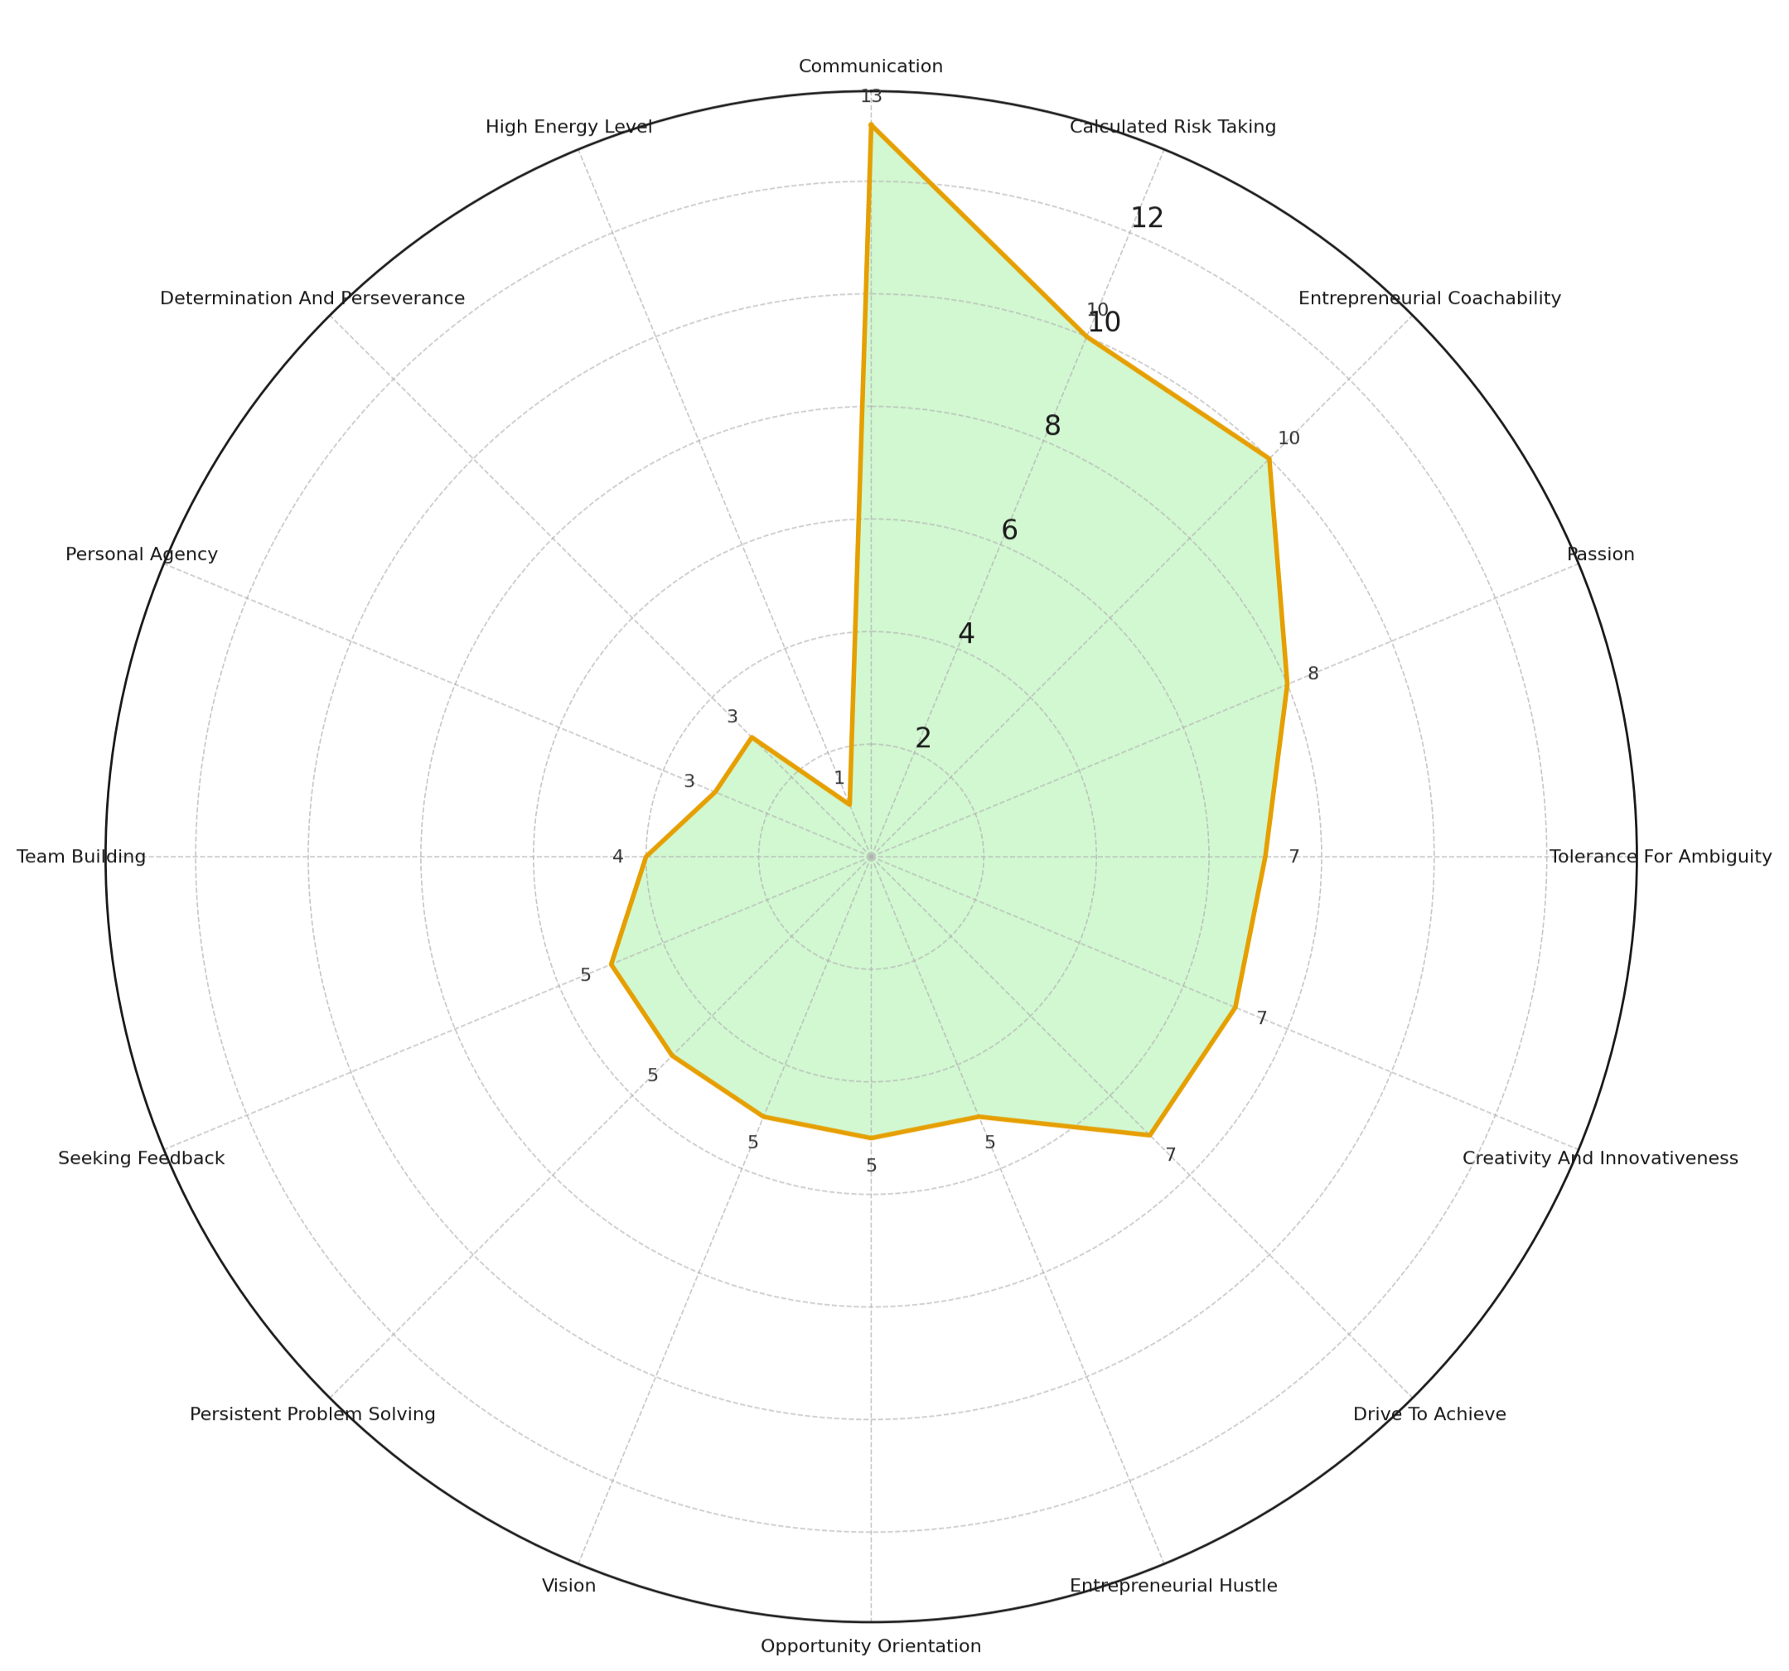
E-IDP Results
This radial chart shows how often each entrepreneurial characteristic was selected by students.
Each of the 16 characteristics appears around the outside of the circle, with the distance from the center representing the number of students who chose it.
The further out the shape extends, the more common that characteristic was. The top 5:
Communication was chosen the most (13 students),
Calculated Risk Taking (10)
Entrepreneurial Coachability (10)
Passion (8)
Tolerance for Ambiguity (7)
By looking at the overall shape, you can see which traits were most emphasized across the group and which ones were less common.
N = 33 (out of 48); 68.75%

