Slide 1
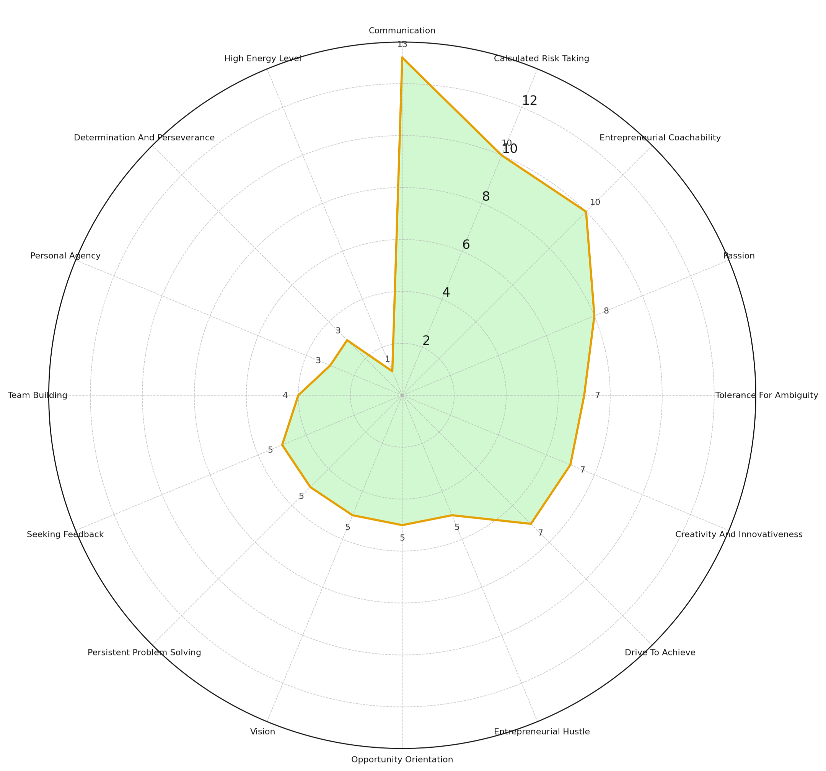
Your E-IDP Results
This radial chart shows how often each entrepreneurial characteristic was selected by students.
Each characteristic appears around the outside of the circle, with the distance from the center representing the number of students who chose it.
The further out the shape extends, the more common that characteristic was. The top 5:
Communication (13 students)
Calculated Risk Taking (10)
Entrepreneurial Coachability (10)
Passion (8)
Tolerance for Ambiguity (7)
By looking at the overall shape, you can see which traits were most emphasized across the group and which ones were less common.
N = 33 (out of 48); 68.75%

Slide 2
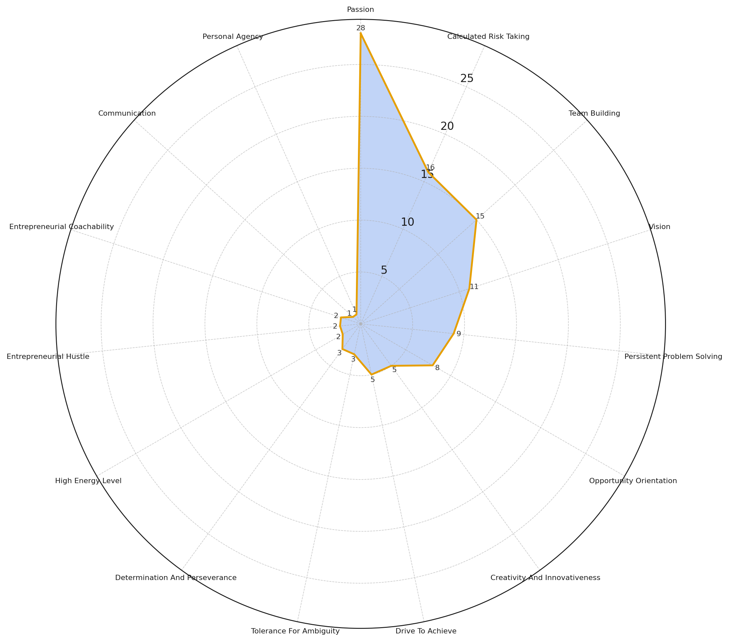
Luke’s E-IDP Results
This radial chart shows how often each entrepreneurial characteristic was selected by students for Luke Holden of Luke’s Lobsters.
Each characteristic* appears around the outside of the circle, with the distance from the center representing the number of students who chose it.
The further out the shape extends, the more common that characteristic was. The top 5 are:
Passion (20 students)
Calculated Risk Taking (14)
Team Building (12)
Persistent Problem Solving (11)
Vision (11)
By looking at the overall shape, you can see which traits stood out most strongly across the group and which ones were less common.
N = 37 (out of 48); 77.08%
*Note: Seeking Feedback was not chosen by any student.

