Slide 1
Impacts of Food Prices on Outcomes of Interest Anne T. Byrne USDA Economic Research Service Research Agricultural Economist Workshop on Food Prices and Forecasting July 31, 2024
Notes:
Tips for converting from standard size to widescreen
Click “Design” Tab
Click “Slide Size”
Click “Widescreen (16:9)”
Resize images for widescreen
Click on “View” tab
Click “Slide Master”
Right-click on the image on the master slides (slides 1 and 2)
Click “Size and Position”
Check “Lock aspect ratio”
Use arrow key on “Scale Height” box and image will automatically resize to correct proportion. Increase percentage until the image fits the screen.
To resize the footer, increase percentage to 133%.

Slide 2
Disclaimer
The findings and conclusions in this presentation are those of the author and should not be construed to represent any official USDA or U.S. Government determination or policy.

Slide 3
Food Markets
Food
Food at Home
Produce
Citrus
Oranges
…

Slide 4
Food Markets
Food
Food at Home
Produce
Citrus
Oranges
…
Time Period
&
Geographic Coverage

Slide 5
Food Markets
Food
Food at Home
Produce
Citrus
Oranges
…

Slide 6
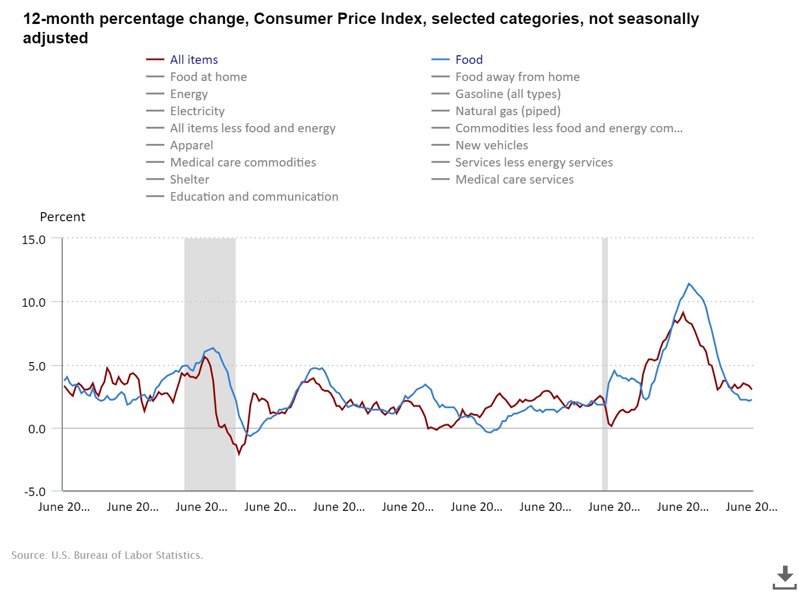
Food prices are described by the Food CPI

Slide 7
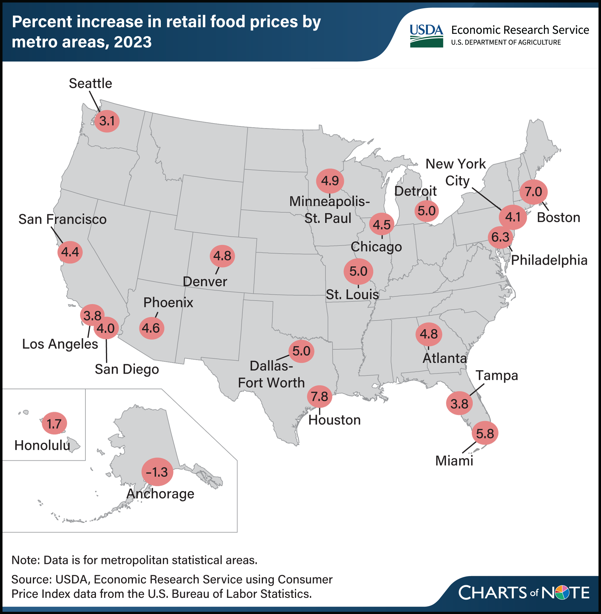
Food prices may vary by geography

Slide 8
Overall food inflation impacts…
Household budget shares
The Bureau of Labor Statistics reports that the average household spends 12.8% of its income on food.
Nutrition and diets
Harding and Lovenheim (2017) found that a nutrient tax (i.e., a 20% tax on sugar) had a more positive effect on nutrition than a “soda tax.”
Food security
In the U.S.: Gregory and Coleman-Jensen (2013) found a one-standard deviation increase in food prices associated with 5.0%, 5.1%, and 12.4% increases in the prevalence of food insecurity in SNAP households, adults, and children.
Internationally: Swinnen and Squicciarini (2012) noted that spikes in food prices increase the cost of food for consumers but increase incomes of farmers, who represent the bulk of the world's poor.
Notes:
https://onlinelibrary.wiley.com/doi/full/10.1093/aepp/ppt024
https://www.science.org/doi/full/10.1126/science.1210806

Slide 9
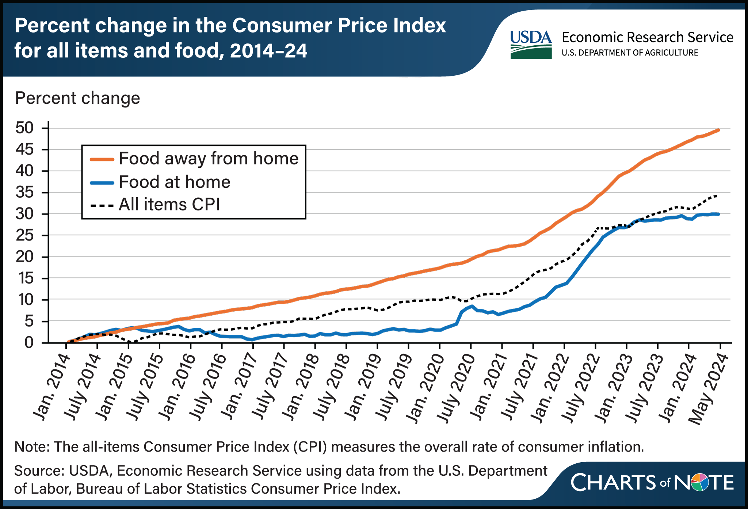
Food is often separated into FAH and FAFH

Slide 10
Food Markets
Food
Food at Home
Produce
Citrus
Oranges
…

Slide 11
FAH prices impact…
Outlet selection
Von Freymann (2002) interviewed types of shoppers and found many shoppers have a “market basket reservation price” which informs initial and ongoing store choice.
Food and nutrition programs
SNAP benefit levels are tied to the Thrifty Food Plan, which considers the cost of a healthy diet at current prices.
Bronchetti, Christensen, Hoynes (2019) describe differences in SNAP purchasing power induced by differences in local food prices using the Quarterly Food-at-Home Price Database from ERS. They found that lower purchasing power leads to “lower utilization of preventive health care and more days of school missed due to illness.”
Economic perception
D’Acunto, Malmendier, Ospina, and Weber (2021) found that frequently purchased items and overall grocery bundles inform expectations about aggregate inflation.
Notes:
https://onlinelibrary.wiley.com/doi/full/10.1093/aepp/ppt024
https://www.science.org/doi/full/10.1126/science.1210806

Slide 12
Food Markets
Food
Food at Home
Produce
Citrus
Oranges
…

Slide 13
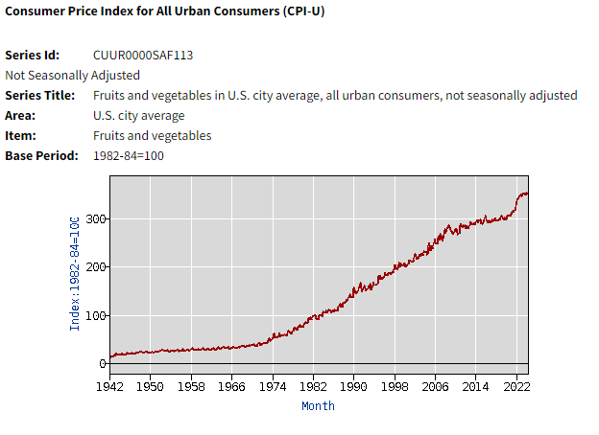
Produce Prices are described by the Fruits and Vegetables Price Index
Source: Bureau of Labor Statistics
Notes:
More detail about price indexes for fruit from BLS and ERS tomorrow

Slide 14
Produce prices impact…
Nutrition and diets
Steele-Adjognon and Weatherspoon (2017) and others that have studied nutrition incentive programs have found that reducing the relative price of fruits and vegetables increased vegetable expenditures, fruit and vegetable expenditure shares, and the variety of fruits and vegetables purchased.
Food and nutrition programs
Çakir et al. (2018) found significant differences in fruit and vegetable purchasing power using WIC vouchers
FNS price parity waivers are available to create programs like Double Up Bucks.
Notes:
https://onlinelibrary.wiley.com/doi/full/10.1093/aepp/ppt024
https://www.science.org/doi/full/10.1126/science.1210806

Slide 15
Food Markets
Food
Food at Home
Produce
Citrus
Oranges
…

Slide 16
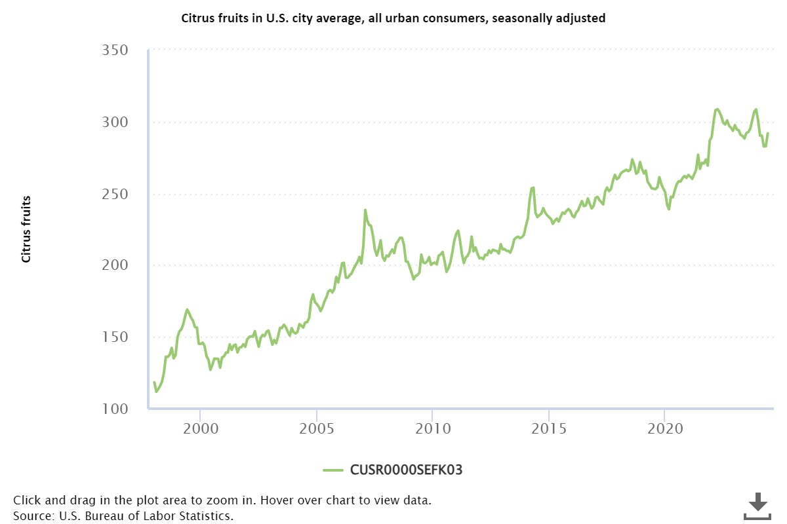
Citrus prices are described by the Citrus Price Index
Notes:
Cold snap in 2007 affected prices

Slide 17
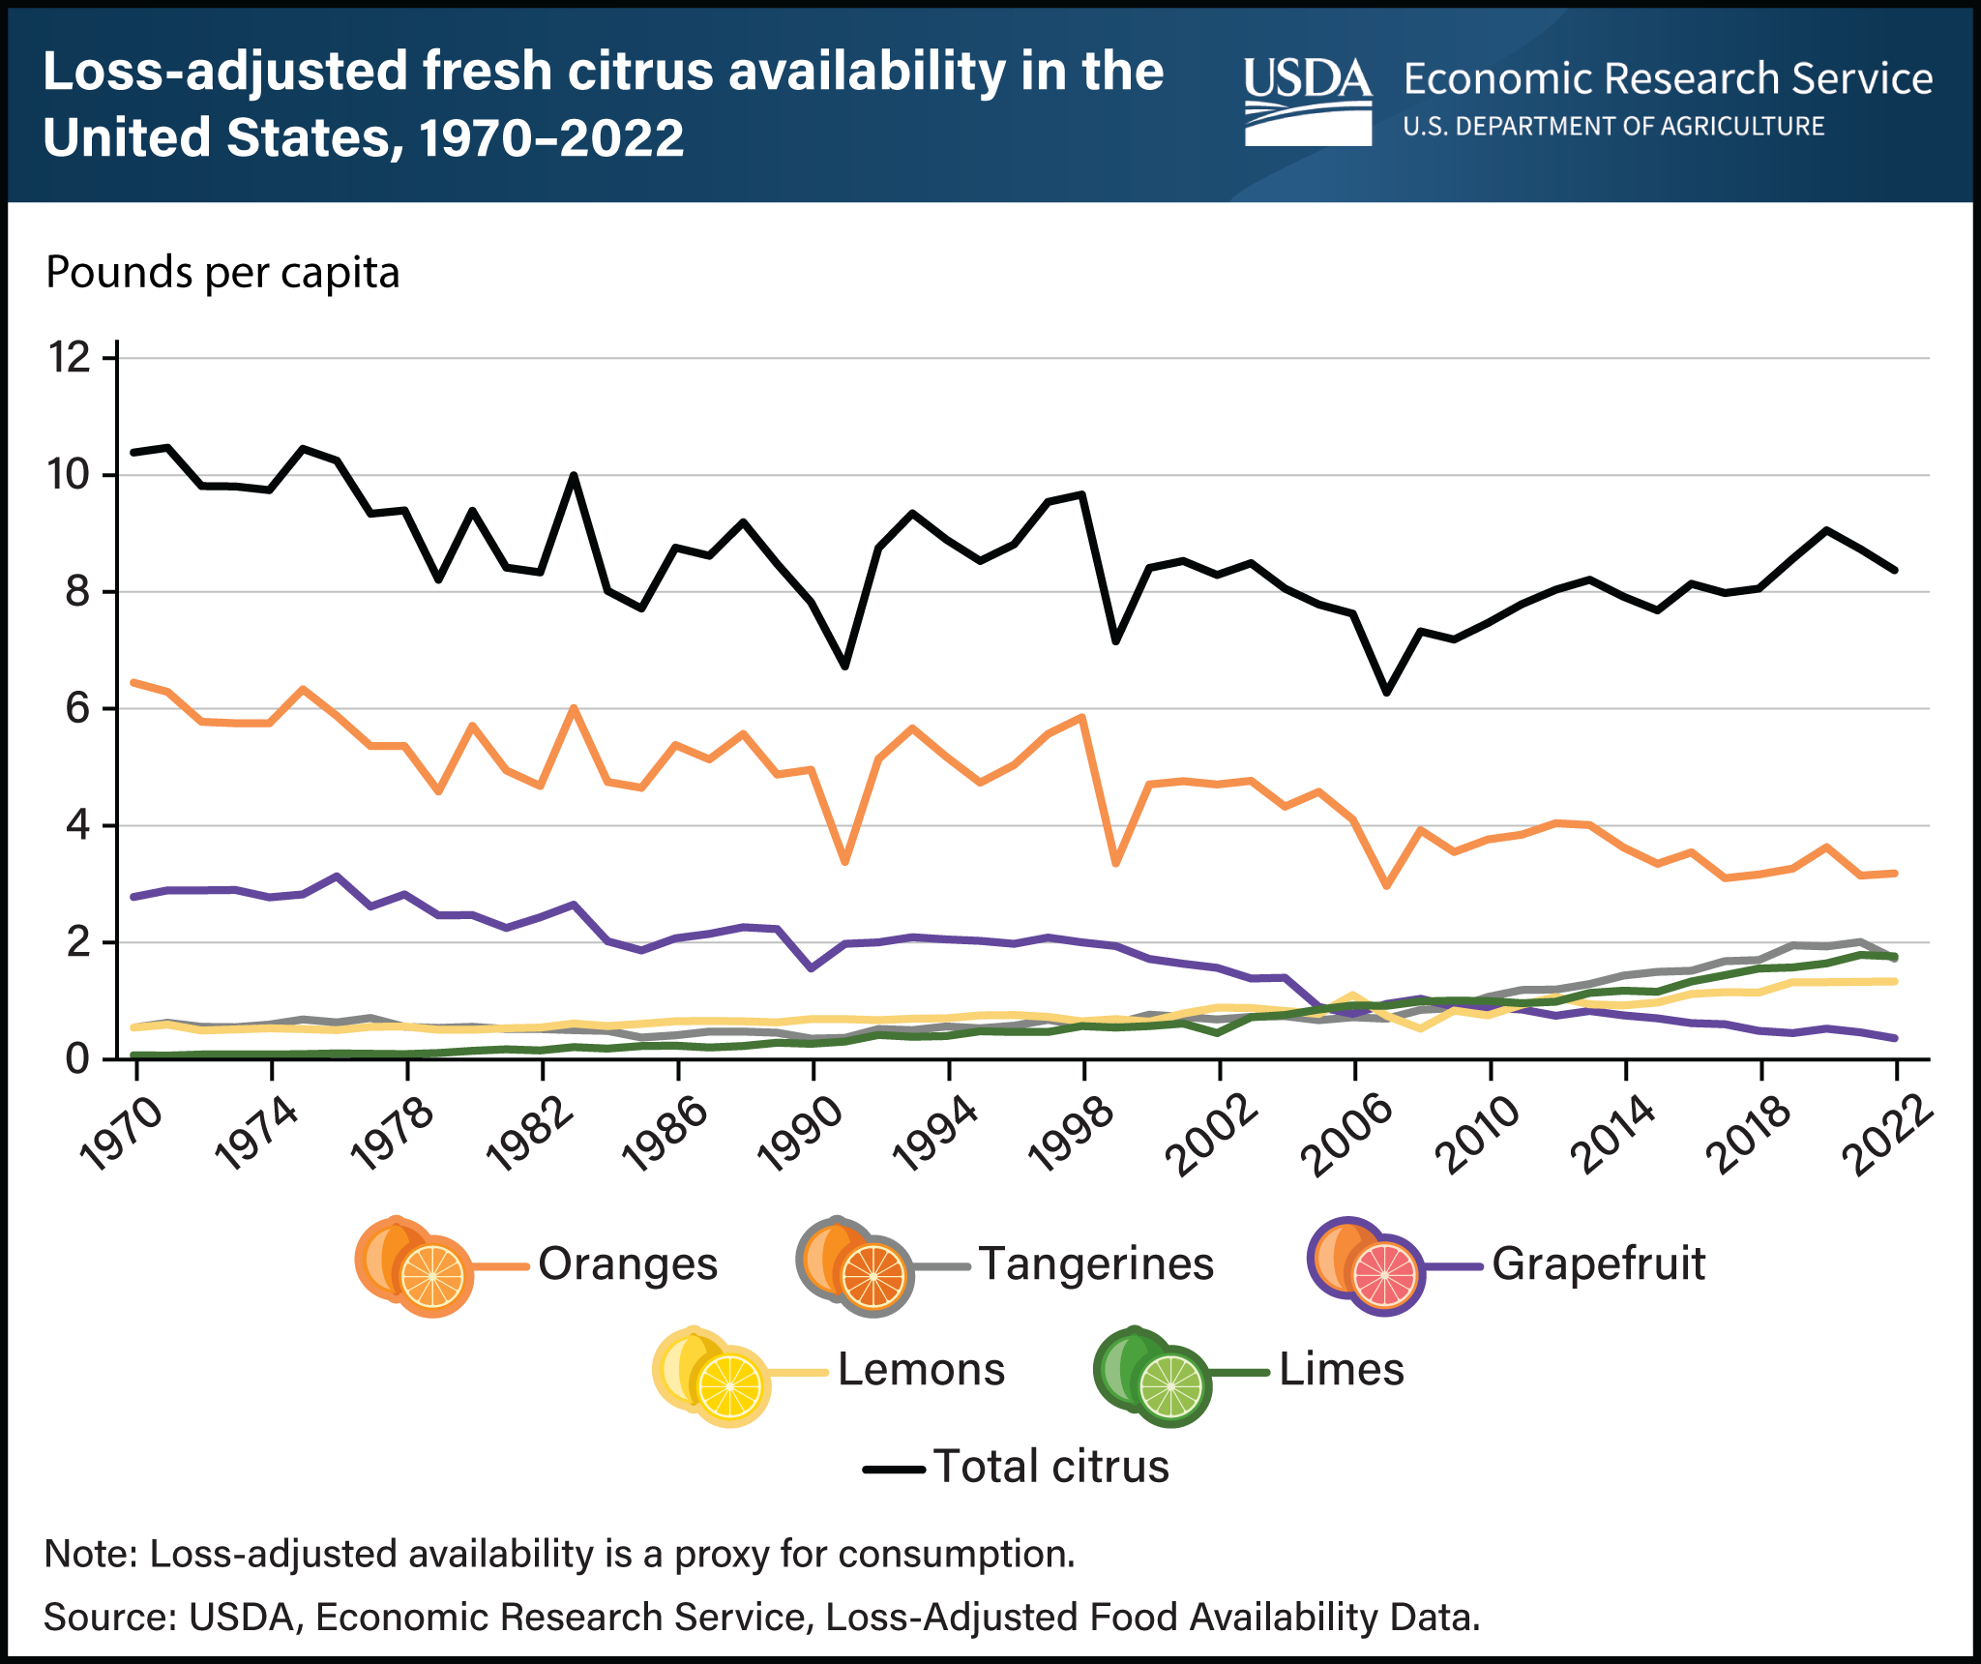
Price indexes are useful when you have changes in basket composition and/or quality changes

Slide 18
Prices for citrus may impact…
Consumption of citrus
Stewart et al. (2024) reports a reduction in citrus consumption which is in part attributed to higher prices.
Consumption of related goods
Dong et al. (forthcoming) estimate the cross-price elasticity of demand for citrus juice and other fruit juice, finding that a 10% increase in the price of citrus would increase purchases of other juices by 2.96%.
Industry and trade decisions
The USDA, Foreign Agriculture Service reports increases in Egypt’s citrus exports have been on an upward trend for over a decade in part due to the opening of new markets.

Slide 19
Food Markets
Food
Food at Home
Produce
Citrus
Oranges
…

Slide 20
Fruit and vegetable prices are available from ERS
ERS Fruit and Vegetable Prices: Oranges
Oranges—Average retail price per pound or pint and per cup equivalent, 2022
Form | Average retail price |  | Preparation yield factor | Size of a cup equivalent |  | Average price per cup equivalent
Fresh¹ | $1.46 | per pound | 0.68 | 0.408 | Pounds | $0.88
Juice
Ready to drink² | $1.06 | per pint | 1 | 8 | Fluid ounces | $0.53
Frozen³ | $0.73 | per pint | 1 | 8 | Fluid ounces | $0.37

Slide 21
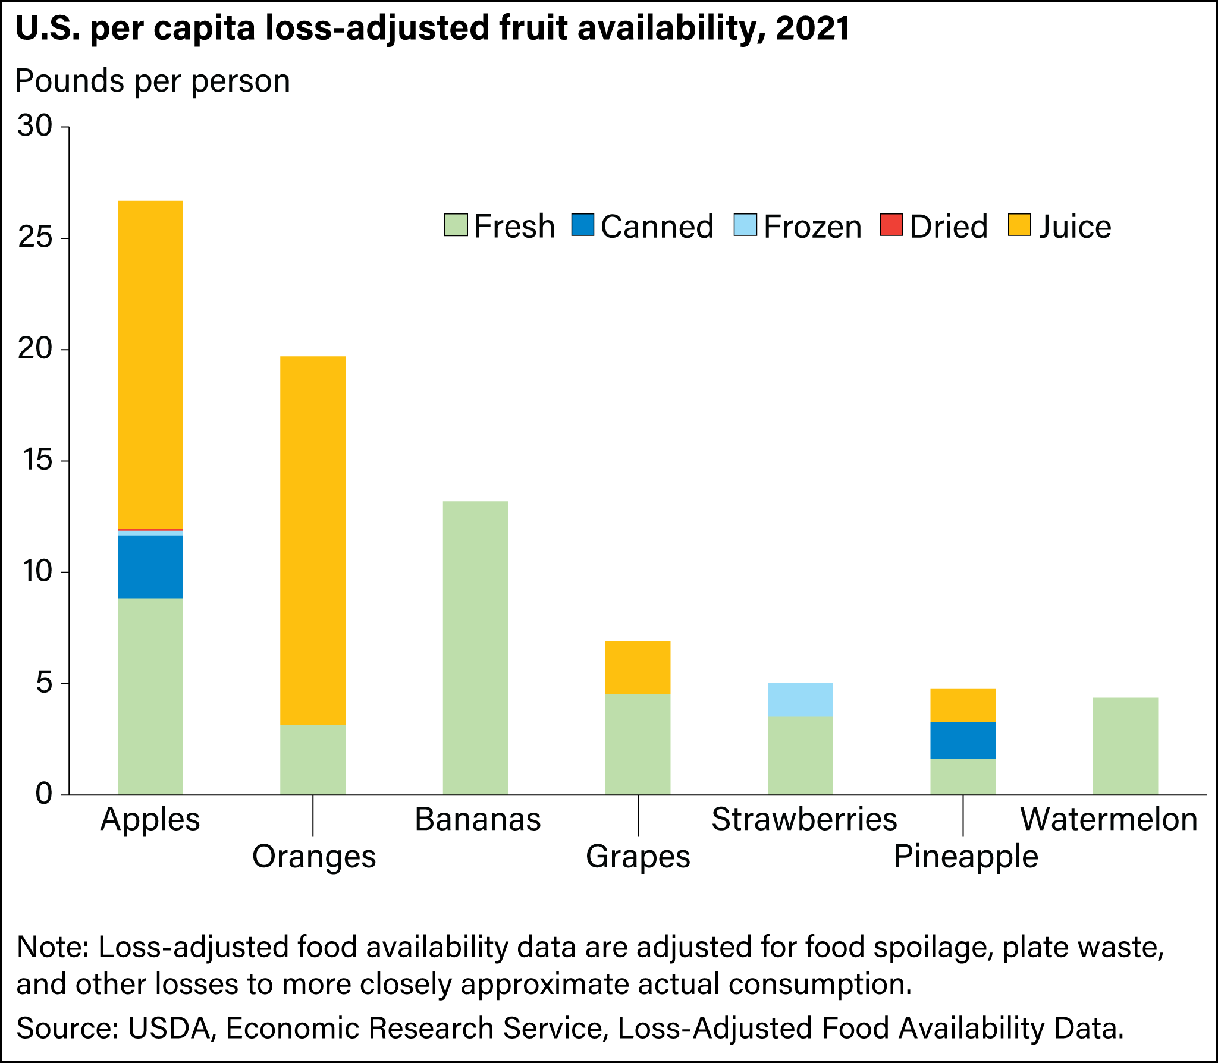
Oranges are a very common food, especially in juice form

Slide 22
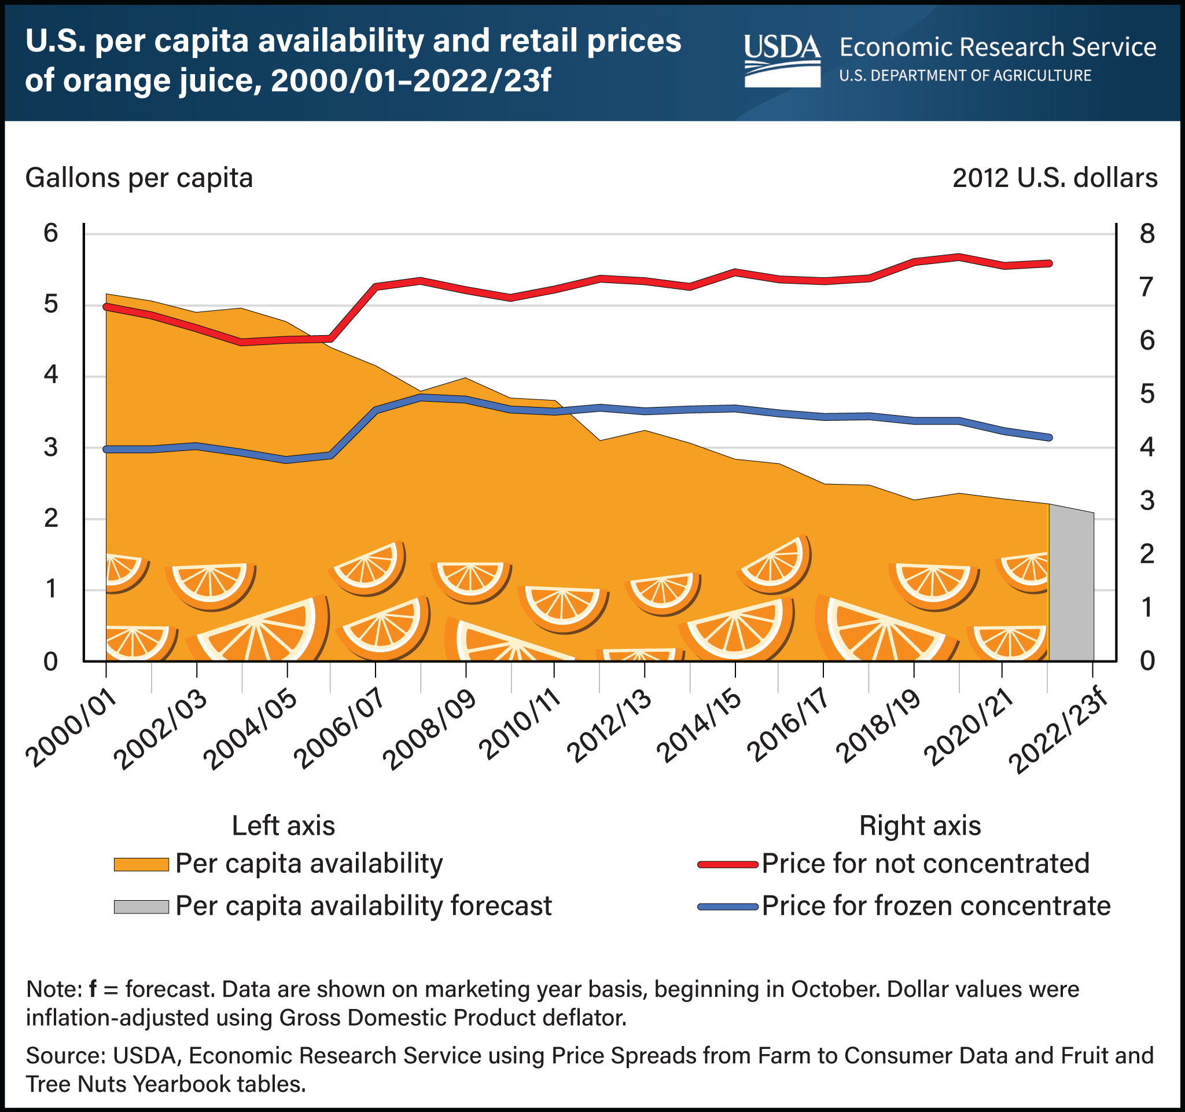
Average orange juice prices have risen since 2000
Notes:
Inflation adjusted – still rose

Slide 23
Orange prices may impact…
Consumption of oranges and related goods
Orange production decisions
Cerdà et al. (2019) report that “due to the reduction in the prices of oranges on the market and social changes such as the aging of the population, traditional orange plantation abandonment in the Mediterranean is taking place.”

Slide 24
Food Markets
Food
Food at Home
Produce
Citrus
Oranges
…

Slide 25
Products can be further disaggregated by characteristics
Formulation
Organic versus conventional
Local
Labeled with country of origin
Labeled with health claims
Brand
Outlet
…

Slide 26
Prices of products with specific attributes may impact…
Production and marketing decisions
Kim, House, and Gao (2012) found an increased willingness to pay for juice squeezed in front of consumers.
Chen et al. (2016) found Chinese consumers willing to pay more for orange juice drinks with higher juice content.
Bi et al. (2015) estimated differences in willingness to pay for organic versus conventional orange juice.

Slide 27
Conclusions
There are numerous different food price measures, which include various price indexes, average prices, and product-specific price data.
Impacts of prices are far-reaching and include food security (and associated outcomes), diet and health outcomes, purchase decisions, and producer decision-making.
Notes:
5 minutes

Slide 28
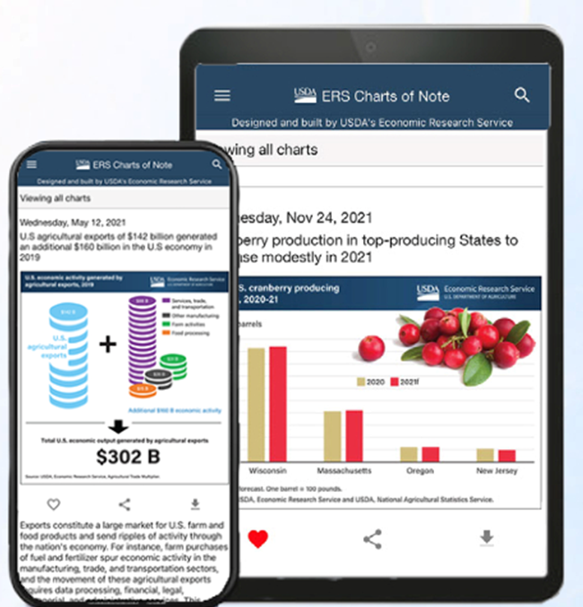



Like, Share, & Follow ERS
www.ers.usda.gov
www.ers.usda.gov/
data-products/charts-of-note
@USDA_ERS
linkedin.com/company/
usda-economic-research-service
Subscribe to Weekly E-mail Notifications: www.ers.usda.gov/subscribe
Learn About Careers at ERS: www.ers.usda.gov/about-ers/careers-at-ers
Notes:
Single Slide Closing Option
Before I close, I’d like to note a few ways you can stay up-to-date with ERS research.
Visit our website – www.ERS.USDA.gov – to explore our research and find full copies of our reports.
View a variety of webinars on ERS reports and data products by going to the multimedia section of our newsroom page.
Go to www.ers.usda.gov/subscribe and subscribe to email updates about specific products of interest such as the Livestock, Dairy, and Poultry Outlook (edit according to your audience’s interests).
You can even subscribe to receive articles from our Amber Waves Magazine and ERS Charts of Note.
Speaking of Charts of Note, I’d like to give a shoutout to our new Charts of Note Mobile App – available in Google Android & Apple app stores.
This app – free of cost – delivers the latest Charts of Note straight to your mobile device. You can search the entire Charts of Note library, mark your favorites and share them on social media.
As always, ERS continues to shape our research program and products to best serve a variety of consumers who rely on our research to make or influence public policy and program decisions every day. This app is just one of many ways we work to get our research to those who need it most.
On social media, you can find us on X (@USDA_ERS) and LinkedIn (USDA Economic Research Service). Follow us to learn about ERS research, events, and more.
Remember to keep ERS in mind in your future pursuits – whether as a helpful resource or potential career path. We’re always seeking the best and the brightest minds to advance our research.
For a list of current ERS openings, visit our careers webpage listed at the bottom of this slide.

Slide 29
Anne T. Byrne USDA Economic Research Service Research Agricultural Economist anne.byrne@usda.gov

