Slide 1

Global Food Price Inflation:
Trends, Channels, and Insights
John Baffes
World Bank
2024 AAEA Annual Meetings
Workshop on “Food Prices and Forecasting”
July 31 – August 1, 2024
New Orleans Marriott

Slide 2
Outline
Commodity prices and global supply conditions
Global food price inflation profile
Likely causes and channels of food price inflation
2

Slide 3
Outline
Commodity prices and global supply conditions
Global food price inflation profile
Likely causes and channels of food price inflation
3

Slide 4
Aggregate commodity price indexes
Broadly stable in 2024 but elevated compared to pre-pandemic (2015-2019) averages
Source: World Bank
Notes: Last observation is June 2024. Shaded area begins in April 2020.
4

Slide 5
Food commodity prices
Food prices in 2024H1 averaged about 30 percent higher than pre-pandemic levels
Source: World Bank
Notes: Last observation is June 2024. Shaded area begins in April 2020.
5

Slide 6
Grains and edible oils supply growth
The ongoing global crop stands at comfortable levels compared its long-term average growth
Grains
Edible oils
mmt
mmt
Source: U.S. Department of Agriculture and World Bank.
Notes: Years refer to crop seasons (e.g., 2024 refers to the 2023-24 crop season). Last observation reflects the USDA update from July 2024; mmt = million metric tons.
6

Slide 7
Global food inventories (stocks-to-use ratio, percent)
Despite easing, inventories relative to consumption are much higher than pre-2014 levels
Grains
Aggregate
Source: U.S. Department of Agriculture and World Bank.
Notes: Years refer to crop seasons (e.g., 2024 refers to the 2023-24 crop season). Last observation reflects the USDA update from July 2024. The aggregate index consists of 12 grains, oilseeds, and edible oils commodities, weighted by calorific content.
7

Slide 8
Outline
Commodity prices and global supply conditions
Global food price inflation profile
Likely causes and channels of food price inflation
8

Slide 9
U.S. and Euro Area inflation profiles
Core is slowly falling and well above target while food is close to pre-pandemic
Headline
Core
Food
Sources: Bureau of Labor Statistics; Eurostat; World Bank.
Note: Last observation is June 2024.
9

Slide 10
Global inflation profile
Falling across most income groups, core seen flattening
Headline
Core
Food
Sources: Haver Analytics; Ha, Kose, and Ohnsorge (2020); World Bank.
Note: Last observation is June 2024. AEs = Advanced Economies; EMDEs = Emerging Market and Developing Economies. Group median inflation for up to 35/31/23 AEs and 101/46/95 EMDEs.
10

Slide 11
Core vs food price inflation
Globally, food price inflation during 2022-23 was twice as high as core inflation
Sources: Haver Analytics; World Bank.
Note: Inflation represents average monthly percent changes over 2022-23, year-on-year. AEs = Advanced Economies, EMDEs = Emerging Market and Developing Economies.
11

Slide 12
Food price index for the G20
The median cumulative increase across the G20 from 2020Q4 to 2023Q4 was 23 percent
Sources: Food and Agriculture Organization of the United Nations (FAOSTAT database); World Bank.
Note: European Union and the Africa Union (both part of the G20) are not shown due to the unavailability of aggregate data. In 2023, G20 countries accounted for nearly 80% of global GDP.
12

Slide 13
Consumer expenditures spent on food in selected countries
The share of household expenditures spent on food ranges from 6.7 percent (U.S.) to 59 percent (Nigeria)
Median
Sources: U.S. Department of Agriculture, 2022 edition.
Note: Consumer expenditures refer to personal spending on goods and services. The chart illustrates data from 27 out of 104 countries surveyed. The median share of consumer expenditures across the entire sample is 23.1% while the median per capita expenditure is $1,720.
13

Slide 14
Outline
Commodity prices and global supply conditions
Global food price inflation profile
Likely causes and channels of food price inflation
14

Slide 15
Persistent food price inflation
Rising food CPI amid falling global food prices
19 months
Source: World Bank; FAO.
Notes: Last observation for Global Food CPI is December 2023, and for the Food Price Index, it is June 2024. The CPI is calculated using weights from food expenditures for each country, adjusted to purchasing power parity. The shaded areas highlight three periods of boom-bust cycles in food commodity prices since 2000: May 2007 to November 2008, July 2015 to July 2020, and the ongoing period from April 2020 to June 2024. The duration of these cycles was estimated using a frequency-domain approach (Baffes and Kabundi 2023).
15

Slide 16
Crude oil price, 2000-2024
The oil price increase during 2022 was moderate compared to 2007-08 and 2011-14
Source: World Bank.
Notes: Last observation is June 2024.
16

Slide 17
Crude oil vs consumption-weighted energy indexes
The consumption-weighted energy index shows a sharper rise during the pandemic
Source: BP Statistical Review and World Bank.
Notes: Last observation is June 2024. The Consumption-weighted index uses the average consumption shares for 2021-22, measured in Exajoules, with the following weights: Coal (32.6%), crude oil (37.6%), and natural gas (29.8%). The World Bank’s energy price index, displayed earlier, is based on exports values by EMDEs, with these weights: Coal (4.7%), crude oil (84.5%), and natural gas (10.8%). The shaded areas correspond to the same periods as in the pervious slide.
17

Slide 18
Key takeaways
The surge in headline and food price inflation during 2022-23 is a global phenomenon, impacting most economies. At its peak in the last quarter of 2022, global food price inflation was twice as high as core inflation.
This trend was driven by several pandemic-related factors, including supply chain disruptions amid lockdowns, wage increases due to tight labor markets, and fiscal policies aimed at smoothing consumption to avert recession. Additional trade disruptions following Russia’s invasion to Ukraine exacerbated the situation.
The rise in food price inflation reflected, in part, increasing food commodity prices, driven mostly by cost factors, rather than supply shortfalls as seen during the 2007-08 and 2010-11 periods. Energy prices, particularly those of coal and natural gas, played a significant role, with oil being less impactful. Energy prices peaked at the end of 2022, reaching more than four times their pre-pandemic average. As Blanchard and Bernanke (2024) noted “Globally … inflation was due primarily to supply disruptions and sharp increases in the prices of food and energy.”
Although inflation has declined, it remains above pre-pandemic levels, and the progress has been uneven across countries. Most central banks are now focused on bringing inflation down to target levels.
18

Slide 19
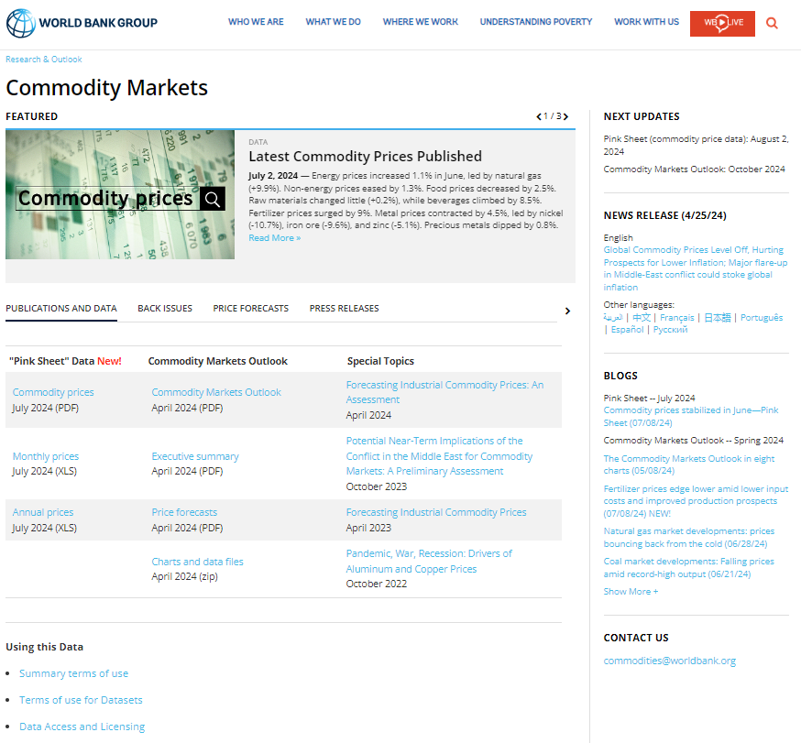
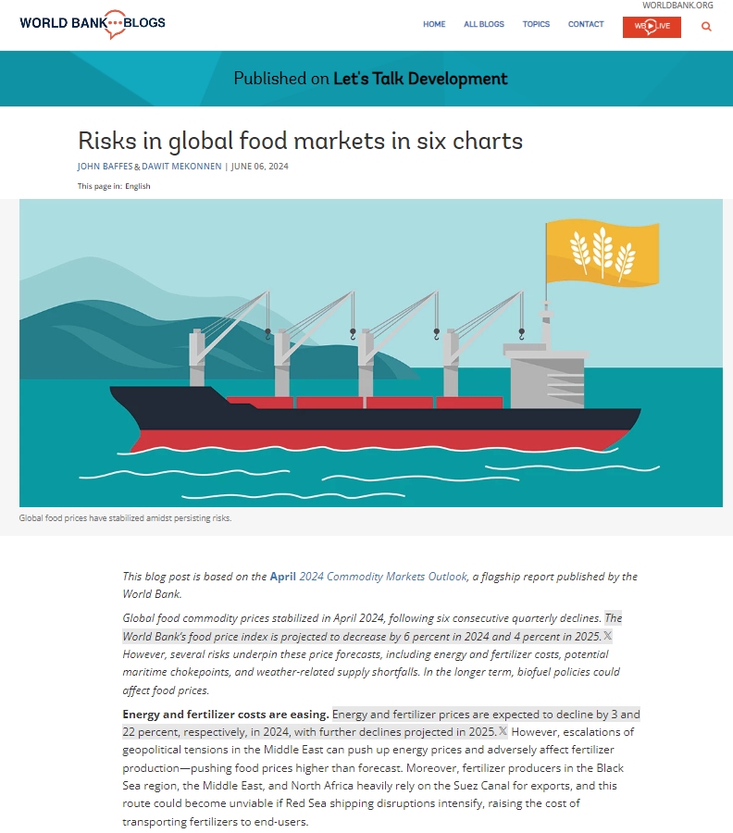
www.worldbank.org/commodities
19

Slide 20
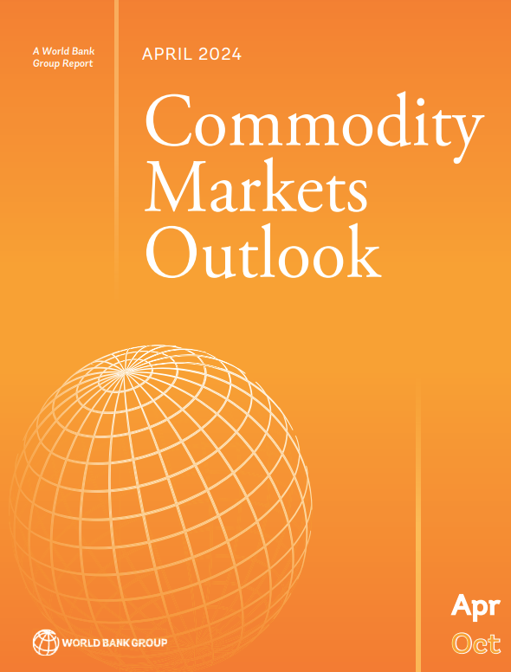
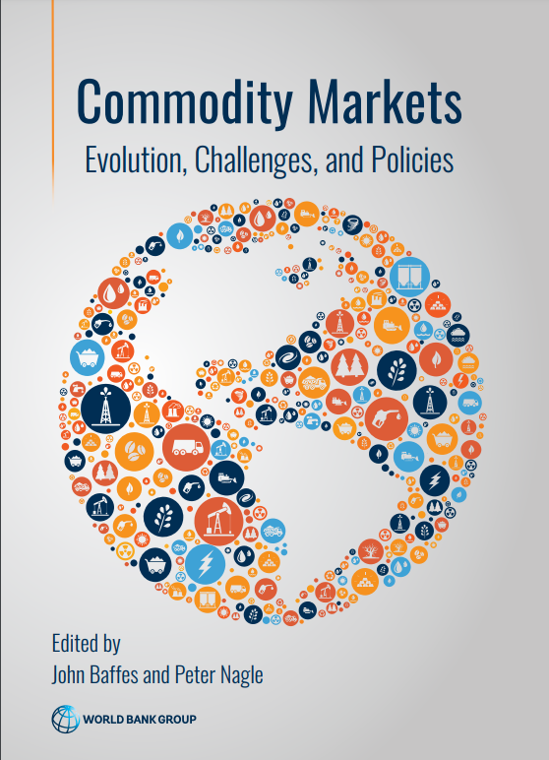
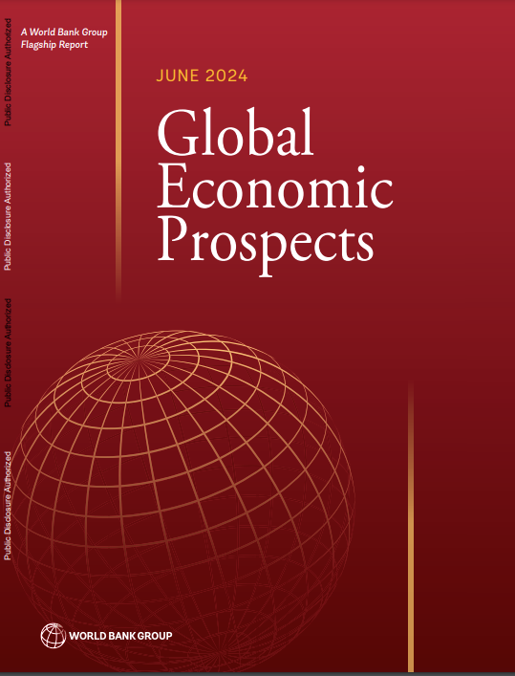
www.worldbank.org/commodities
20

