Slide 1
Impact of Energy Price Shocks on Food Inflation
Xiaoli Etienne
University of Idaho

Slide 2
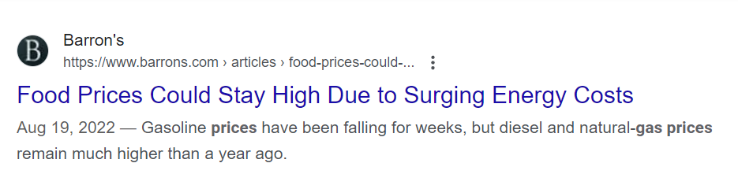

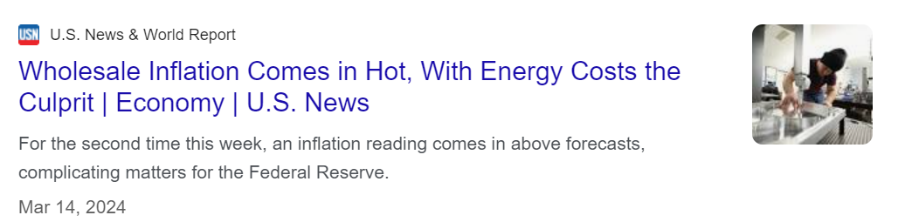
Are rising energy prices culprits of food inflation?

Slide 3
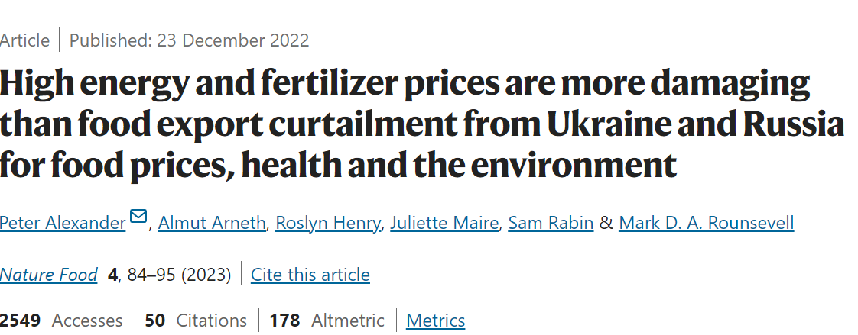
Are rising energy prices culprits of food inflation?

Slide 4
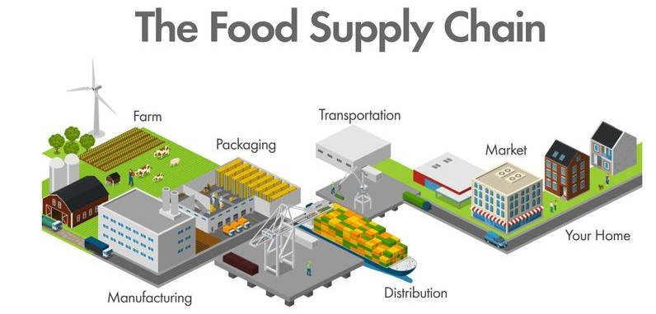
How energy prices may affect food prices
Energy
Energy
Energy
Energy
Energy

Slide 5
How energy prices may affect food prices
Source: USDA ERS

Slide 6
How energy prices may affect food prices
Source: USDA ERS

Slide 7
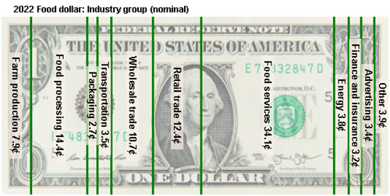
Energy small share of food dollar
Sources: USDA ERS

Slide 8
Energy small share of food dollar
Source: USDA ERS

Slide 9
Indirect impact of energy shock on food prices
Renewable fuel: food vs. fuel debate
Increased biofuel → higher price & volatility transmission from energy to food
Inflationary pressure
rising energy prices contribute to overall inflation
business along supply chain pass on higher costs to consumers by ↑ food prices
Macroeconomic factors
Oil price shock often trigger macroeconomic responses (fiscal and monetary policies, exchange rate change)

Slide 10
Monthly CPI: Energy, year-over-year change
Source: BLS
Notes:
Source: U.S. Bureau of Labor Statistics Release: Consumer Price Index Units: Index 1982-1984=100, Not Seasonally Adjusted Frequency: Monthly Handbook of Methods - (https://www.bls.gov/opub/hom/pdf/cpihom.pdf) Understanding the CPI: Frequently Asked Questions - (http://stats.bls.gov:80/cpi/cpifaq.htm) U.S. Bureau of Labor Statistics, Consumer Price Index for All Urban Consumers: Energy in U.S. City Average [CPIENGNS], retrieved from FRED, Federal Reserve Bank of St. Louis; https://fred.stlouisfed.org/series/CPIENGNS, July 10, 2024.

Slide 11
Energy CPI vs. Farm products PPI
Source: BLS
Notes:
Source: U.S. Bureau of Labor Statistics Release: Consumer Price Index Units: Index 1982-1984=100, Not Seasonally Adjusted Frequency: Monthly Handbook of Methods - (https://www.bls.gov/opub/hom/pdf/cpihom.pdf) Understanding the CPI: Frequently Asked Questions - (http://stats.bls.gov:80/cpi/cpifaq.htm) U.S. Bureau of Labor Statistics, Consumer Price Index for All Urban Consumers: Energy in U.S. City Average [CPIENGNS], retrieved from FRED, Federal Reserve Bank of St. Louis; https://fred.stlouisfed.org/series/CPIENGNS, July 10, 2024.

Slide 12
Energy CPI vs Processed food PPI
Source: BLS
Notes:
Source: U.S. Bureau of Labor Statistics Release: Consumer Price Index Units: Index 1982-1984=100, Not Seasonally Adjusted Frequency: Monthly Handbook of Methods - (https://www.bls.gov/opub/hom/pdf/cpihom.pdf) Understanding the CPI: Frequently Asked Questions - (http://stats.bls.gov:80/cpi/cpifaq.htm) U.S. Bureau of Labor Statistics, Consumer Price Index for All Urban Consumers: Energy in U.S. City Average [CPIENGNS], retrieved from FRED, Federal Reserve Bank of St. Louis; https://fred.stlouisfed.org/series/CPIENGNS, July 10, 2024.

Slide 13
Energy CPI vs. Food CPI
Source: BLS
Notes:
Source: U.S. Bureau of Labor Statistics Release: Consumer Price Index Units: Index 1982-1984=100, Not Seasonally Adjusted Frequency: Monthly Handbook of Methods - (https://www.bls.gov/opub/hom/pdf/cpihom.pdf) Understanding the CPI: Frequently Asked Questions - (http://stats.bls.gov:80/cpi/cpifaq.htm) U.S. Bureau of Labor Statistics, Consumer Price Index for All Urban Consumers: Energy in U.S. City Average [CPIENGNS], retrieved from FRED, Federal Reserve Bank of St. Louis; https://fred.stlouisfed.org/series/CPIENGNS, July 10, 2024.

Slide 14
Energy CPI vs. Food away from home CPI vs. Food at home CPI
Source: BLS
Notes:
Source: U.S. Bureau of Labor Statistics Release: Consumer Price Index Units: Index 1982-1984=100, Not Seasonally Adjusted Frequency: Monthly Handbook of Methods - (https://www.bls.gov/opub/hom/pdf/cpihom.pdf) Understanding the CPI: Frequently Asked Questions - (http://stats.bls.gov:80/cpi/cpifaq.htm) U.S. Bureau of Labor Statistics, Consumer Price Index for All Urban Consumers: Energy in U.S. City Average [CPIENGNS], retrieved from FRED, Federal Reserve Bank of St. Louis; https://fred.stlouisfed.org/series/CPIENGNS, July 10, 2024.

Slide 15
Research questions
How do shocks to energy prices propagate through food supply chain in the U.S.?
Do impacts differ between general food inflation, food at home, and food away from home inflation?

Slide 16
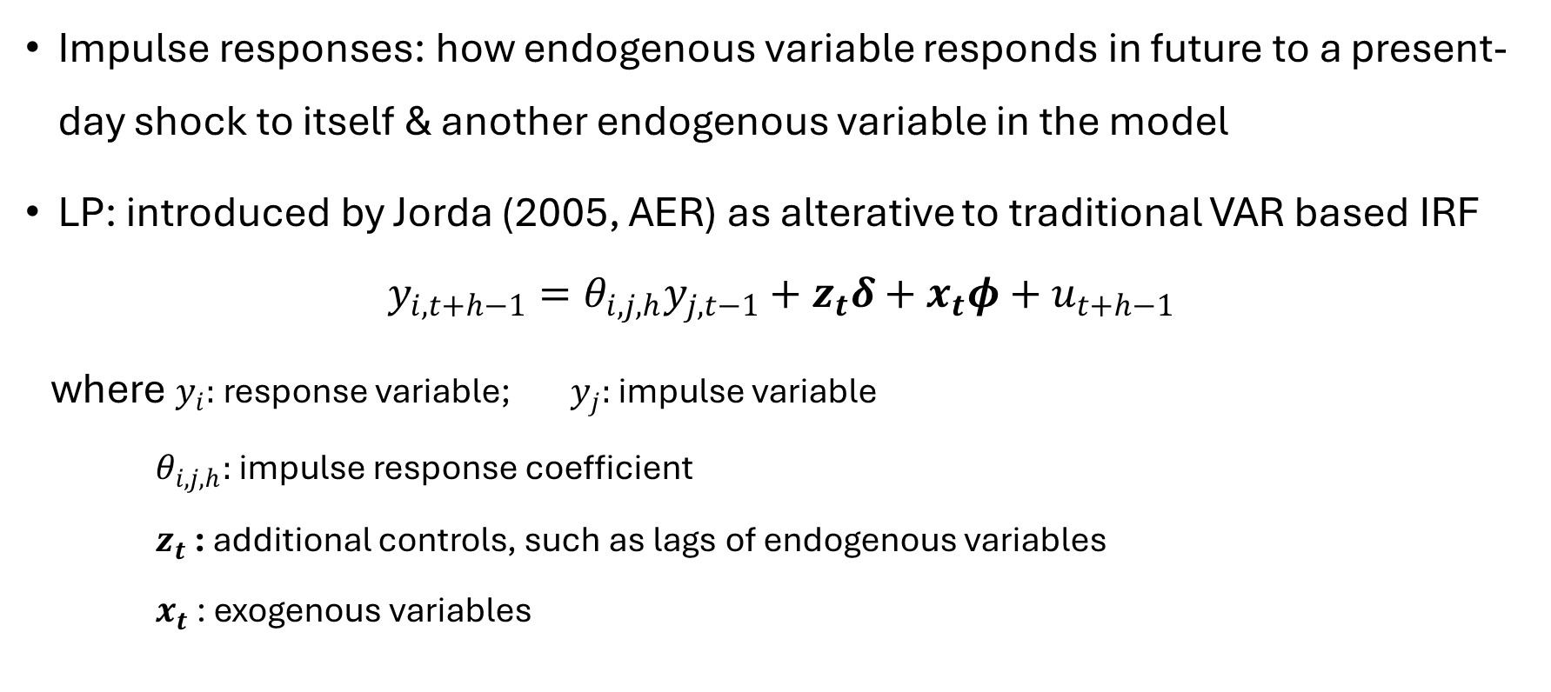
Empirical procedure: Impulse responses based on local projections
Impulse responses: how endogenous variable responds in future to a present-day shock to itself & another endogenous variable in the model
LP: introduced by Jorda (2005, AER) as alterative to traditional VAR based IRF
$$y_{i,t+h−1}=θ_{i,j,h}y_{j,t−1}+z_{t}δ+x_{t}φ+u_{t+h−1}$$
where $y_{i}:$response variable; $y_{j}:$impulse variable
$θ_{i,j,h}:$impulse response coefficient
$z_{t}$ : additional controls, such as lags of endogenous variables
$x_{t}$ : exogenous variables
Notes:
An IRF measures how an endogenous variable responds in the future to a present-day shock to itself or another endogenous variable in the model.
Local projections were introduced by Jord` a (2005) as an alternative to traditional IRF estimation based on vector autoregressive (VAR) models

Slide 17
Empirical procedure: Impulse responses based on local projections
Equation-by-equation, horizon-by-horizon estimation
Not constrained by a model, more flexible impulse-response coefficients
Confidence intervals have better small-sample coverage than those from VAR (asymptotic distribution and delta method)
Li, Plagborg-Moller and Wolf (2024): LP estimators have lower bias than VAR estimators, but they also have higher variance at intermediate and long horizons.
Bias-efficiency tradeoff
Notes:
An IRF measures how an endogenous variable responds in the future to a present-day shock to itself or another endogenous variable in the model.
Local projections were introduced by Jord` a (2005) as an alternative to traditional IRF estimation based on vector autoregressive (VAR) models

Slide 18
Data
Price indexes along food supply chain
PPI for farm products
PPI for processed foods and feeds
CPI for food; CPI for food away from home, CPI for food at home
Price index for energy
CPI for energy
Sample period: monthly data from 1960 to 2024
All data in year-over-year change

Slide 19
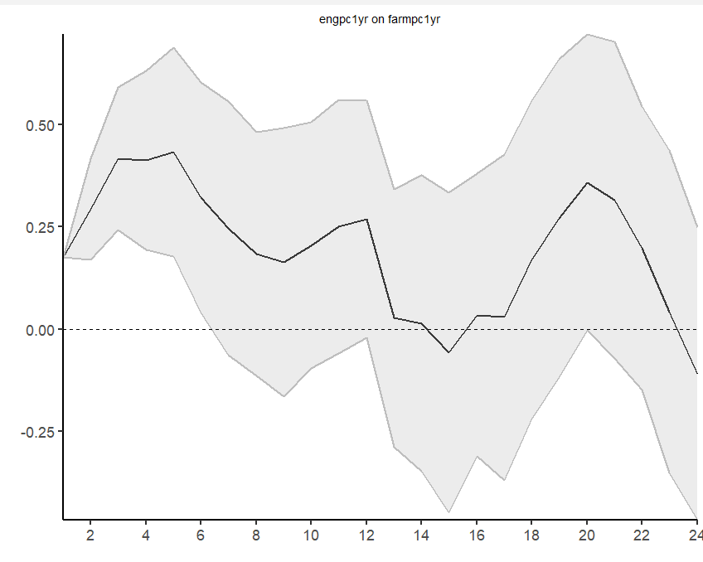
Impact of energy shock on farm product PPI
Months

Slide 20
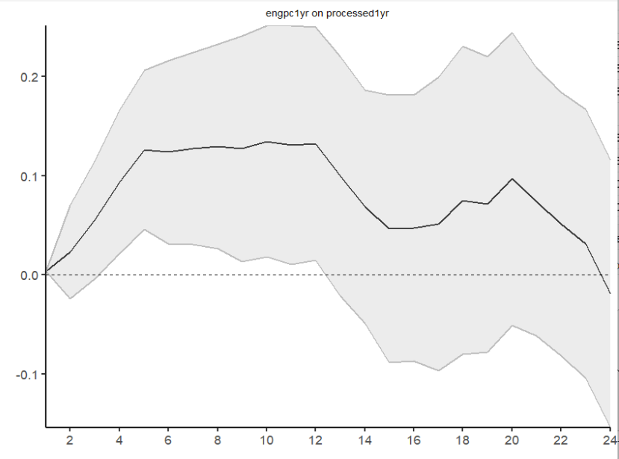
Impact of energy shock on processed food PPI
Months

Slide 21
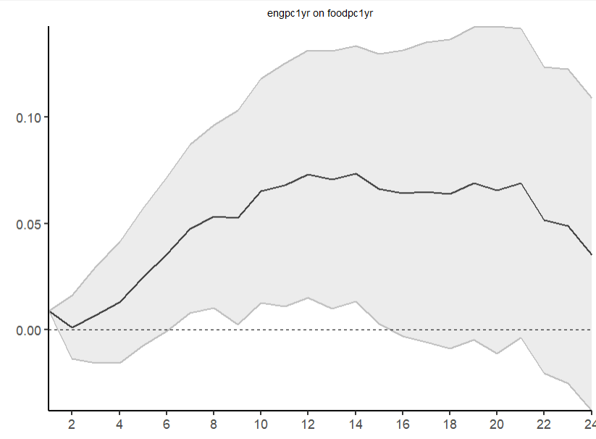
Impact of energy shock on food CPI
Months

Slide 22
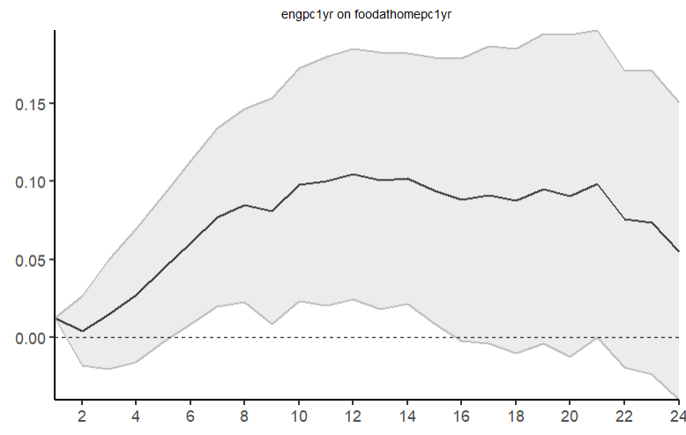
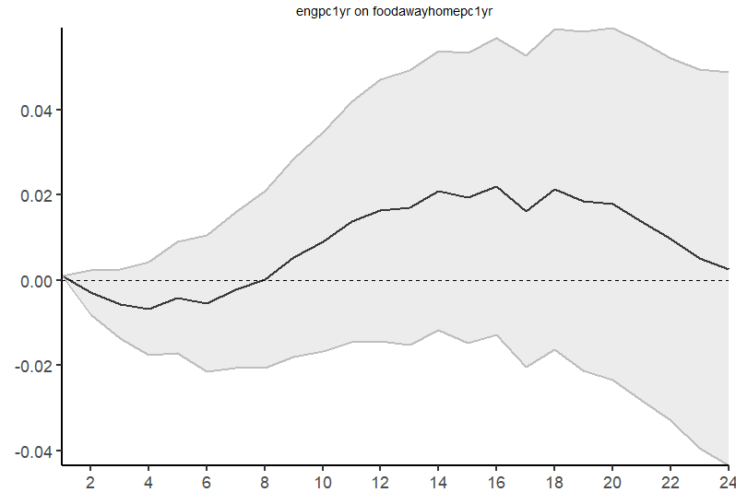
Impact of energy shock on food at home CPI
Impact of energy shock on food away from home CPI
Months
Months

Slide 23
Robustness checks
Model specification
different lag structures
with and without trend
seasonally adjusted vs. non-seasonally adjusted
Using instrumental variable for energy prices

Slide 24
Conclusions
Impact of energy price shocks differ along the food supply chain
A unit positive energy shock leads to
Farm product PPI: 15~40% increase in 1-6 months after the shock
Processed food PPI: 5-10% increase in 3-12 months after the shock
Food CPI: 3-6% increase in 6-15 months after the shock
Impact on food CPI mostly occurs in food at home CPI
Food at home CPI: impulse responses very similar to overall food CPI
Food away from home CPI: non-significant impulse responses

Slide 25
Conclusions
Role of energy prices on food inflation less important than stated in media or some recent academic studies
Impact of energy prices have large, immediate impact on farm product PPI, delayed and smaller impact on processed food and overall inflation
Possible explanations
More factors contributing to prices further along the supply chain
Market power plays more important role in wholesale and retail sectors

Slide 26
Questions?

