Slide 1
HOOK
Right now, someone in Mississippi is searching for a payday loan.
Does your ad budget know that?
1

Slide 2
THE PROBLEM
EPCVIP sells leads to lenders. Leads are worth more in high-demand markets.
So which markets have the highest demand — and why?
2

Slide 3
WHAT I BUILT
A pipeline that tracks financial keyword demand across every US state — automatically.
pytrends API
→
GitHub Actions
→
Snowflake
→
dbt
→
Streamlit Dashboard
Runs daily. No manual work. Always fresh.
3

Slide 4
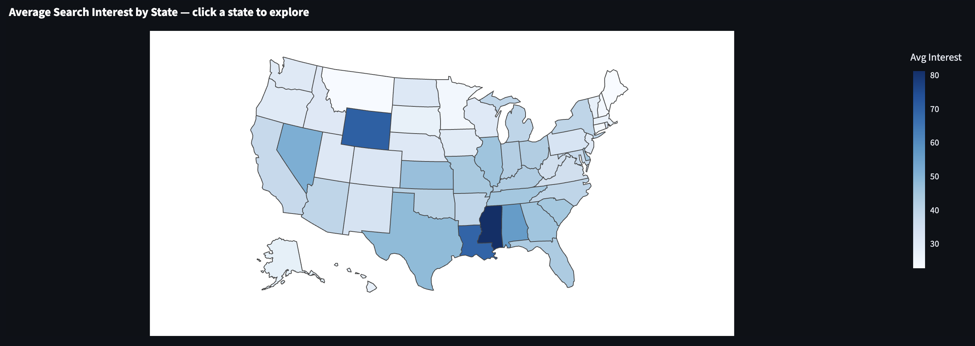
DESCRIPTIVE — WHAT HAPPENED?
Personal loans lead nationally. But the map tells a different story.
Personal Loans
52
Cash Advance
50
Credit Cards
42
Payday Loans
27
Installment Loans
19
4

Slide 5
DIAGNOSTIC — WHY DID IT HAPPEN?
The South is underbanked. That's where the demand is.
100
CATEGORY
TOP STATE
SCORE
Short-term credit
Mississippi
100
Revolving credit
Wyoming
100
Consumer lending
Mississippi
84.5
payday loan score in Mississippi vs. 38 national average
Mississippi leads 2 of 3 categories — lower incomes, fewer banks, highest unmet credit demand.
5

Slide 6
RECOMMENDATION
Go where the demand is.
Shift 30–40% of short-term credit budget to Mississippi, Louisiana, Wyoming
Higher-intent leads in underserved markets with lower advertiser competition
Lower cost-per-lead vs. saturated markets like California, New York, Texas
Pipeline refreshes daily — rerun this analysis monthly as demand shifts
6

Slide 7
LIVE DEMO
Let me show you the dashboard.
junior-data-analyst-56witkrgeceqhugwofdpzf.streamlit.app
📈
🔍
📚
Descriptive tab
Diagnostic tab
Knowledge base
Click a state → see keyword breakdown
Category comparison + top states
Industry research, synthesized
7

Slide 8
The signal exists. The pipeline captures it.
Now act on it.
github.com/laurendelosreyes22-commits/junior-data-analyst
8

