Slide 1

The Success of Book to Film Adaptations
What book characteristics are associated with film success?
Team Stegosaurus: Matthew Bishop, Ashley Gates, Lauren To

Slide 2
Agenda
Background
Analysis
Conclusion
Implications

Slide 3
Background
“Do book adaptations perform well as movies?”
Explored book ratings, page counts, genre, audience, publisher type.
Analyzed 45,000 movies released from March 1910 to July 2017, to find that 835 movies were based on novels during that time period. Performed EDA on 11,128 books via the Goodreads.
Final dataset consisted of 105 books and corresponding movies.

Slide 4
Approach
Identify data sources and dependencies
Collect and clean movie and book data
Merge (5) datasets based on which movies have corresponding book data
Run analysis and visualizations of consequential attributes
Analyze results—Regression, ANOVA, and T-tests

Slide 5
Approach
Limitations:
Limited sample size (both book and film data)
Limited time, scope of project
Book editions are from 1910 on
Books can be adapted more than once
Film release and book sales influence one another
Assumptions:
Assume data is correct
Assume that “Based on Novel” is correctly attributed in the dataset
Assume that movie and book IDs match correctly

Slide 6
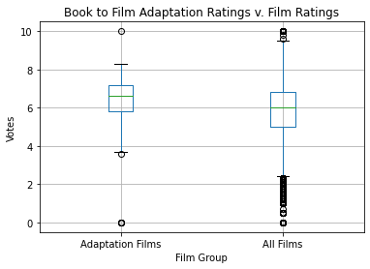
Hypothesis 1: Book to film adaptations have higher ratings than most films.

Slide 7
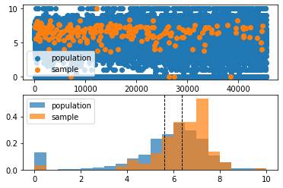
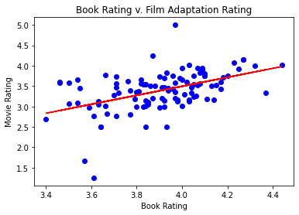
statistic=8.333635521004798, pvalue=8.03194619929397e-15
The r-value is: 0.4813170546977568

Slide 8
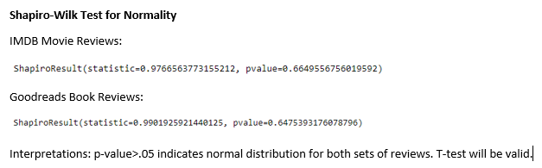

Slide 9
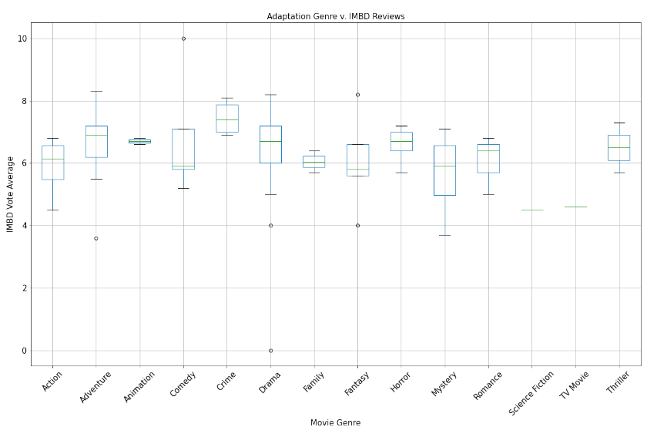
Hypothesis 2: Horror adaptation films have higher ratings than other film genres.
statistic=1.4613602433882171, pvalue=0.22261097775355887

Slide 10
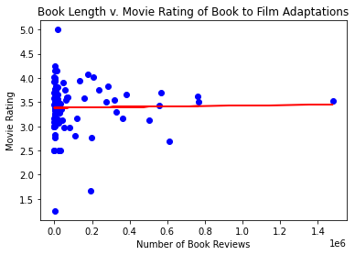
Hypothesis 3: The number of book reviewers and rating for adaptation films are correlated.
The r-value is: 0.019169007359004328

Slide 11
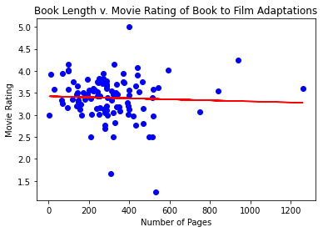
Hypothesis 4: The number of pages for adaptation films are correlated.
The r-value is: -0.043778432195029734

Slide 12
Conclusion
Hypotheses
1. Book to film adaptations have higher ratings than most films ☺
2. Horror adaptation films have higher ratings than other film genres ☹
3. The number of book reviewers and rating for adaptation films are correlated ☹
4. The number of pages for adaptation films are correlated ☹

Slide 13
Conclusion
Business Implications
Movie studios would find this data helpful in choosing where to invest production dollars, namely book rating
Book publishers could promote highly rated books for movie optioning
Could also have implications for which books get published
Could encourage book publishers and film companies to collaborate
Ideas for Further Exploration
Explore further correlations between books and movies, there’s more data to be analyzed
Use predictive methods to choose books to adapt to movies

Slide 14
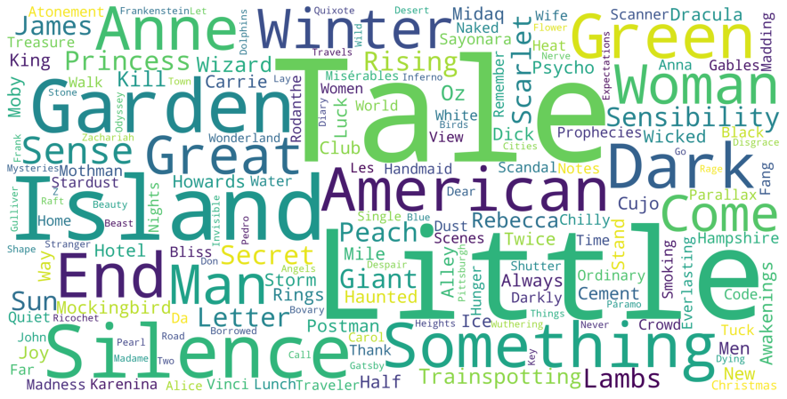
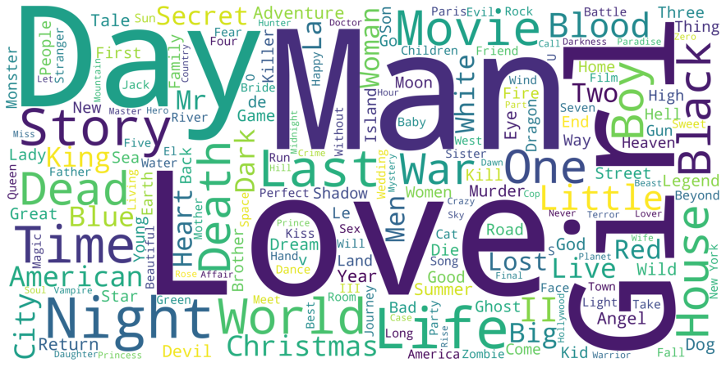
Further Exploration
Film Adaptations - Themes
All Films - Themes

Slide 15

Questions?

