Slide 1
Word2vec and tSNE
https://colab.research.google.com/drive/1HJpR8BZh1NK1ugILXgLuWyohQKdx8NZz?usp=sharing

Slide 2
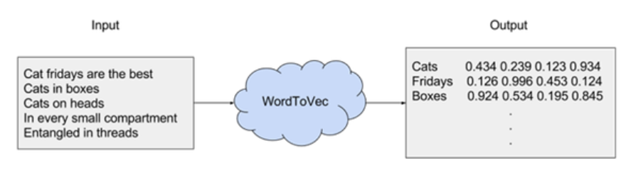
Word2vec
Word2vec can represent words by vectors. These vectors capture contextual sequential information about a word.
Word2vec tutorial: https://medium.com/@zafaralibagh6/a-simple-word2vec-tutorial-61e64e38a6a1
Notes:
https://en.wikipedia.org/wiki/Word2vec

Slide 3
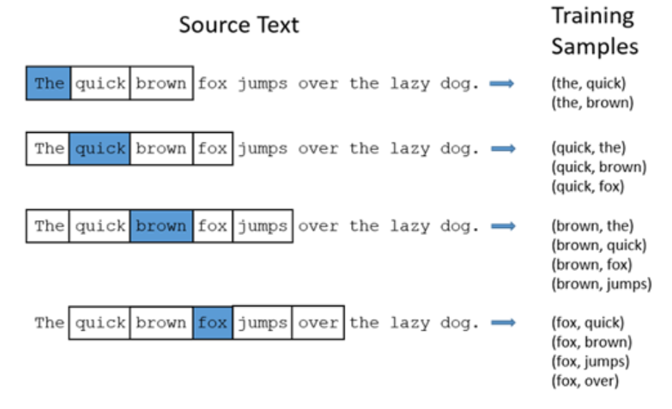
Context and windows

Slide 4
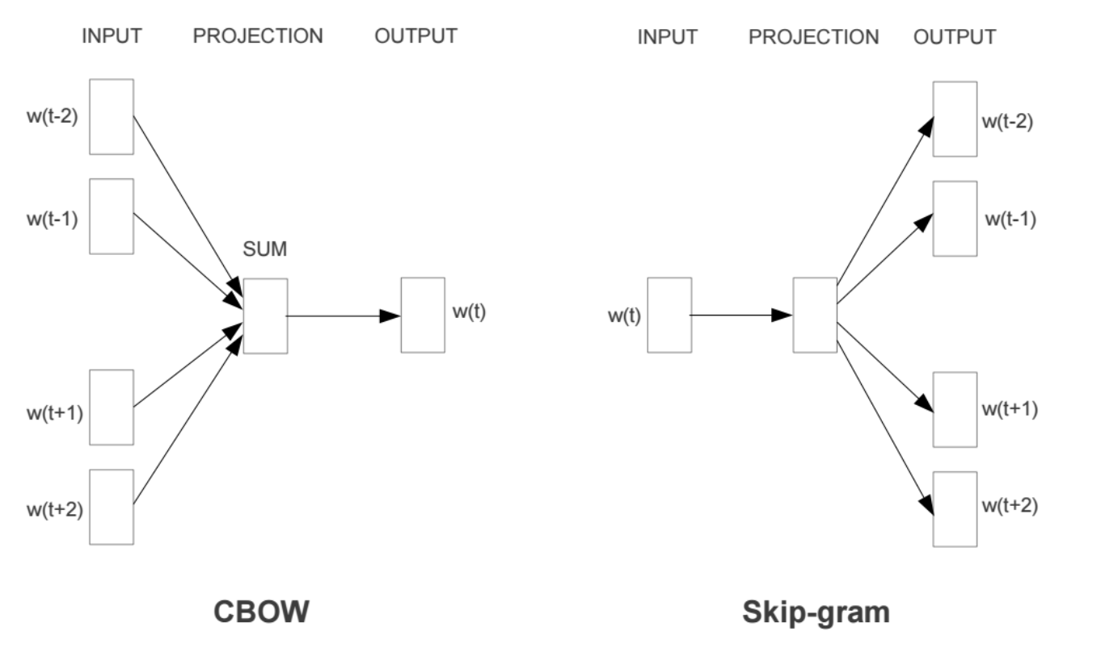
Skip-gram and CBOW models
CBOW (Continuous Bag Of Words): using context to predict current word
Skip-gram: using word to predict current context
Notes:
Word vectors, or word embeddings, or distributed representation of words, generally refer to a dense vector representation of a word, as compared to a sparse (i.e. one-hot) traditional representation. There are actually two different implementations of models that learn dense representation of words: the Skip-Gram model and the Continuous Bag of Words model. Both of these models learn dense vector representation of words, based on the words that surround them (ie, their context).
The difference is that the skip-gram model predicts context (surrounding) words given the current word, whereas the continuous bag of words model predicts the current word based on several surrounding words.

Slide 5
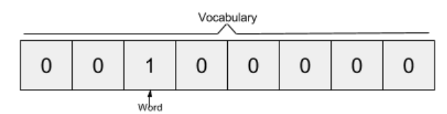
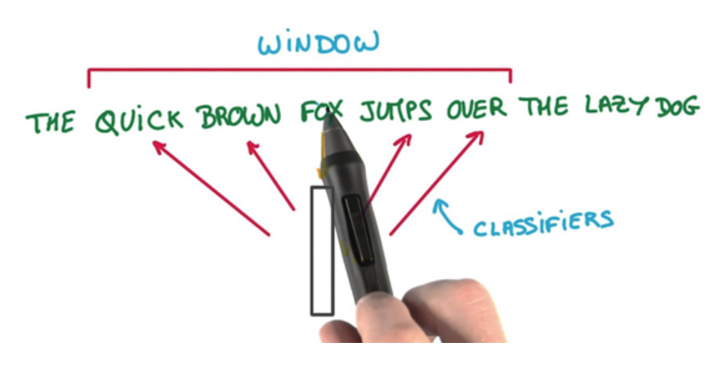
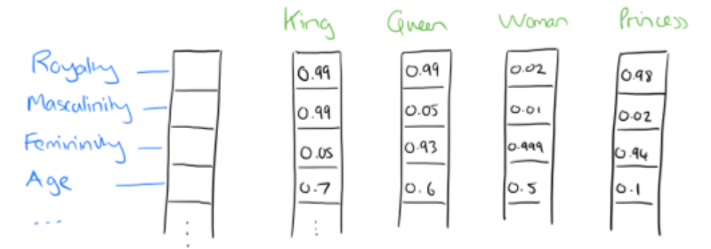
word2vec vector
The output of word2vec is a single vector (also with 10,000 components) containing, for every word in our vocabulary, the probability that a randomly selected nearby word is that vocabulary word.
Hypothetical label – one word in blue

Slide 6
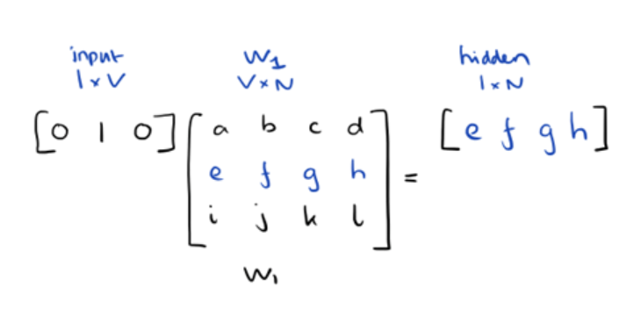
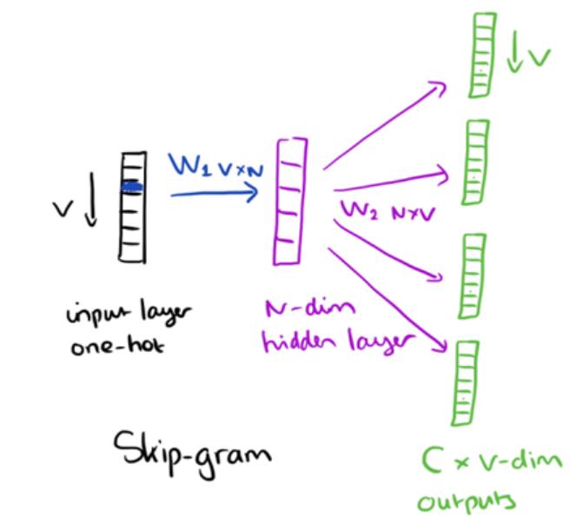
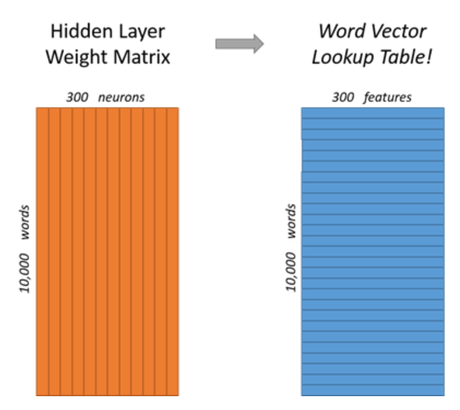
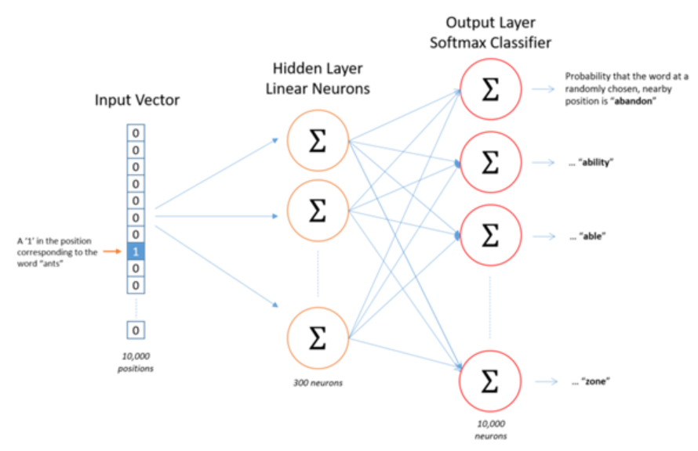
Skip-gram

Slide 7
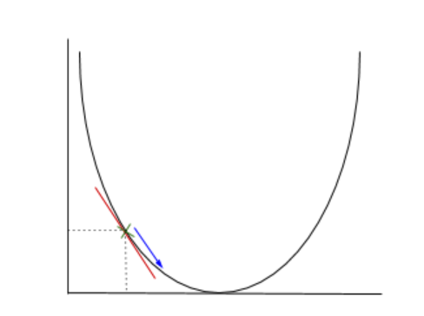
Gradient Descent
we apply stochastic gradient descent to change the values of the weights in order to get a more desirable value for the probability calculated
In gradient descent we need to calculate the gradient of the function being optimised at the point representing the weight that we are changing. The gradient is then used to choose the direction in which to make a step to move towards the local optimum

Slide 8
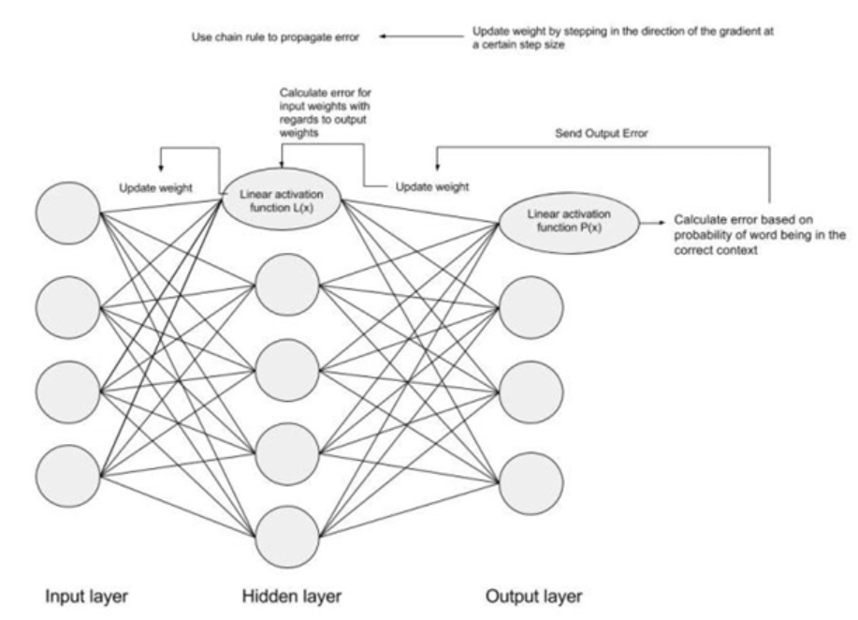
Backpropagation
The next step is using Backpropagation, to adjust the weights between multiple layers. The error that is computed at the end of the output layer is passed back from the output layer to the hidden layer by applying the Chain Rule. Gradient descent is used to update the weights between these two layers. The error is then adjusted at each layer and sent back further.

Slide 9
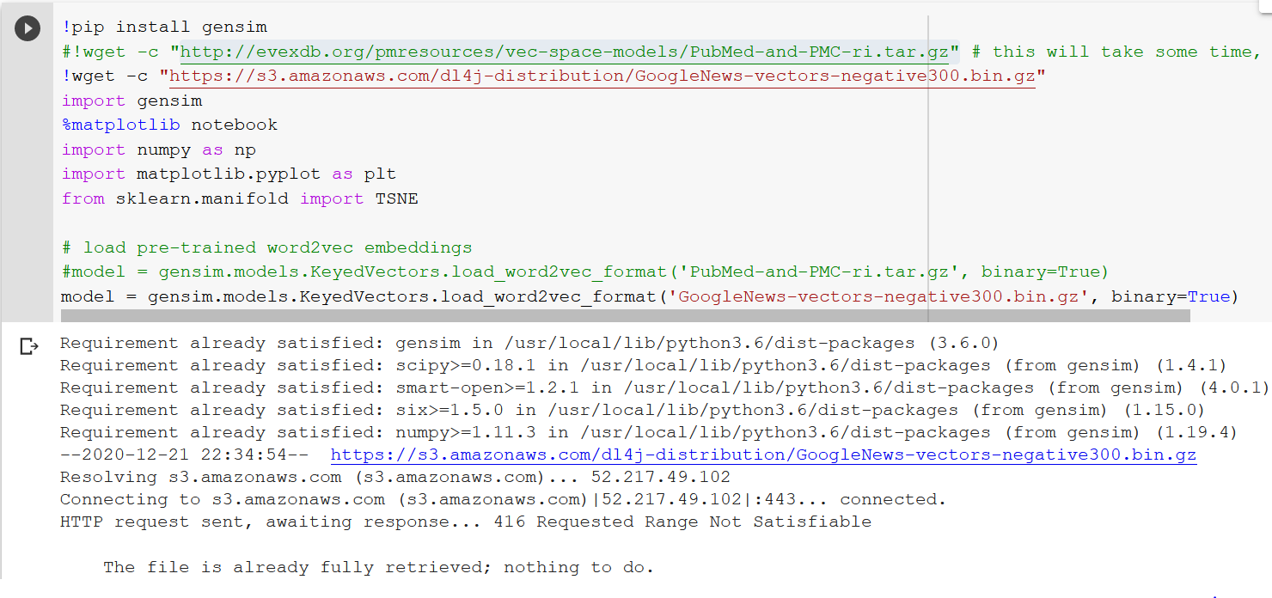
Download pre-trained word2vec

Slide 10
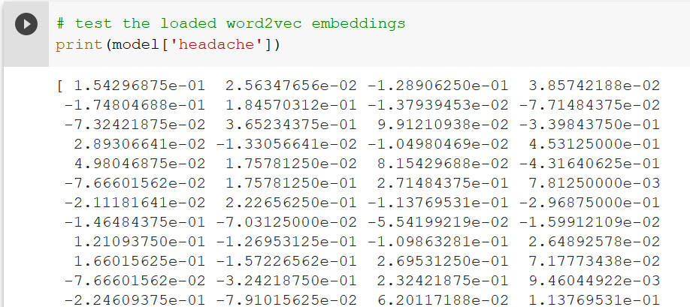
Test word2vec
The raw vector for a word

Slide 11
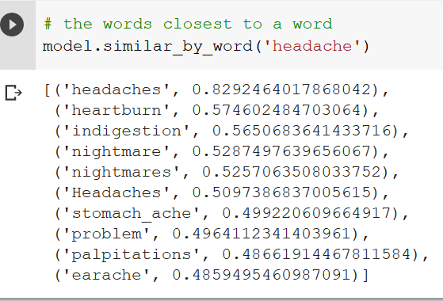
Closest words
The words closest to a word

Slide 12
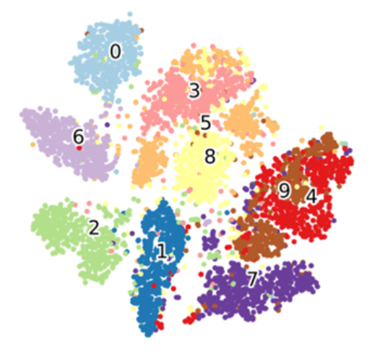
Visualization: tSNE
t-distributed stochastic neighbor embedding
T-distributed Stochastic Neighbor Embedding (t-SNE) is a machine learning algorithm for visualization developed by Laurens van der Maaten and Geoffrey Hinton. It is a nonlinear dimensionality reduction technique well-suited for embedding high-dimensional data for visualization in a low-dimensional space of two or three dimensions. Specifically, it models each high-dimensional object by a two- or three-dimensional point in such a way that similar objects are modeled by nearby points and dissimilar objects are modeled by distant points with high probability.
https://towardsdatascience.com/t-distributed-stochastic-neighbor-embedding-t-sne-bb60ff109561
Notes:
https://en.wikipedia.org/wiki/T-distributed_stochastic_neighbor_embedding

Slide 13
PCA vs. tSNE
PCA
An unsupervised, deterministic algorithm used for feature extraction as well as visualization
Applies a linear dimensionality reduction technique where the focus is on keeping the dissimilar points far apart in a lower-dimensional space.
Transforms the original data to a new data by preserving the variance in the data using eigenvalues.
Outliers impact PCA.
t-SNE
An unsupervised, randomized algorithm, used only for visualization
Applies a non-linear dimensionality reduction technique where the focus is on keeping the very similar data points close together in lower-dimensional space.
Preserves the local structure of the data using student t-distribution to compute the similarity between two points in lower-dimensional space.
t-SNE uses a heavy-tailed Student-t distribution to compute the similarity between two points in the low-dimensional space rather than a Gaussian distribution, which helps to address the crowding and optimization problems.
Outliers do not impact t-SNE

Slide 14
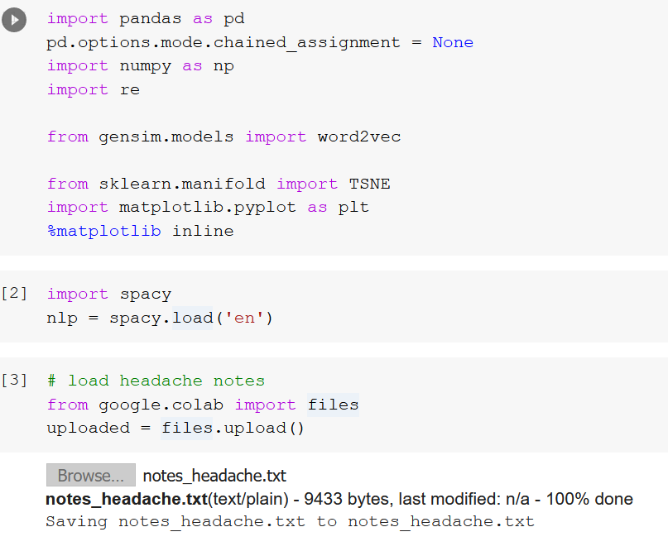
Headache in Spacy using word2vec and tSNE

Slide 15
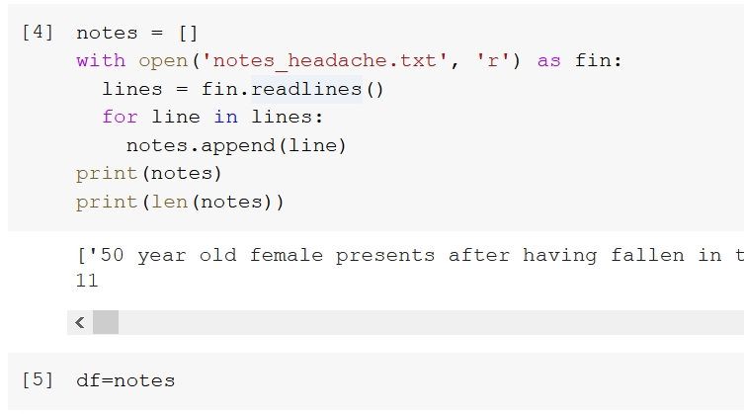
Build notes

Slide 16
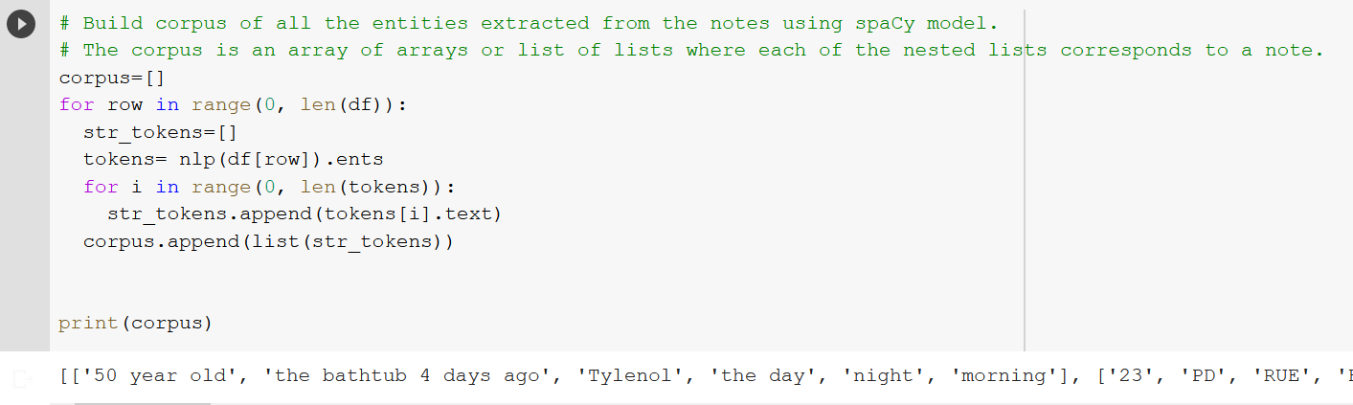
Build corpus

Slide 17
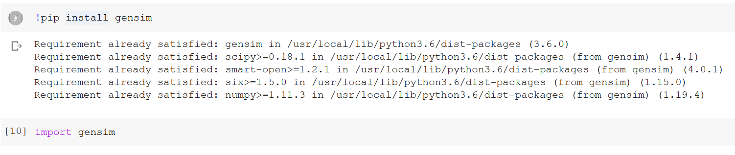

Get word2vec

Slide 18
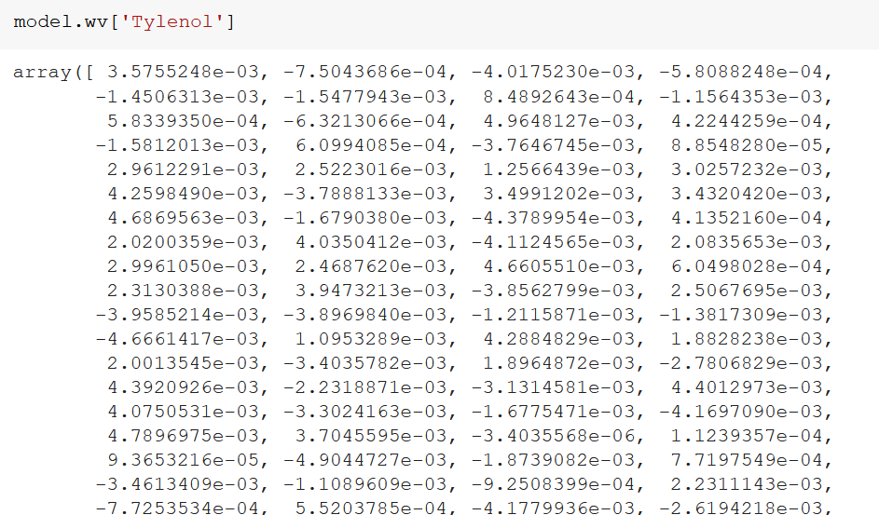
word2vec

Slide 19
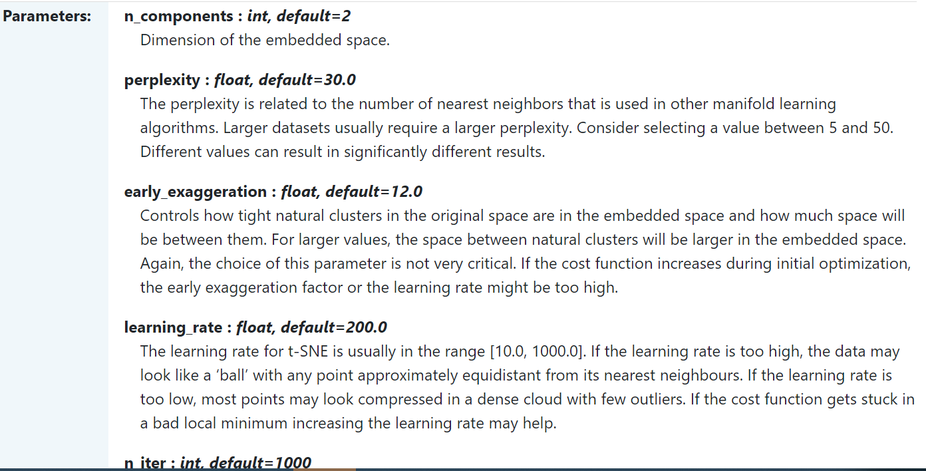
tSNE
https://scikit-learn.org/stable/modules/generated/sklearn.manifold.TSNE.html

Slide 20
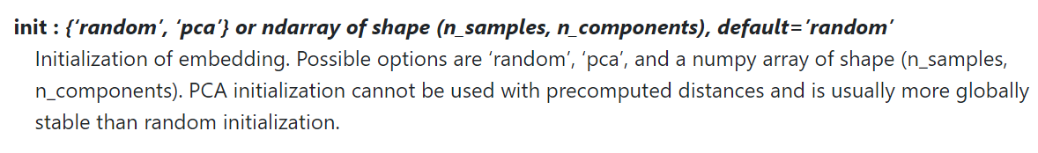
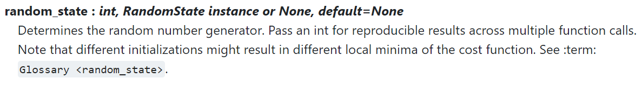

tSNE

Slide 21
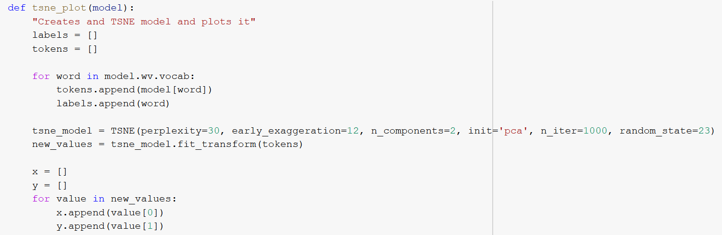
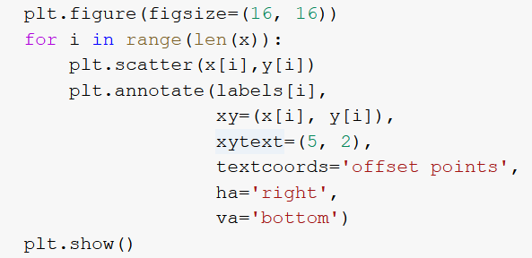

Using tSNE to plot

Slide 22
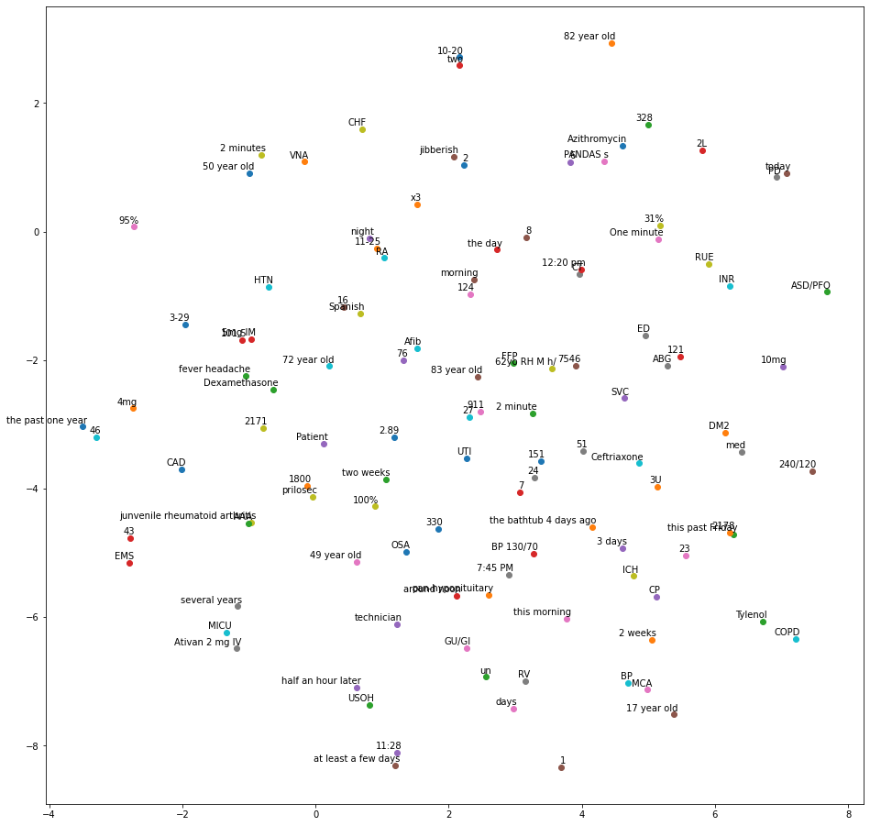
tSNE plot

Slide 23
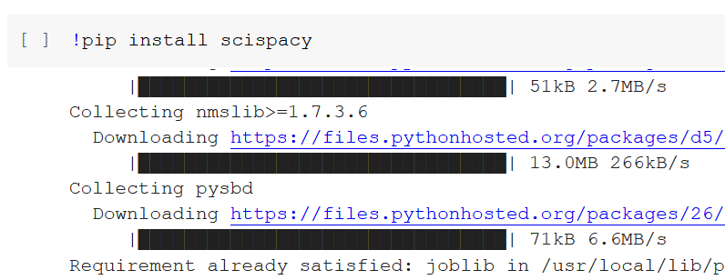
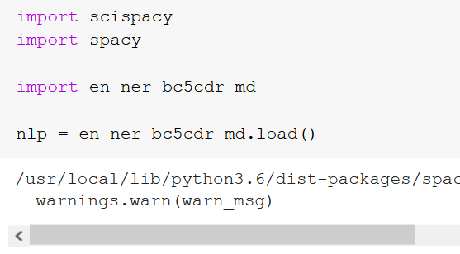
Headache in SciSpacy using word2vec and tSNE

Slide 24
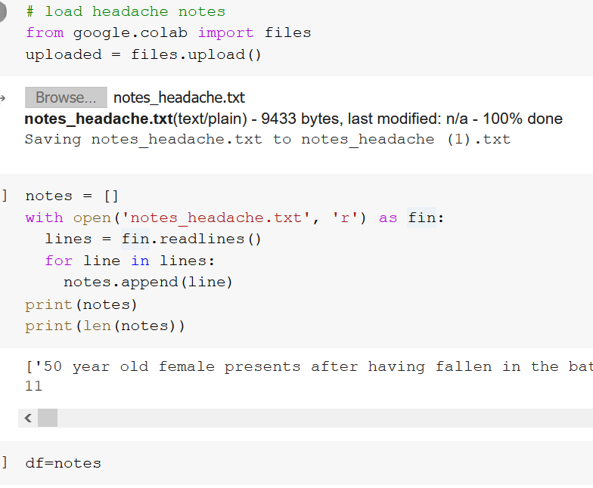
Load notes

Slide 25
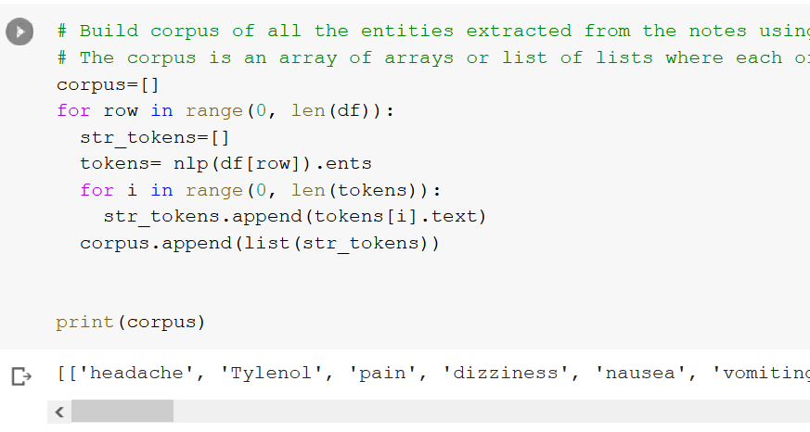
Build corpus using SciSpacy

Slide 26
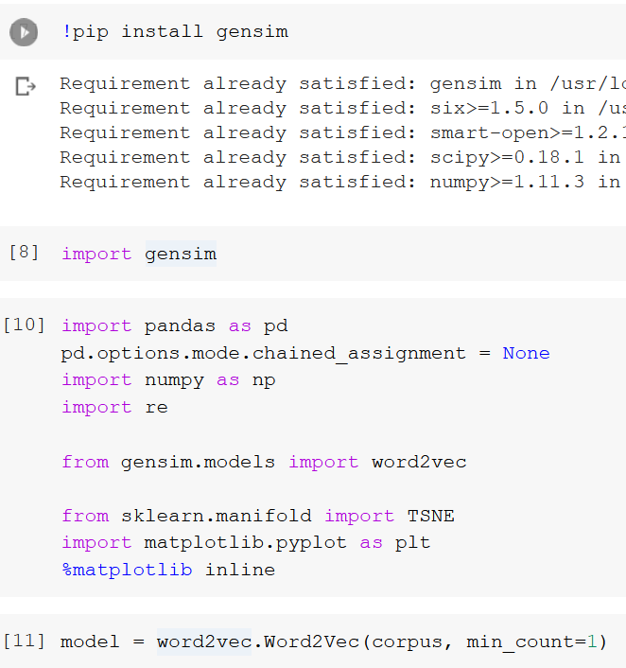
Get word2vec

Slide 27
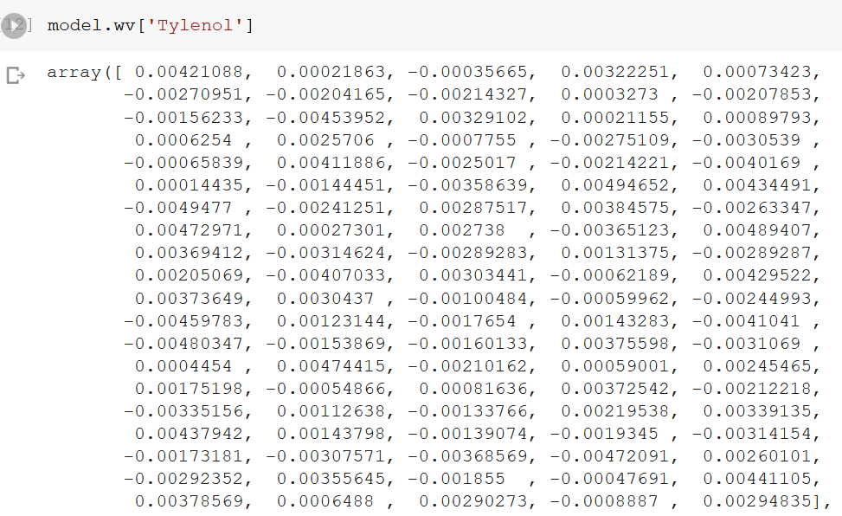
Show one word2vec example

Slide 28
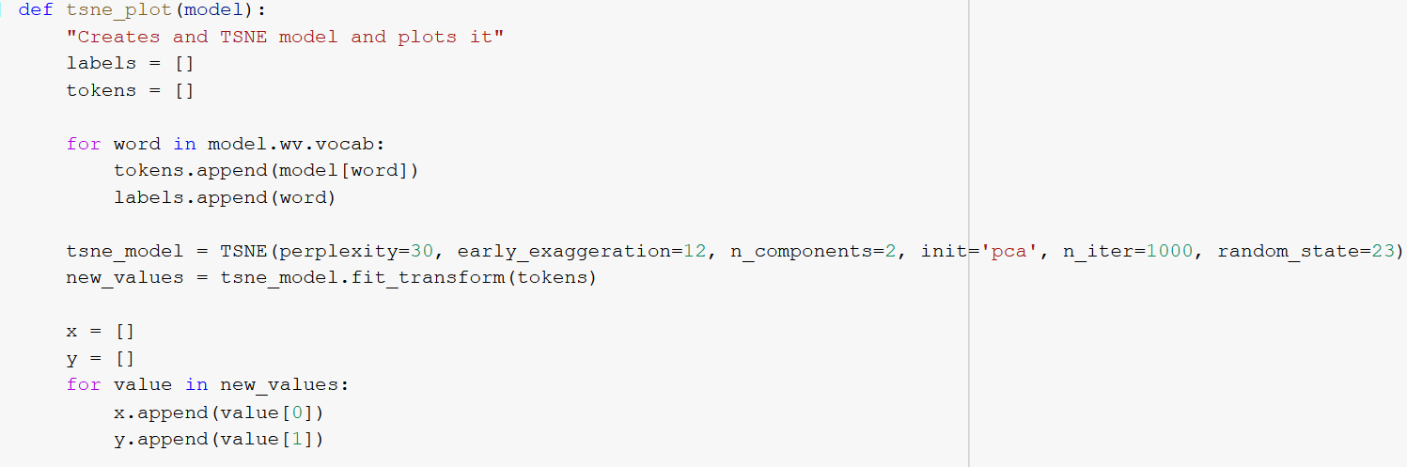
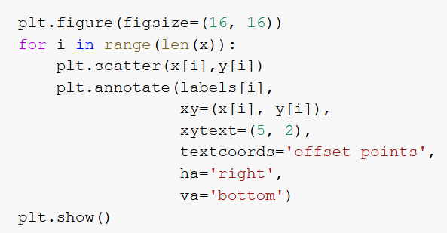
tSNE plot

Slide 29
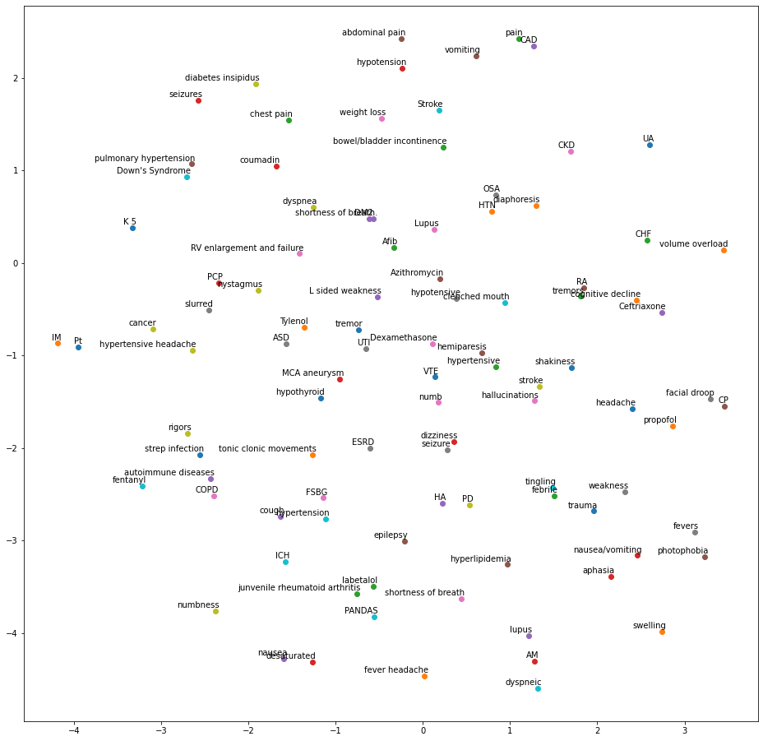

tSNE plot using SciSpacy

Slide 30
Exercise
Getting headache discharge notes from MIMIC III (around 700 notes)
Using SciSpacy entity extraction
Connecting with word2vec
Plotting them using tSNE

Slide 31
Headache notes from MIMIC
select diagnoses_icd.subject_id, diagnoses_icd.hadm_id, text
from noteevents inner join diagnoses_icd
on noteevents.hadm_id=diagnoses_icd.hadm_id
and noteevents.subject_id=diagnoses_icd.subject_id
where diagnoses_icd.ICD9_CODE='430'
select diagnoses_icd.subject_id, diagnoses_icd.hadm_id, text
from noteevents inner join diagnoses_icd
on noteevents.hadm_id=diagnoses_icd.hadm_id
where diagnoses_icd.ICD9_CODE='430' and noteevents.CATEGORY = 'Discharge summary'
select diagnoses_icd.subject_id, diagnoses_icd.hadm_id, ICD9_CODE
from noteevents inner join diagnoses_icd
on noteevents.hadm_id=diagnoses_icd.hadm_id
where diagnoses_icd.ICD9_CODE='430' and noteevents.CATEGORY = 'Discharge summary'
https://querybuilder-lcp.mit.edu/

Slide 32
Thank you!

