Slide 1
Natural Language Processing

Slide 2
Related Efforts
cTAKES,
MetaMap,
QuickUMLS
BioBert
ClinicalBert

Slide 3

1. Spacy

Slide 4

spaCy

Slide 5
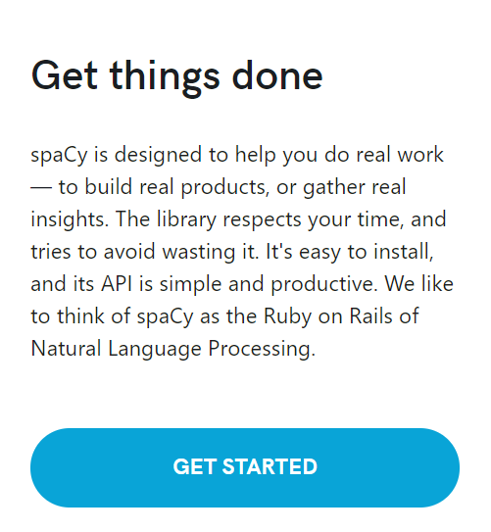
https://spacy.io/

Slide 6
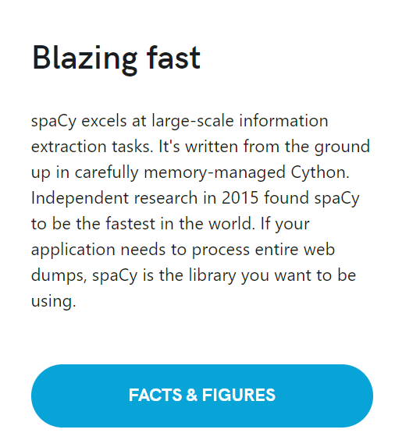

Slide 7
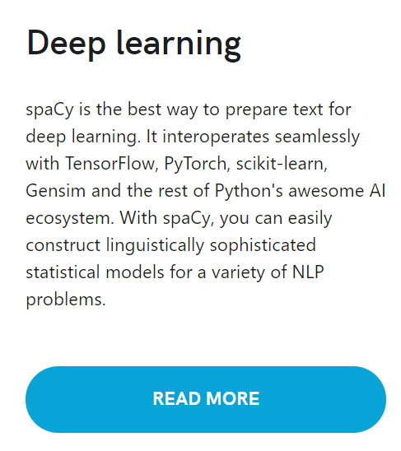

Slide 8
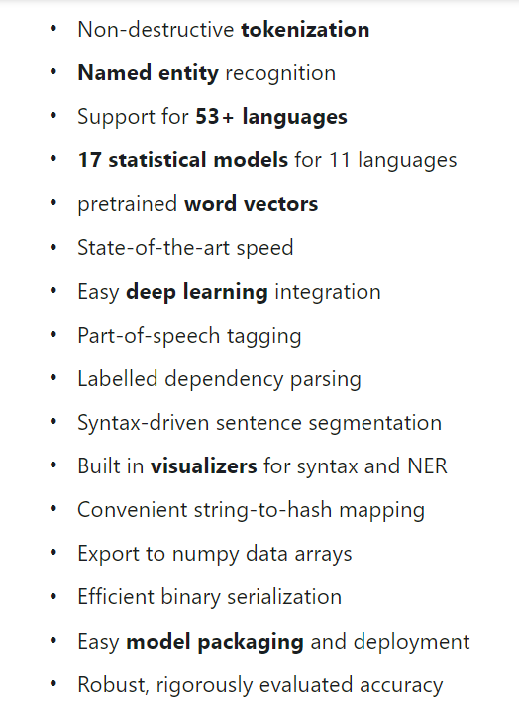
Features

Slide 9
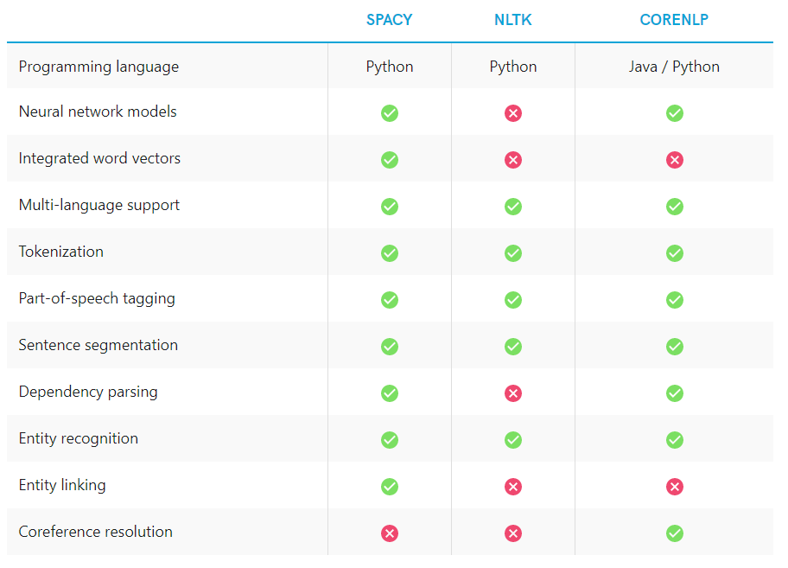

Slide 10
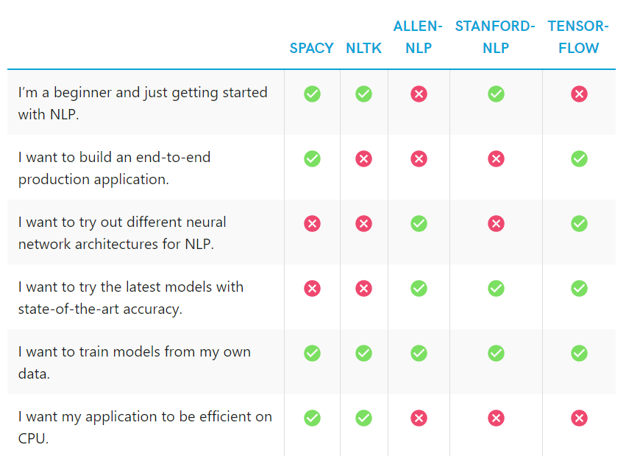

Slide 11
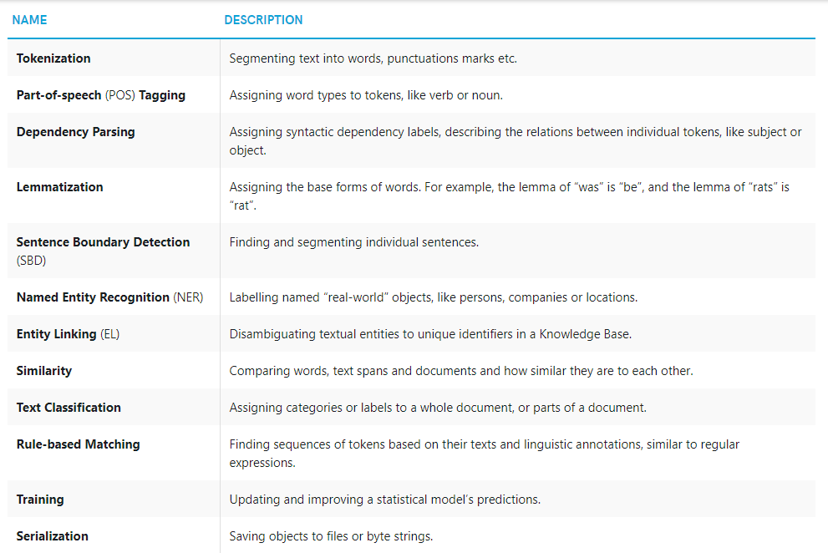

Slide 12
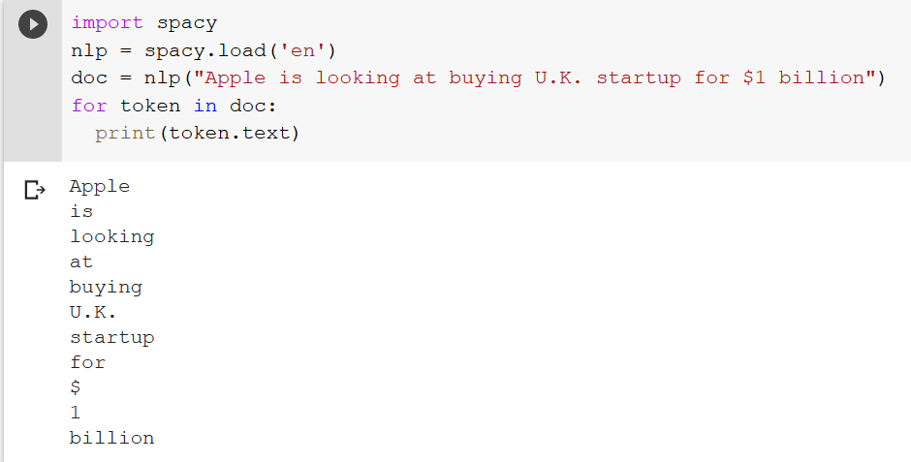
Start with SpaCy

Slide 13
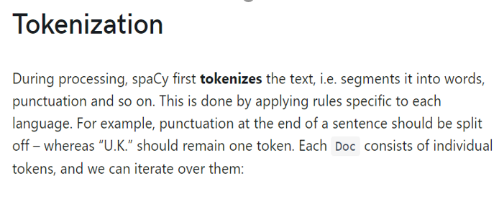
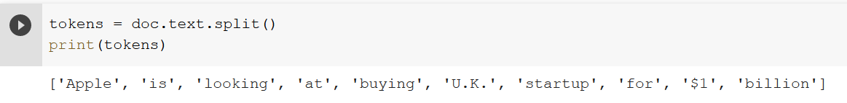
Tokenization

Slide 14
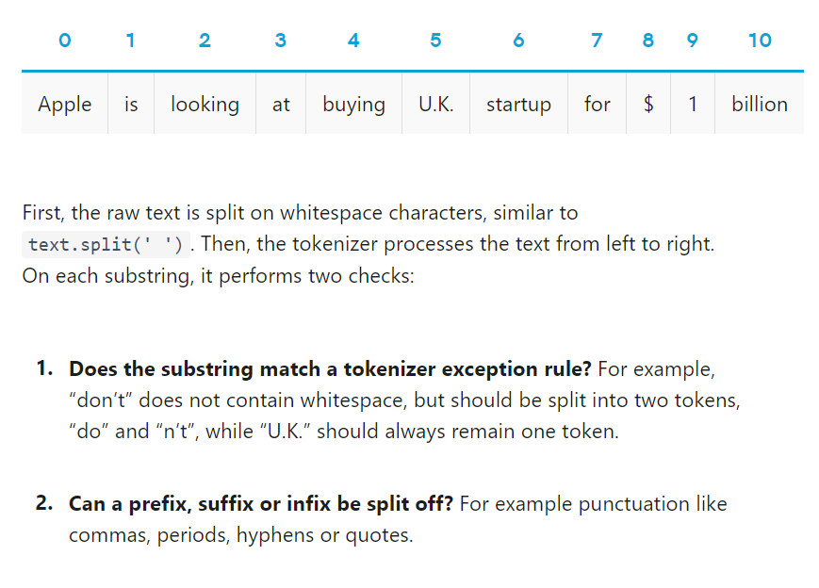

Slide 15
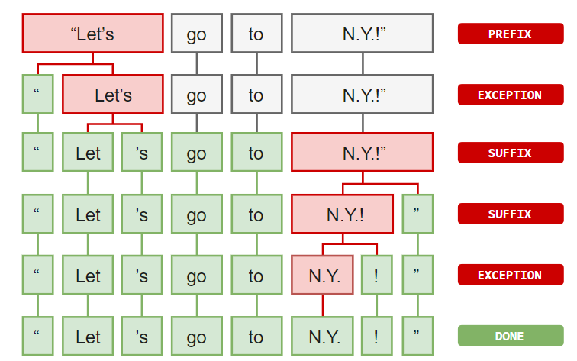
Tokenization

Slide 16
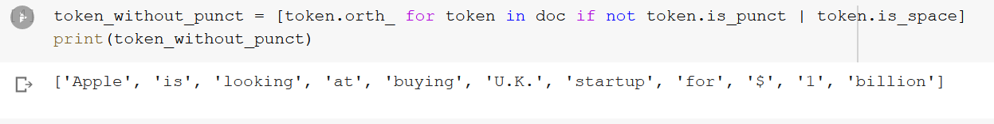
Get tokens without punctations or white space
https://spacy.io/api/

Slide 17
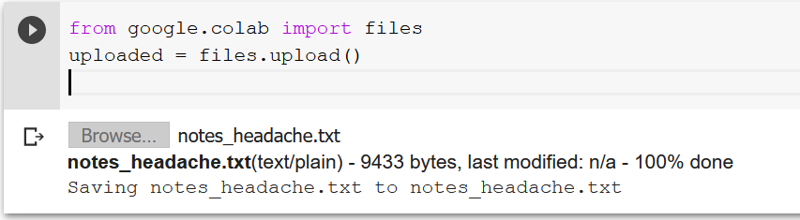
Load headache notes

Slide 18
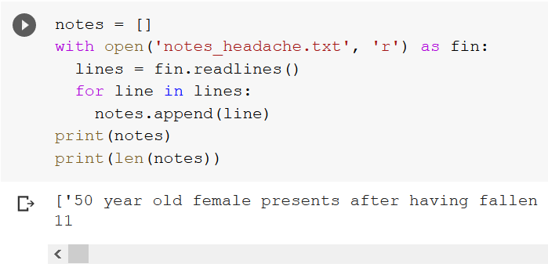
Read headache notes

Slide 19
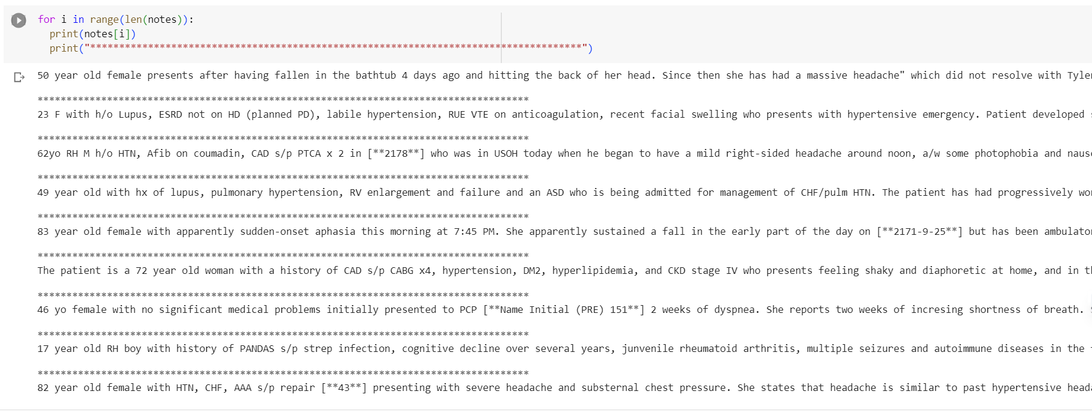
Print all the headache notes

Slide 20
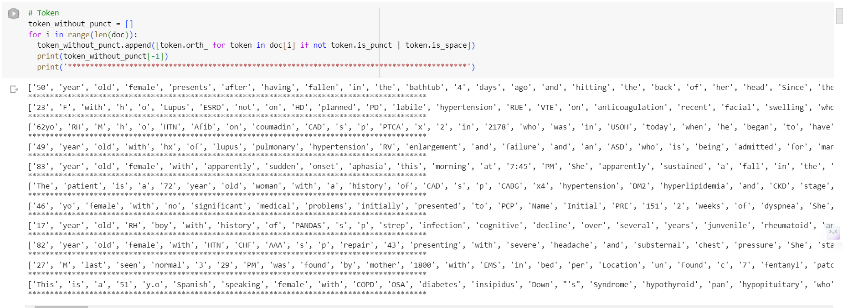
Get tokens without punctations or white space – for all the notes
50 year old female presents after having fallen in the bathtub 4 days ago and hitting the back of her head. Since then she has had a massive headache" which did not resolve with Tylenol. She states that she has a high threshold for pain and did not realize how bad it was during the day while at work but then when she got home at night she noticed it. The patient noticed ""silvery spects"" in her vision and she had trouble with some simple tasks like finding the tags on the back of her clothing in the morning. She reported that she had to check several times to make sure she did not put her clothes on backwards. She has had some dizziness, but no nausea or vomiting. Her speech has not been affected.

Slide 21
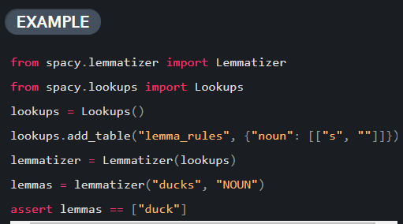
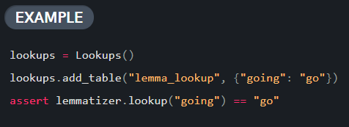
Lemmatization

Slide 22
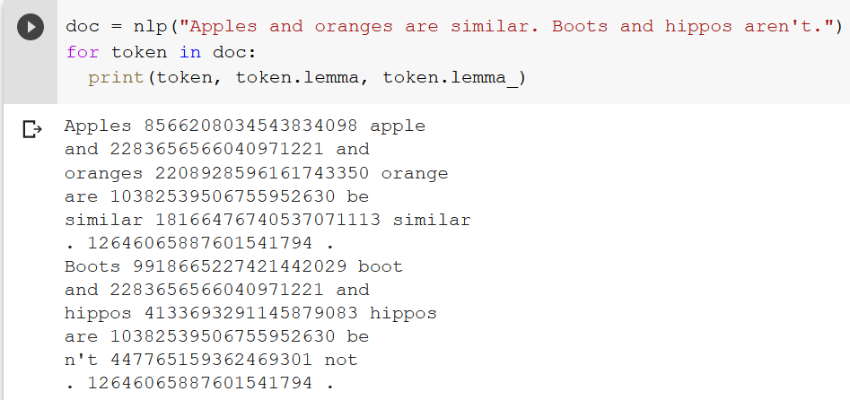
Lemmatization

Slide 23
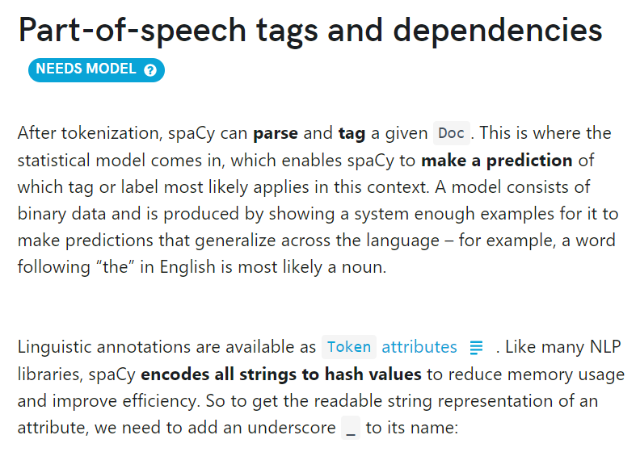
POS Tagging

Slide 24
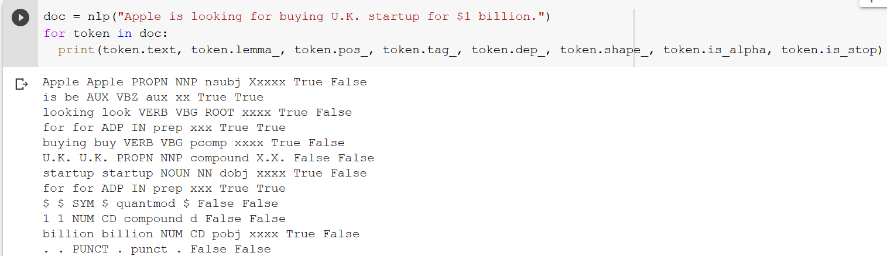
POS Tagging

Slide 25
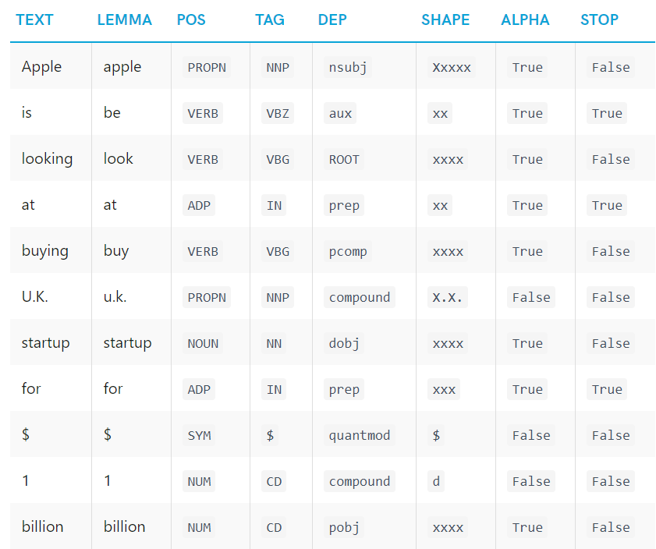
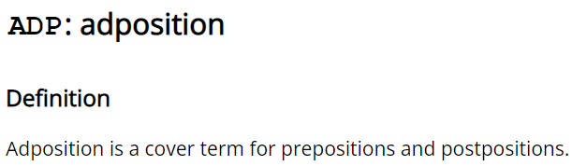
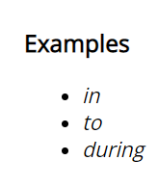
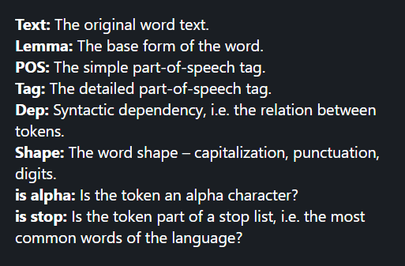
https://universaldependencies.org/u/pos/all.html

Slide 26
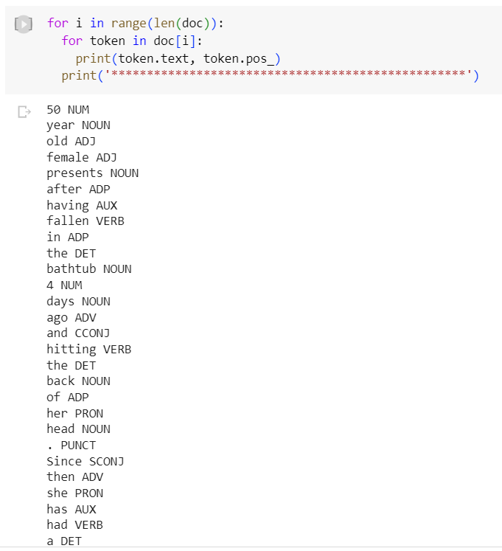
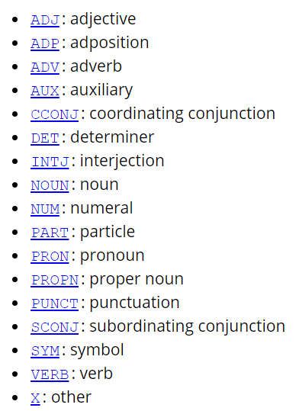
POS Tagging

Slide 27
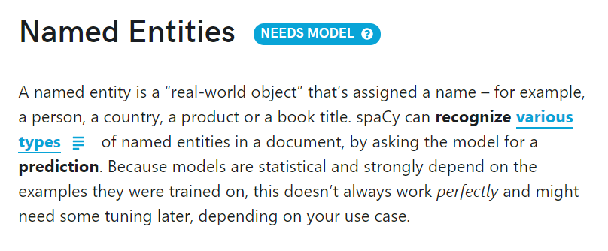
Named Entities

Slide 28
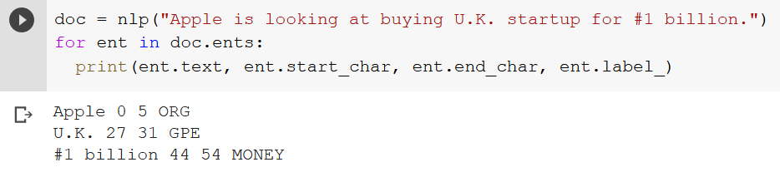
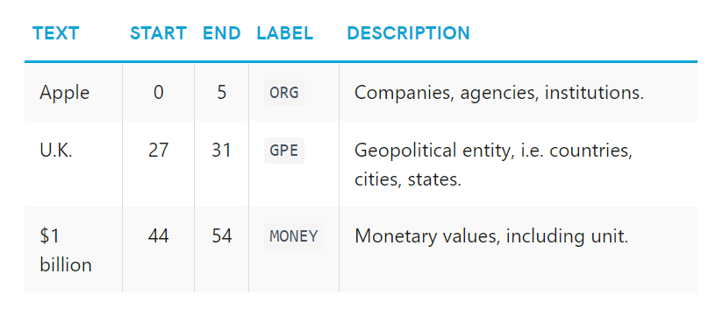
Named Entities

Slide 29
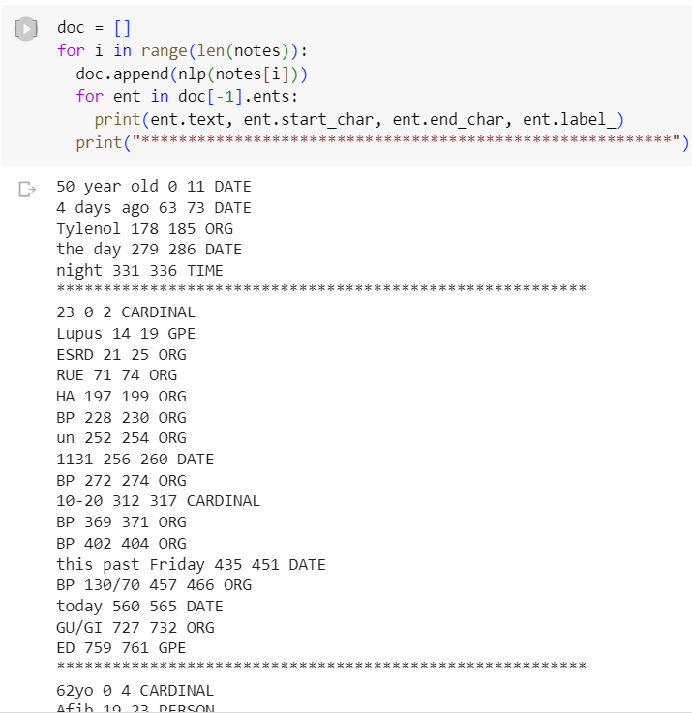
Entity recognition

Slide 30
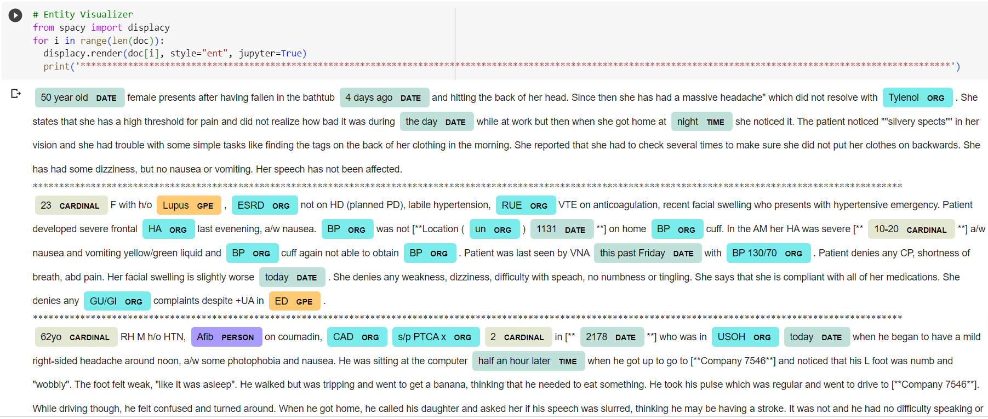
Entity Visualizer

Slide 31
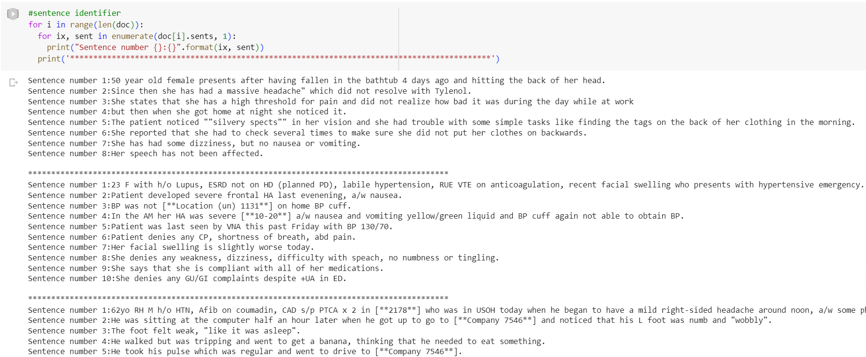
Sentence identifier

Slide 32
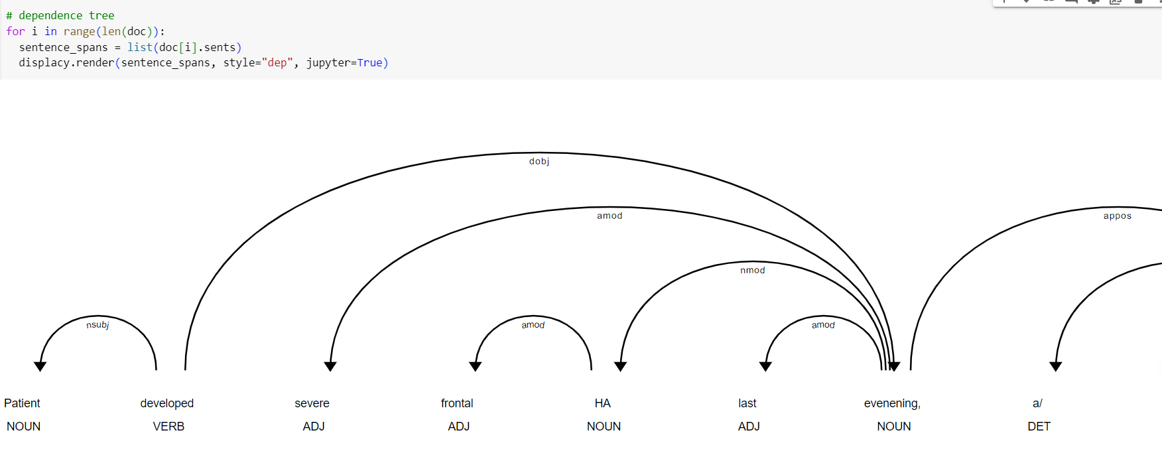
Visualizing dependencies

Slide 33
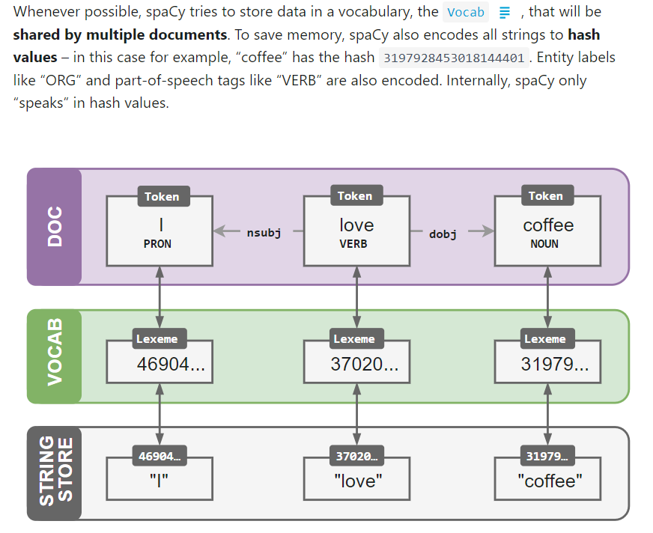
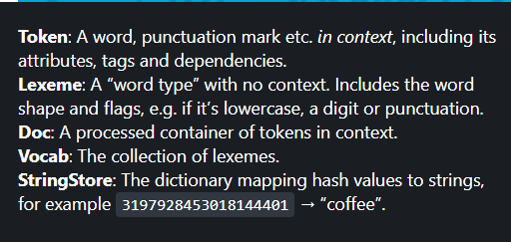

Slide 34
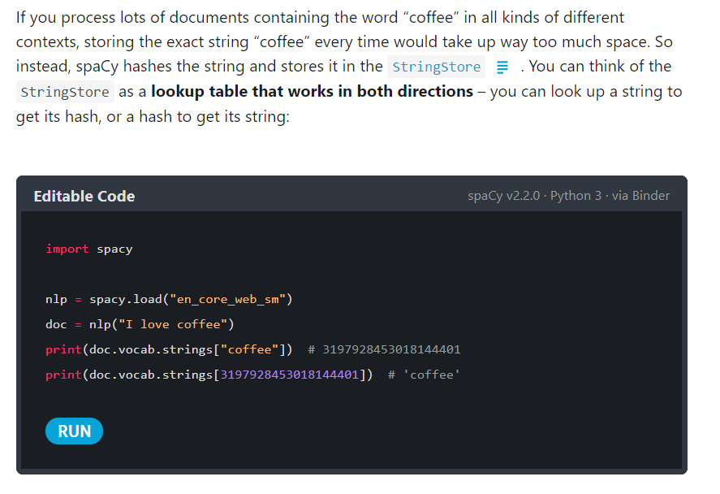

Slide 35
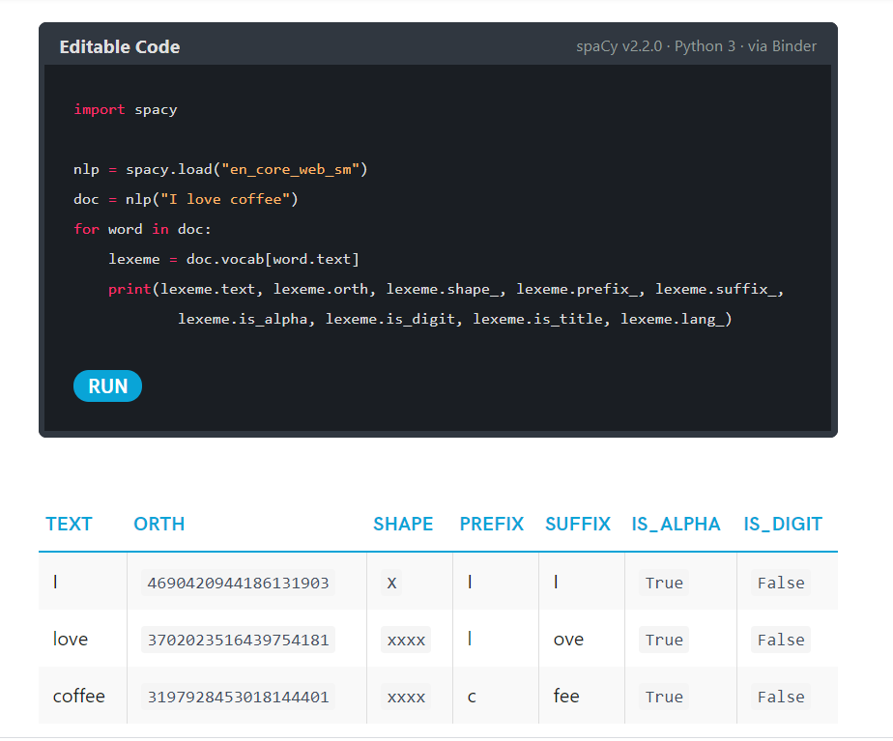

Slide 36
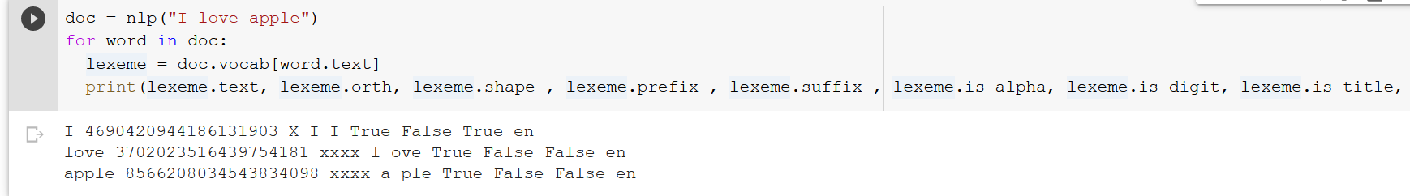

Slide 37
SCISPACY
https://towardsdatascience.com/using-scispacy-for-named-entity-recognition-785389e7918d

Slide 38
SciSpacy
Spacy is not good at extracting entities in biomedical domain.
SciSpacy is specialized for biomedical text processing
https://allenai.github.io/scispacy/

Slide 39
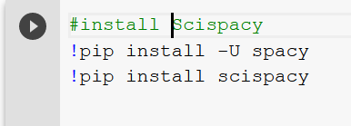
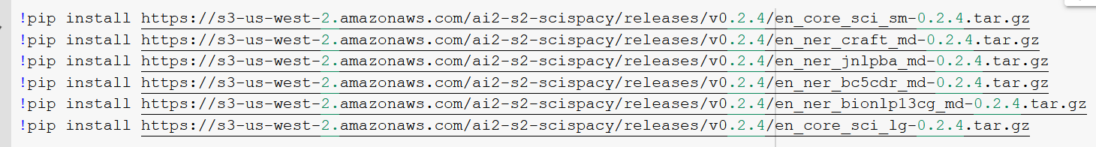
Installing SciSpacy

Slide 40
Pick up a pretrained model
After installing scispaCy, you next need to install one of their pre-trained models.
scispaCy models come in two flavors: Core and NER.
  The Core models come in three sizes (small, medium, large) based on the amount of vocabulary stored, and they identify entities but do not classify them.
  The NER models, on the other hand, identify and classify entities. There are 4 different NER models built on different entity categories.

Slide 41
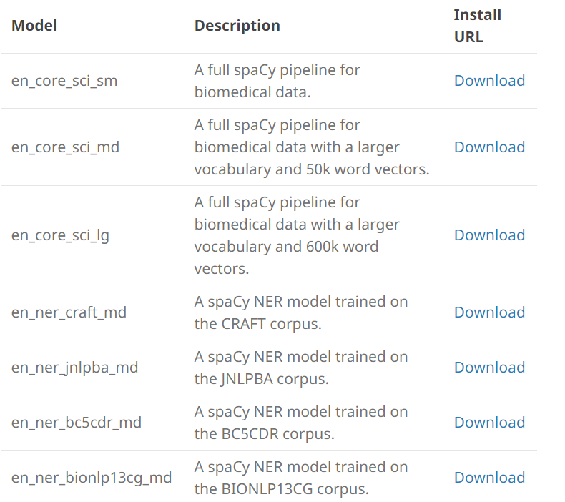
Pre-trained Model

Slide 42
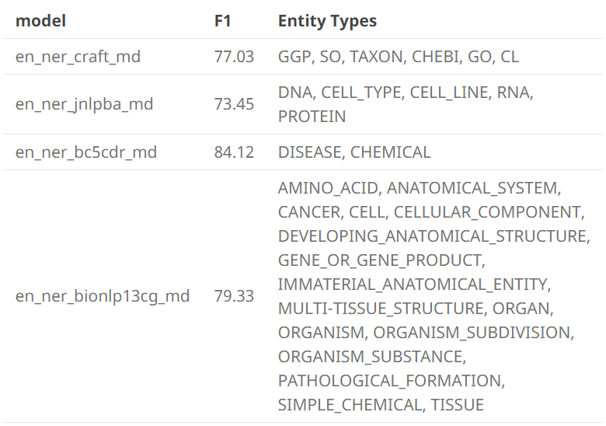
Pre-trained NER model

Slide 43
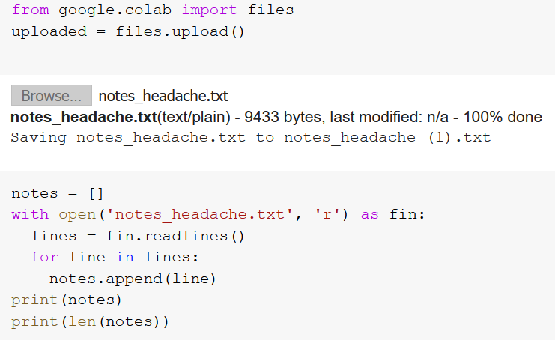
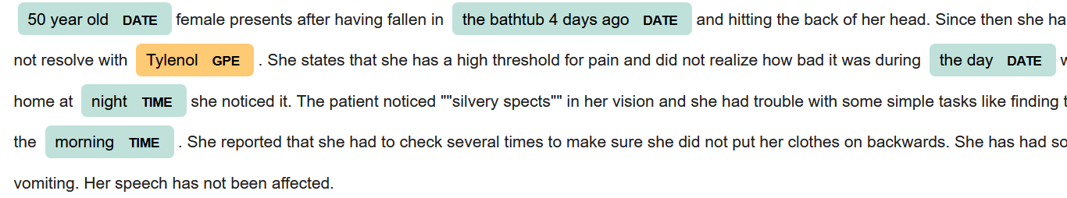
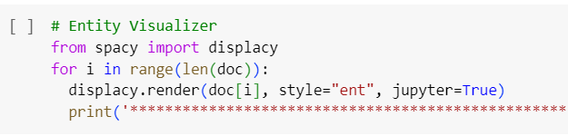

Spacy vs. scispacy
What Spacy can do

Slide 44
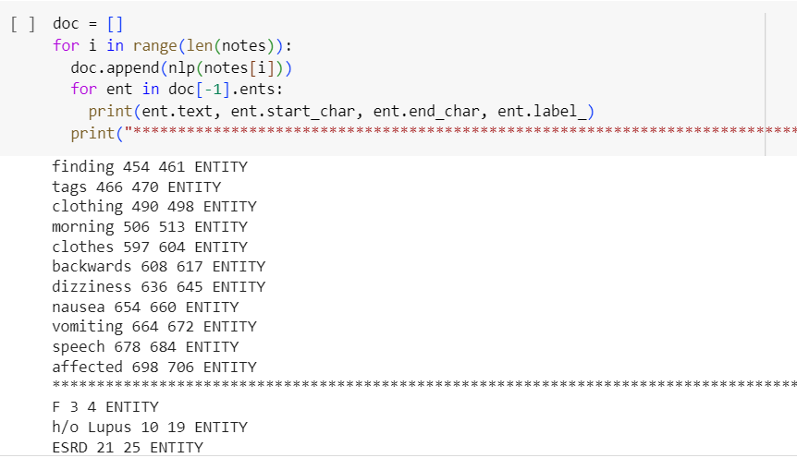
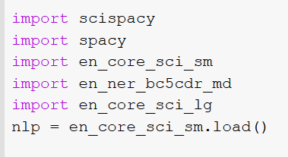
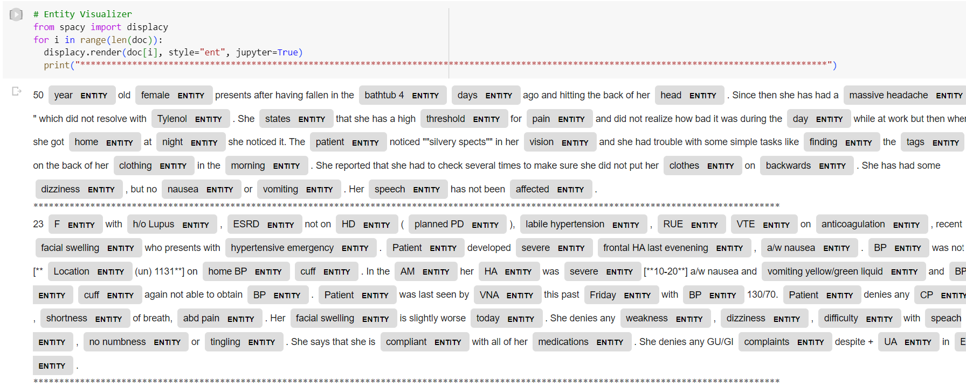
Spacy vs. scispacy
What SciSpacy can do

Slide 45

Scispacy

Slide 46


Different NERs

Slide 47

Different NERs

Slide 48

Different NERs

Slide 49
Thank you!

