Slide 1




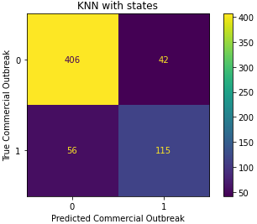

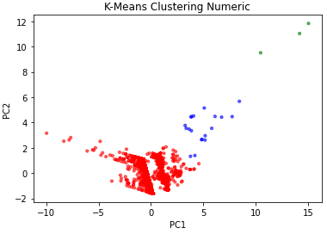
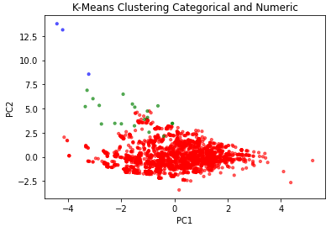
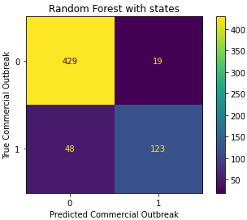
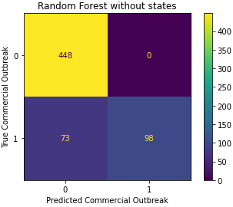
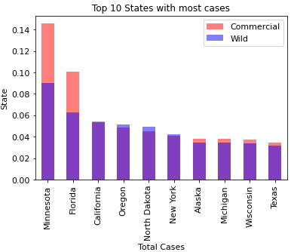
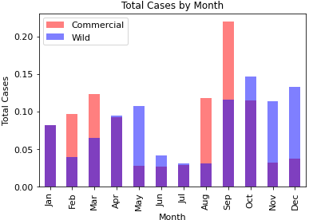
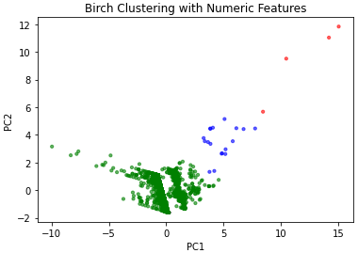
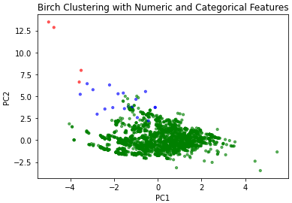
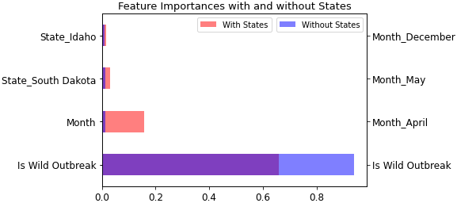
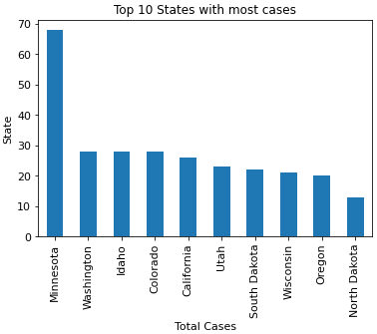
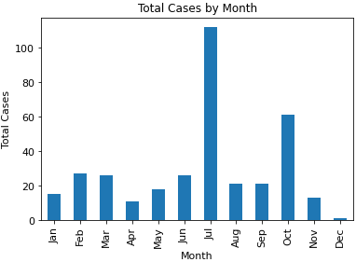

Avian Influenza Commercial and Wild Case Analysis
Lauren Lui luil@rpi.edu
¹Rensselaer Polytechnic Institute, Tetherless World Constellation, Troy, NY, United States,
Abstract and Problem Area
Data Analysis
Avian Influenza, more commonly known as Bird Flu, spread rapidly through commercial chicken farms in the United States in 2022. This outbreak lowered egg inventory, raising egg and poultry prices across the country. Through an article on the 2014-2015 avian influenza outbreak in the United States poultry sector, I found that wild bird flu cases and migratory patterns are a major predictors of commercial bird flu cases. After exploring literature reviews, I decided that the scope of this research would be examining the relationship between wild and commercial bird flu cases for the continental United States of America in the year 2022.
My hypothesis was that wild bird flu cases would positively correlate with commercial cases. I also believed that the time of year would be a significant predictor as well. While I wasn’t sure how accurate a model of commercial cases could be with the limited features in this report, I attempted to create a model that could predict the occurrence of a commercial bird flu outbreak in a given area from historical or current wild bird flu cases. In addition to a prediction model, I also performed clustering analysis to see if there are any distinguishable types of cases that could be subjects of future research.
My goal when modeling the data was to utilize two different classification models and two clustering models. The classification models would serve as a measure of how well we can predict the existence of a commercial outbreak in given a state, county, month, and the existence of wild cases in that time. The two classification models used were KNN Classification, as a base classifier, and Random Forest Classification, as a more accurate model with feature importance. For the clustering models, my goal was to gain insight to the types of cases. I wanted to see if there were clear clusters that could be the subject of future research, or if there weren’t with the features I provided. The two models that I chose for this were K-means clustering and BIRCH clustering.
Classification Models
Clustering Models
For each classification model, I chose to keep only the important features and represent any categorical values as dummy variables. I chose to train my models on a standard 80-20 split, and to run each model at two different levels: one including state, month, and the existence of a wild outbreak, and one without the states
For clustering, I decided to run the data at two levels: with just numeric data, and with categorical data as well. For the numeric data, the features used were: Commercial Outbreak Count, Total Commercial Cases, Wild Outbreak Count, and Month. For the categorical and numeric data, the numerical features were the same as the previous model, with the addition of both Month and State. For each model, I performed the elbow method to find the optimal number of clusters to use, finding the optimal number of clusters as three for each. I visualized these clusters by finding the first two principle components from Principle Component Analysis (PCA).
KNN Classification:
KNN Classification provided decent initial results for datasets with and without states. The model with the states had a significantly higher accuracy and was better at correctly predicting outbreaks
EDA and Data Formatting
K-Means Clustering:
Kmeans Clustering did not show any distinct features for either level of analysis. Both levels of analysis took between 8-10 seconds to run.
The data used was gathered from the USDA, containing location, date, and various bird flu specific features, such as flock type and size for commercial cases.
Before merging the datasets, I performed an Exploratory Data Analysis (EDA) on each set separately. For wild cases, I learned that most cases take place in the spring and fall, and in the state of Minnesota. Additionally, I found that if I joined the data at the day level, there would only be 19 counties that had overlapping wild and commercial states.
Once the initial EDA was completed, I moved on to data formatting and merging. Due to the limited number of overlapping days, I chose to aggregate values based on the following granularity: month, state, county. I aggregated the data to find the count of commercial outbreaks and wild cases. The following figures show the distribution of the dataset with overlapping wild and commercial cases.
Random Forest Classification:
Random Forest classification did a much better job at modeling the data than KNN did, and provided insight to important features.
BIRCH Clustering:
Birch clustering, interestingly, provided results very similar to those of K-Means clustering.
Unlike my hypothesis that one of the two models would fit the data better, both Birch and K-means provided almost identical results. This highlights the fact that there is a noticeable difference in these points, and that they are important to look at to gain further insight as to how this disease behaves in the United States.
Conclusion
The results of the classification models are shown in the table below with three measures of model performance: accuracy, precision, and recall. We can see that the Random Forest models performed better than KNN. We can also see that the models that included location performed significantly better than those without.
As for the clustering models, the similarity between the clusters found by all four models brings interest for future study to be done on the smaller clusters. Additionally, since there wasn’t any difference between the clusters, we can conclude that between K-means and birch clustering, there is not a “better” model.
As I went through the project, I felt like I gained more insight as to how the datasets were related, and learned more about what I would like to do in the future with the information I learned in this process. In conclusion, I’m happy with my results, but am interested to see what other types of analysis can be done with these datasets in the future.
Model | Dataset | Accuracy Score | Precision | Recall
KNN Classification | 80-20 Split Merged Data with States | 0.8417 | 0.7325 | 0.6725
KNN Classification | 80-20 Split Merged Data without States | 0.7884 | 0.5926 | 0.7485
Random Forest Classification | 80-20 Split Merged Data with States | 0.8918 | 0.8662 | 0.7193
Random Forest Classification | 80-20 Split Merged Data without States | 0.8821 | 1 | 0.5731
Sponsors:
Glossary:
Avian Influenza – More commonly known as bird flu, in this context it is the HPAI strain
Python – A programming language, capable of processing data/statistical analysis
Package – software package to be loaded to perform extra tasks
Accuracy score – a common, general measure of model performance
Precision – a measure of how many of your predicted commercial outbreaks are correct
Recall – a measure of how many of the true commercial outbreaks you predict
Resources:
M. M. a. A. M. Sean Ramos, "Impacts of the 2014-2015 Highly Pathogenic Avian Influenza Outbreak on the U.S. Poultry Sector,“
https://www.aphis.usda.gov/aphis/ourfocus/animalhealth/animal-disease-information/avian/avian-influenza/hpai-2022/2022-hpai-commercial-backyard-flocks
https://www.aphis.usda.gov/aphis/ourfocus/animalhealth/animal-disease-information/avian/avian-influenza/hpai-2022/2022-hpai-wild-birds

