Slide 1
BI 410/510: Data management and visualization
Dr. Lauren Hallett

Slide 2
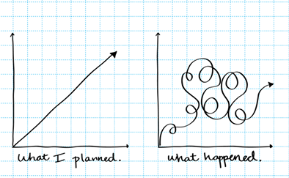
Image: Rosanne Bane

Slide 3
Overall goals
Your learning
Understand and design steps that link raw data to communicated findings
Interpret raw data as well as figures presented in scientific papers/the media
Gain exposure to R and comfort with programming
Your experience
Resources to empower you to learn and explore
Flexibility to adapt to challenging times
Community to support and develop together

Slide 4
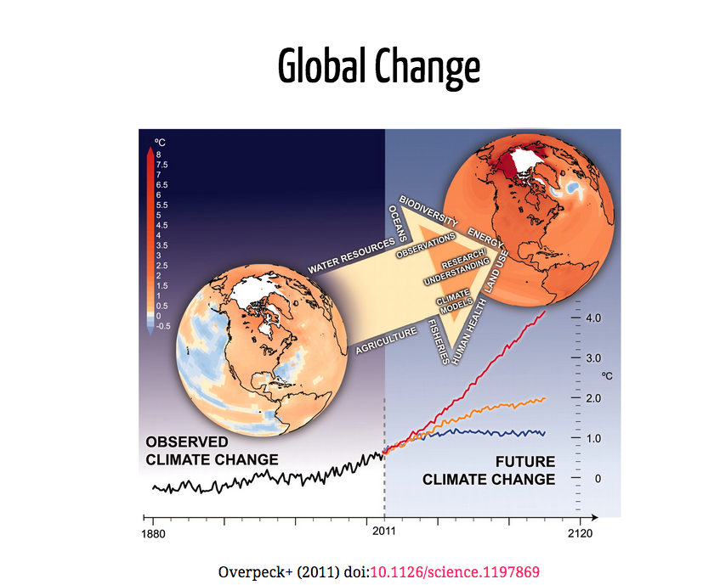

Slide 5
What types of data are being used?

Slide 6
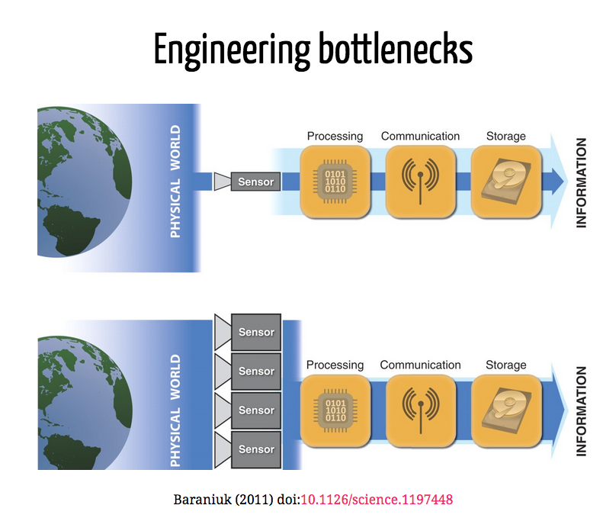

Slide 7
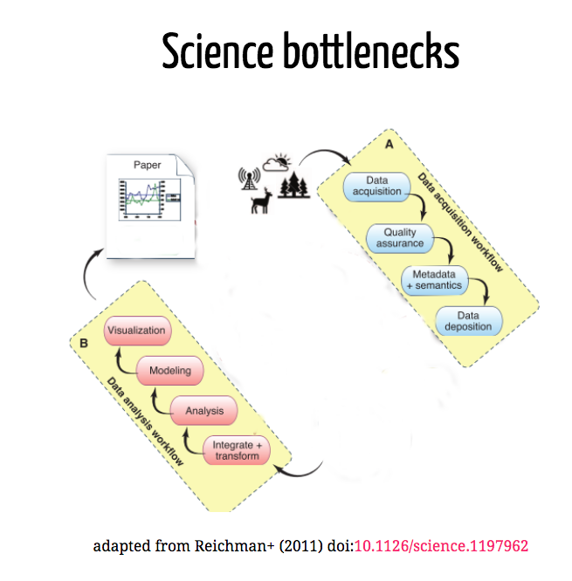

Slide 8
Our focus is on these Science bottlenecks

Slide 9
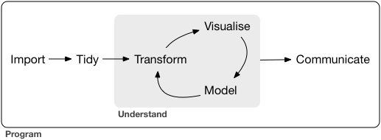
Course content: Developing workflows for the data life cycle
Wickham and Grolemund R for Data Science

Slide 10
This course:
Real data, real tools
Things will break
Things will change

Slide 11
This course:
Some things will be in keeping with good pedagogy:
We’ll start with graphs first
Short videos and active learning
Some things aren’t:
We’ll jump forward and back at times
Starting at the deep end

Slide 12
How we’ll do it:
Different modules that transition from demonstration to independent coding
Modules can be completed fully asynchronously, but I recommend you watch the videos and then finish the code with me in class
Frequent practice via four problem sets
An independent project in which you go from raw data to a reproducible final report
A free online text to help you along! https://r4ds.had.co.nz/

Slide 13
What you said:
Most are using Apple. If Windows, help each other and be patient with me!
Most have either never heard of R or not used it – we’re in this together!
A few of you are familiar with command line programming – help those that don’t!

Slide 14
What you said:
You liked having access to resources – short videos, class recordings
You liked frequent polling during class, and liked classes that were more interactive
Discussion boards were not fun, breakout rooms only work if everyone talks
You wanted your homework back quickly Help each other here – get your HW in on time
You want reminders of assignment dates

Slide 15
Office Hours
3-4 pm Tuesday
10-11 am Thursday

Slide 16


Slide 17
Exploratory data analysis exercise
Goals for this exercise:
Highlight the value of plotting our data before we analyze it
Get to know one another
Viscerally appreciate how much easier R will make our lives!

Slide 18
Set up check!
Can you open R Studio?

Slide 21
Before the first class
Check out materials in the “START HERE” module to learn the nuts and bolts of course structure and introduce yourself
Watch the videos associated with the “Week 1” module
Follow the computer set-up instructions to install R and RStudio

